Slide 1
HOLY SPIRIT
Gifts of the
Martin Pearson

Slide 2
1 Corinthians 14:1 - Amplified Bible
Pursue [this] love [with eagerness, make it your goal], yet earnestly desire and cultivate the spiritual gifts [to be used by believers for the benefit of the church], but especially that you may prophesy [to foretell the future, to speak a new message from God to the people].

Slide 3
1 Corinthians 12:1-11
Now about the gifts of the Spirit, brothers and sisters, I do not want you to be uninformed….
…There are different kinds of gifts, but the same Spirit distributes them. There are different kinds of service, but the same Lord. There are different kinds of working, but in all of them and in everyone it is the same God at work.
Now to each one the manifestation of the Spirit is given for the common good. To one there is given through the Spirit a message of wisdom, to another a message of knowledge by means of the same Spirit, to another faith by the same Spirit, to another gifts of healing by that one Spirit, to another miraculous powers, to another prophecy, to another distinguishing between spirits, to another speaking in different kinds of tongues, and to still another the interpretation of tongues. All these are the work of one and the same Spirit, and he distributes them to each one, just as he determines

Slide 4
1 Corinthians 12:1-11
Now about the gifts of the Spirit, brothers and sisters, I do not want you to be uninformed….
…There are different kinds of gifts, but the same Spirit distributes them. There are different kinds of service, but the same Lord. There are different kinds of working, but in all of them and in everyone it is the same God at work.
Now to each one the manifestation of the Spirit is given for the common good. To one there is given through the Spirit a message of wisdom, to another a message of knowledge by means of the same Spirit, to another faith by the same Spirit, to another gifts of healing by that one Spirit, to another miraculous powers, to another prophecy, to another distinguishing between spirits, to another speaking in different kinds of tongues, and to still another the interpretation of tongues. All these are the work of one and the same Spirit, and he distributes them to each one, just as he determines

Slide 5
The Gift of Wisdom
…the gift to see with the wisdom of God

Slide 6
The Gift of Knowledge
…the gift to comprehensively understand a spiritual issue or have a situation revealed to you.

Slide 7
The Gift of Faith
…the gift to trust God and inspire others to trust God, no matter the conditions.

Slide 8
The Gift of Healing
…the gift of using God's healing power to cure a person who is ill, wounded or suffering.

Slide 9
The Gift of Miracles
…the gift to display signs and miracles that reveal God's Word and the Gospel message.

Slide 10
The Gift of Prophecy
…the gift to declare a message from God.

Slide 11
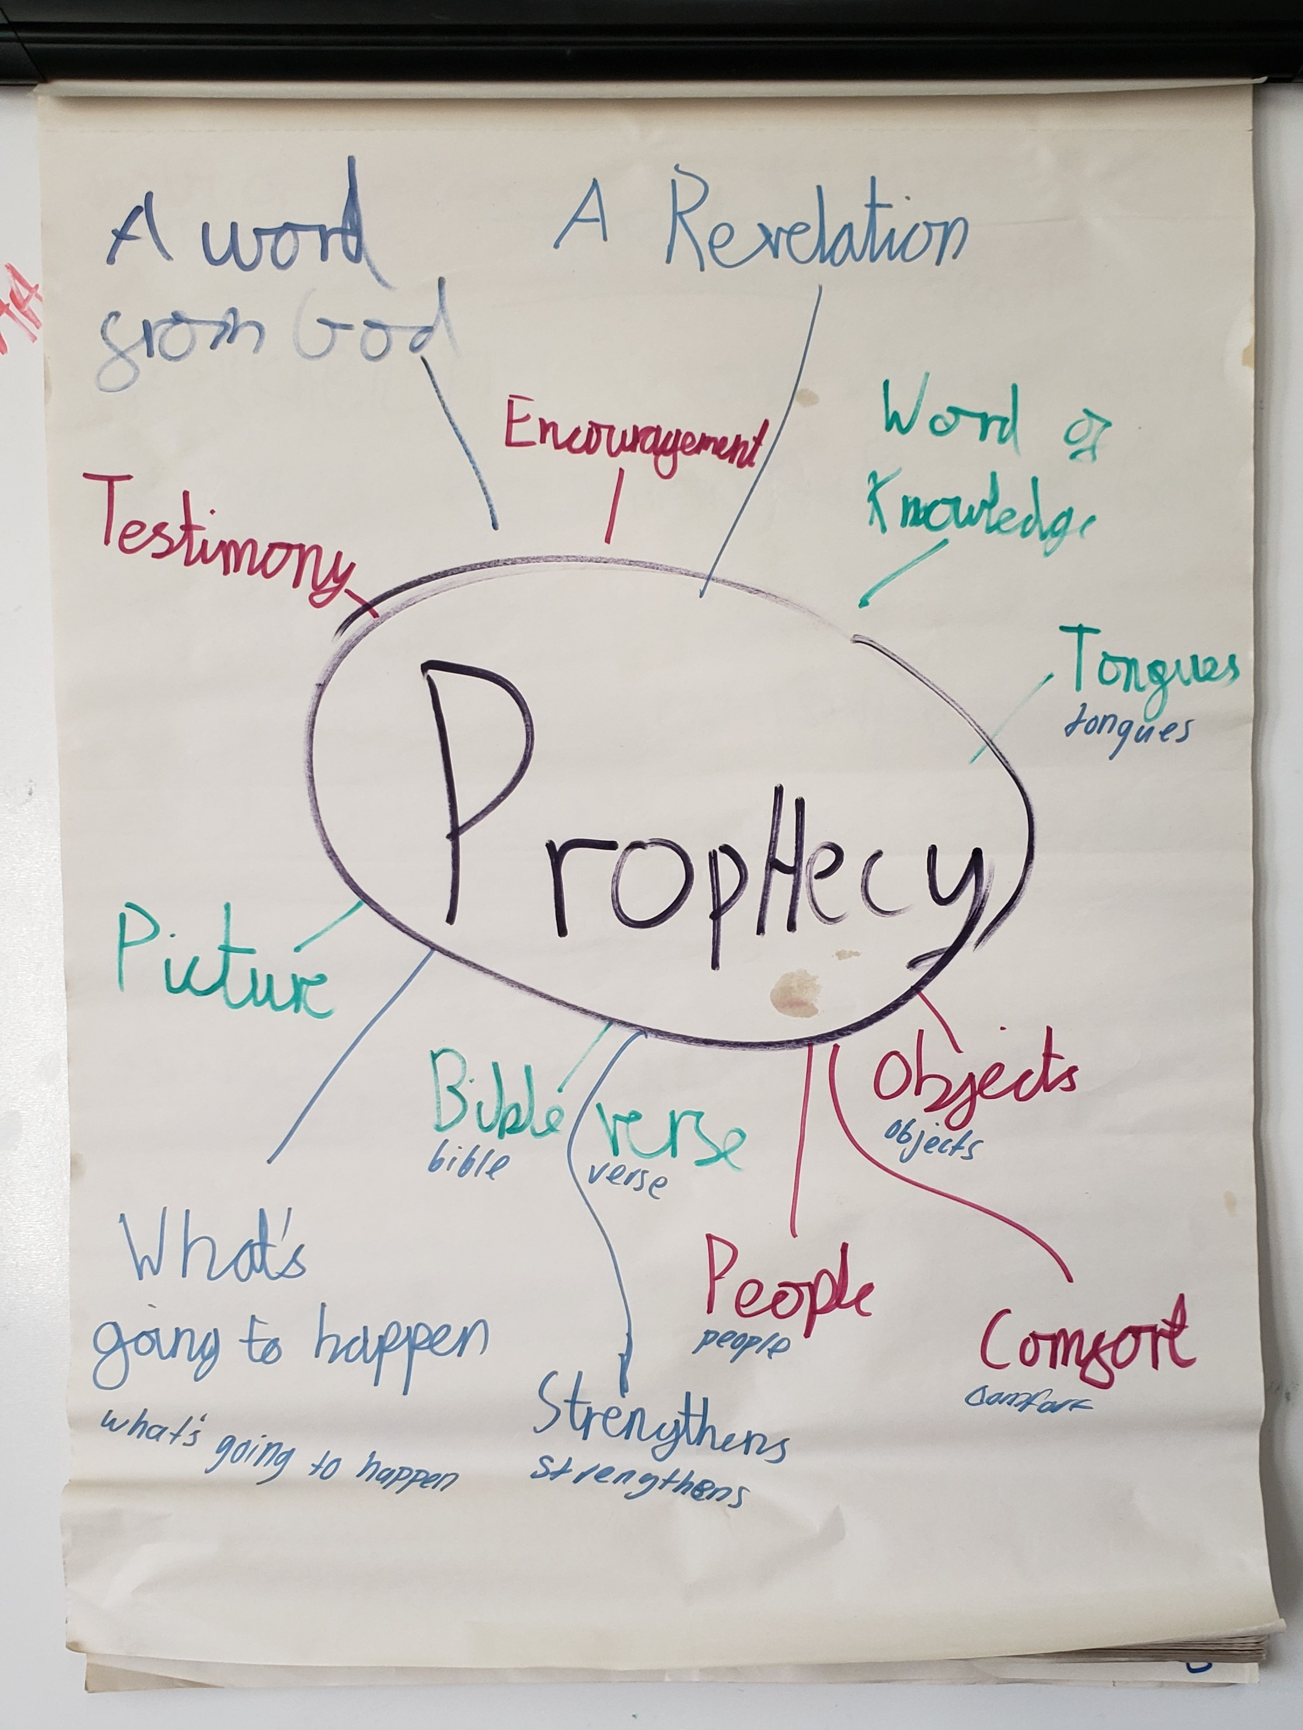
A word
A revelation
Encouragement
Testimony
Word of knowledge
Testimony
Pictures
Bible verses
Objects
What’s going to happen
Strengtheners
People
Comfort

Slide 12
The Gift of Discernment
…the gift to recognise whether something is from God.

Slide 13
The Gift of Tongues
…the gift to communicate in a foreign or angelic language you do not have experience with.

Slide 14
1 Corinthians 14:1-5, 26-27
Follow the way of love and eagerly desire gifts of the Spirit, especially prophecy. For anyone who speaks in a tongue does not speak to people but to God. Indeed, no one understands them; they utter mysteries by the Spirit. But the one who prophesies speaks to people for their strengthening, encouraging and comfort. Anyone who speaks in a tongue edifies themselves, but the one who prophesies edifies the church. I would like every one of you to speak in tongues, but I would rather have you prophesy. The one who prophesies is greater than the one who speaks in tongues, unless someone interprets, so that the church may be edified…
…what then shall we say, brothers and sisters? When you come together, each of you has a hymn, or a word of instruction, a revelation, a tongue or an interpretation. Everything must be done so that the church may be built up. If anyone speaks in a tongue, two - or at the most three - should speak, one at a time, and someone must interpret.

Slide 15
The Gift of Interpretation
…the gift of interpreting yours or anothers different language and helping others understand.

Slide 16
The Gifts of the Holy Spirit
The Gift of Wisdom
The Gift of Knowledge
The Gift of Faith
The Gift of Healing
The Gift of Miracles
The Gift of Prophecy
The Gift of Discernment
The Gift of Tongues
The Gift of Interpretation

Slide 17
Romans 12:3-8
For by the grace given me I say to every one of you: Do not think of yourself more highly than you ought, but rather think of yourself with sober judgment, in accordance with the faith God has distributed to each of you. For just as each of us has one body with many members, and these members do not all have the same function, so in Christ we, though many, form one body, and each member belongs to all the others. We have different gifts, according to the grace given to each of us. If your gift is prophesying, then prophesy in accordance with your[a] faith; if it is serving, then serve; if it is teaching, then teach; if it is to encourage, then give encouragement; if it is giving, then give generously; if it is to lead, do it diligently; if it is to show mercy, do it cheerfully.

Slide 18
Holy Spirit, as uncomfortable
as it is to pray this, today I ask You to give me whatever gift You want to give me, and I yield myself to whatever plan You have for using it. Wherever I am, whomever I am near, I give you permission to work through me
Lectio 365 - 20th April

Slide 19
1 Corinthians 12:27-31
Now you are the body of Christ, and each one of you is a part of it. And God has placed in the church first of all apostles, second prophets, third teachers, then miracles, then gifts of healing, of helping, of guidance, and of different kinds of tongues. Are all apostles? Are all prophets? Are all teachers? Do all work miracles? Do all have gifts of healing? Do all speak in tongues? Do all interpret?
Now eagerly desire the greater gifts.

