Slide 1
Foundation Stones Pt.6

Slide 2
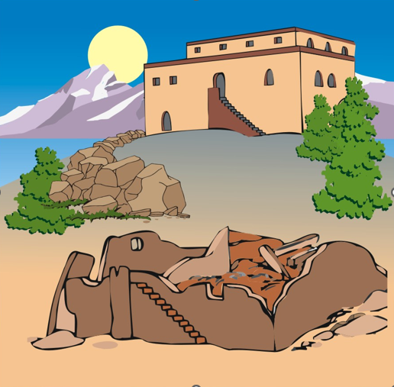

Slide 3
So far we’ve looked at…
The Kingdom of God
New Life, New Birth
Positive Repentance
Active Faith
The Lordship of Christ
Baptism in Water
Baptism in the Holy Spirit
The Church
Meetings
More than just Meetings

Slide 4
Our New Life and Our New Lifestyle
Get to know God
Live for God
Discover Freedom in God
Give To God

Slide 5
FAITH
FAMILY
FRIENDS
FOOD
FUN

Slide 6
Let Us…
Be a covenant people
Remind ourselves that church isn’t something we go to, it’s who we are
Remind ourselves we are part of something bigger
Remember we all have different skills, gifts and abilities
Let us be authentic with generous hearts
Love our neighbours as ourselves

Slide 7
Our New Life and Our New Lifestyle
Submitting to one another
Leadership and spiritual authority
Growing in God – Discipleship
Growing in God - Personal Pastoring
Growing in God - Small Groups

Slide 8
Submitting to one another
As in all things,
Jesus sets the example

Slide 9
So Jesus called them together and said, “You know that the rulers in this world lord it over their people, and officials flaunt their authority over those under them. But among you it will be different. Whoever wants to be a leader among you must be your servant, and whoever wants to be first among you must be the slave of everyone else. For even the Son of Man came not to be served but to serve others and to give his life as a ransom for many.”
Mark 10:42-45

Slide 11
It was just before the Passover Festival. Jesus knew that the hour had come for him to leave this world and go to the Father. Having loved his own who were in the world, he loved them to the end.
The evening meal was in progress, and the devil had already prompted Judas, the son of Simon Iscariot, to betray Jesus. Jesus knew that the Father had put all things under his power, and that he had come from God and was returning to God; so he got up from the meal, took off his outer clothing, and wrapped a towel around his waist. After that, he poured water into a basin and began to wash his disciples’ feet, drying them with the towel that was wrapped around him.
John 13:1-5

Slide 12
Do nothing out of selfish ambition or vain conceit.
Rather, in humility value others above yourselves
Philippians 2:3

Slide 14
Leadership and Spiritual Authority
As in all things, Jesus sets the example
Principles of God’s delegation of authority:
To be in authority, you need to be under authority
The one under authority has the same authority as the one who sends him
Authority is a gift; it can never be taken on yourself.
Authority involves being a servant for someone else.

Slide 15
Obey your spiritual leaders and do what they say. Their work is to watch over your souls, and they are accountable to God. Give them reason to do this with joy and not with sorrow. That would certainly not be for your benefit.
Hebrews 13:17

Slide 17
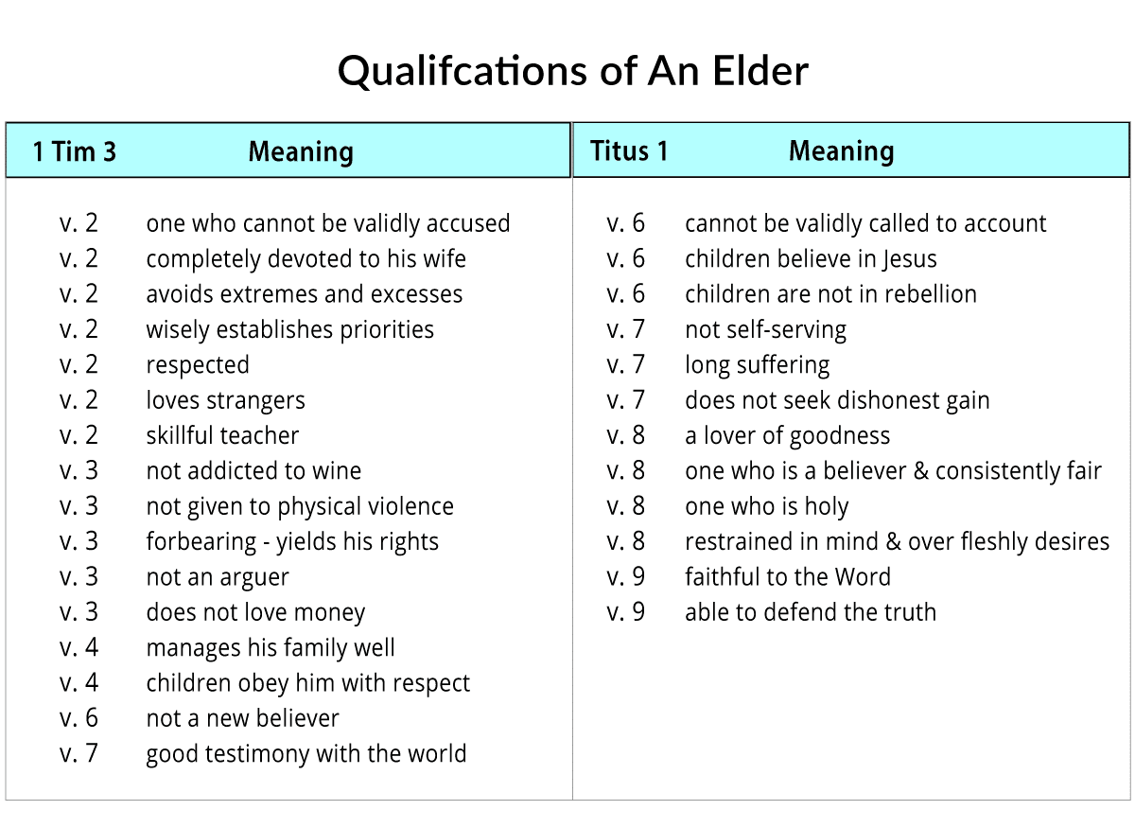

Slide 19
Growing in God - Discipleship

Slide 21
Growing in God - Discipleship
Putting Jesus first in all things (Mark 8:34-38)
Following Jesus' teachings (John 8:31-32)
Fruitfulness (John 15:5-8)
Love for other disciples (John 13:34-35)
Evangelism - Making new disciples (Matthew 28:18-20)

Slide 22
Growing in God – Personal Pastoring

Slide 24
I don’t mean to say that I have already achieved these things or that I have already reached perfection. But I press on to possess that perfection for which Christ Jesus first possessed me.
Philippians 3:12

Slide 25
Purpose of Personal Pastoring
Guiding and lead on to maturity
Provoking into God
Encouraging
Exhorting
Maybe, to confront if necessary
To protect

Slide 27
Growing in God – Small Groups
Help us to stay focused on Jesus during the week
Provide opportunities to explore the Word of God
Create strong relationships between group members.
Encourage us to be “outward focussed”

Slide 28
FAITH, FAMILY, FRIENDS, FOOD, FUN
…and in all things,
Jesus sets the example.

