Slide 1
How deep is the Father’s love
Tracy Spiers

Slide 2
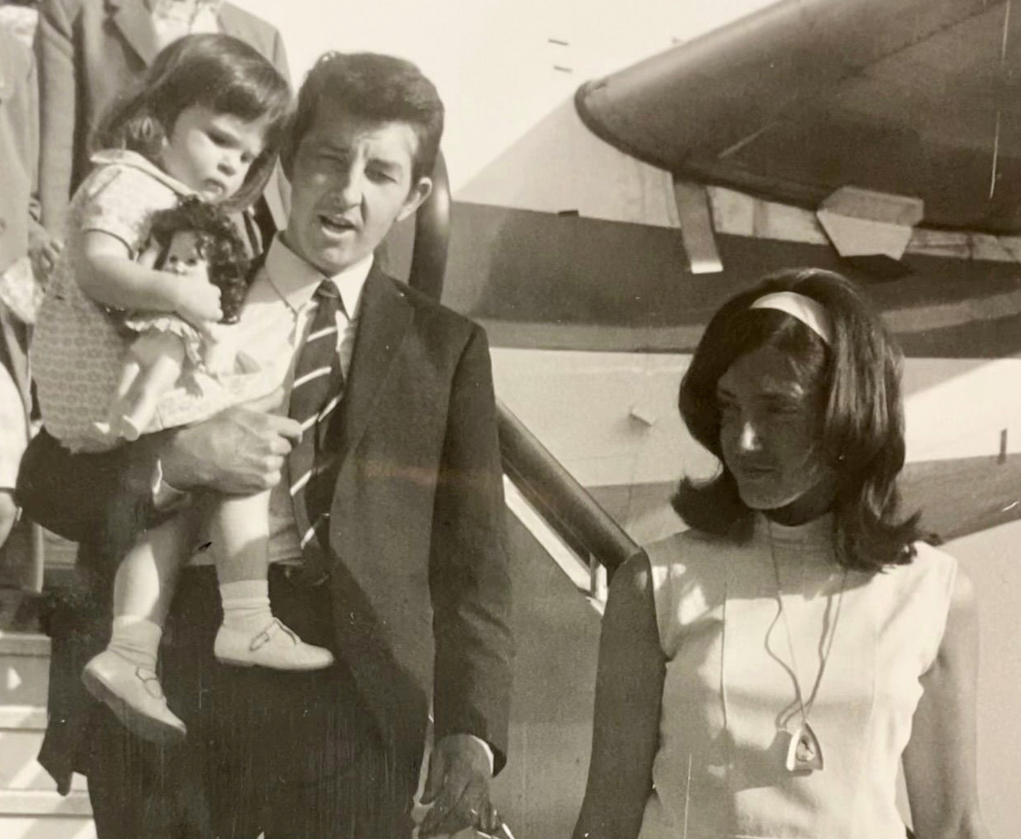
A child’s view

Slide 3
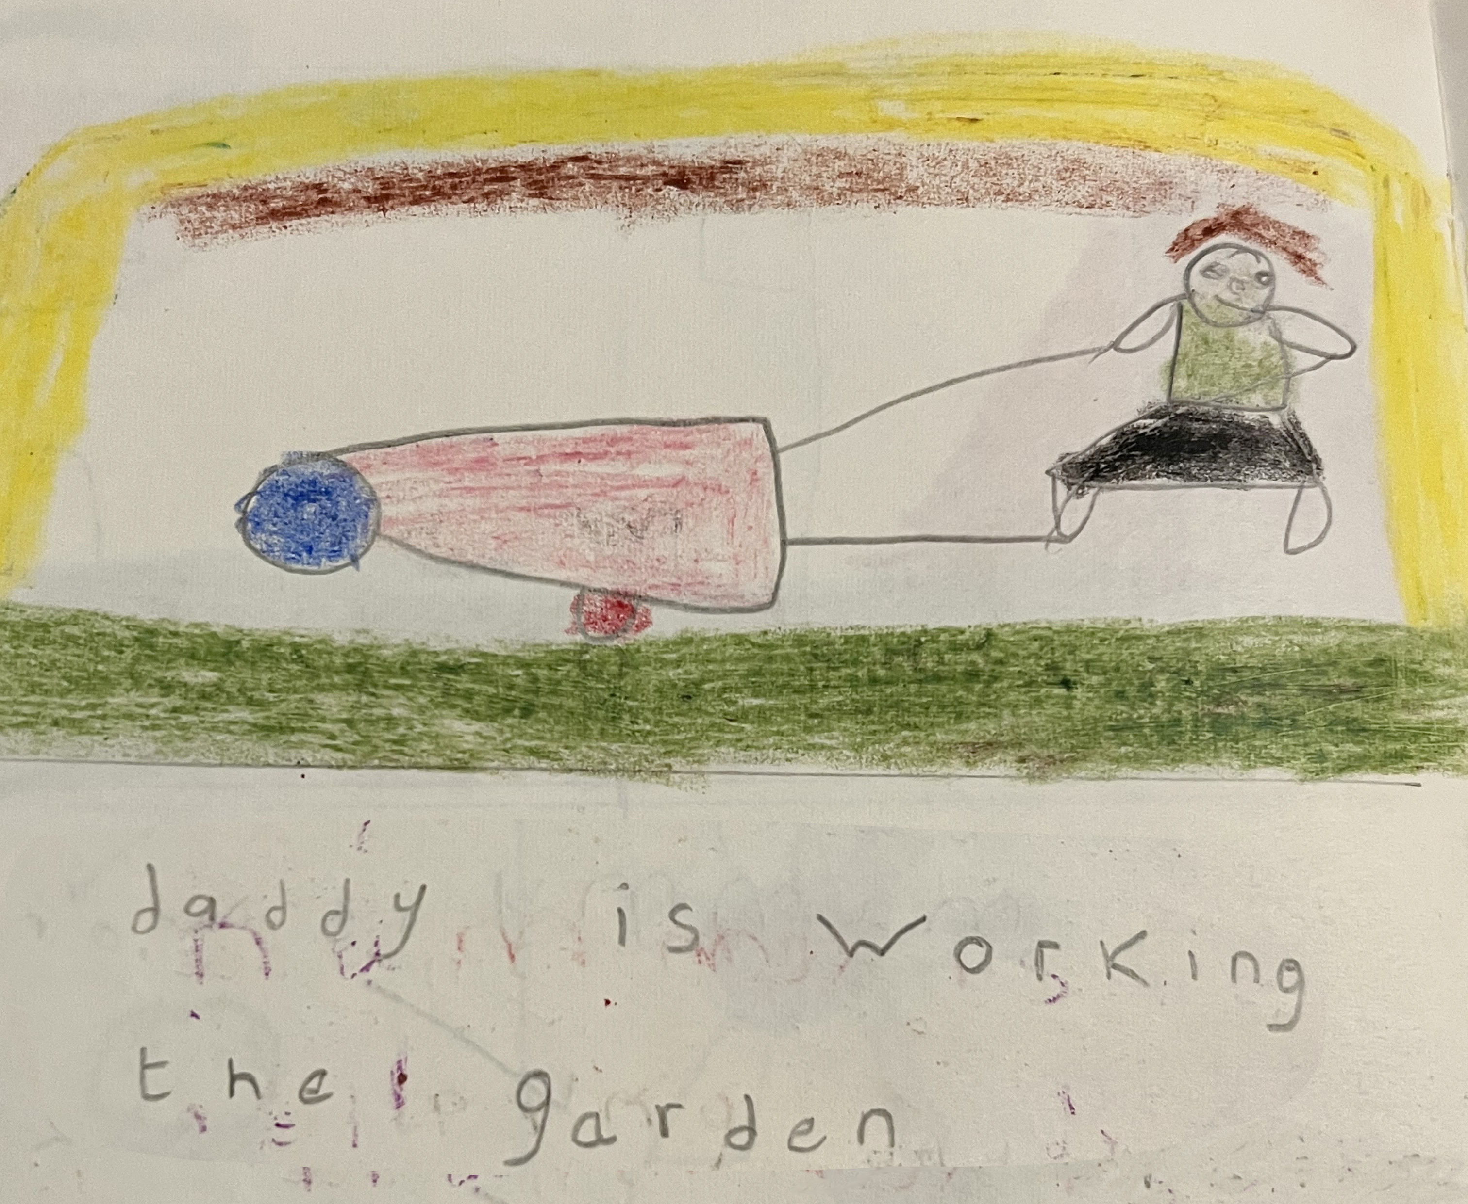

Slide 4
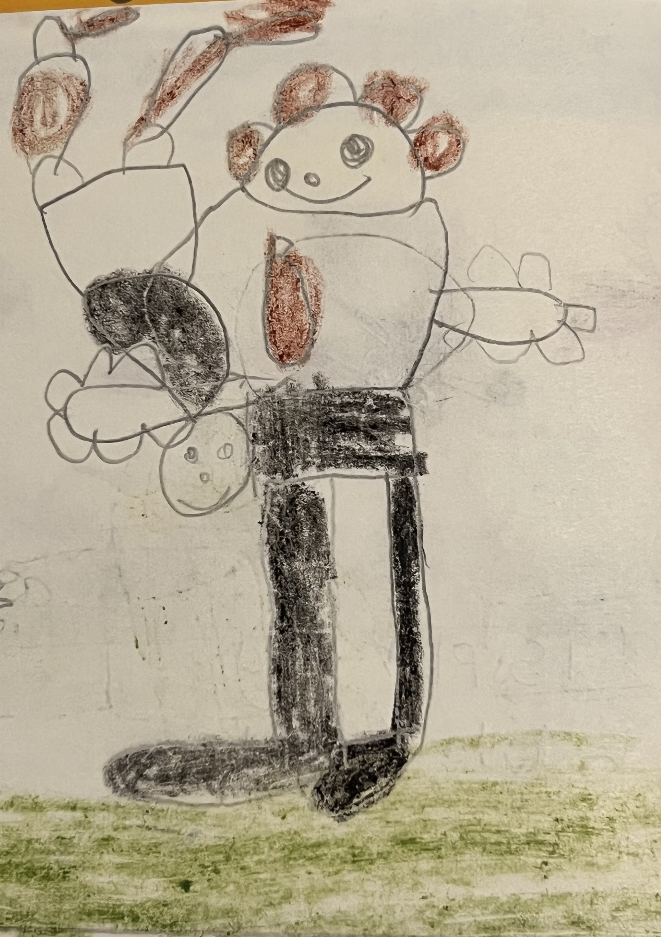

Slide 5
Daddy giving me a Fireman’s lifthere

Slide 6
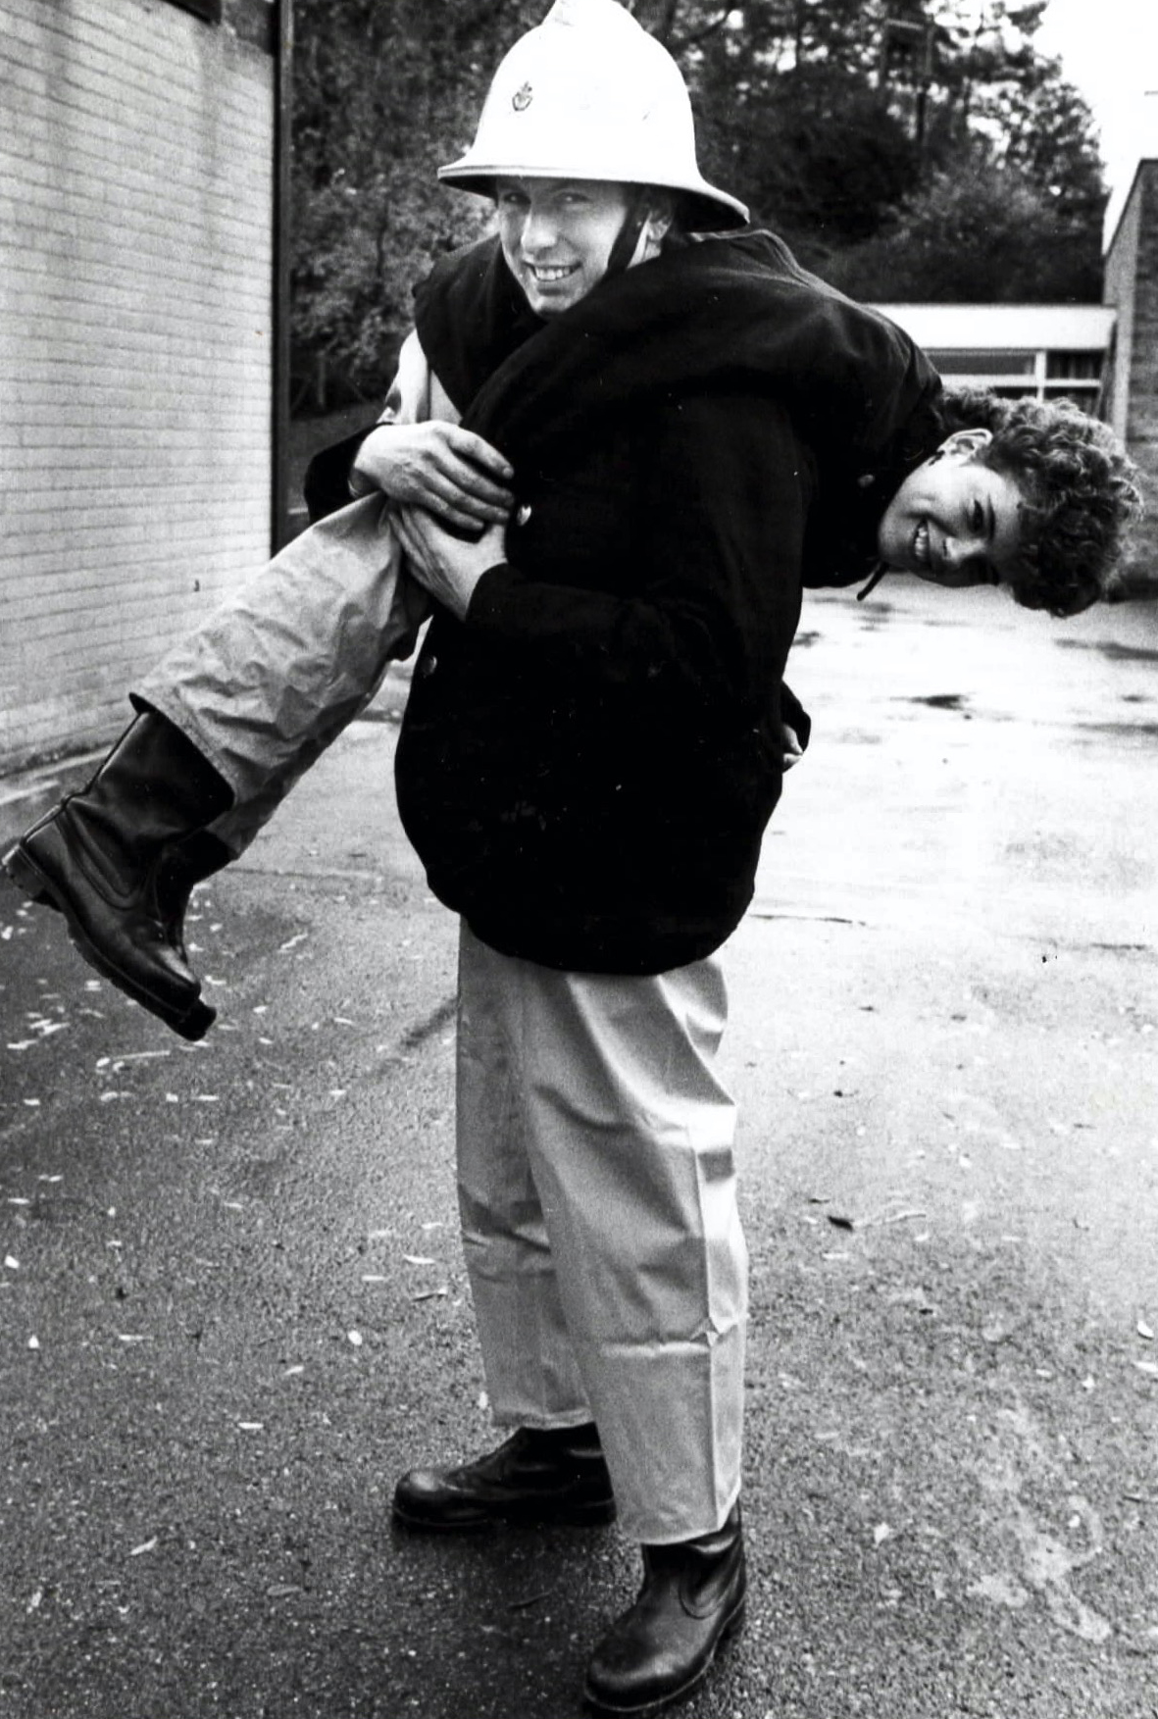
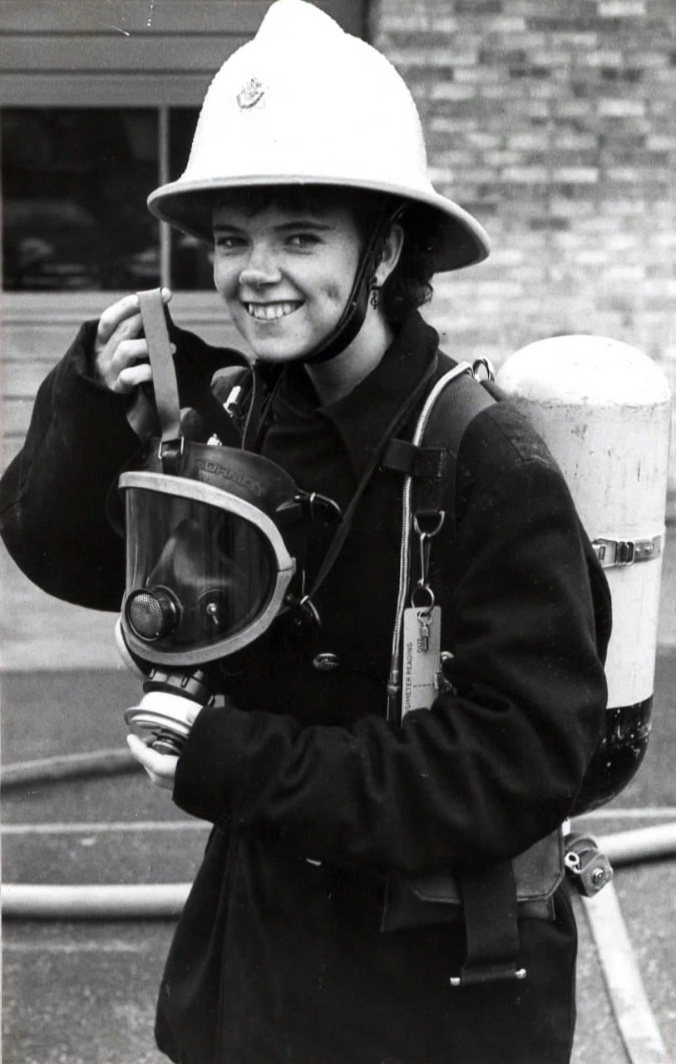

Slide 8
