Slide 1
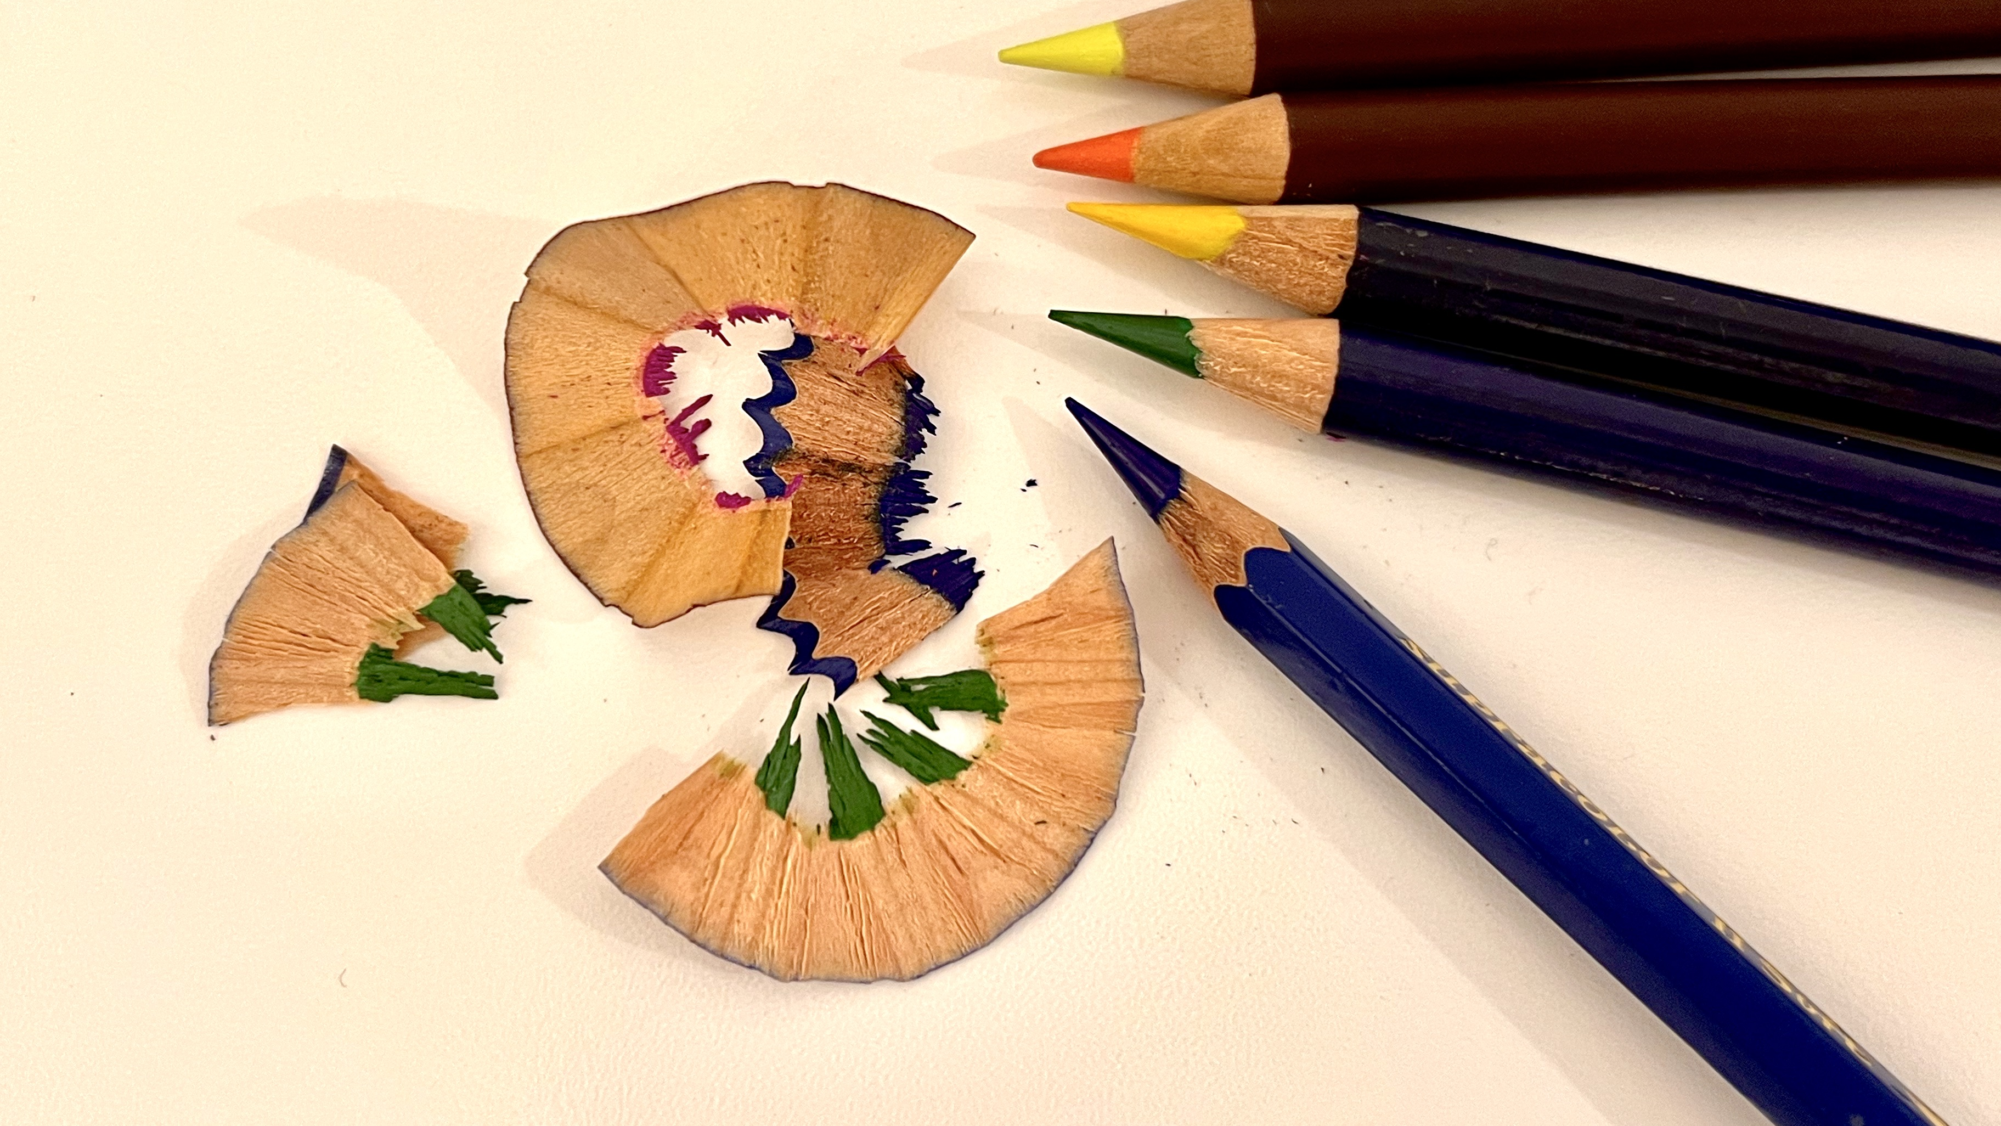
SHARPENING OUR SPIRITUAL SENSES
Wake up
Church!
Tracy Spiers

Slide 2
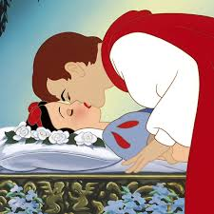
We don’t know
we are asleep
until we wake up

Slide 3
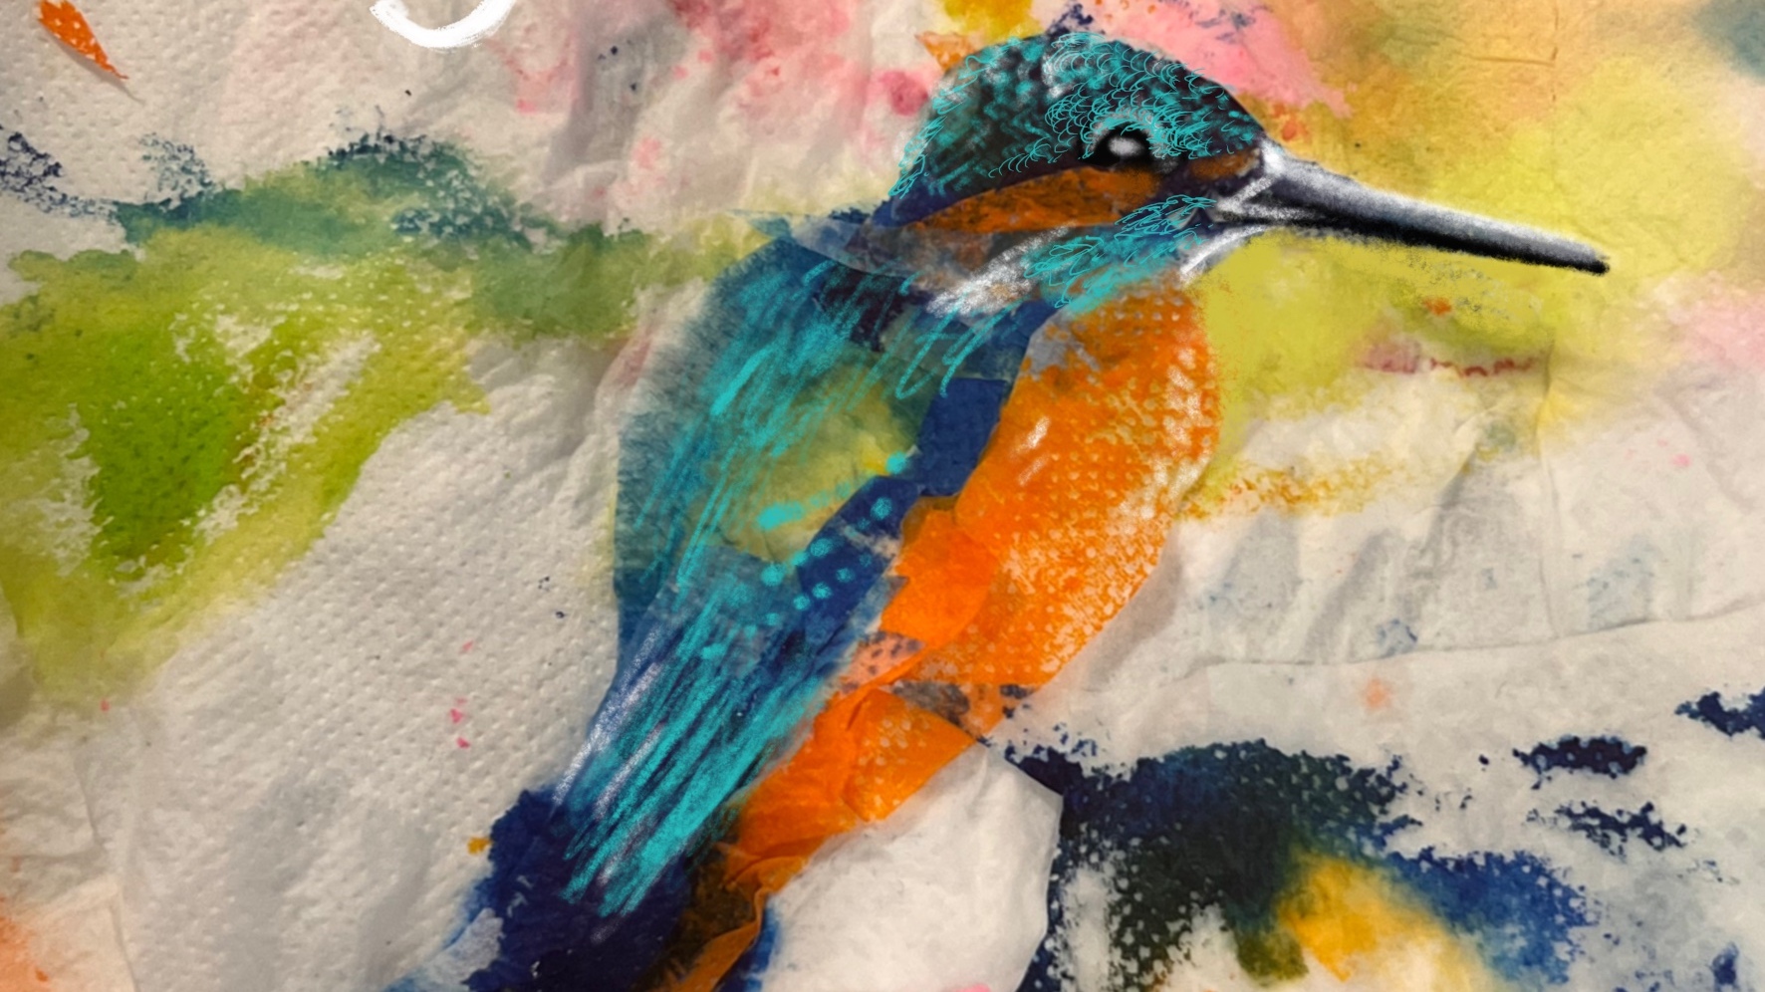
SIGHT

Slide 4
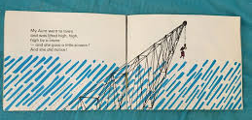
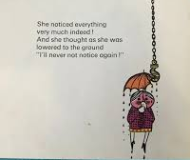

Slide 5
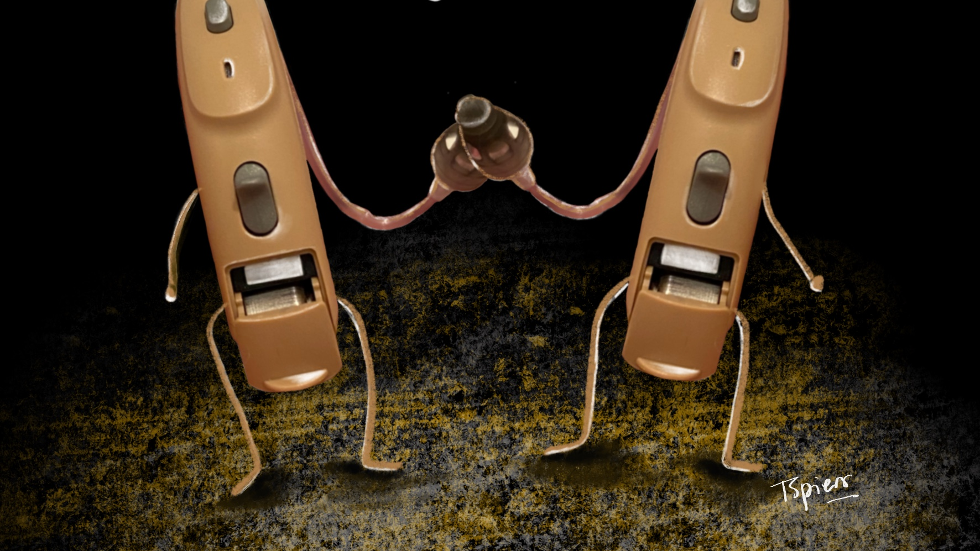
HEAR

Slide 6
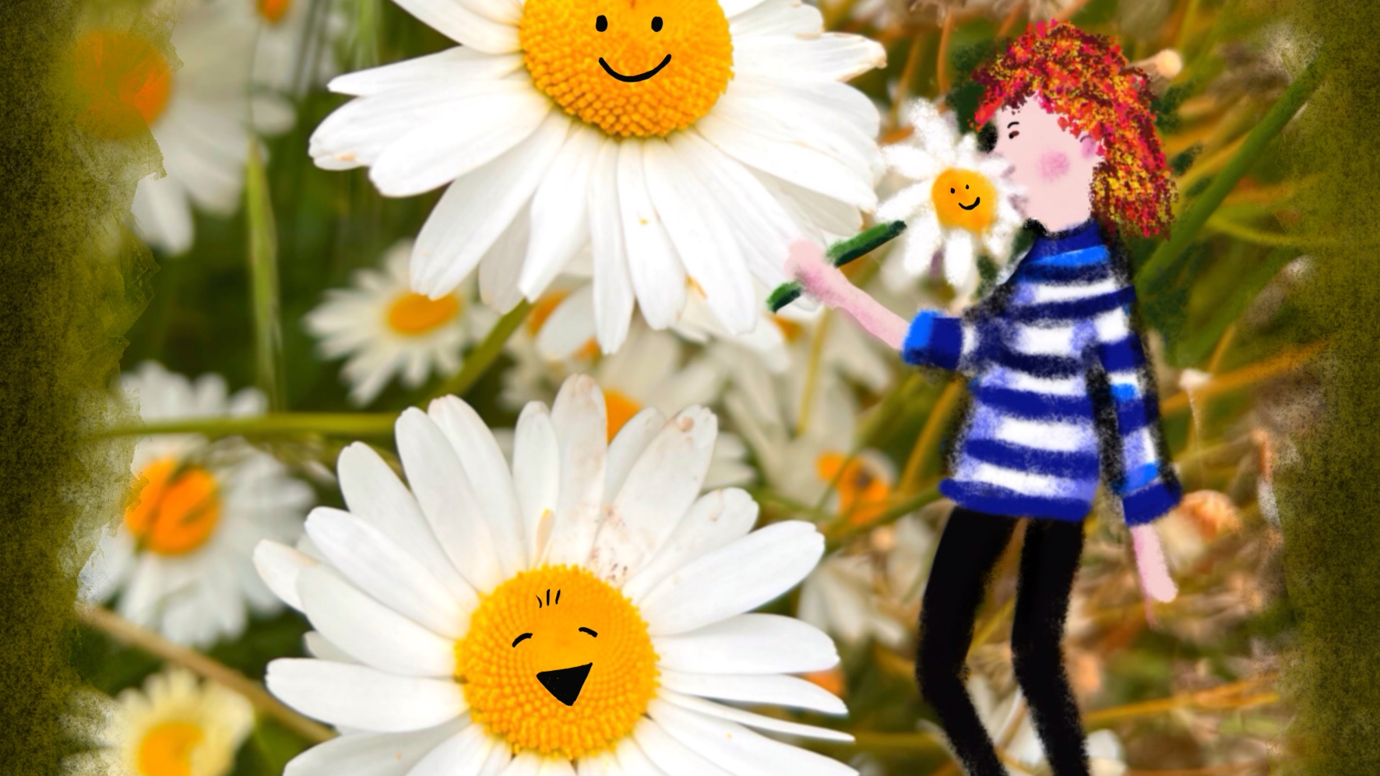
SMELL

Slide 7
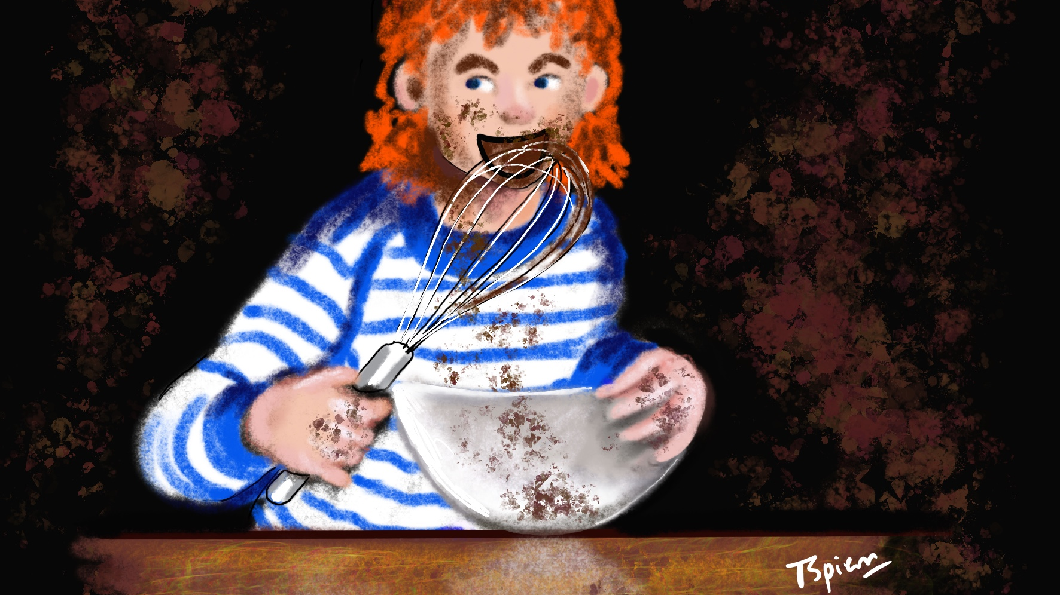
TASTE

Slide 8
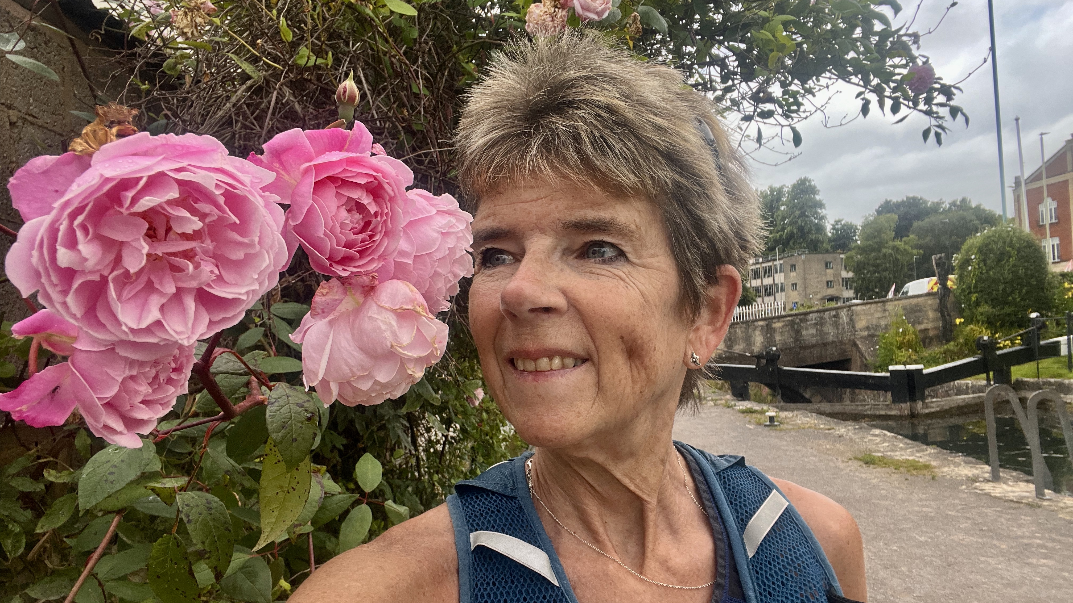
Wake up and smell the roses!

Slide 9
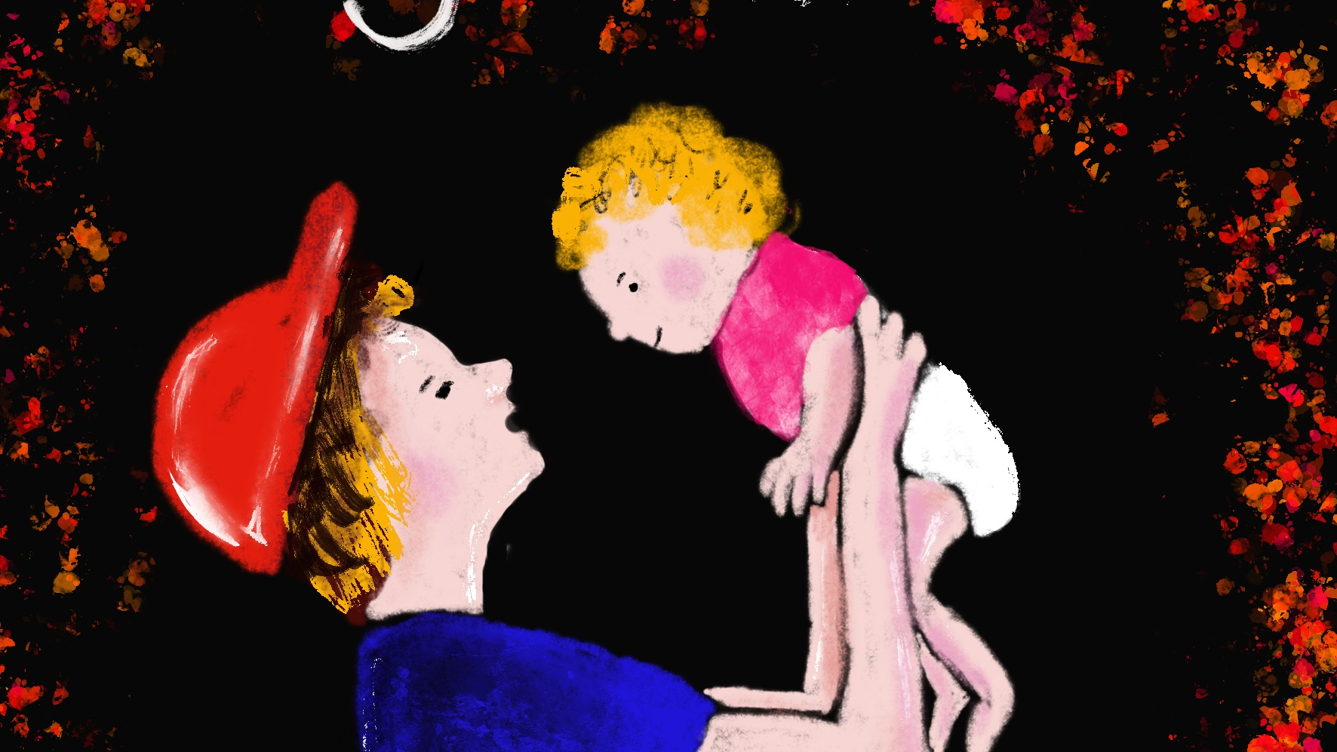
TOUCH

Slide 10
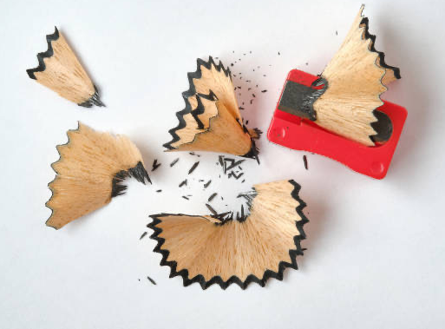
Let’s sharpen
one another

Slide 11
From passive seeing
to active noticing
From familiar to
fascinated

