Slide 1
Sunday 6th October Martin Pearson
The
God
Story
Weeks 1 to 3
The Origin The Fall The Seed of Promise

Slide 2
1. God’s Presence 2. God’s Family 3. God’s Kingdom

Slide 3
1. What am I learning about God and His people?
2. How do I see God’s plan unfolding in this part of the story?

Slide 4
Psalm 8
O LORD, our Lord, your majestic name fills the earth!
Your glory is higher than the heavens.
You have taught children and infants to tell of your strength,
silencing your enemies and all who oppose you.
When I look at the night sky and see the work of your fingers -
the moon and the stars you set in place -
What are mere mortals that you should think about them,
human beings that you should care for them?

Slide 5
Psalm 8
Yet you made them only a little lower than God
and crowned them with glory and honour.
You gave them charge of everything you made,
putting all things under their authority -
the flocks and the herds and all the wild animals,
the birds in the sky, the fish in the sea, and everything that swims the ocean currents.
O LORD, our Lord, your majestic name fills the earth!

Slide 6
The Origin
1

Slide 7
“Sabbath is a heavenly metronome to allow us all to keep singing in tune”

Slide 8
Imagine God delighting in the reflection of himself in his very own image bearing son, like the wide-eyed wonder of a parent holding their newborn baby for the first time. God is gazing into the wonderstruck eyes of his child through whom his dream for the world, his very own nature, will be multiplied. And it fascinates him. Every person will fascinate him forever.

Slide 9
God did not make robots! He could never force humankind to love Him or it wouldn’t be perfect love. God’s holy love speaks of ultimate freedom. God was not laying down a demand to love him in the creation of humanity, rather he was carrying a hope in his heart, a hope that we would freely return the love he has for us.

Slide 10
We are designed to mimic the trinity through self-giving love to one another. We are loved by the Father and we are formed in a family. Fellow human beings should be understood primarily as gifts to one another, each one capable of reflecting an unrepeatable dimension of the image of God to the other.

Slide 11
The Origin
1
God’s Presence God’s Family God’s Kingdom

Slide 12
The Fall
2

Slide 13
Genesis 3 is the most devastating account of identity-theft you will ever read. Here we witness the enemy steal the core of humankind’s identity in the tender place of their belonging. Adam and Eve were already made in the image and likeness of God. The luring voice of the serpent deceived them to believe there was something more they needed to do. It was the voice that says ‘know more’, ‘achieve more’, ‘become more.’ It was the voice that says ‘don’t settle for being like God, you can be God!

Slide 14
2
Genesis 3:9
“Where are you?”

Slide 15
2
SHAME (v7-8)
FEAR (v10)
BLAME GAME (v11-13)

Slide 16
The Fall
2
God’s Presence God’s Family God’s Kingdom

Slide 17
The Seed of Promise
3

Slide 18
Gen 12:1-3 The Lord had said to Abram, “Leave your native country, your relatives, and your father’s family, and go to the land that I will show you. I will make you into a great nation. I will bless you and make you famous, and you will be a blessing to others. I will bless those who bless you and curse those who treat you with contempt. All the families on earth will be blessed through you.”
3

Slide 19
Gen 15:4 “This man will not be your heir, but a son who is your own flesh and blood will be your heir.” He took him outside and said, “Look up at the sky and count the stars - if indeed you can count them.” Then he said to him, “So shall your offspring be.”
3

Slide 20
Gen 15:6 “Abram believed the Lord, and the Lord counted him as righteous because of his faith.”
3

Slide 21
A small and insignificant nomadic tribe with a host of dysfunctional issues have been caught up in the eternal purposes of God for the world.”

Slide 22
The Seed of Promise
3
God’s Presence God’s Family God’s Kingdom

Slide 23
Coming this Wednesday
Week 4
The Birth of a Nation

Slide 27
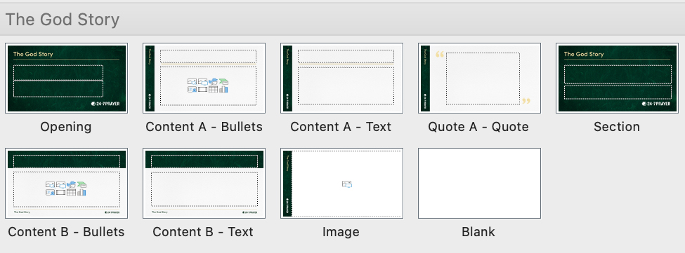
Add a new slide using the ‘Layout’ drop down
Helvetica is the suggested typeface

