Slide 1
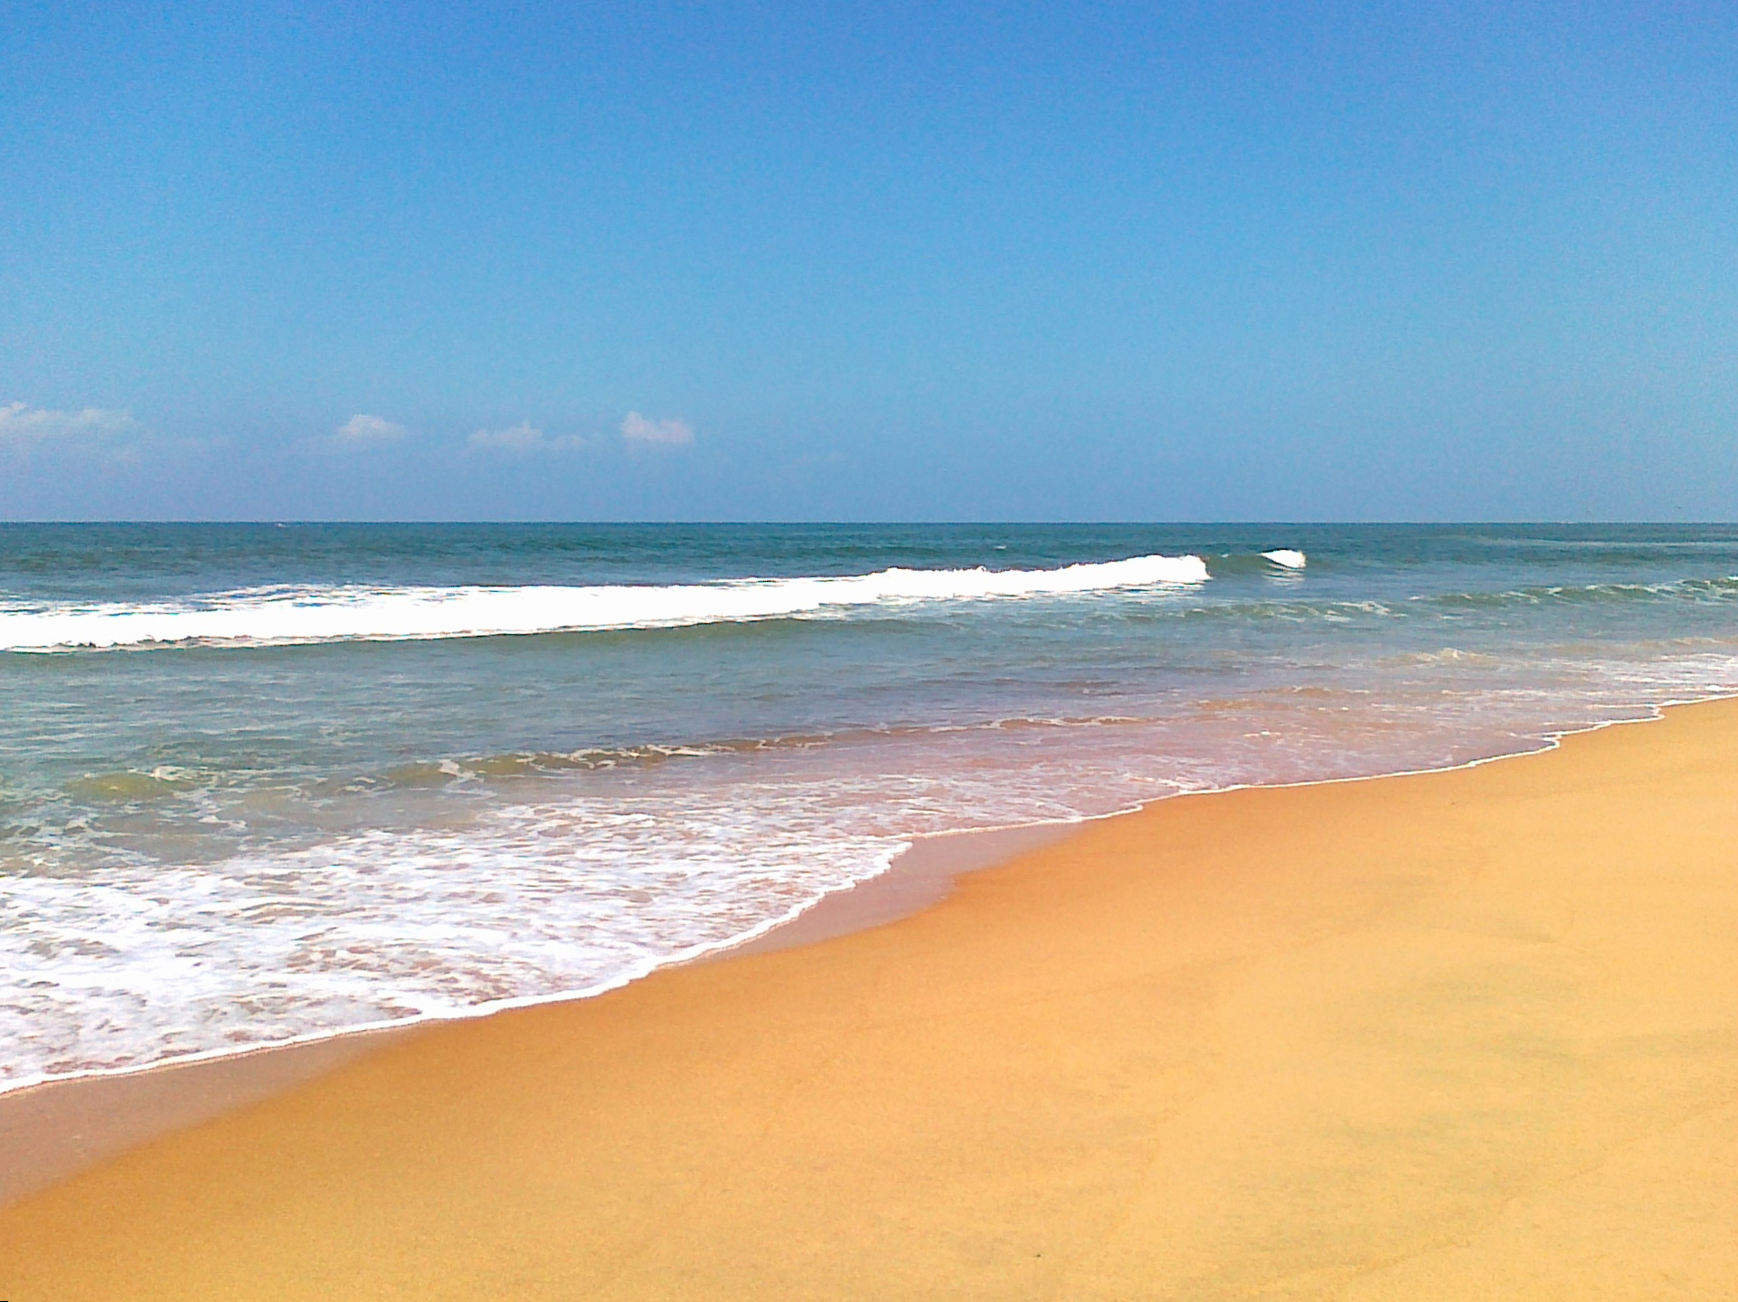
Changing Tides
Fiona Parker 3rd november 2024

Slide 2
Changing Tides
Constant motion:
life & renewal

Slide 3
Changing Tides
discipleship

Slide 4
Above all else, guard your heart, for everything you do flows from it.
Proverbs 4:23
Be kind and compassionate to one another, forgiving each other, just as in Christ God forgave you.
Ephesians 4:32
“Do not judge, and you will not be judged. Do not condemn, and you will not be condemned. Forgive, and you will be forgiven.”
Luke 6:37

Slide 6
Church is ….
In constant motion (IN/OUT)
Full of real ordinary people called to be extraordinary
Built on Prayer in a personal relationship with Jesus
Showing love, compassion, patience and forgiveness
Sharing God’s Word
It’s better to look at the world through His eyes, trying to see things from His perspective. The Holy Spirit is a Gift to enable us to do this
We need to be prepared to make sacrifices.

Slide 7
Changing Tides
IN GOD’S ARENA…
SIZE DOES NOT MATTER!

