Slide 1
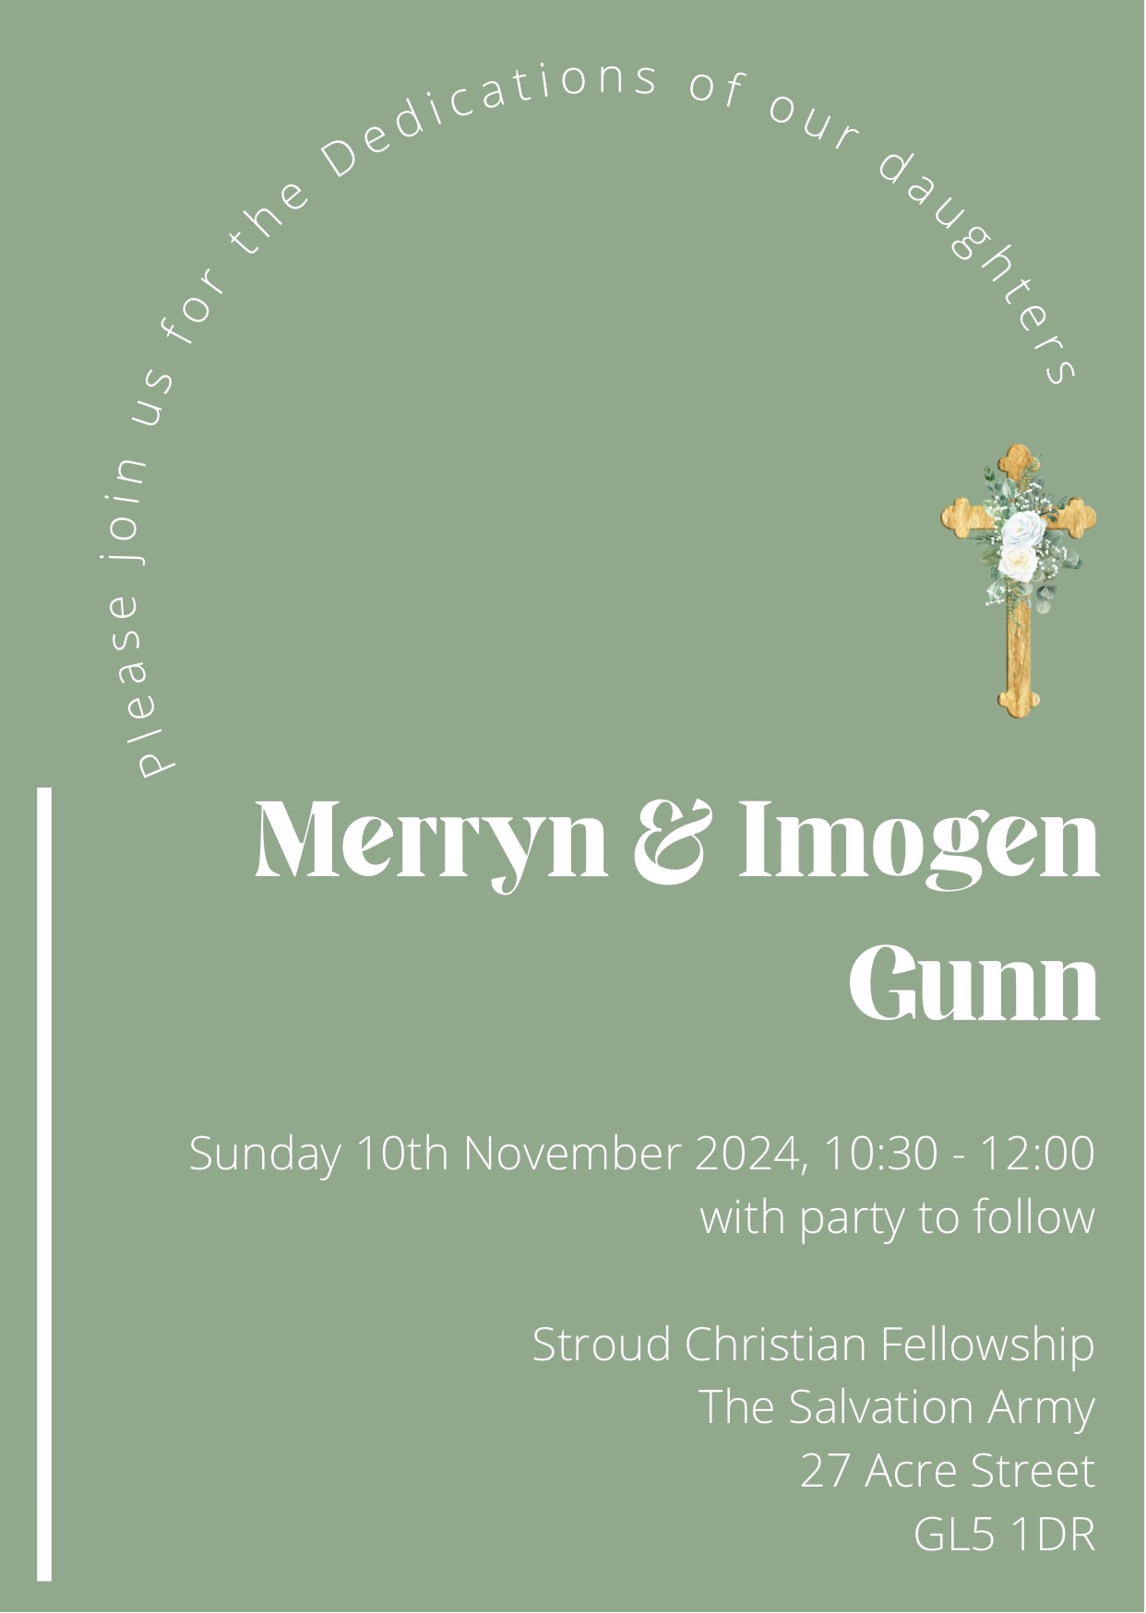

Slide 2
Dedication of Merryn and Imogen

Slide 5
