Slide 1

HOW WILL
THEY KNOW?
MARTIN PEARSON
26th January 2025

Slide 2
Matthew 13:1-9
Later that same day Jesus left the house and sat beside the lake. A large crowd soon gathered around him, so he got into a boat. Then he sat there and taught as the people stood on the shore. He told many stories in the form of parables, such as this one:
“Listen! A farmer went out to plant some seeds. As he scattered them across his field, some seeds fell on a footpath, and the birds came and ate them. Other seeds fell on shallow soil with underlying rock. The seeds sprouted quickly because the soil was shallow. But the plants soon wilted under the hot sun, and since they didn’t have deep roots, they died. Other seeds fell among thorns that grew up and choked out the tender plants. Still other seeds fell on fertile soil, and they produced a crop that was thirty, sixty, and even a hundred times as much as had been planted! Anyone with ears to hear should listen and understand.”

Slide 3
Matthew 13:18-23
“Now listen to the explanation of the parable about the farmer planting seeds: The seed that fell on the footpath represents those who hear the message about the Kingdom and don’t understand it. Then the evil one comes and snatches away the seed that was planted in their hearts. The seed on the rocky soil represents those who hear the message and immediately receive it with joy. But since they don’t have deep roots, they don’t last long. They fall away as soon as they have problems or are persecuted for believing God’s word. The seed that fell among the thorns represents those who hear God’s word, but all too quickly the message is crowded out by the worries of this life and the lure of wealth, so no fruit is produced. The seed that fell on good soil represents those who truly hear and understand God’s word and produce a harvest of thirty, sixty, or even a hundred times as much as had been planted!”

Slide 4
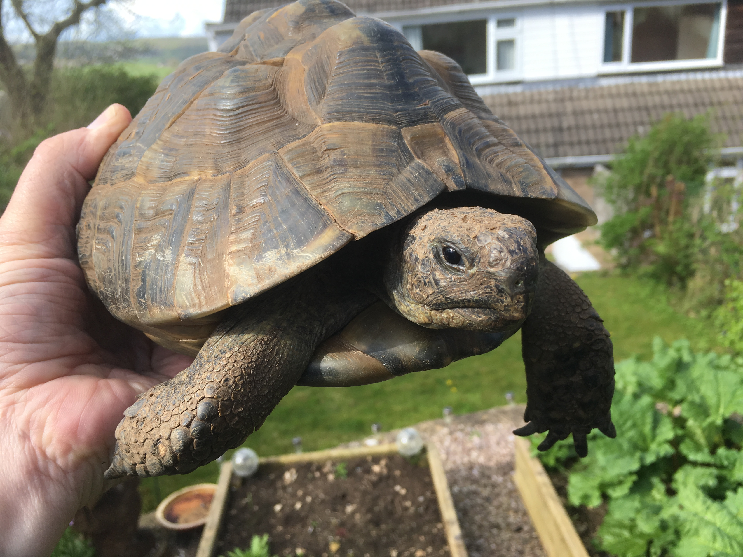
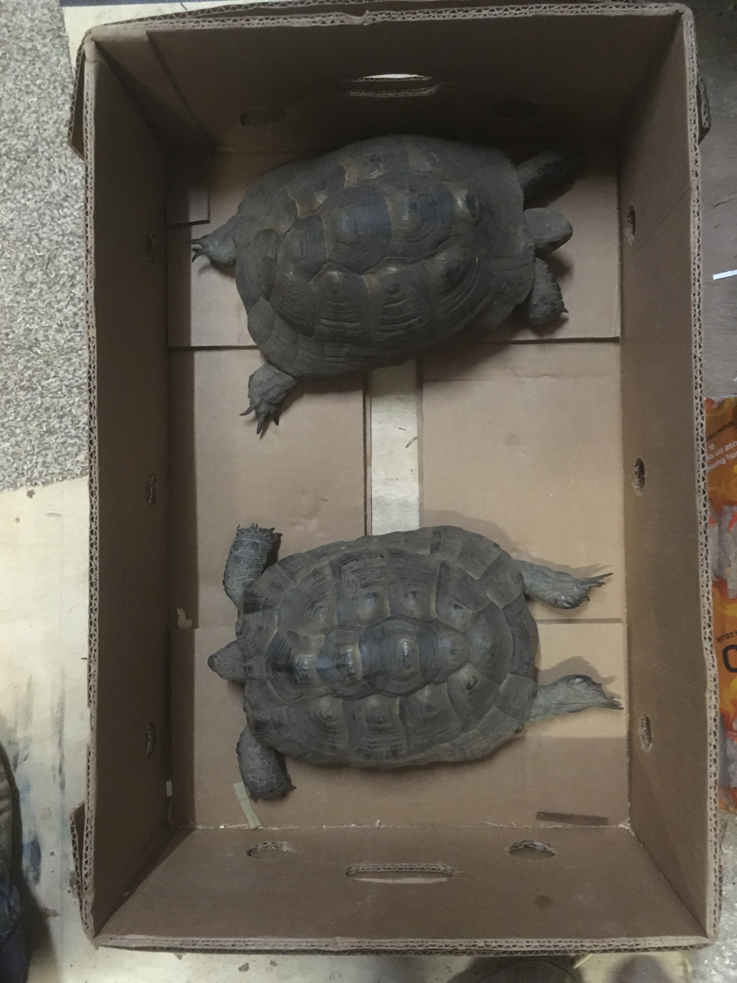
Flash & Gordon

Slide 5
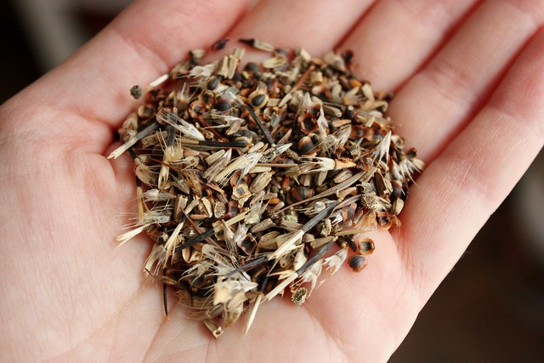

Slide 6
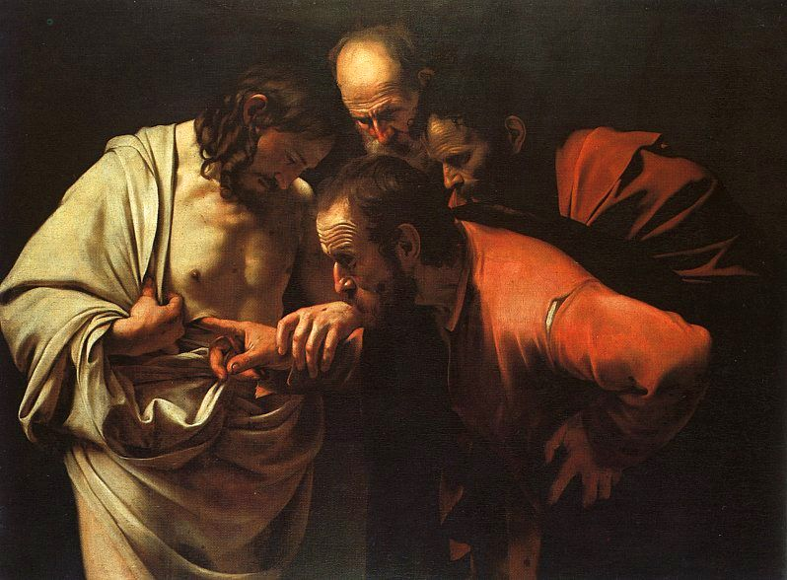
John 20:20-22
As he spoke, he showed them the wounds in his hands and his side. They were filled with joy when they saw the Lord!
Again he said, “Peace be with you. As the Father has sent me, so I am sending you.” Then he breathed on them and said, “Receive the Holy Spirit

Slide 7
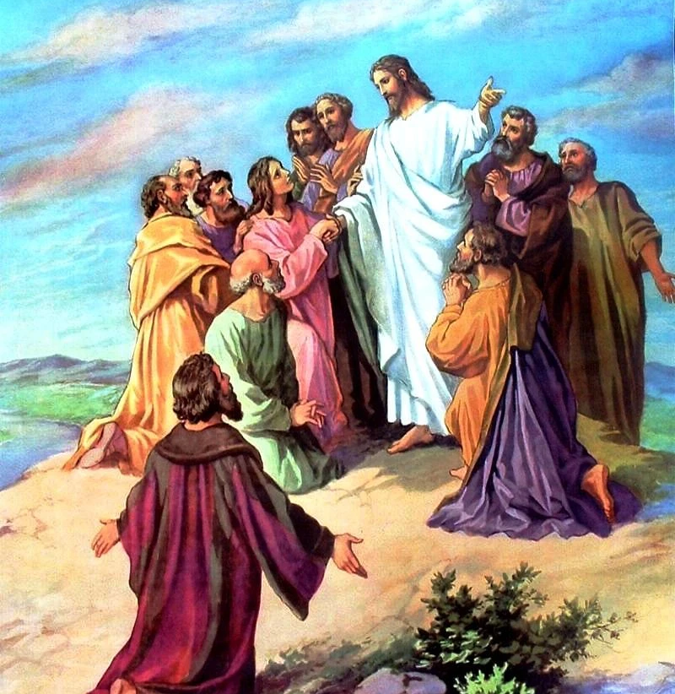
Matthew 28:18-20
(The Message)
Jesus, undeterred, went right ahead and gave his charge: “God authorised and commanded me to commission you: Go out and train everyone you meet, far and near, in this way of life, marking them by baptism in the threefold name: Father, Son, and Holy Spirit. Then instruct them in the practice of all I have commanded you. I’ll be with you as you do this, day after day after day, right up to the end of the age.”

Slide 8

Romans 1:16
For I am not ashamed of this Good News about Christ. It is the power of God at work, saving everyone who believes
Romans 10:14,15
But how can they call on him to save them unless they believe in him? And how can they believe in him if they have never heard about him? And how can they hear about him unless someone tells them? And how will anyone go and tell them without being sent? That is why the Scriptures say, “How beautiful are the feet of messengers who bring good news!”

Slide 9
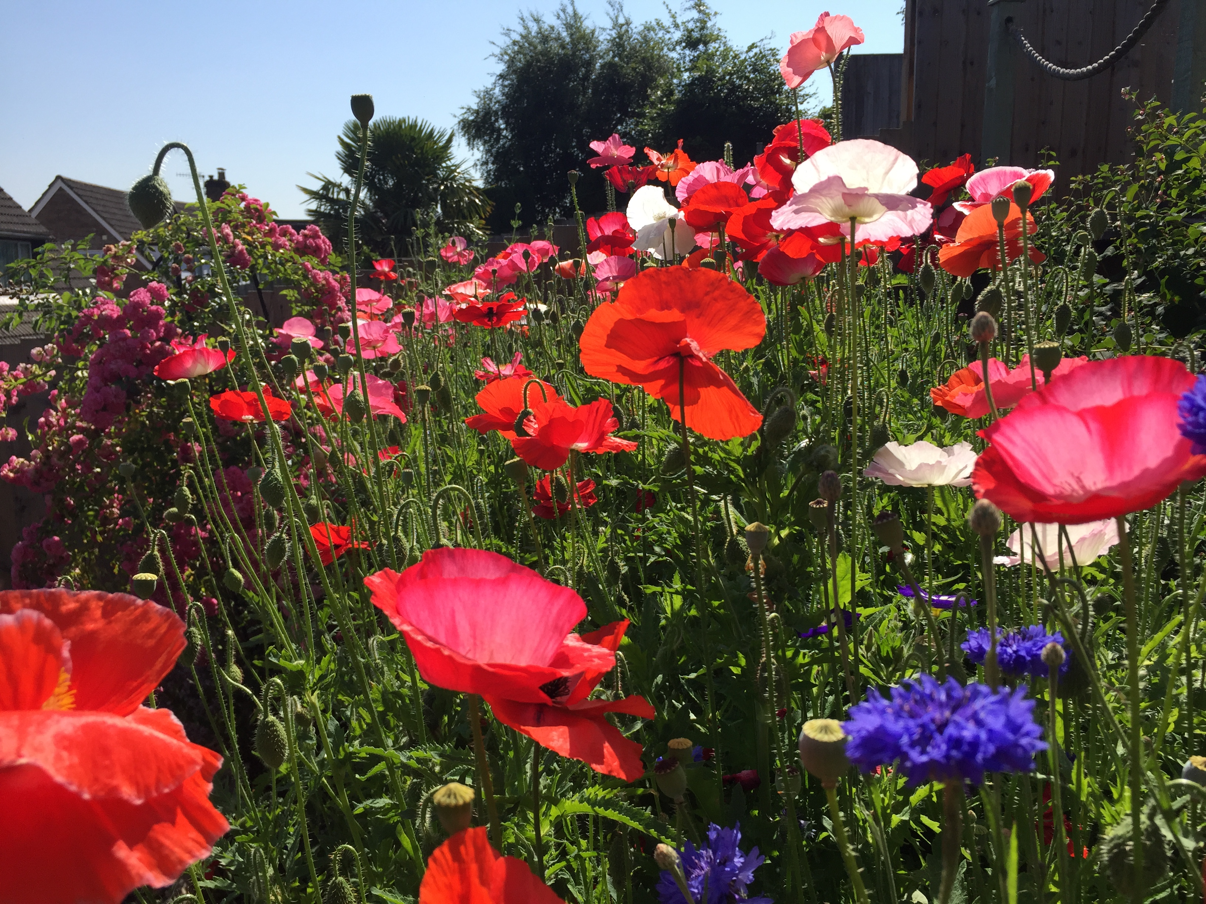

Slide 10
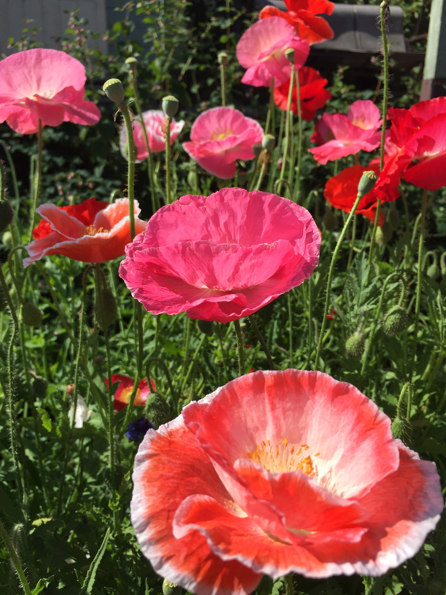
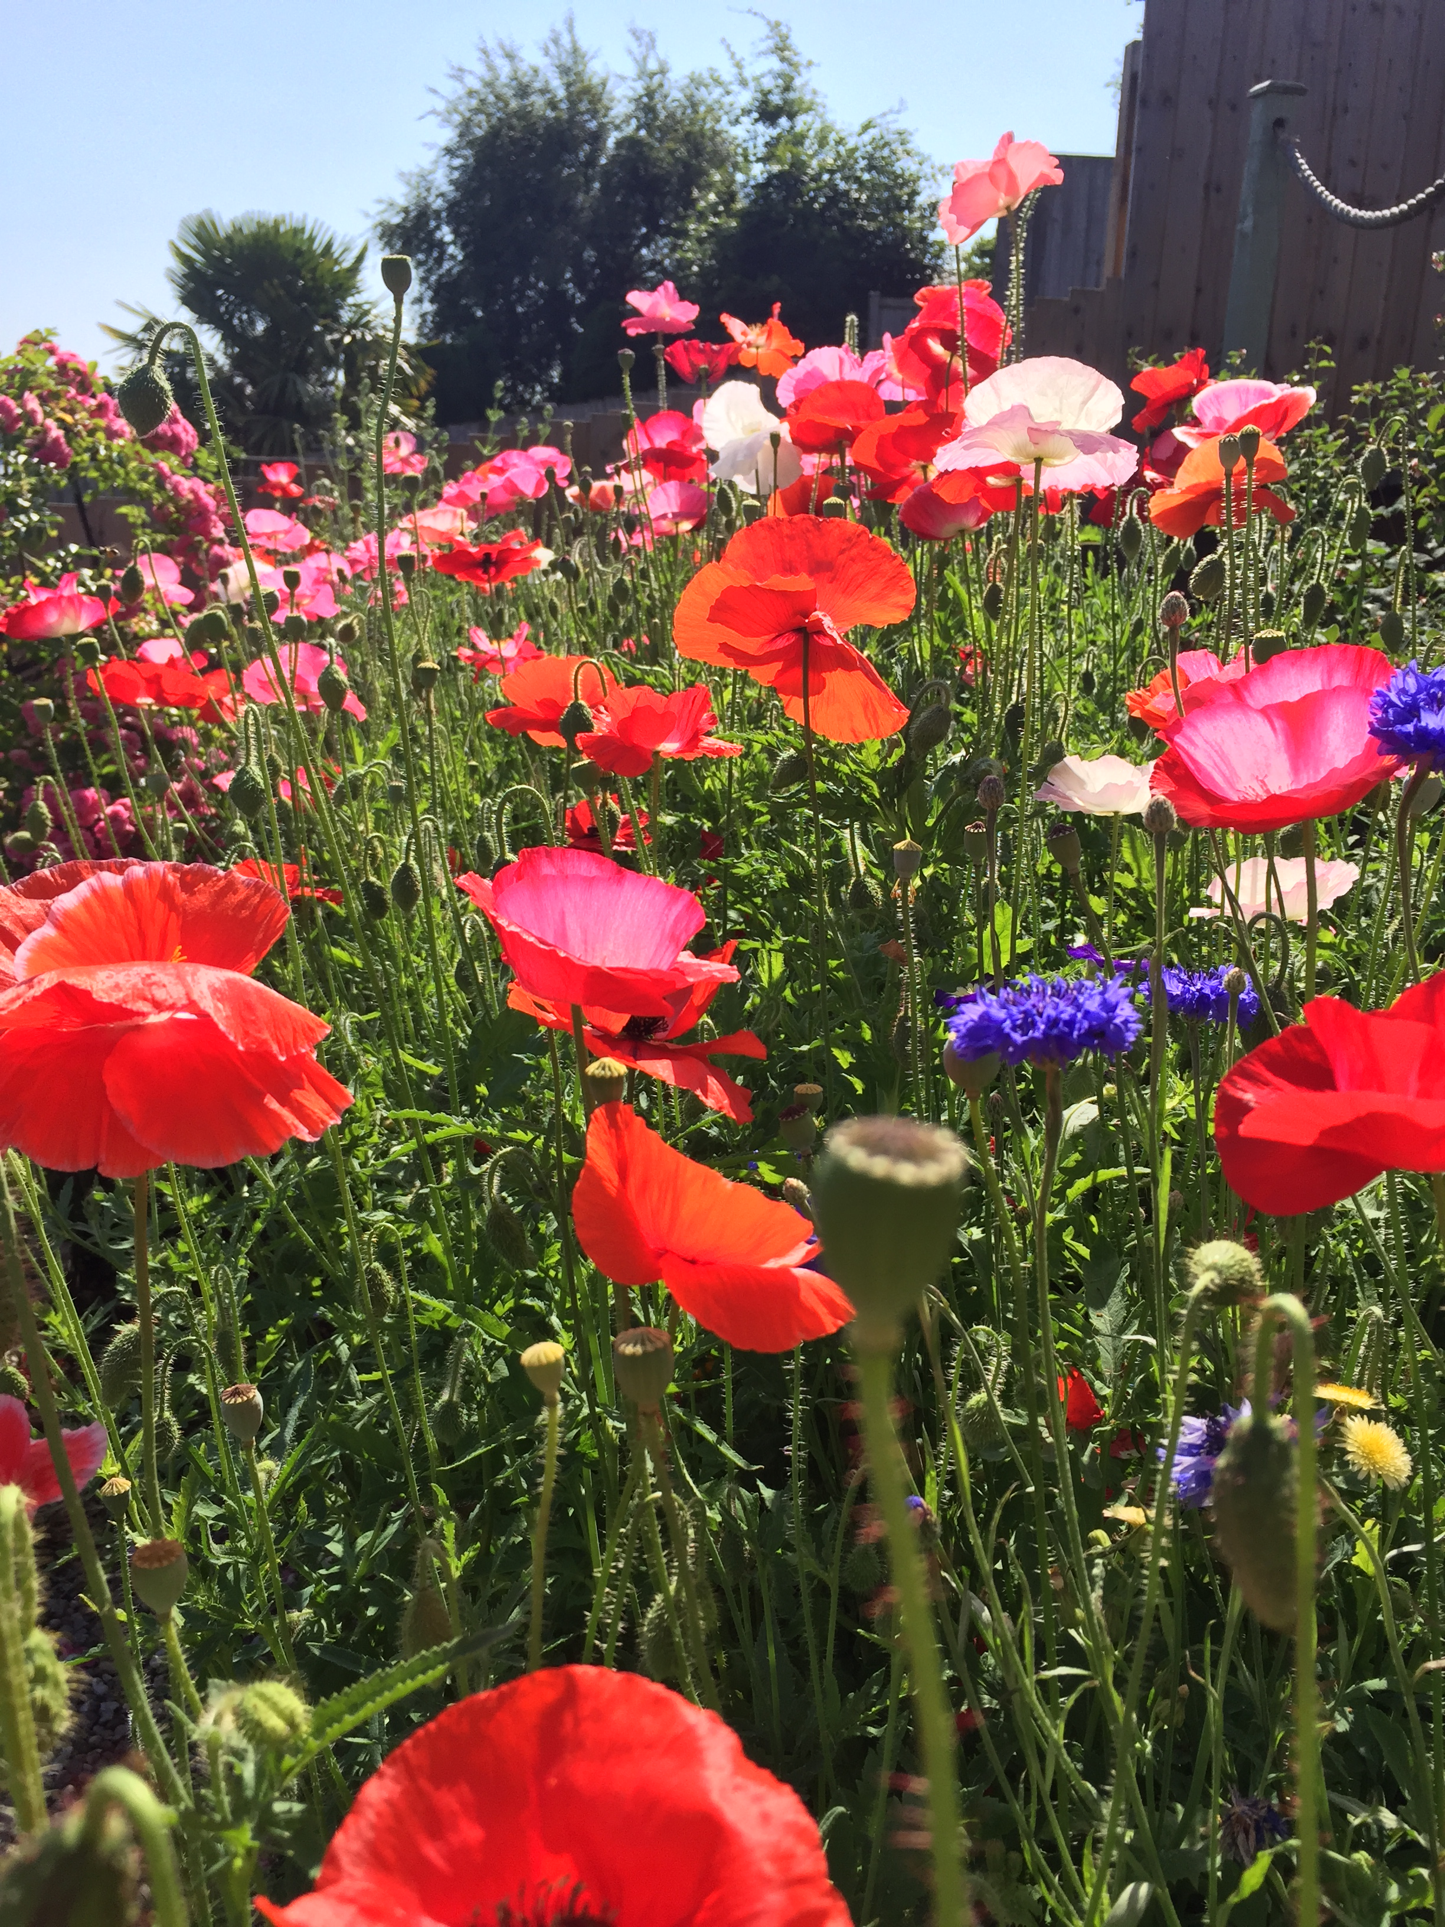
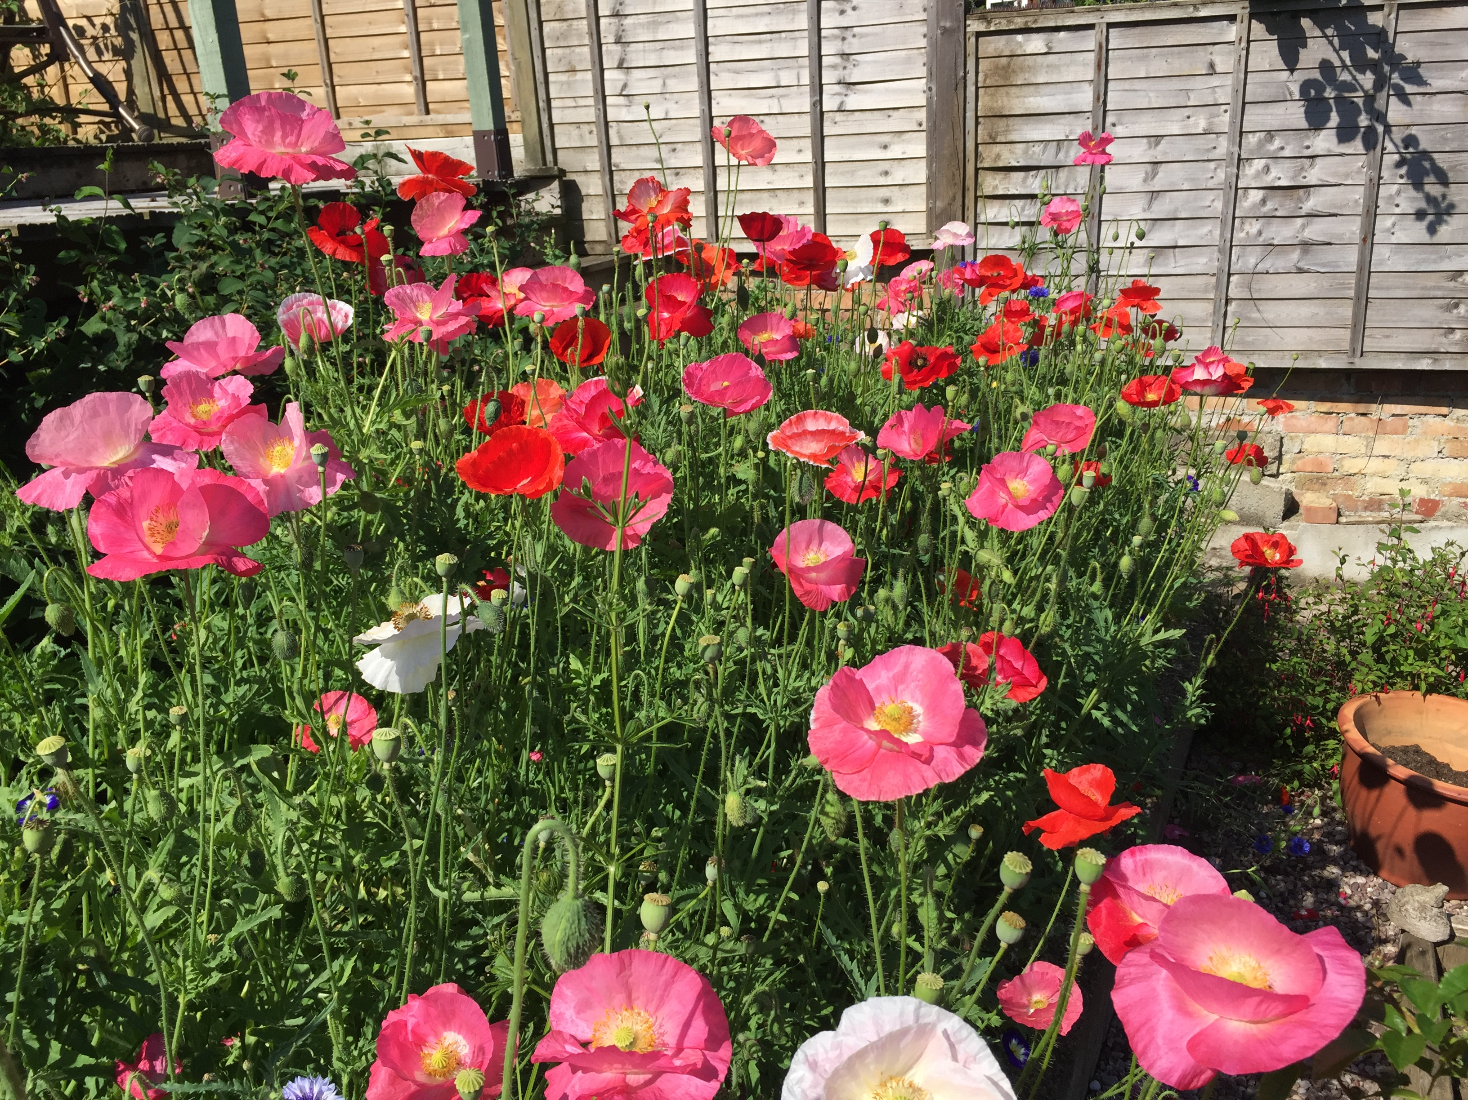

Slide 11
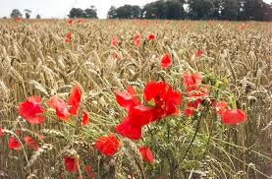
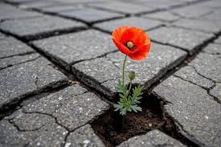

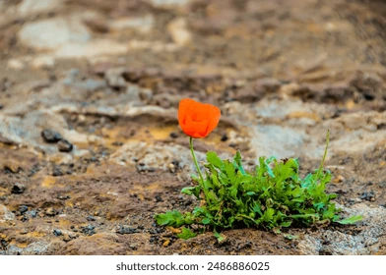

Slide 12
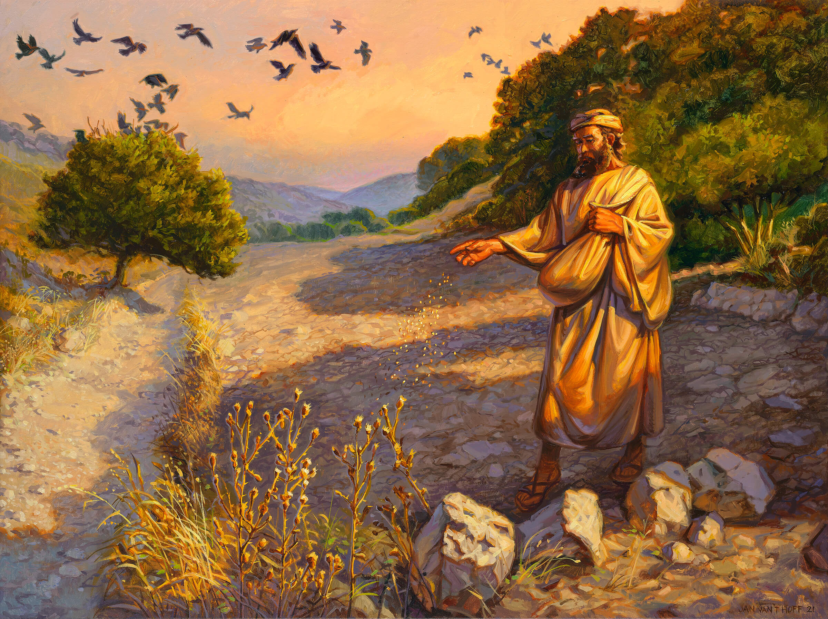

Slide 13
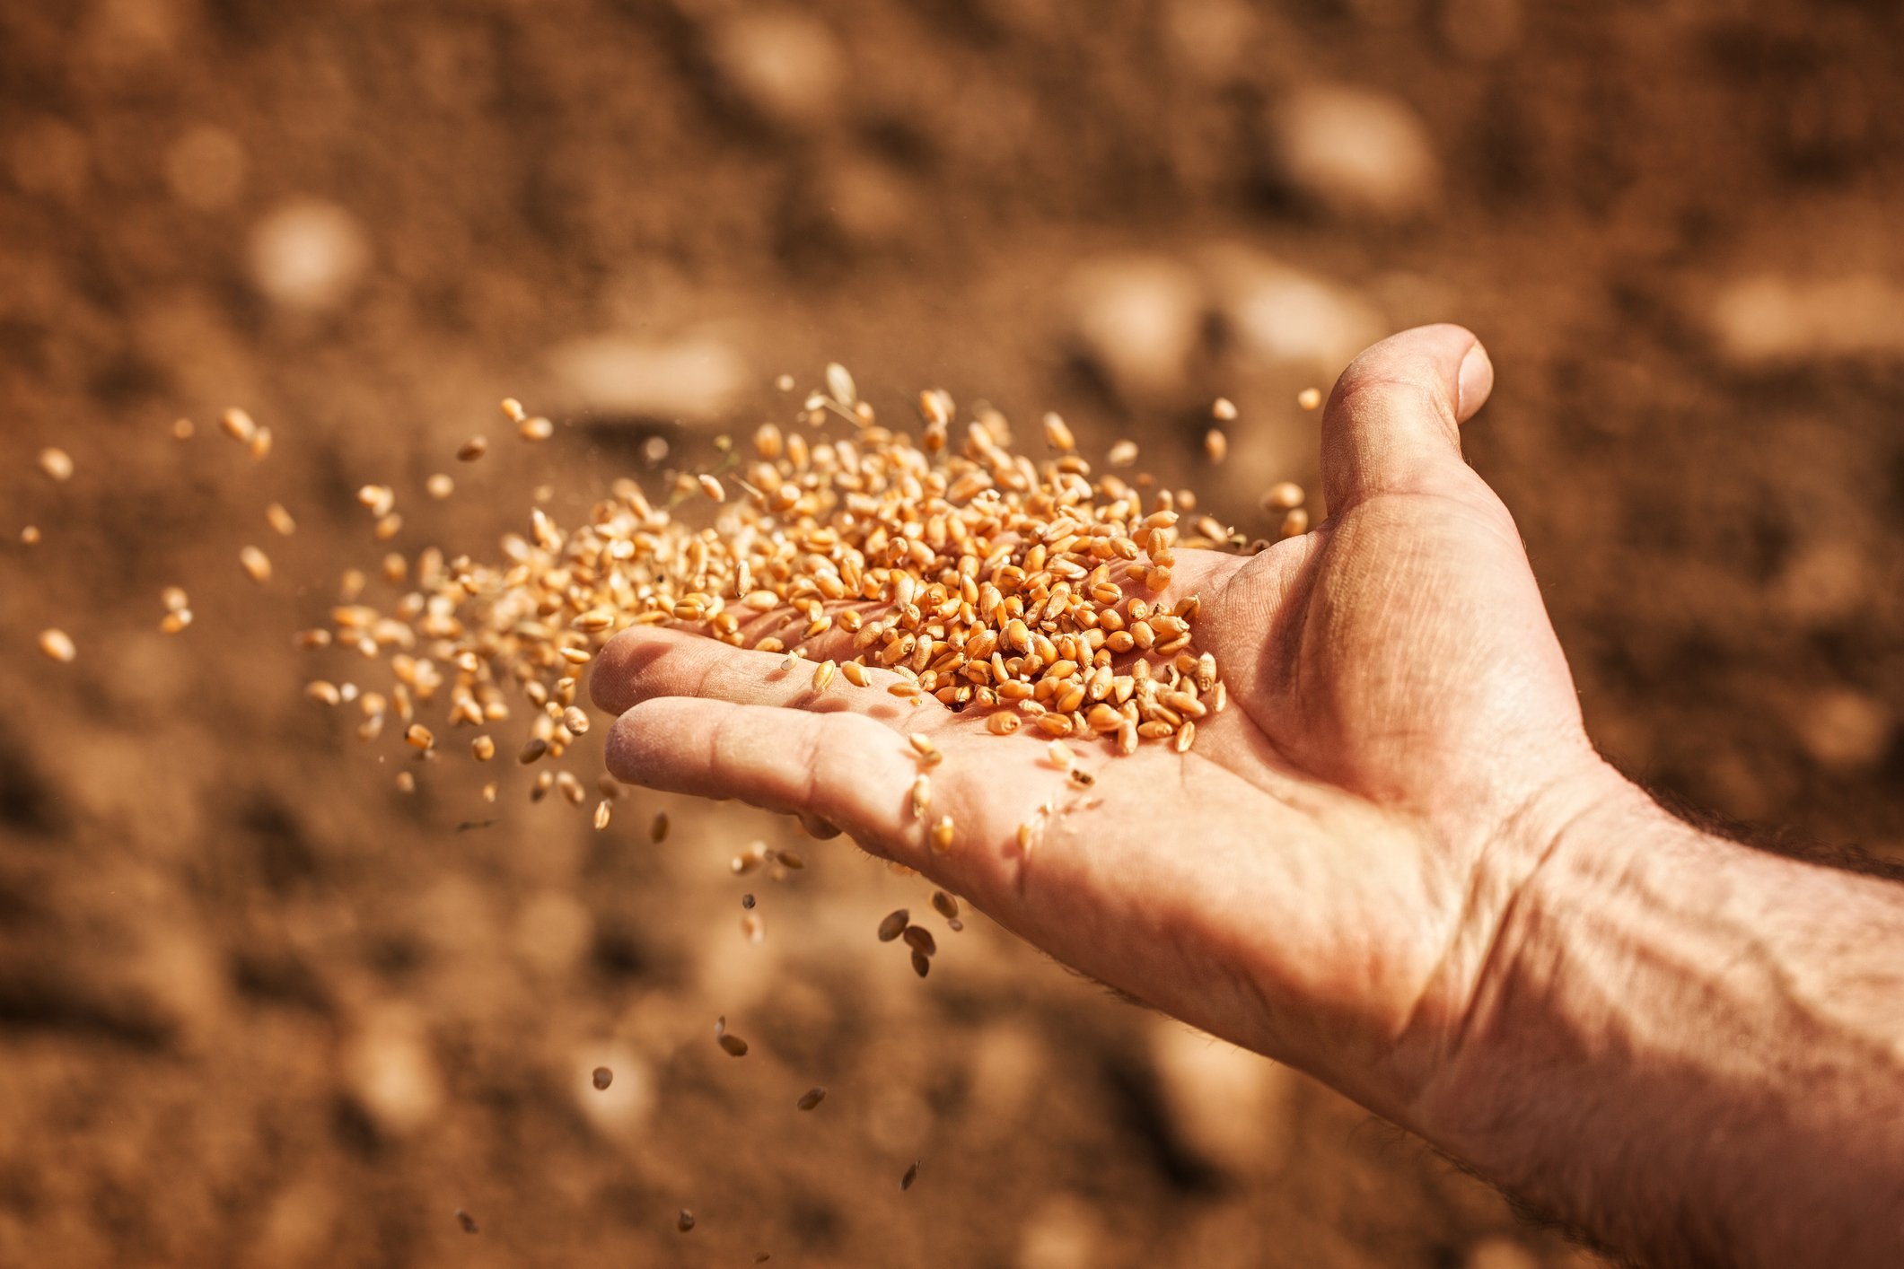

Slide 14
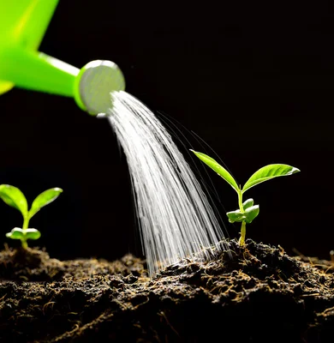
1 Corinthians 3:7,8
It’s not important who does the planting, or who does the watering. What’s important is that God makes the seed grow. The one who plants and the one who waters work together with the same purpose. And both will be rewarded for their own hard work.

Slide 15

Proverbs 25:25 (ERV)
Good news from a faraway place is like a cool drink of water when you are hot and thirsty.

Slide 16
