Slide 5
JESUS’ FRIENDS
THE BEST OF FRIENDS
CIRCLES OF FRIENDS
1
BEST FRIEND
3
INNER CIRCLE
12
HUDDLE
72
NETWORK
ADD A ZERO
FOLLOWING

Slide 7
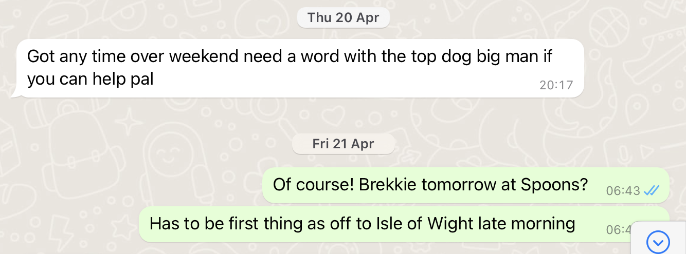

Slide 8
