Slide 3
Psalm 139:13-16
You made all the delicate, inner parts of my body
and knit me together in my mother’s womb.
Thank you for making me so wonderfully complex!
Your workmanship is marvellous—how well I know it.
You watched me as I was being formed in utter seclusion,
as I was woven together in the dark of the womb.
You saw me before I was born. Every day of my life was recorded in your book.
Every moment was laid out before a single day had passed.

Slide 4
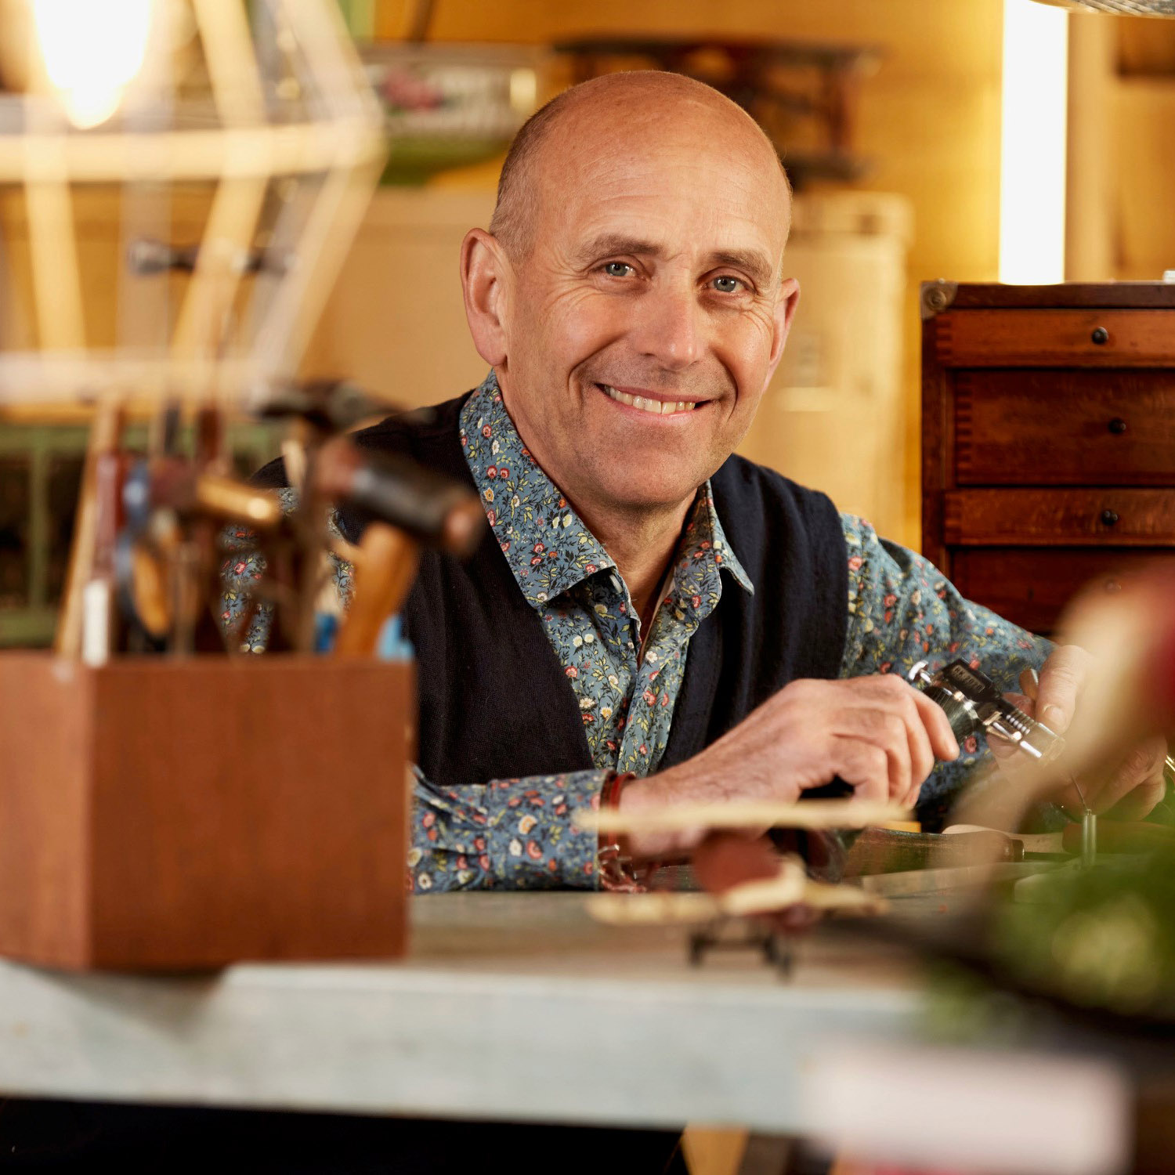
If someone’s made it,
then I can fix it
Brenton West

Slide 6
A jolly good clean
Carefully assess
Japanese tissue paper
Sand blast metal
Clock fluid
Rehydrate paper & leather
Areas of loss restored
Polished
Put back together
Painted
Restuffed – stuffing knocked out of them
Touched up
Broken pieces reconstructed
Distortion reshaped
Rust cut out and made new
Put a bush in it, to stop it wobbling
New bits made!!

Slide 7
I will restore to you,
the years that the locust have eaten.
Joel 2:25

Slide 8
Then God looked over all he had made, and he saw that it was very good!
Genesis 1:31

Slide 9
Jesus replied, “I tell you the truth, unless you are born again, you cannot see the Kingdom of God.”
“What do you mean?” exclaimed Nicodemus. “How can an old man go back into his mother’s womb and be born again?”
Jesus replied, “I assure you, no one can enter the Kingdom of God without being born of water and the Spirit. Humans can reproduce only human life, but the Holy Spirit gives birth to spiritual life.
John 3:3-6

Slide 10
Then Jesus said, “Come to me, all of you who are weary and carry heavy burdens, and I will give you rest.
Matthew 11:28
This means that anyone who belongs to Christ has become a new person. The old life is gone; a new life has begun!
2 Corinthians 5:17
The Spirit of God, who raised Jesus from the dead, lives in you. And just as God raised Christ Jesus from the dead, he will give life to your mortal bodies by this same Spirit living within you.
Romans 8:11

Slide 11
But the Holy Spirit will come and help you, because the Father will send the Spirit to take my place. The Spirit will teach you everything and will remind you of what I said while I was with you. I give you peace, the kind of peace only I can give. It isn't like the peace this world can give. So don't be worried or afraid.
John 14:26-27
And the one sitting on the throne said, “Look, I am making everything new!” And then he said to me, “Write this down, for what I tell you is trustworthy and true.”
Revelation 21:5

Slide 12
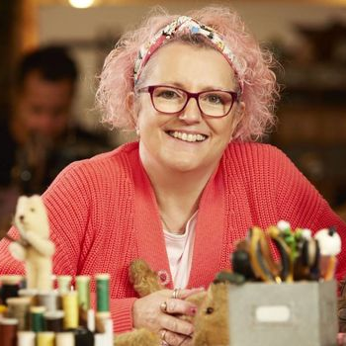
Ohhhhh,
I like what I’m seeing
Amanda Middleditch

Slide 13
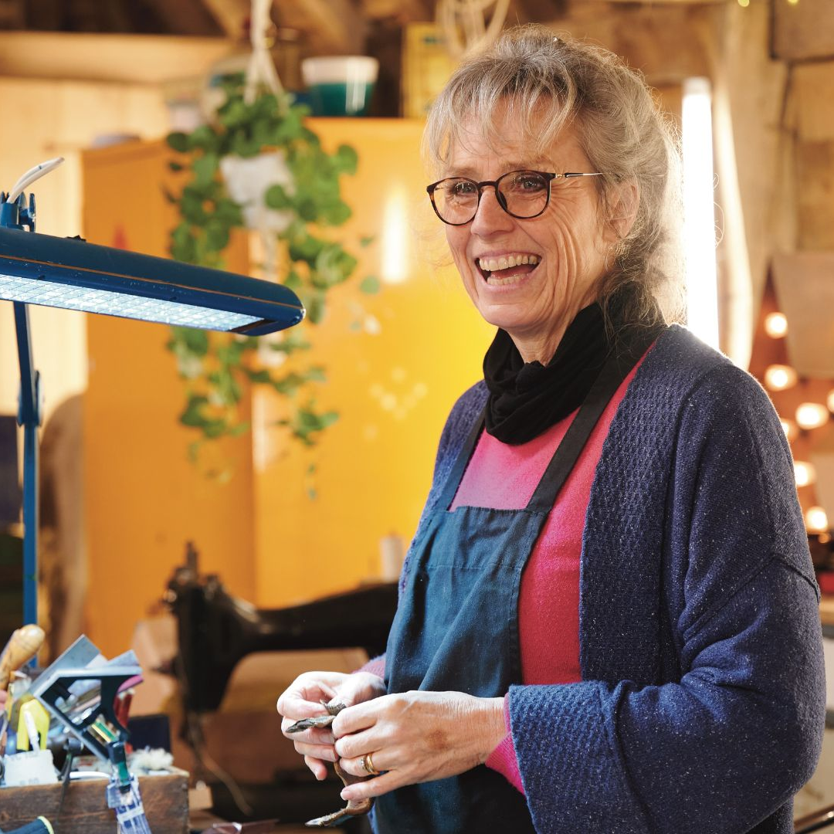
I’m really liking the end result
Suzie Fletcher

Slide 16
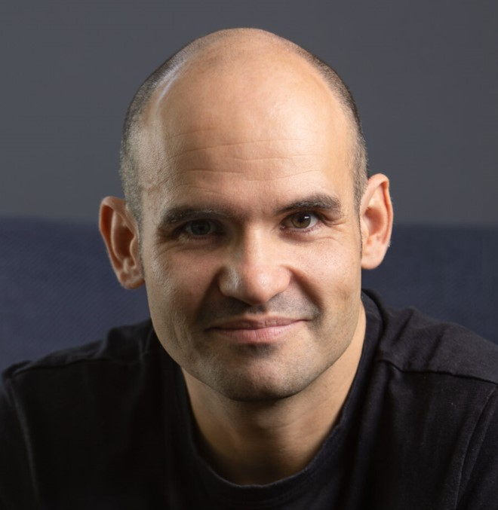
We are Good News people in a bad news world
Phil Knox

