Slide 1
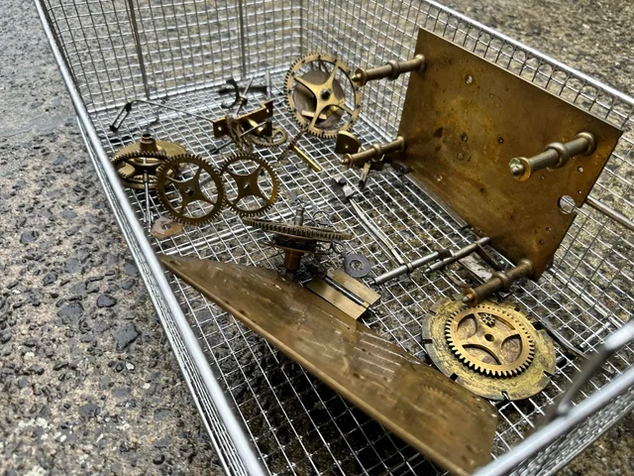

Slide 2
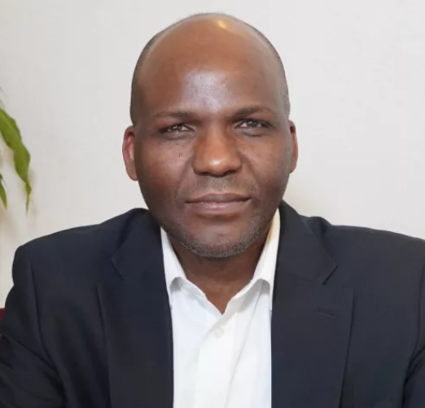
“You can’t multi-task in God’s presence”
Anderson Moyo Snr Pastor Sheffield Community Church

Slide 3
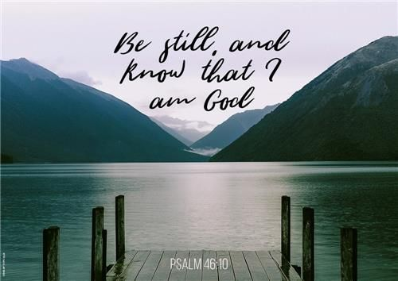

Slide 4
God is our refuge and strength, always ready to help in times of trouble. So we will not fear when earthquakes come and the mountains crumble into the sea. Let the oceans roar and foam. Let the mountains tremble as the waters surge!
A river brings joy to the city of our God, the sacred home of the Most High. God dwells in that city; it cannot be destroyed. From the very break of day, God will protect it. The nations are in chaos, and their kingdoms crumble! God’s voice thunders, and the earth melts! The Lord of Heaven’s Armies is here among us; the God of Israel is our fortress.
Come, see the glorious works of the Lord: See how he brings destruction upon the world. He causes wars to end throughout the earth. He breaks the bow and snaps the spear; he burns the shields with fire.
“Be still, and know that I am God! I will be honored by every nation. I will be honored throughout the world.”
The Lord of Heaven’s Armies is here among us; the God of Israel is our fortress.
Psalm 46

Slide 5
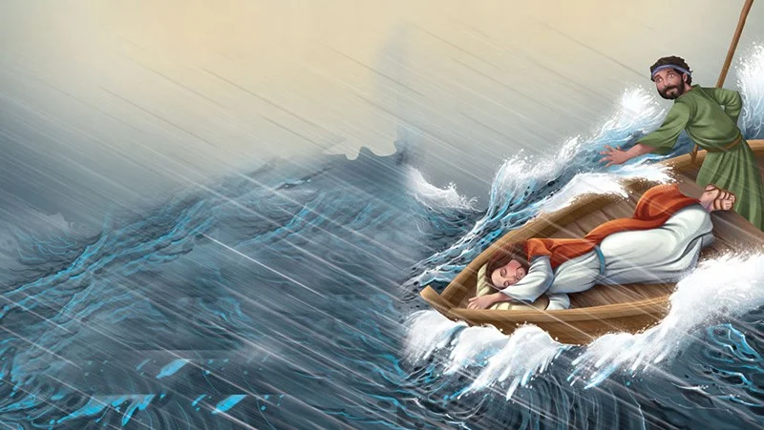

Slide 6
As evening came, Jesus said to his disciples, “Let’s cross to the other side of the lake.” So they took Jesus in the boat and started out, leaving the crowds behind (although other boats followed). But soon a fierce storm came up. High waves were breaking into the boat, and it began to fill with water.
Jesus was sleeping at the back of the boat with his head on a cushion. The disciples woke him up, shouting, “Teacher, don’t you care that we’re going to drown?”
When Jesus woke up, he rebuked the wind and said to the waves,
“Silence! Be still!”
Suddenly the wind stopped, and there was a great calm. Then he asked them, “Why are you afraid? Do you still have no faith?”
The disciples were absolutely terrified. “Who is this man?” they asked each other. “Even the wind and waves obey him!”
Mark 4:35-41

Slide 9
The Lord is my shepherd; I have all that I need. He lets me rest in green meadows; he leads me beside peaceful streams. He renews my strength. He guides me along right paths, bringing honor to his name. Even when I walk through the darkest valley, I will not be afraid, for you are close beside me. Your rod and your staff protect and comfort me. You prepare a feast for me in the presence of my enemies. You honor me by anointing my head with oil. My cup overflows with blessings. Surely your goodness and unfailing love will pursue me all the days of my life, and I will live in the house of the Lord forever.
Psalm 23

Slide 10
“You can’t multi-task in God’s presence”
Anderson Moyo Snr Pastor Sheffield Community Church

Slide 11
As Jesus and the disciples continued on their way to Jerusalem, they came to a certain village where a woman named Martha welcomed him into her home. Her sister, Mary, sat at the Lord’s feet, listening to what he taught. But Martha was distracted by the big dinner she was preparing. She came to Jesus and said, “Lord, doesn’t it seem unfair to you that my sister just sits here while I do all the work? Tell her to come and help me.”
But the Lord said to her, “My dear Martha, you are worried and upset over all these details! There is only one thing worth being concerned about. Mary has discovered it, and it will not be taken away from her.”
Luke 10:38-42

Slide 12
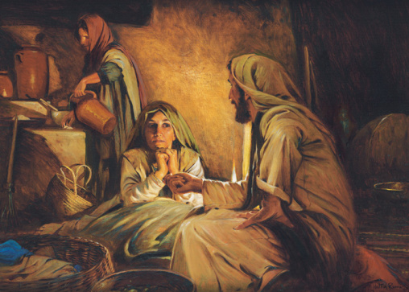

Slide 13
“You can’t multi-task in God’s presence”
Anderson Moyo Snr Pastor Sheffield Community Church

Slide 14
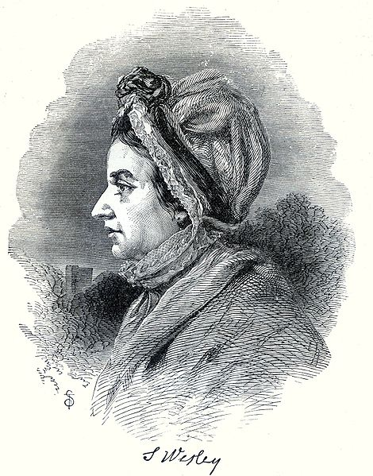
Susanna Wesley
1669-1742

Slide 15
Jesus said, “‘Love the Lord your God with all your passion and prayer and intelligence.’ This is the most important, the first on any list. But there is a second to set alongside it: ‘Love others as well as you love yourself.’ These two commands are pegs; everything in God’s Law and the Prophets hangs from them.”
Matthew 22:37-40 (The Message)

