Slide 1
God bless you
The power of
spoken blessings
Tracy Spiers

Slide 2
'Worry weighs a person
down, but an encouraging
word cheers a person up.’
Proverbs 12: 25

Slide 3
‘Words kill, words give life. They are either poison or fruit, you choose.’
Proverbs 18: 21

Slide 5
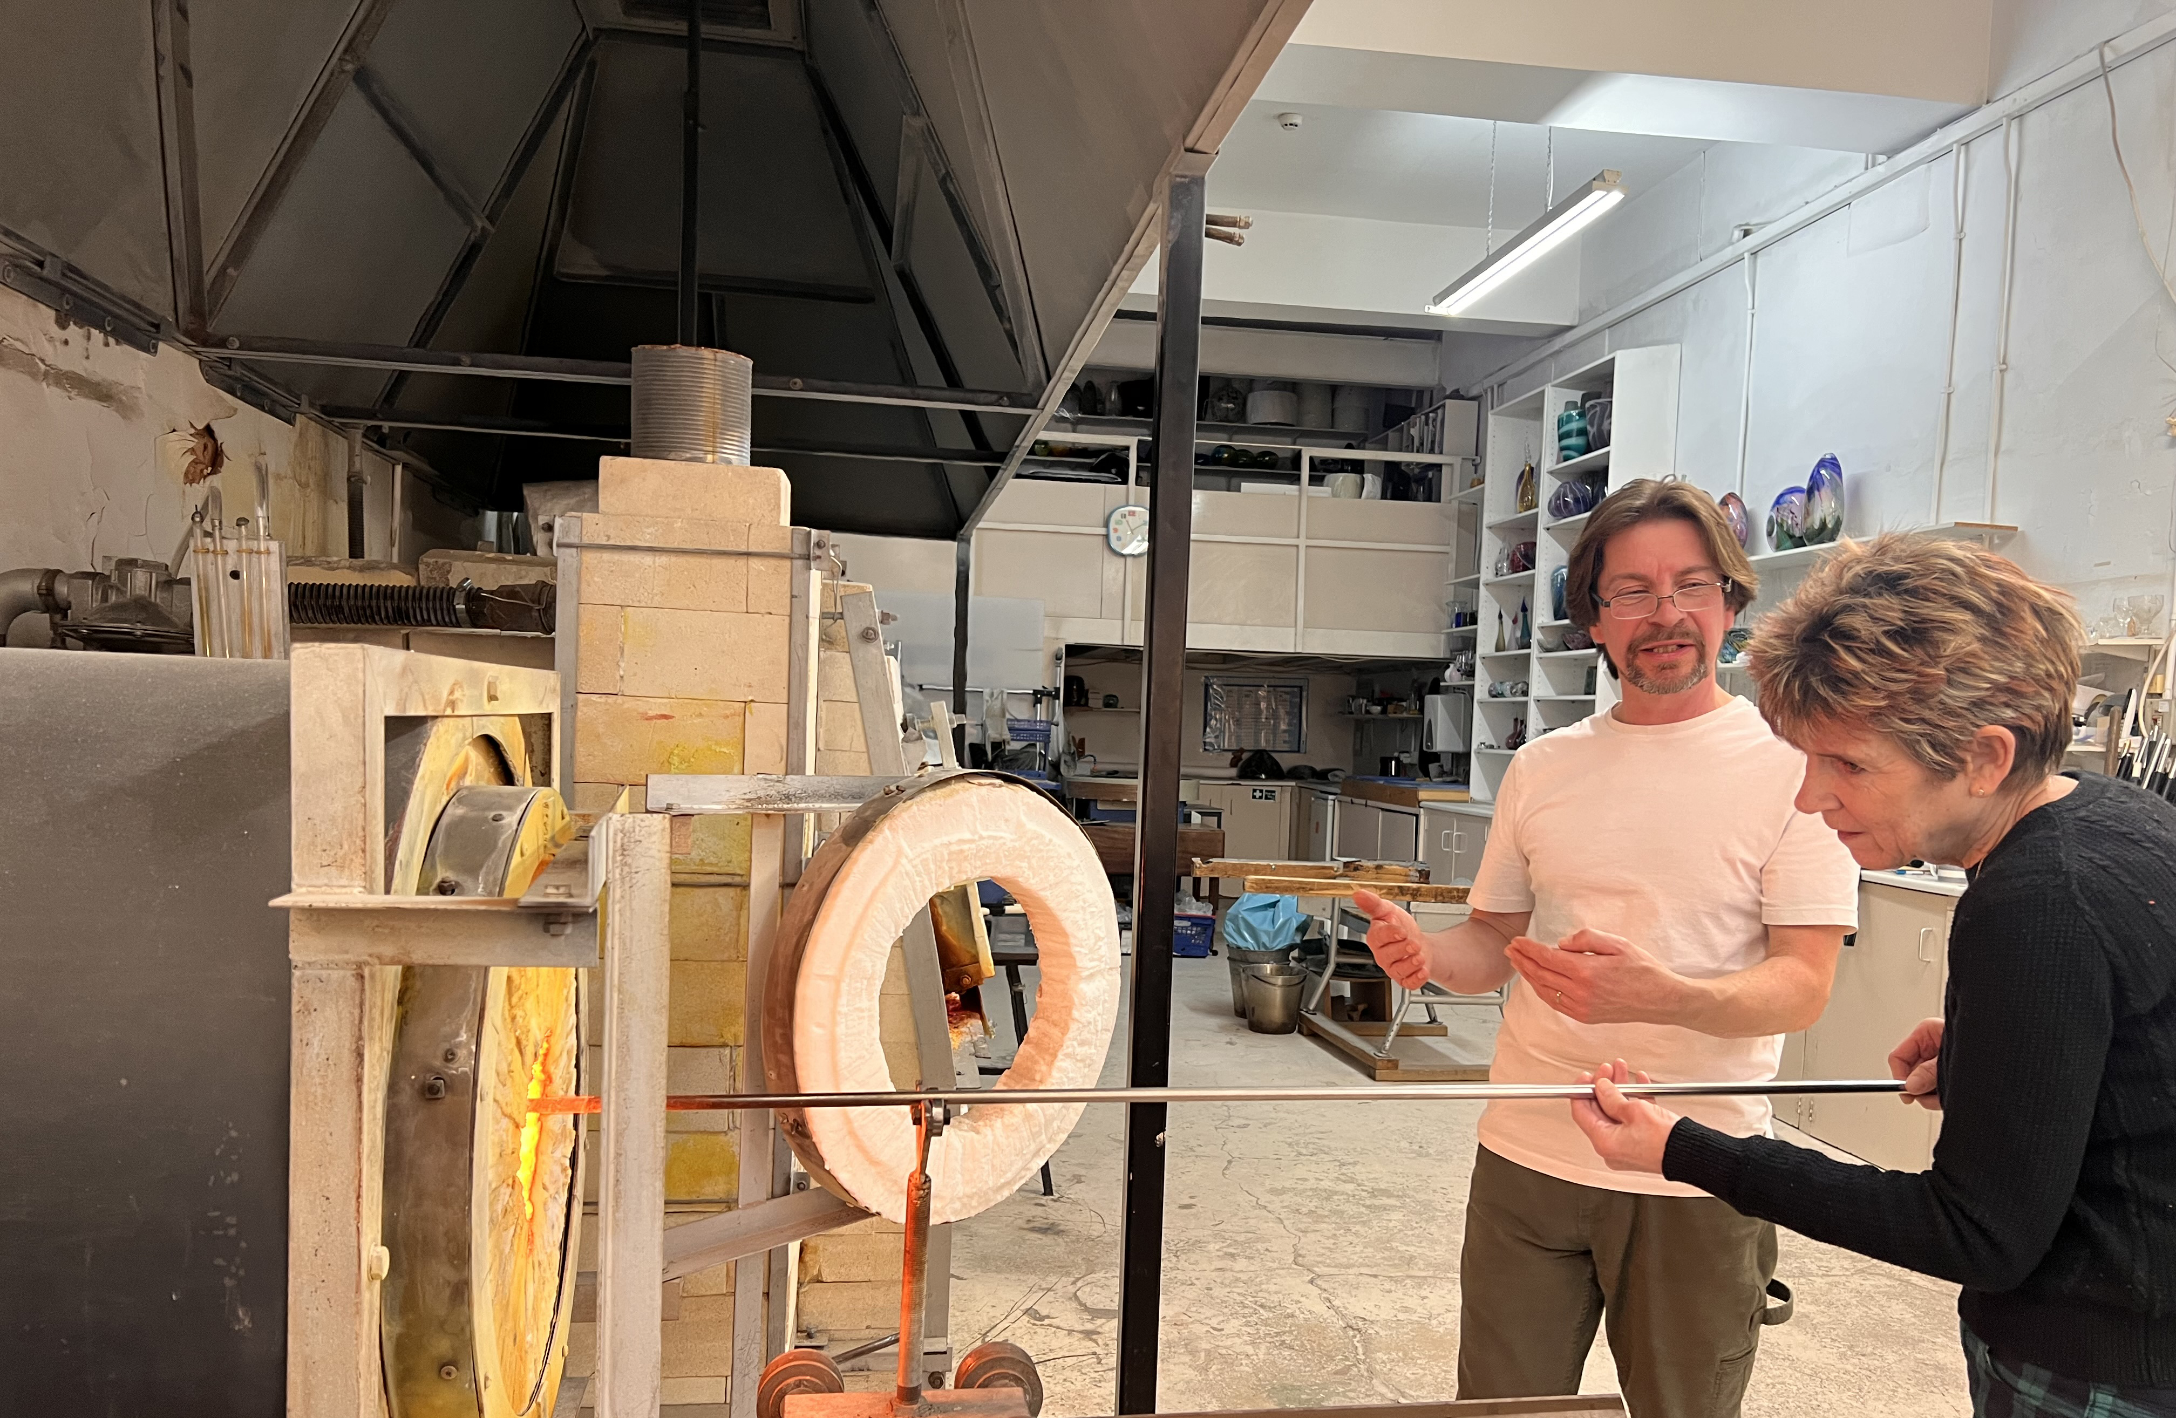

Slide 6
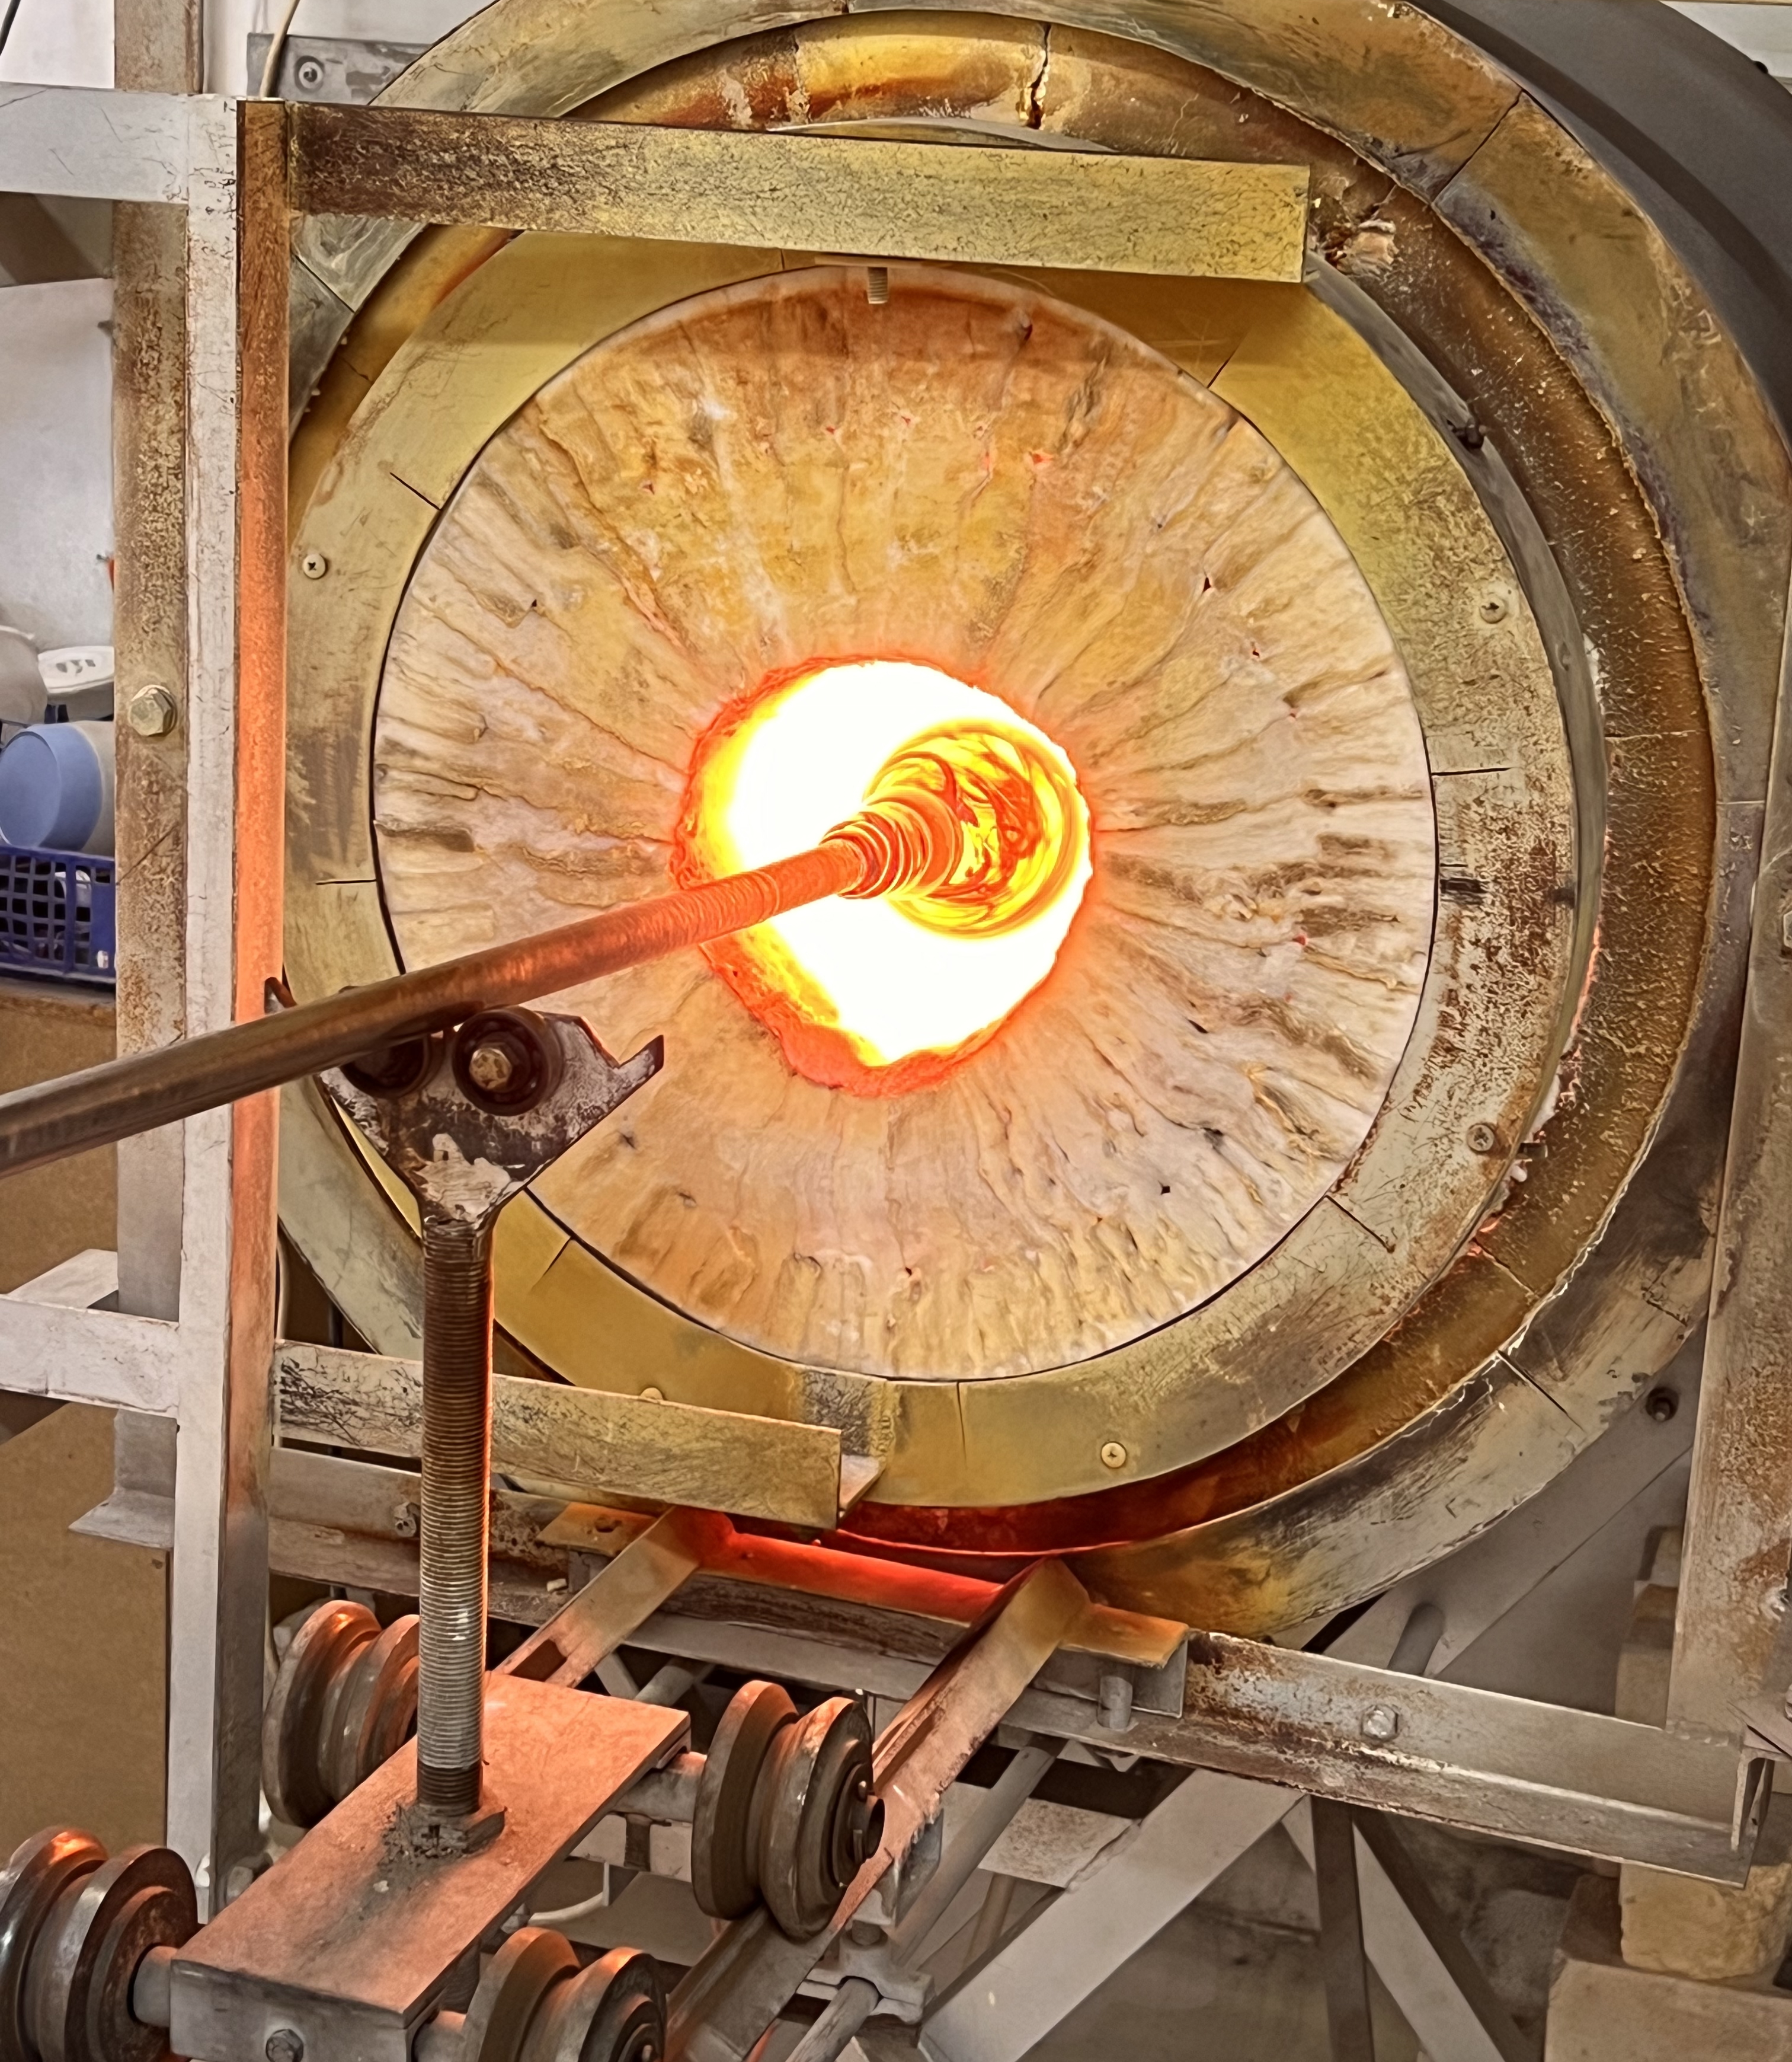
‘And we all, with unveiled face, beholding the glory of the Lord, are being transformed into the same image from one degree of glory to another’
2 Corinthians 3: 18

Slide 7
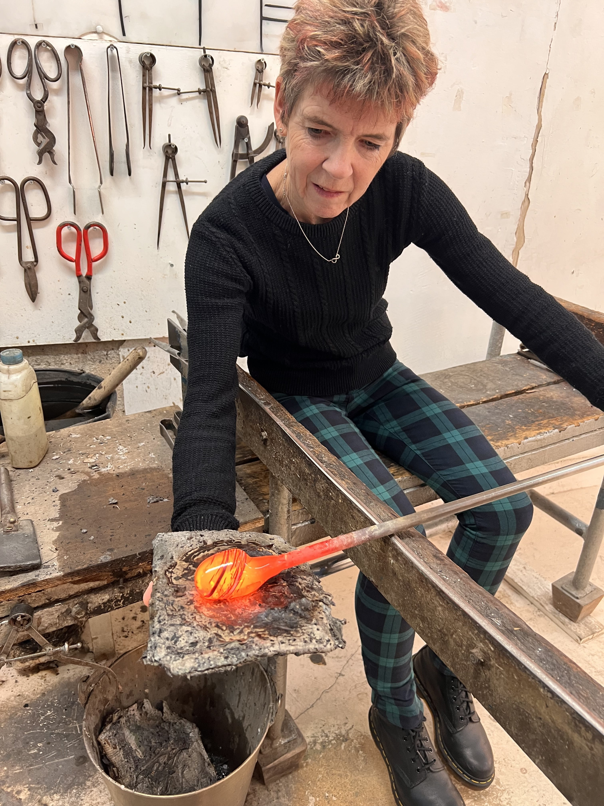
We are moulded together as one in the ‘glory hole’ which is the refining fire

Slide 9
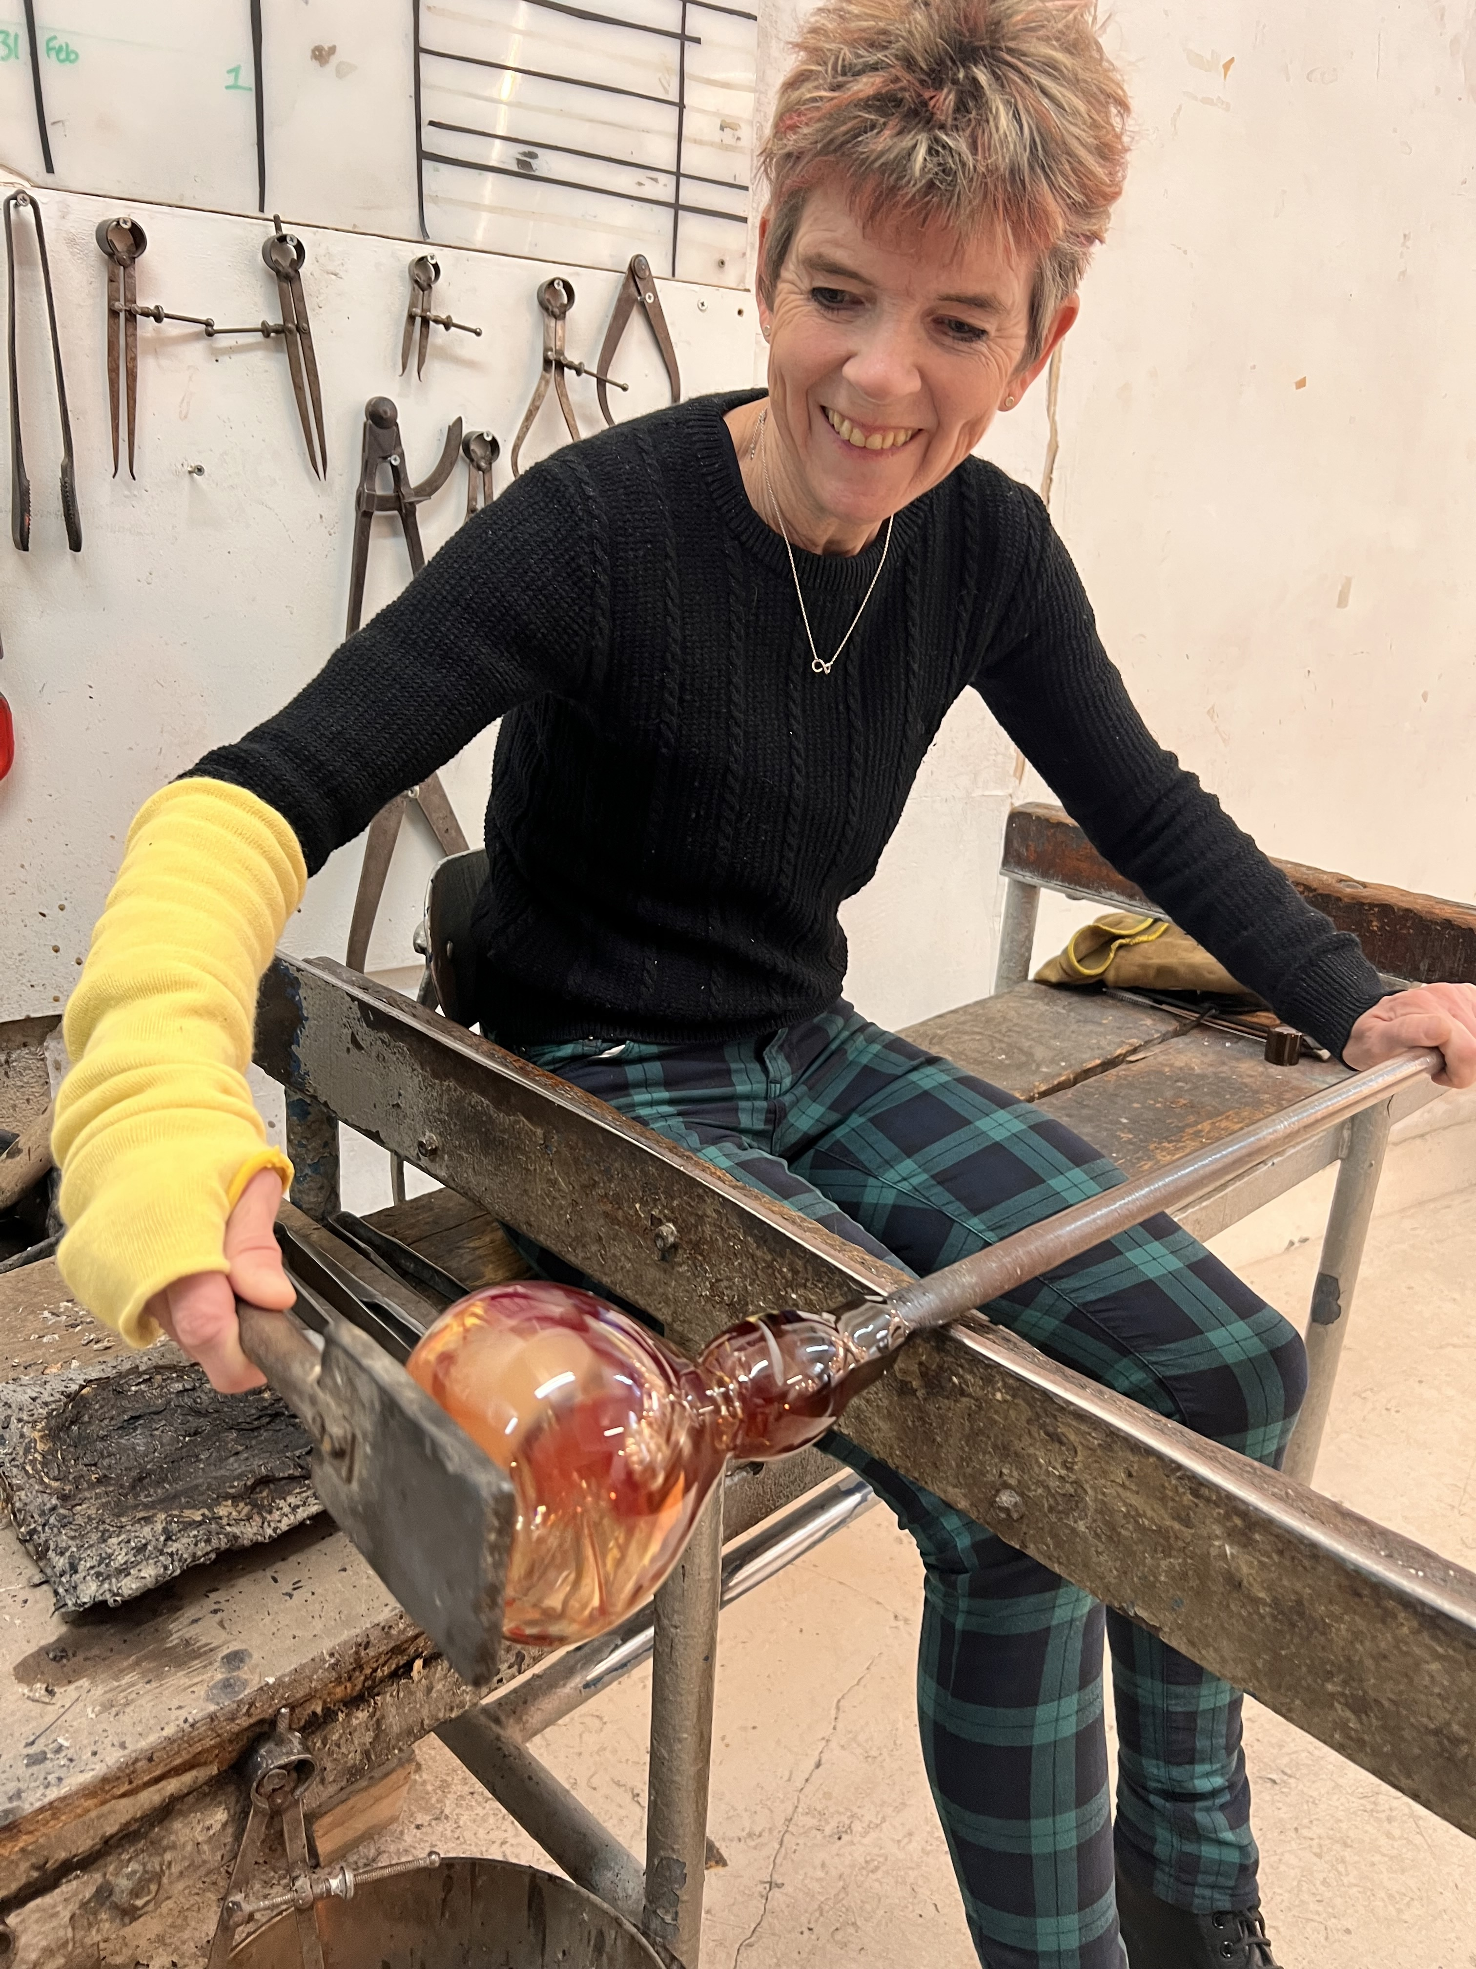

Slide 10
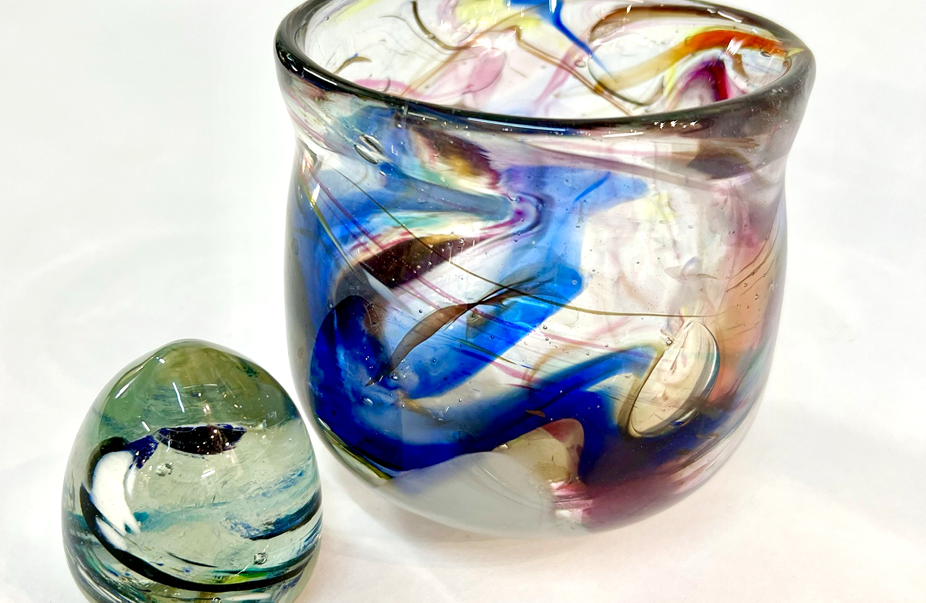

Slide 11
B – body – that is blessing their health, protection and strength
L – labour – work, income, security
E – emotions – joy, peace and hope
S – social – love, marriage, family, friends
S – spiritual – salvation, faith and grace

