Slide 1
Growing pains of faith
Tracy Spiers

Slide 2
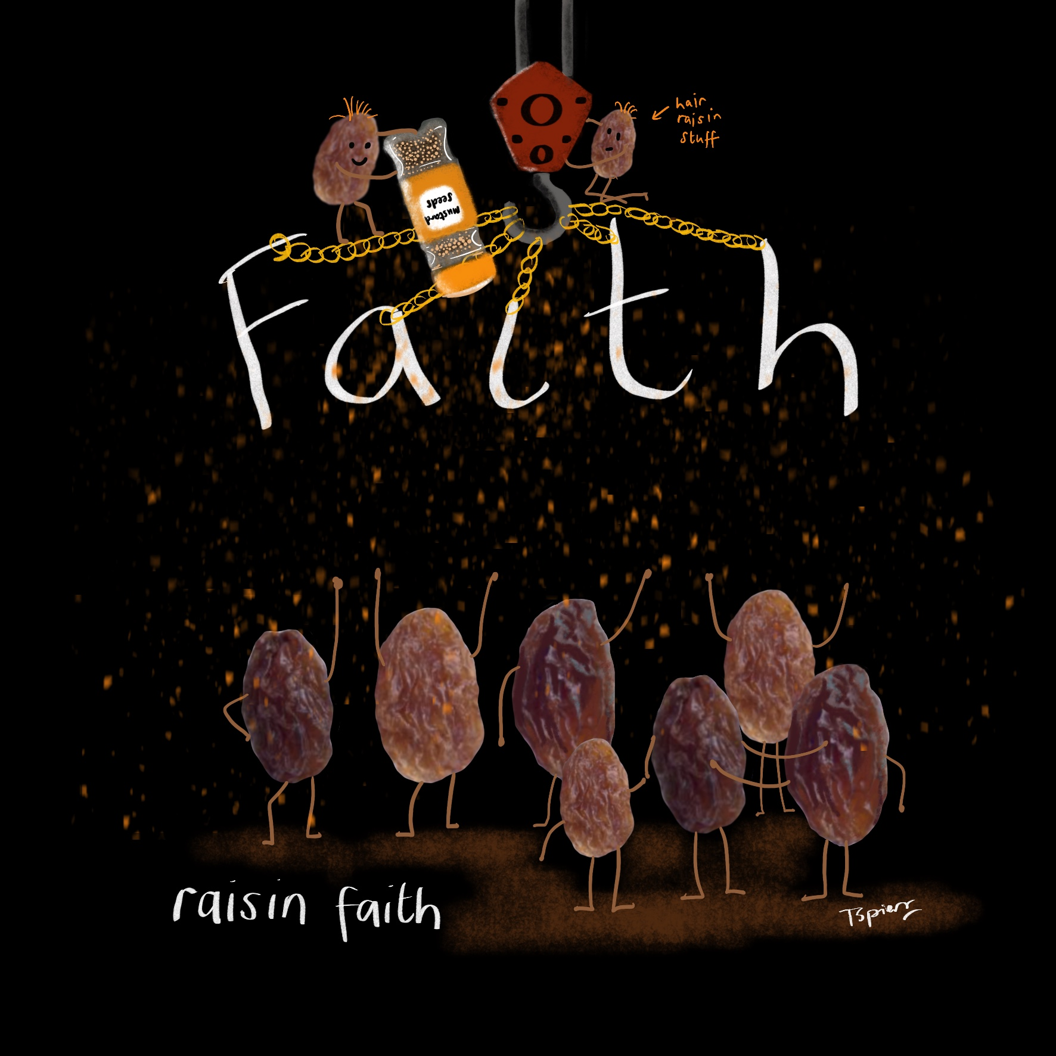
‘And it is impossible to please God without faith. Anyone who wants to come to him must believe that God exists and that he rewards those who sincerely seek him.’
Hebrews 11: 6

Slide 3
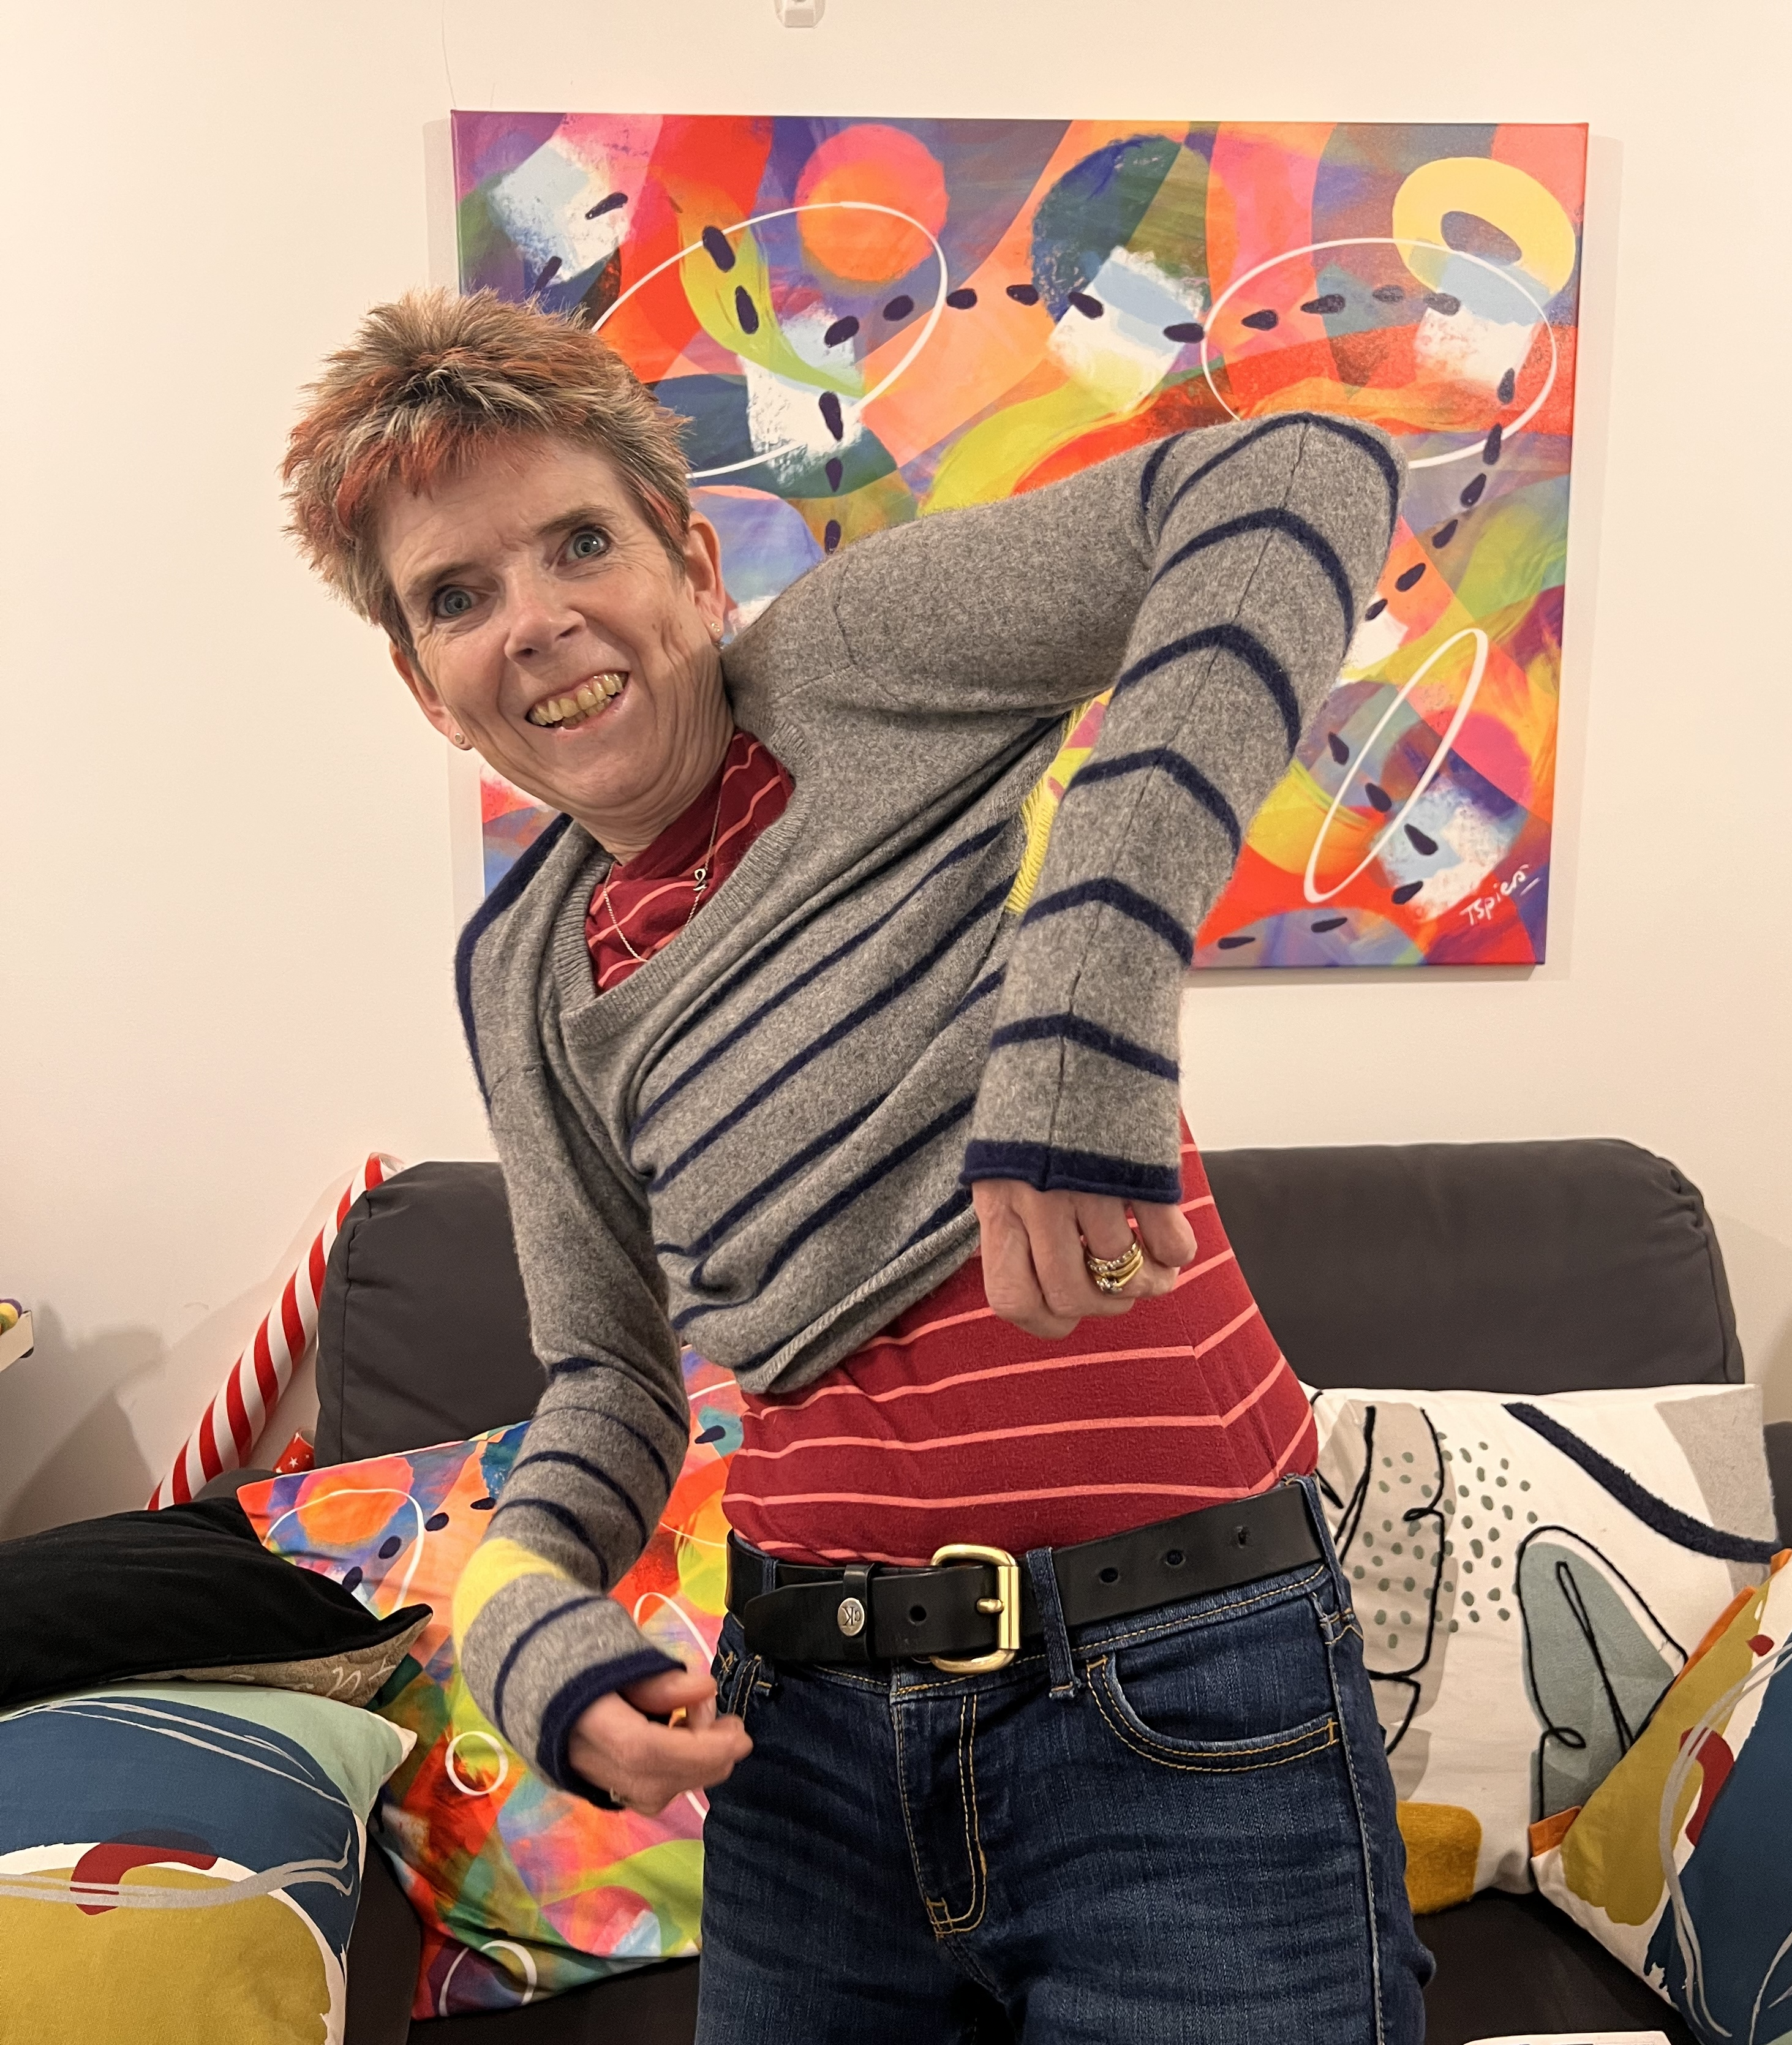
God is not limited by
our circumstances,
He is limited by what we believe

Slide 4
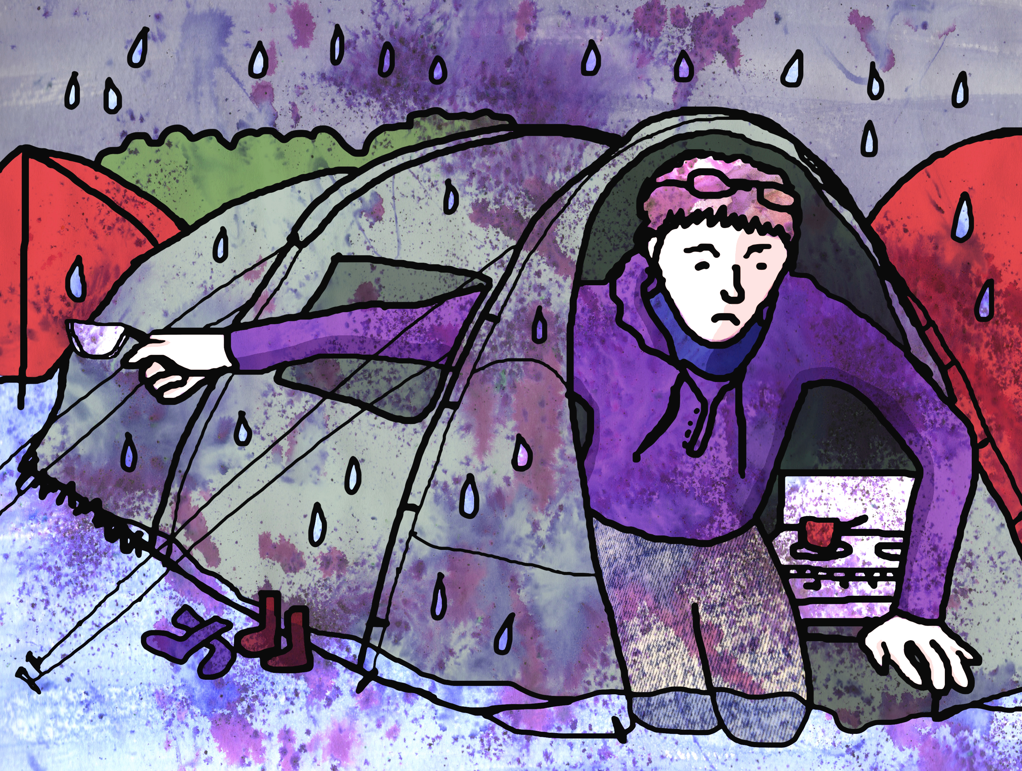

Slide 5
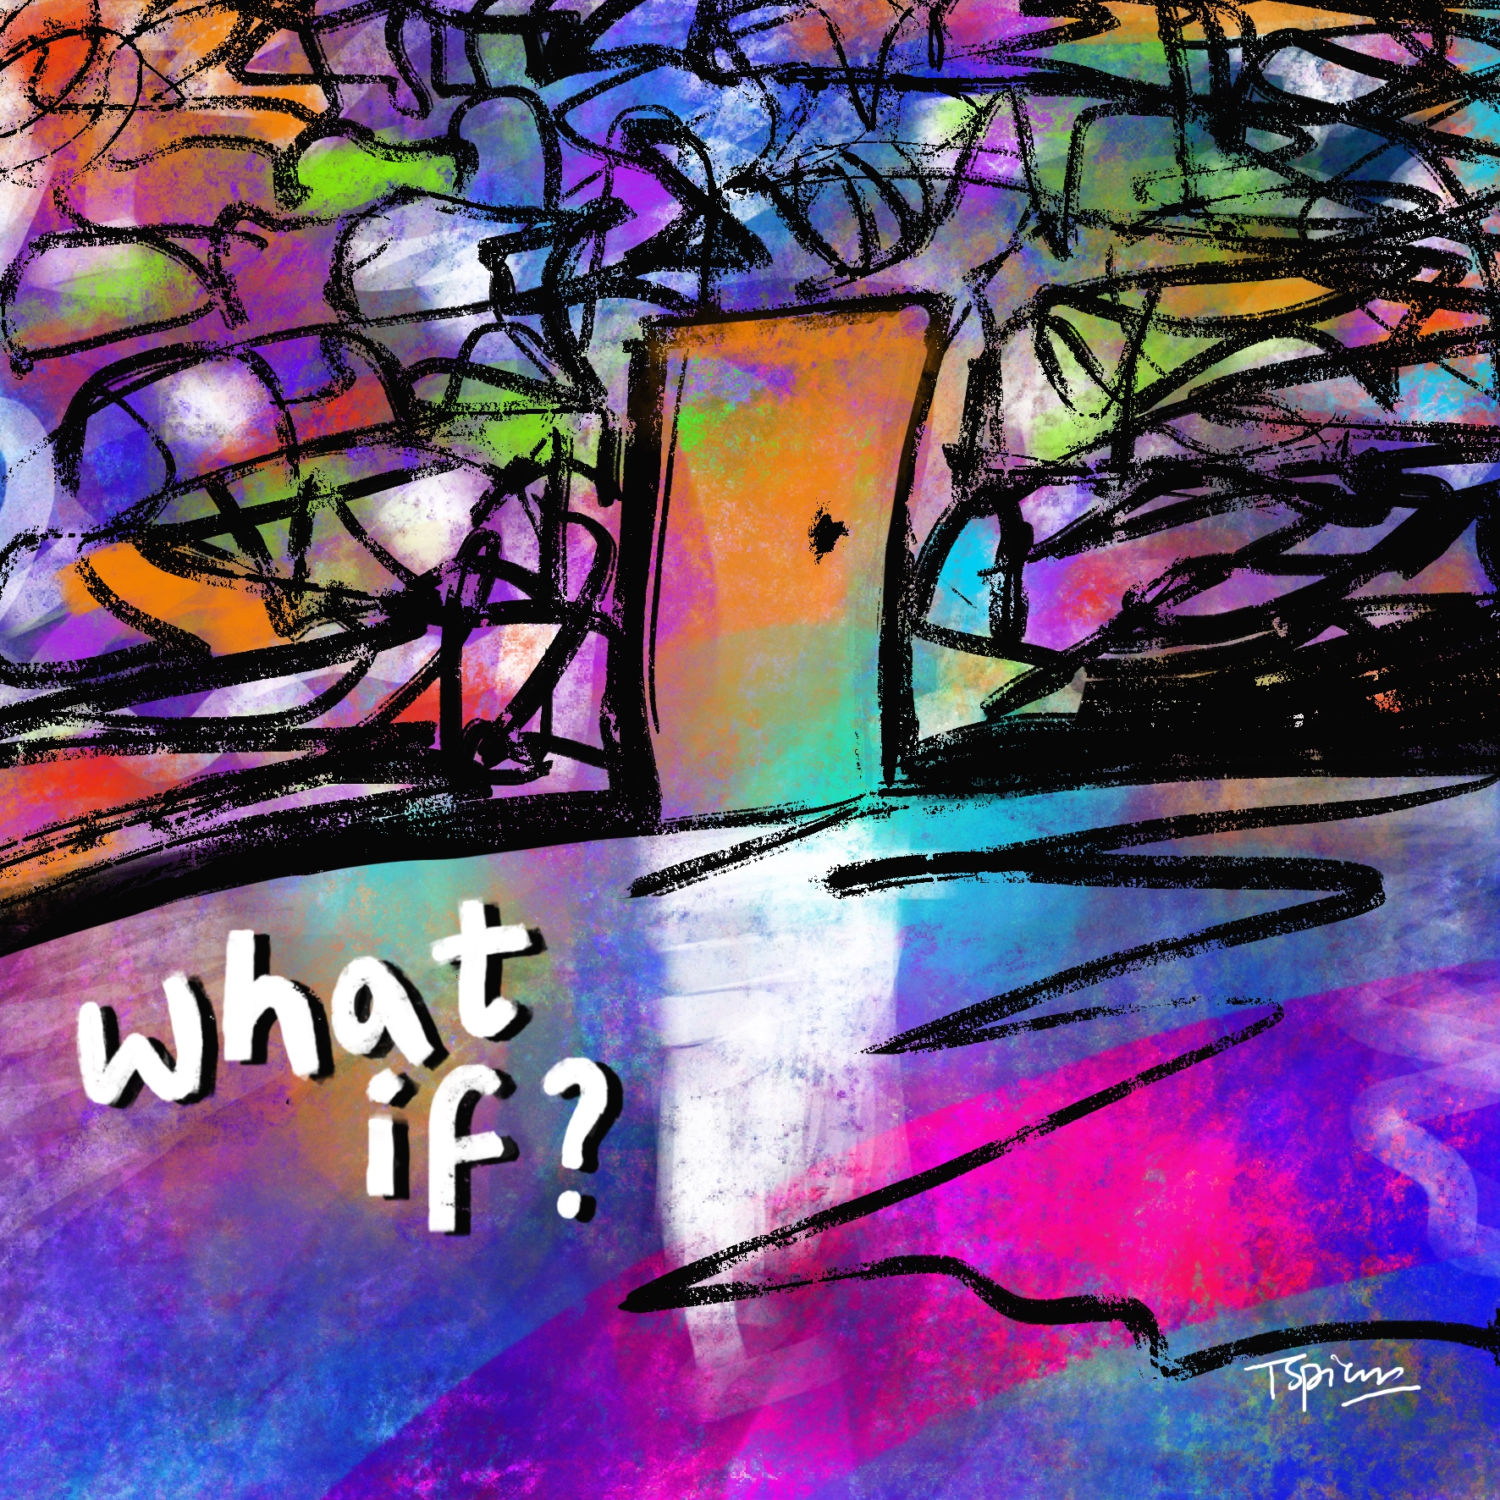
What if the door swings open
To all I've been hoping and praying for
And what if my season of waiting
Was changing and leading to
something more,
What if jumping leads to flying
And fear didn't stop me from trying
What if God's just waiting for me to
start seeing How big He is?
What if?

Slide 6
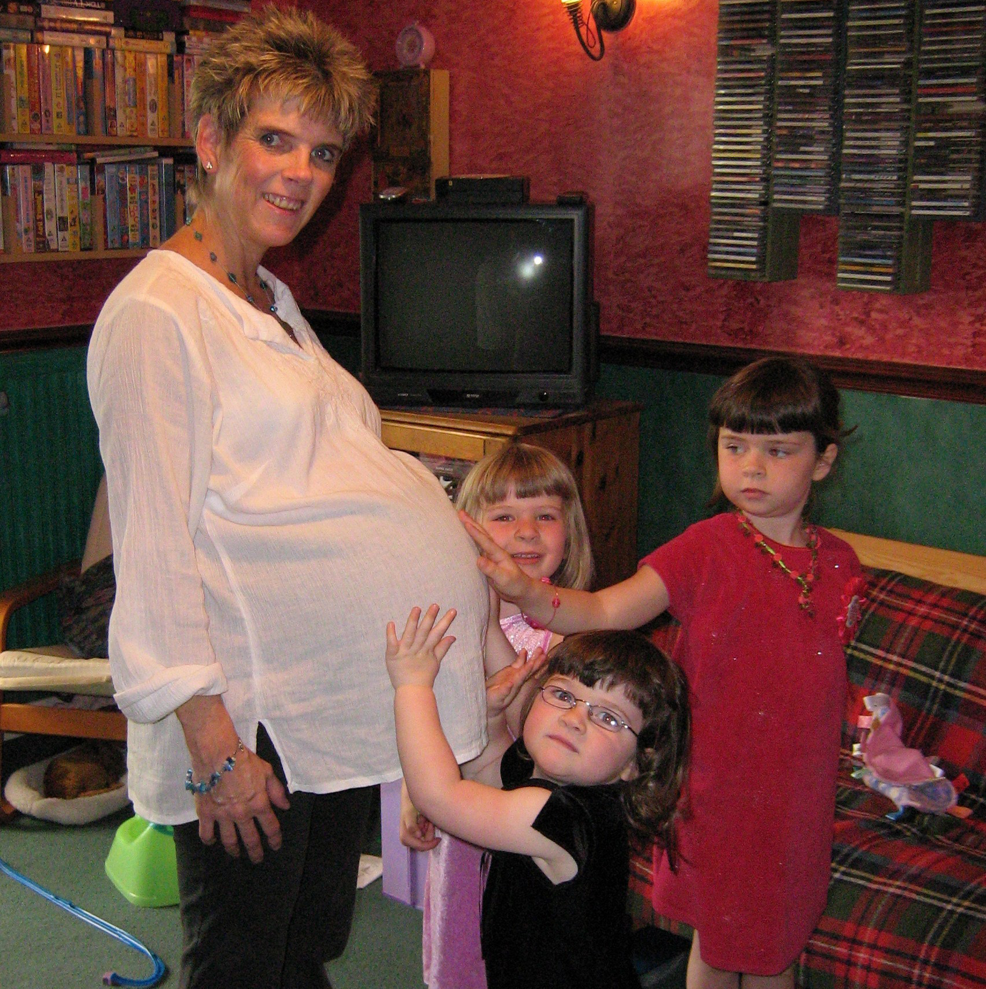

Slide 7
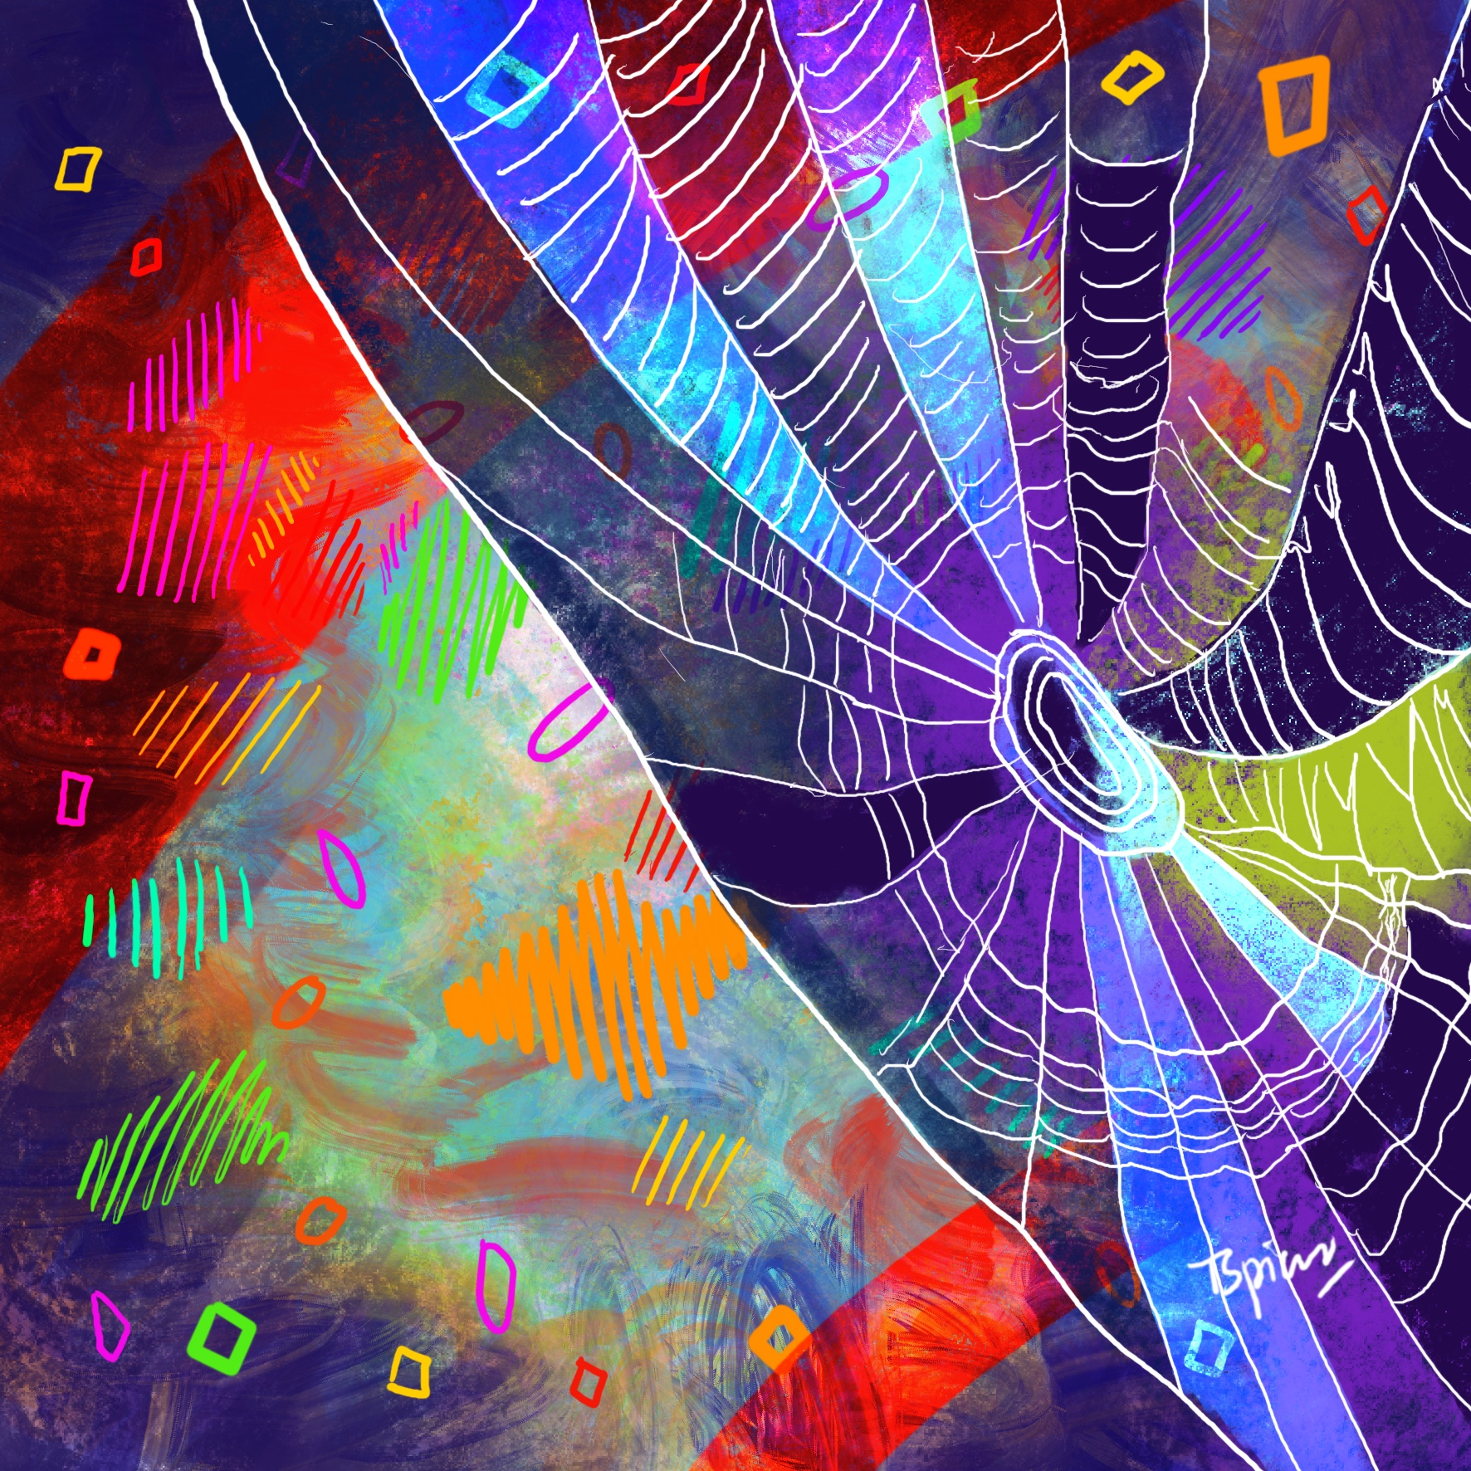
‘Sometimes the place of our greatest limitation turns out to be the place of our greatest fruit.
Maybe our greatest place of limitation turns out to be the perfect canvas for Him to demonstrate His power and glory and not our own.’
- Rachel Hughes, Gas Street Church, Birmingham

Slide 8
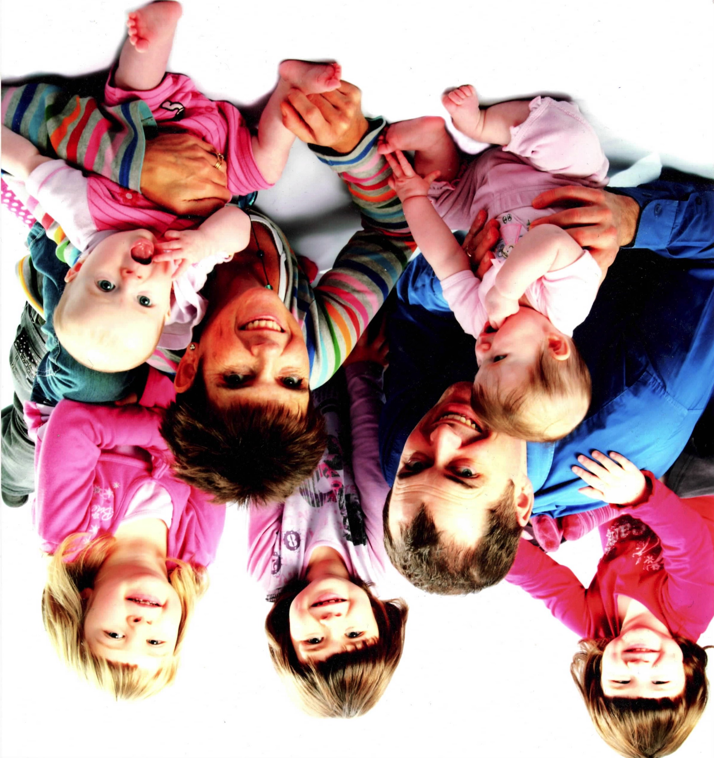

Slide 9
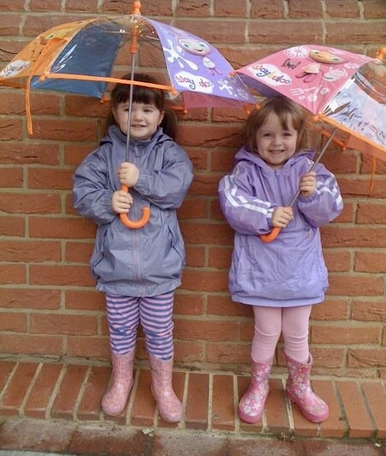
Like Job, if we don’t give up and we keep on believing, God will give us double for our trouble

Slide 10
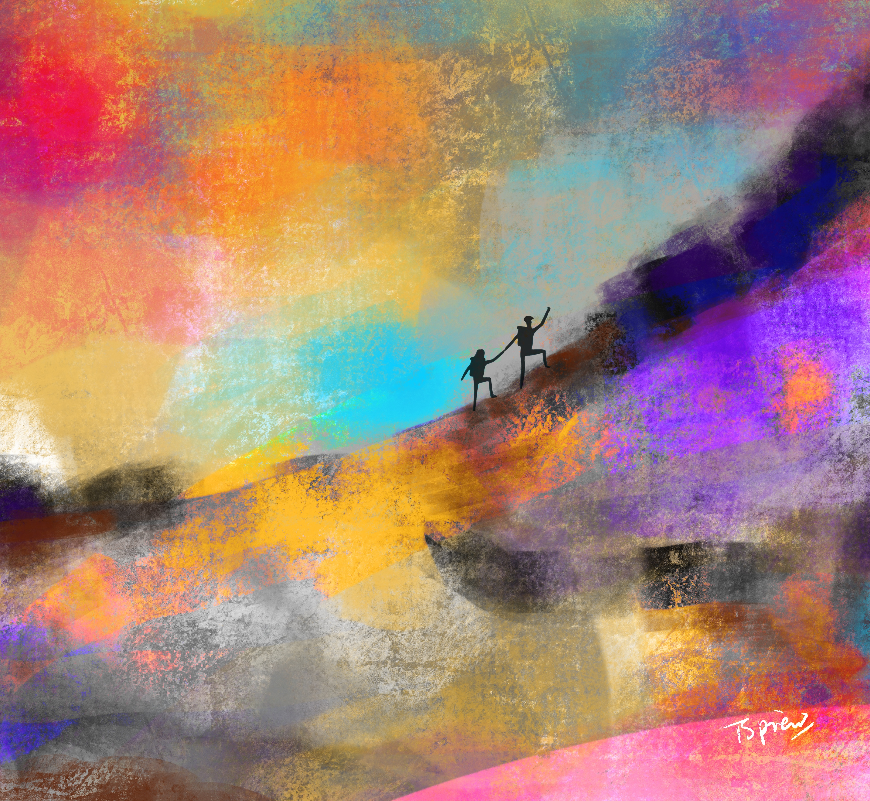
‘Faith sees the invisible, believes the unbelievable, and receives the impossible.’
— Corrie ten Boom

