Slide 1
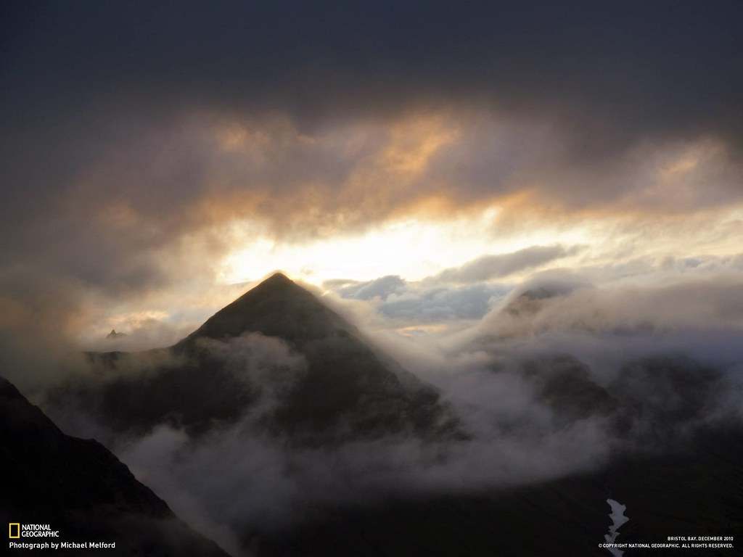

Slide 2
Where does my help come from?

Slide 3
Psalm 121
A song of ascents.
¹ I lift up my eyes to the mountains— where does my help come from? ² My help comes from the Lord, the Maker of heaven and earth.
³ He will not let your foot slip— he who watches over you will not slumber; ⁴ indeed, he who watches over Israel will neither slumber nor sleep.
⁵ The Lord watches over you— the Lord is your shade at your right hand; ⁶ the sun will not harm you by day, nor the moon by night.
⁷ The Lord will keep you from all harm— he will watch over your life; ⁸ the Lord will watch over your coming and going both now and forevermore.

Slide 4
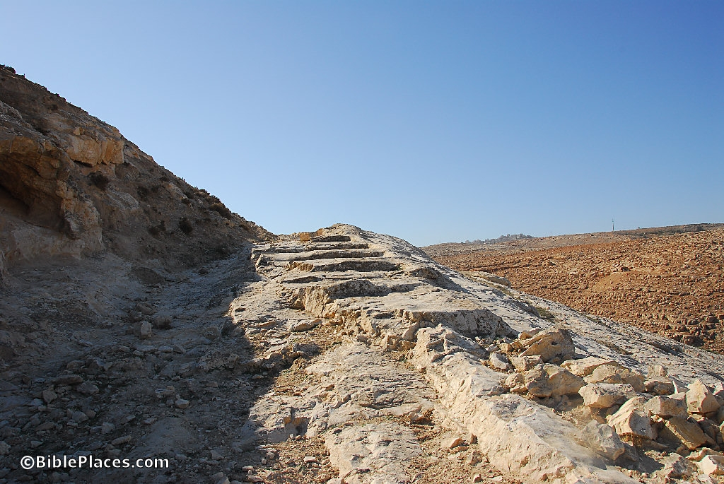
Psalm 122
Home
Psalm 121
Trust
Psalm 120
Distress

Slide 5
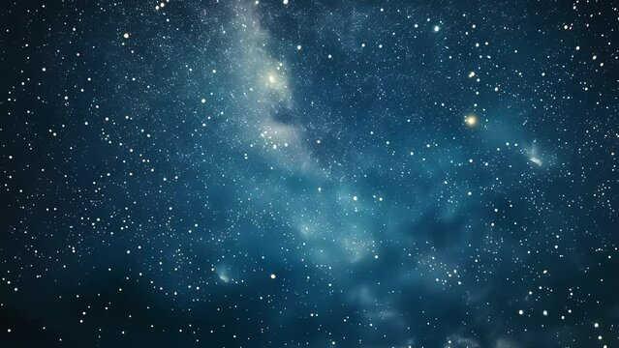
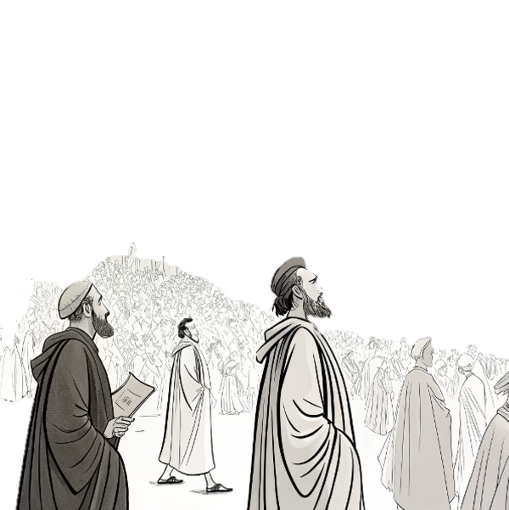
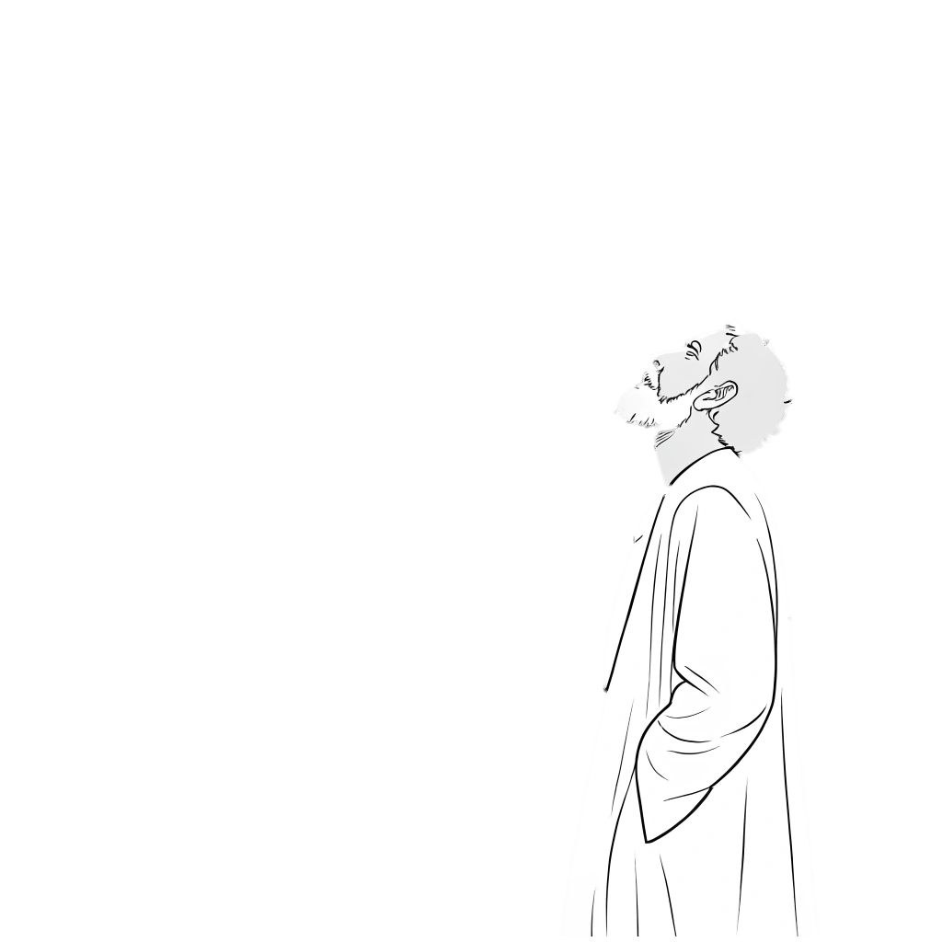
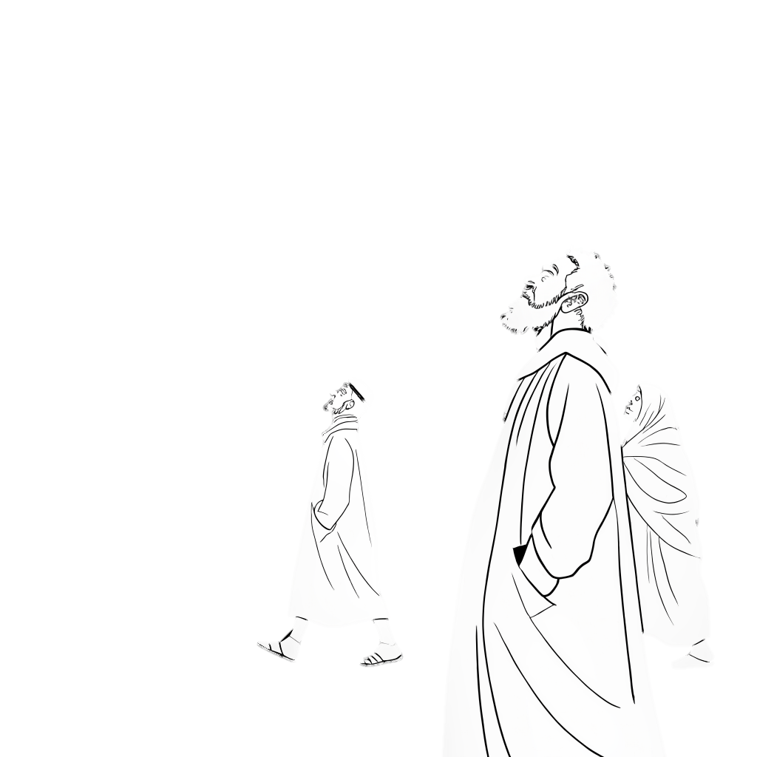
Genesis 15
Psalm 121
Matthew 28

Slide 6
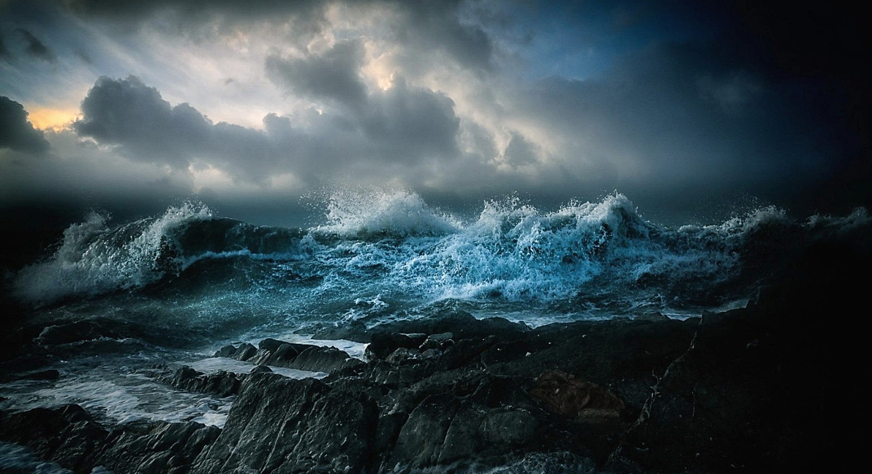
He is the miracle maker

Slide 7
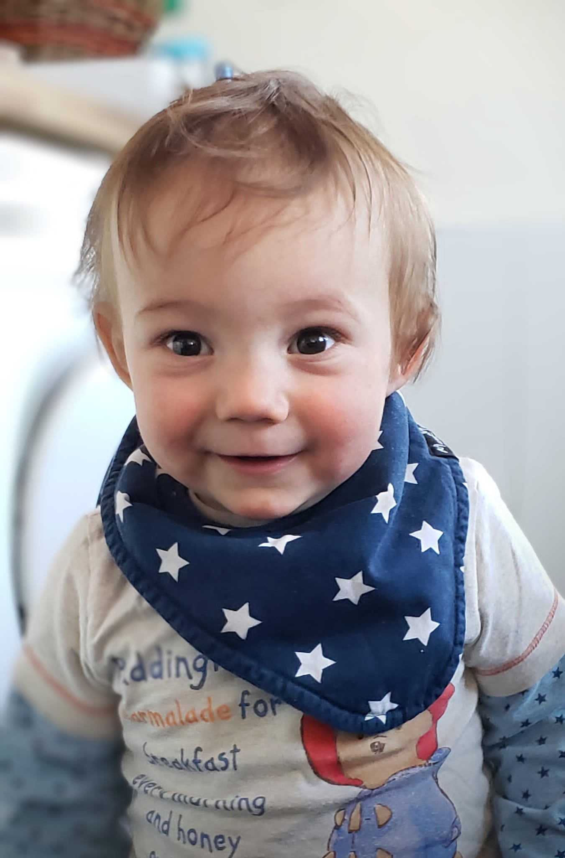

Slide 11
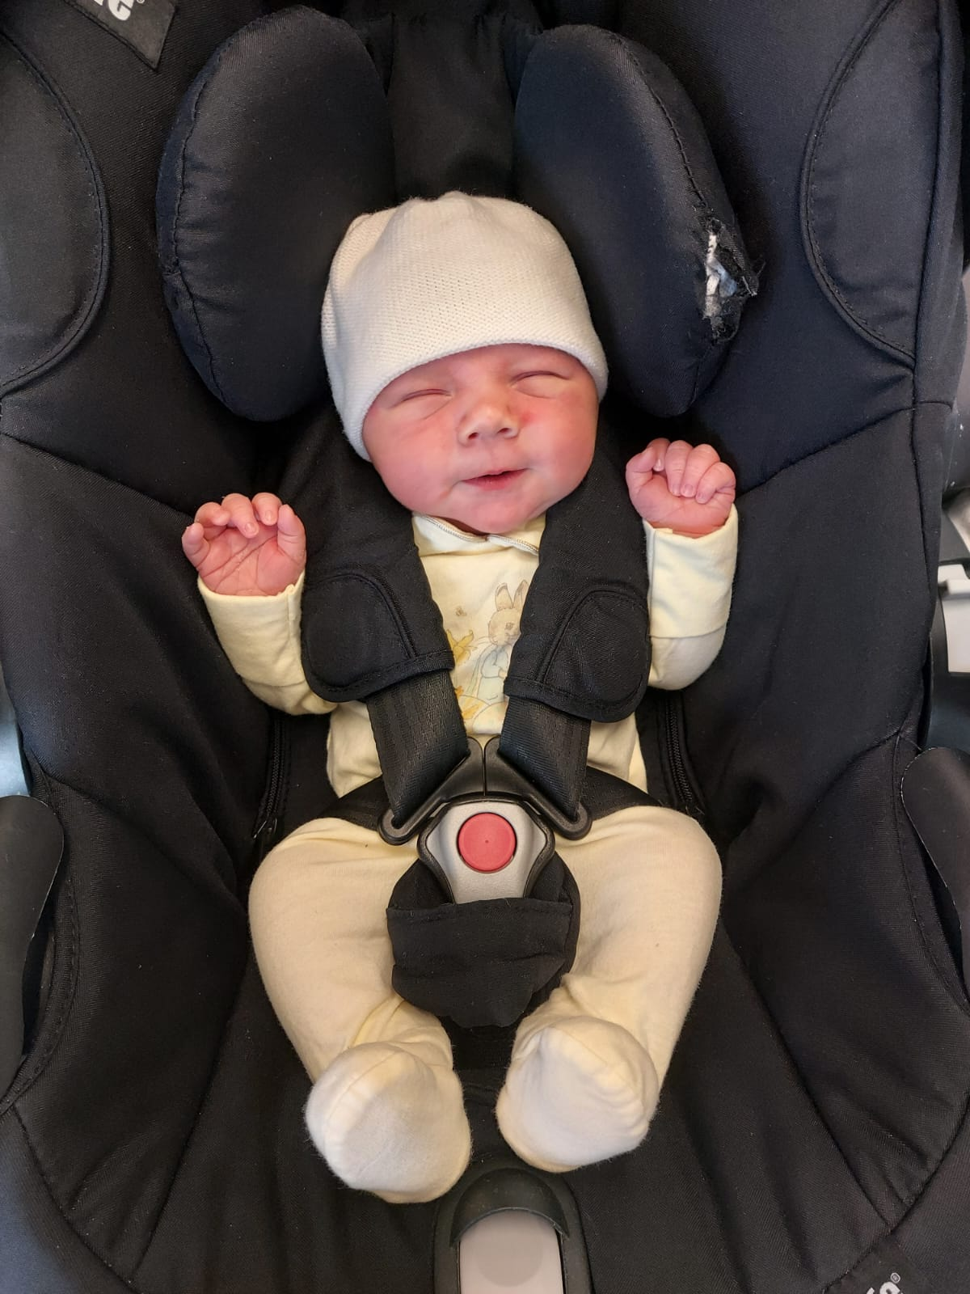

Slide 12
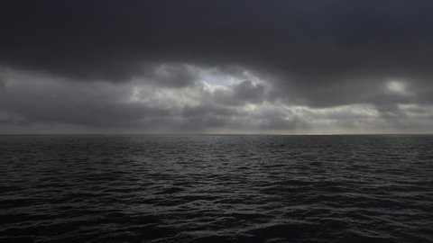
Mark 5:“Daughter, your faith has healed you.”
Luke 17: “rise and go, your faith has made you well.”
Luke 18: “Receive your sight; your faith has healed you.”
Matthew 15 “Woman, you have great faith! Your request is granted”

Slide 13
Faith = belief + expectation.
Faith = Belief + Expectation

Slide 14
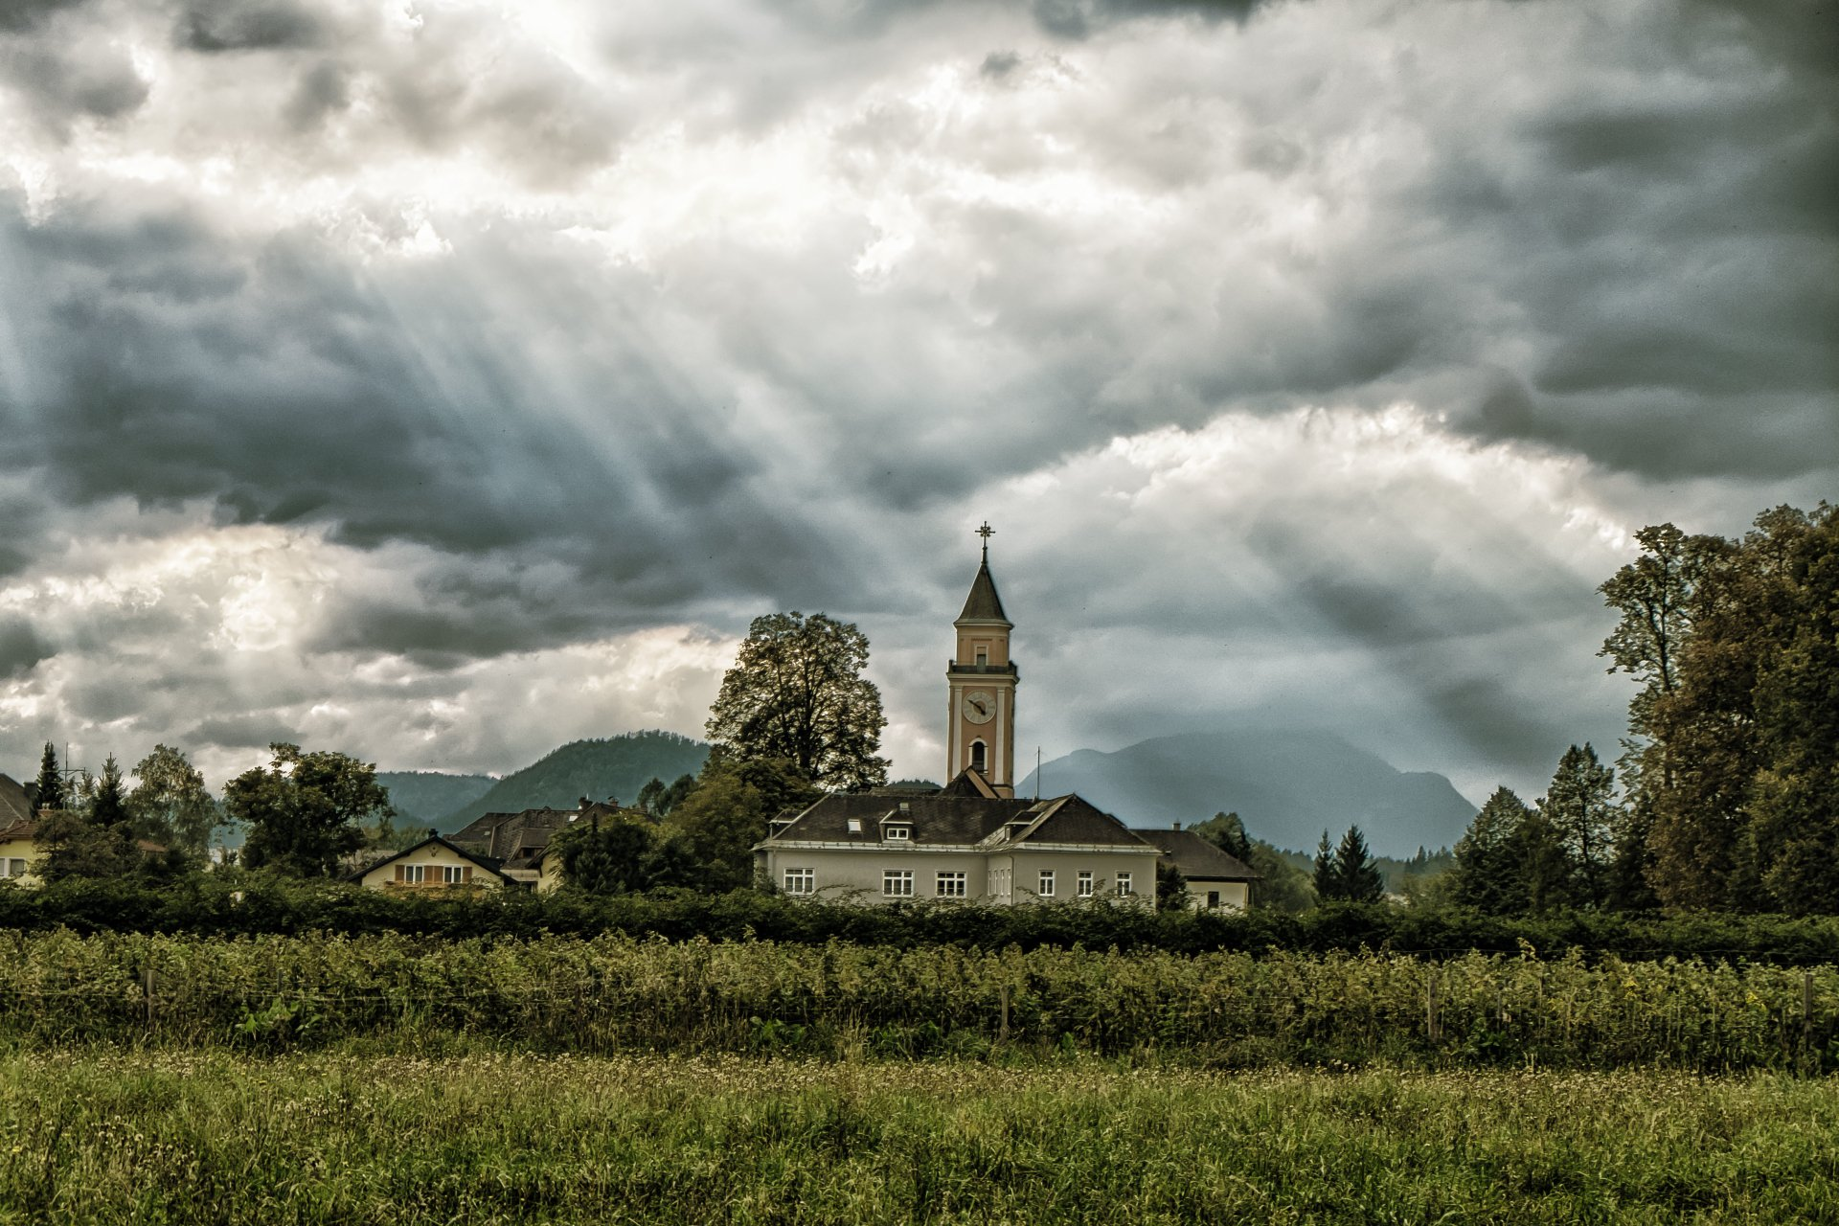
The miracle maker who also uses His church

Slide 15
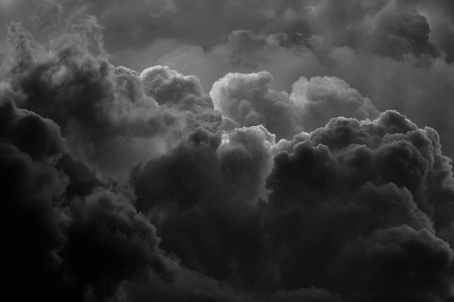
Where does our Help come from?
The miracle maker who also uses His church
So where was my help?

Slide 16
Psalm 13
How long, Lord? Will you forget me forever? How long will you hide your face from me? How long must I wrestle with my thoughts and day after day have sorrow in my heart? How long will my enemy triumph over me? Look on me and answer, Lord my God. Give light to my eyes, or I will sleep in death, and my enemy will say, “I have overcome him,” and my foes will rejoice when I fall.
But I trust in your unfailing love; my heart rejoices in your salvation. I will sing the Lord’s praise, for he has been good to me.

Slide 17
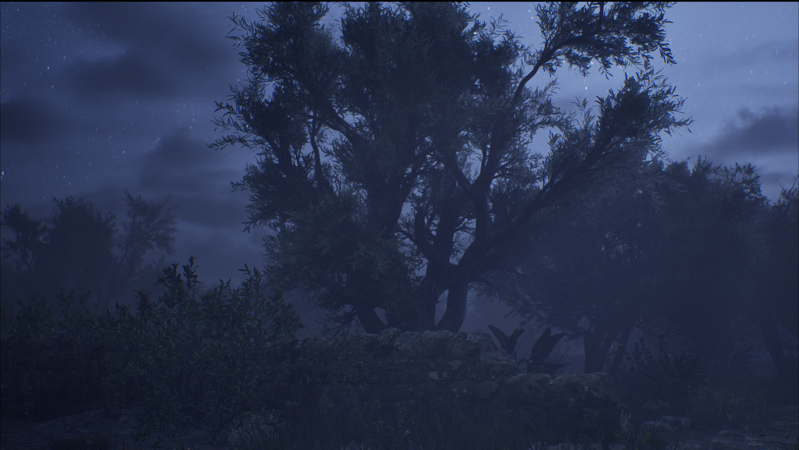
“My Father, if it be possible, let this cup pass from me; nevertheless, not as I will, but as you will.”

Slide 18
God’s World
God’s War
God’s Will

Slide 19
Choose to be vulnerable with fellow believers
Choose to hold on to God’s love
Choose to push into prayer to God
Choose to turn to God for comfort in our distress
Choose to remember God’s authority
Choose to be honest
Choose to trust that which we cannot understand
Choose to hold onto hope

Slide 20
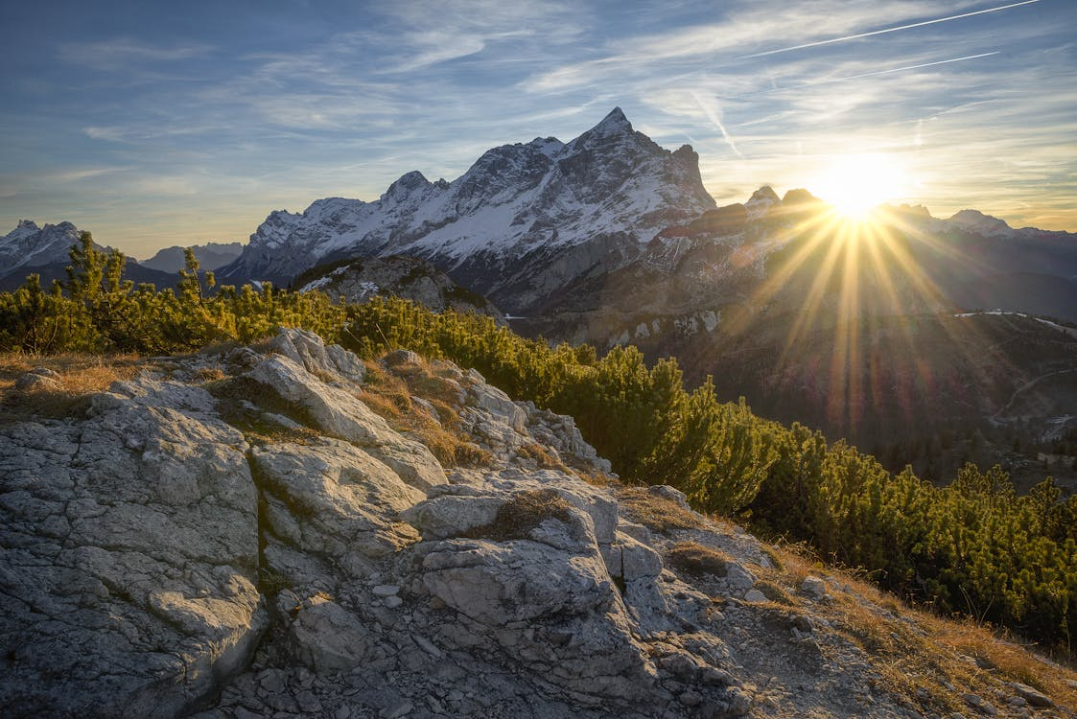
Where does my help come from?
My help comes from the Lord, the Maker of heaven and earth.
So where do I go next?
Testimony
How can we be the answer to other’s prayer?
Share vulnerably in fellowship, united in Faith
By doing these things, we can share of the Goodness of God in this Earth and the hope we have for the next.

