Slide 1
Palm Sunday in Stroud
Sunday April 13th

Slide 2
John 12:9-19 New International Version
⁹ Meanwhile a large crowd of Jews found out that Jesus was there and came, not only because of him but also to see Lazarus, whom he had raised from the dead. ¹⁰ So the chief priests made plans to kill Lazarus as well, ¹¹ for on account of him many of the Jews were going over to Jesus and believing in him.
Jesus Comes to Jerusalem as King
¹² The next day the great crowd that had come for the festival heard that Jesus was on his way to Jerusalem. ¹³ They took palm branches and went out to meet him, shouting,
“Hosanna!^{[a]}”

Slide 3
John 12:9-19 New International Version
Blessed is he who comes in the name of the Lord!”^{[b]}
“Blessed is the king of Israel!”
¹⁴ Jesus found a young donkey and sat on it, as it is written:
¹⁵ “Do not be afraid, Daughter Zion; see, your king is coming, seated on a donkey’s colt.”^{[c]}
¹⁶ At first his disciples did not understand all this. Only after Jesus was glorified did they realize that these things had been written about him and that these things had been done to him.

Slide 4
John 12:9-19 New International Version
¹⁷ Now the crowd that was with him when he called Lazarus from the tomb and raised him from the dead continued to spread the word. ¹⁸ Many people, because they had heard that he had performed this sign, went out to meet him. ¹⁹ So the Pharisees said to one another, “See, this is getting us nowhere. Look how the whole world has gone after him!”

Slide 5
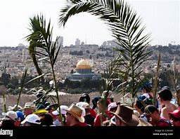
1. A Celebration of realisation
The one who Saves (Hosanna)
The Messiah – The one who comes in the name of the Lord
The King – The King of Israel

Slide 6
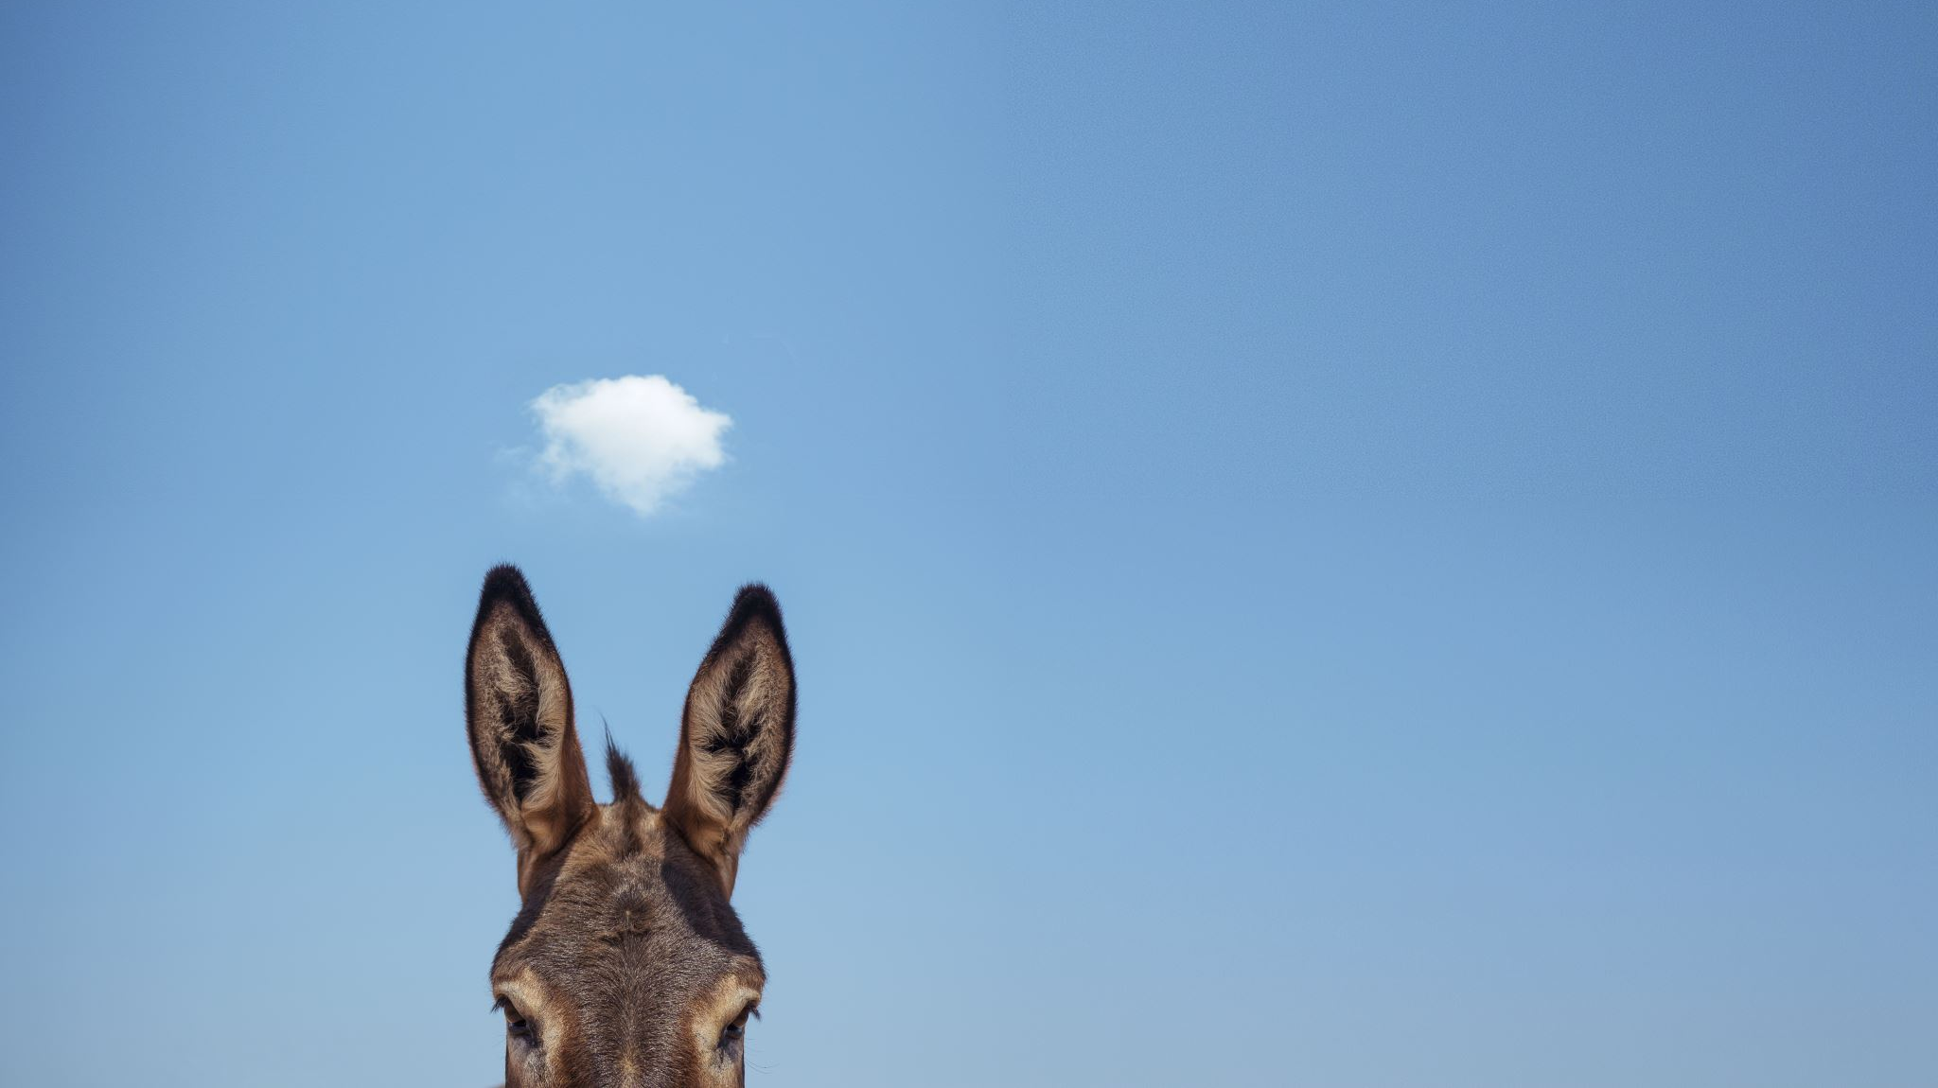
2. Yet he comes on a donkey

Slide 7
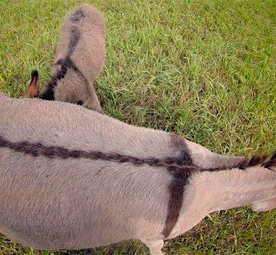
Zechariah 9.9
English Standard Version Rejoice greatly, O daughter of Zion! Shout aloud, O daughter of Jerusalem! Behold, your king is coming to you; righteous and having salvation is he, humble and mounted on a donkey, on a colt, the foal of a donkey.

Slide 8
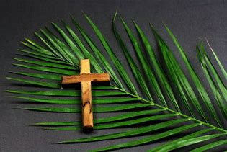
3. Parts
Victory
Having Salvation
Humble (Lowly)

Slide 9
Look how the whole world has gone after him (v19) * “Good news for people in a bad news world” * We carry a different spirit of Victory, Salvation and Humility

