Slide 1
Citizen of Heaven
Philippians 3:1 – 4:9

Slide 2
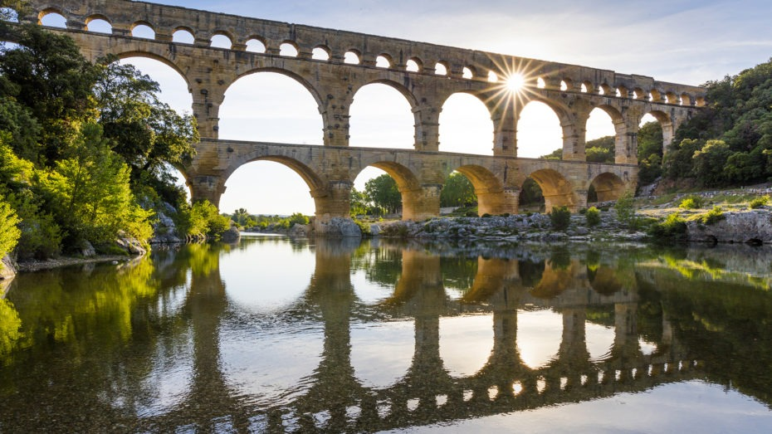
Pont du Gard – What did the Romans ever do for us?

Slide 3
Philippians 3:1-11
Ch3 Whatever happens, my dear brothers and sisters, rejoice in the Lord. I never get tired of telling you these things, and I do it to safeguard your faith.
2 Watch out for those dogs, those people who do evil, those mutilators who say you must be circumcised to be saved. 3 For we who worship by the Spirit of God are the ones who are truly circumcised. We rely on what Christ Jesus has done for us. We put no confidence in human effort, 4 though I could have confidence in my own effort if anyone could. Indeed, if others have reason for confidence in their own efforts, I have even more!
5 I was circumcised when I was eight days old. I am a pure-blooded citizen of Israel and a member of the tribe of Benjamin—a real Hebrew if there ever was one! I was a member of the Pharisees, who demand the strictest obedience to the Jewish law. 6 I was so zealous that I harshly persecuted the church. And as for righteousness, I obeyed the law without fault.
7 I once thought these things were valuable, but now I consider them worthless because of what Christ has done. 8 Yes, everything else is worthless when compared with the infinite value of knowing Christ Jesus my Lord. For his sake I have discarded everything else, counting it all as garbage, so that I could gain Christ 9 and become one with him. I no longer count on my own righteousness through obeying the law; rather, I become righteous through faith in Christ. For God’s way of making us right with himself depends on faith. 10 I want to know Christ and experience the mighty power that raised him from the dead. I want to suffer with him, sharing in his death, 11 so that one way or another I will experience the resurrection from the dead!

Slide 4
Philippians 3:1-11
The old ways of thinking and being, the old measures are worthless by comparison with…
Knowing Jesus Christ our Lord better.
Grow our faith and our righteousness.
Experience his power.
A righteousness measured by God on his terms.
Removal of all that limits and spoils, so that we can freely worship by the Spirit of God in our heart

Slide 5
Philippians 3:12-4:1
12 I don’t mean to say that I have already achieved these things or that I have already reached perfection. But I press on to possess that perfection for which Christ Jesus first possessed me. 13 No, dear brothers and sisters, I have not achieved it, but I focus on this one thing: Forgetting the past and looking forward to what lies ahead, 14 I press on to reach the end of the race and receive the heavenly prize for which God, through Christ Jesus, is calling us.
15 Let all who are spiritually mature agree on these things. If you disagree on some point, I believe God will make it plain to you. 16 But we must hold on to the progress we have already made.
17 Dear brothers and sisters, pattern your lives after mine, and learn from those who follow our example. 18 For I have told you often before, and I say it again with tears in my eyes, that there are many whose conduct shows they are really enemies of the cross of Christ. 19 They are headed for destruction. Their god is their appetite, they brag about shameful things, and they think only about this life here on earth. 20 But we are citizens of heaven, where the Lord Jesus Christ lives. And we are eagerly waiting for him to return as our Saviour. 21 He will take our weak mortal bodies and change them into glorious bodies like his own, using the same power with which he will bring everything under his control.
Ch4 Therefore, my brothers and sisters, you whom I love and long for, my joy and crown, stand firm in the Lord in this way, dear friends!

Slide 6
Philippians 3:12-4:1
Not just where I am going but how I am going to get there.
Don’t settle for what you have, always onwards and upwards.
Not about ‘getting out of here’, its about drawing God’s transformational power down now.
Issues are always the same:
There is an empire that wants your allegiance and puts pressure on you.
There is pressure from false teaching.

Slide 7
Philippians 4:2-9
2 I plead with Euodia and I plead with Syntyche to be of the same mind in the Lord. 3 Yes, and I ask you, my true companion, help these women since they have contended at my side in the cause of the gospel, along with Clement and the rest of my co-workers, whose names are in the book of life.
4 Rejoice in the Lord always. I will say it again: Rejoice! 5 Let your gentleness be evident to all. The Lord is near. 6 Do not be anxious about anything, but in every situation, by prayer and petition, with thanksgiving, present your requests to God. 7 And the peace of God, which transcends all understanding, will guard your hearts and your minds in Christ Jesus.
8 Finally, brothers and sisters, whatever is true, whatever is noble, whatever is right, whatever is pure, whatever is lovely, whatever is admirable—if anything is excellent or praiseworthy—think about such things. 9 Whatever you have learned or received or heard from me, or seen in me—put it into practice. And the God of peace will be with you.

Slide 8
So what does that mean for us?
Accepting that we don’t know everything we should live up to what we do know.
Citizen of Heaven:
Be different
Have a different perspective
Be ambassadors

Slide 9
So what does that mean for us? Be different
We are new creations. Don’t conform to the world, be transformed by the renewing of your mind.
Citizens of Heaven:
Do their part without seeking the glory of accomplishment.
Persist because God has spoken and they trust him, not out of human strength.
Have faith in the Lord Jesus Christ their saviour rather than in events or progress.
Are assured because they are on the side of God, but not arrogant because all the glory is His.

Slide 10
So what does that mean for us? Have a different perspective
If something worldly is ever starting to change your Kingdom perspective, then drop it like a hot rock and back away from it.
Citizens of Heaven:
Understand that this fallen world is not our country, our real home.
Don’t give things of the world Glory (Its fine to appreciate).
Trust God our Father (even when they don’t understand).
Don’t let things of the world get in the way of the Kingdom (even good things)

Slide 11
So what does that mean for us? Be ambassadors - 2 Corinthians 5:14-21
14 Either way, Christ’s love controls us. Since we believe that Christ died for all, we also believe that we have all died to our old life. 15 He died for everyone so that those who receive his new life will no longer live for themselves. Instead, they will live for Christ, who died and was raised for them.
16 So we have stopped evaluating others from a human point of view. At one time we thought of Christ merely from a human point of view. How differently we know him now! 17 This means that anyone who belongs to Christ has become a new person. The old life is gone; a new life has begun!
18 And all of this is a gift from God, who brought us back to himself through Christ. And God has given us this task of reconciling people to him. 19 For God was in Christ, reconciling the world to himself, no longer counting people’s sins against them. And he gave us this wonderful message of reconciliation. 20 So we are Christ’s ambassadors; God is making his appeal through us. We speak for Christ when we plead, “Come back to God!” 21 For God made Christ, who never sinned, to be the offering for our sin, so that we could be made right with God through Christ.

Slide 12
So what does that mean for us? Be ambassadors
Ambassadors are important
Citizens of Heaven:
A representative of the Kingdom of God here in a foreign land.
Are different, rather than going native.
Actively encouraging Emigration to our real home.
Live like it, by our lives and our words

Slide 13
Conclusion Good news people in a bad news world
There is another way, a better way
We are Citizens of Heaven and ambassadors of the KoG, we represent a different way of living that draws down God’s transforming power now. Most importantly, this Kingdom has a King, and that anyone who believes in Jesus as their saviour and their Lord is welcome to full citizenship.
27 Whatever happens, conduct yourselves in a manner worthy of the gospel of Christ. Then, whether I come and see you or only hear about you in my absence, I will know that you stand firm in the one Spirit, striving together as one for the faith of the gospel 28 without being frightened in any way by those who oppose you. This is a sign to them that they will be destroyed, but that you will be saved—and that by God.

Slide 14
Conclusion Prayer
Father please help us to be good Citizens of Heaven, to attach ourselves to the things of your Kingdom and hold lightly to the things of this world.
Help us to press on, to grab hold of what you have for us, to keep learning and to live up to what we have learnt as we continue to press on in you.
Help us to recognise that we are ambassadors of your Kingdom living in this world and help us to represent you well.
Help us to trust you and your wisdom, preferring it to our own.
Help us Lord to start each day intending to do this, and to accept your forgiveness when we don’t
For your glory Lord… Amen.

