Slide 1
What Inspires Us to Worship
Martin Pearson

Slide 2
Rom 12:11 (Common English Bible)
Don’t hesitate to be enthusiastic,
be on fire in the Spirit as you serve the Lord!

Slide 3
Proskuneo - προσκυνέω

Slide 4
Rom 12:11 (Common English Bible)
Don’t hesitate to be enthusiastic,
be on fire in the Spirit as you serve the Lord!

Slide 6
Where do we start?

Slide 7
Gen 1:1 In the beginning God created the heavens and the earth.
Gen 1:16
God made two great lights - the larger one to govern the day, and the smaller one to govern the night. He also made the stars

Slide 9
Is 40:26 (ESV) Lift up your eyes on high and see: who created these? He who brings out their host by number, calling them all by name; by the greatness of his might and because he is strong in power, not one is missing.

Slide 10
Job 38/39 Where were you when I laid the foundations of the earth? Tell me, if you know so much. Who determined its dimensions and stretched out the surveying line? What supports its foundations, and who laid its cornerstone as the morning stars sang together and all the angels shouted for joy?
Ecclesiastes 3:11
Yet God has made everything beautiful for its own time. He has planted eternity in the human heart

Slide 11
John 1:1 –14 In the beginning the Word already existed. The Word was with God, and the Word was God. He existed in the beginning with God. God created everything through him, and nothing was created except through him. The Word gave life to everything that was created, and his life brought light to everyone. The light shines in the darkness, and the darkness can never extinguish it. God sent a man, John the Baptist, to tell about the light so that everyone might believe because of his testimony. John himself was not the light; he was simply a witness to tell about the light. The one who is the true light, who gives light to everyone, was coming into the world.

Slide 12
He came into the very world he created, but the world didn’t recognize him. He came to his own people, and even they rejected him. But to all who believed him and accepted him, he gave the right to become children of God. They are reborn—not with a physical birth resulting from human passion or plan, but a birth that comes from God. So the Word became human and made his home among us. He was full of unfailing love and faithfulness. And we have seen his glory, the glory of the Father’s one and only Son.

Slide 13
Heb 1:3
The Son radiates God’s own glory and expresses the very character of God, and he sustains everything by the mighty power of his command. When he had cleansed us from our sins, he sat down in the place of honour at the right hand of the majestic God in heaven

Slide 14
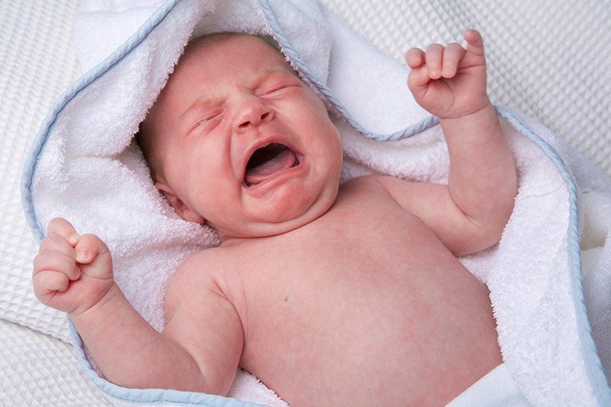

Slide 15
Rev 4:11 You are worthy, O Lord our God, to receive glory and honour and power. For you created all things, and they exist because you created what you pleased

Slide 16
Psalm 19:1
The heavens proclaim the glory of God. The skies display his craftsmanship
Rom 11:36
For everything comes from him and exists by his power and is intended for his glory. All glory to him forever! Amen.

Slide 17
Life is not measured by the number of breaths we take, but by the moments that take our breath away

Slide 18
Jude 1:24,25 Now all glory to God, who is able to keep you from falling away and will bring you with great joy into his glorious presence without a single fault. All glory to him who alone is God, our Saviour through Jesus Christ our Lord. All glory, majesty, power, and authority are his before all time, and in the present, and beyond all time! Amen.

Slide 19
Proskuneo - προσκυνέω

