Slide 1
My Dad is bigger than your Dad
Martin Pearson

Slide 2
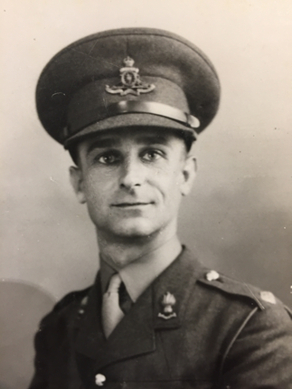

Slide 3
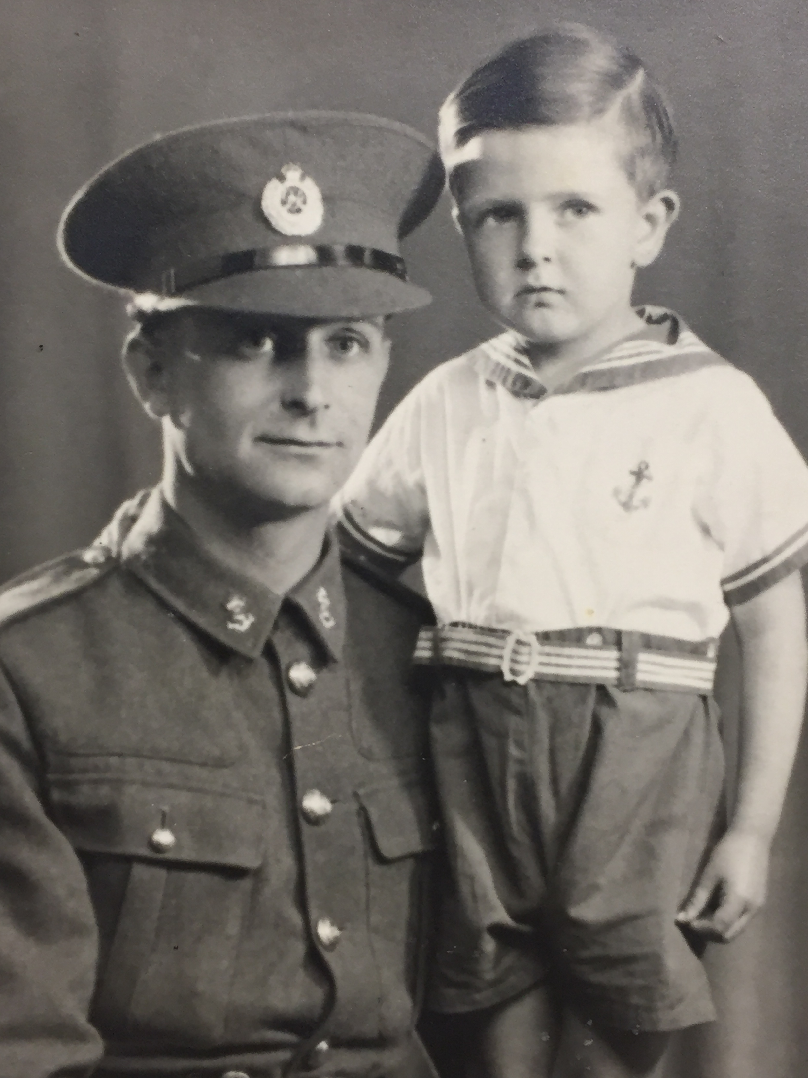
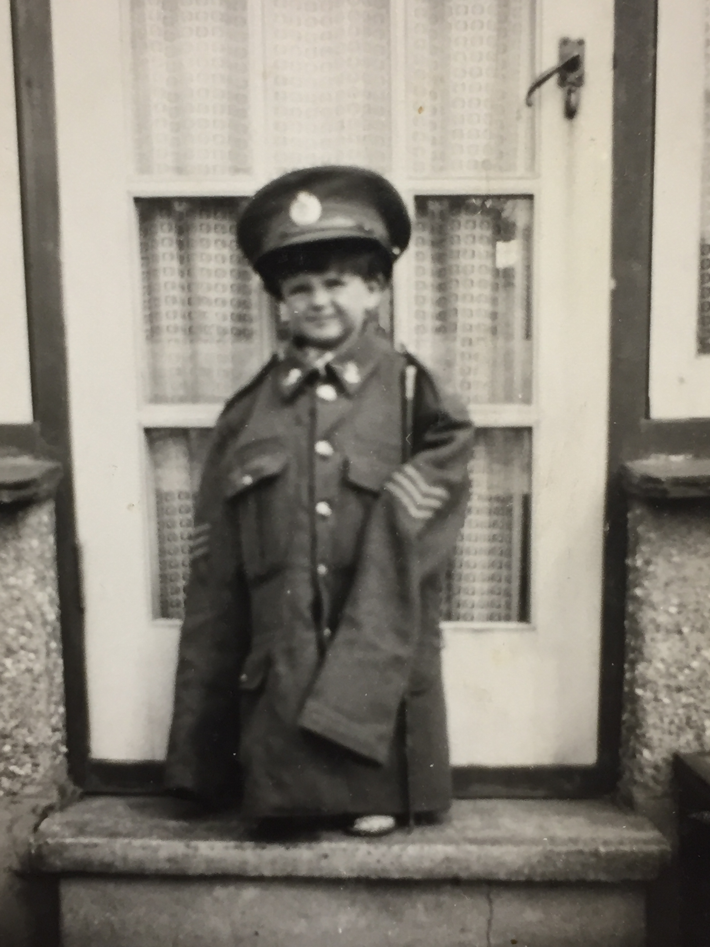

Slide 4
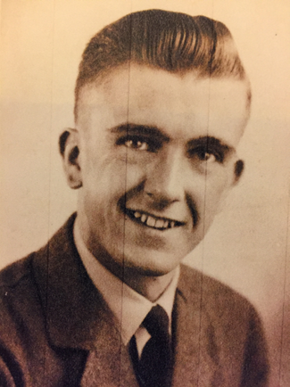
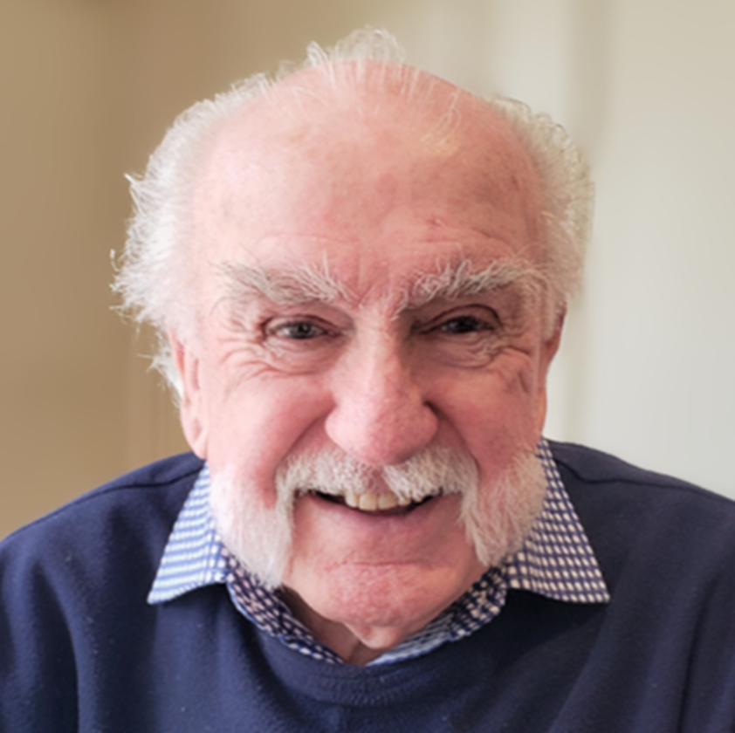

Slide 5
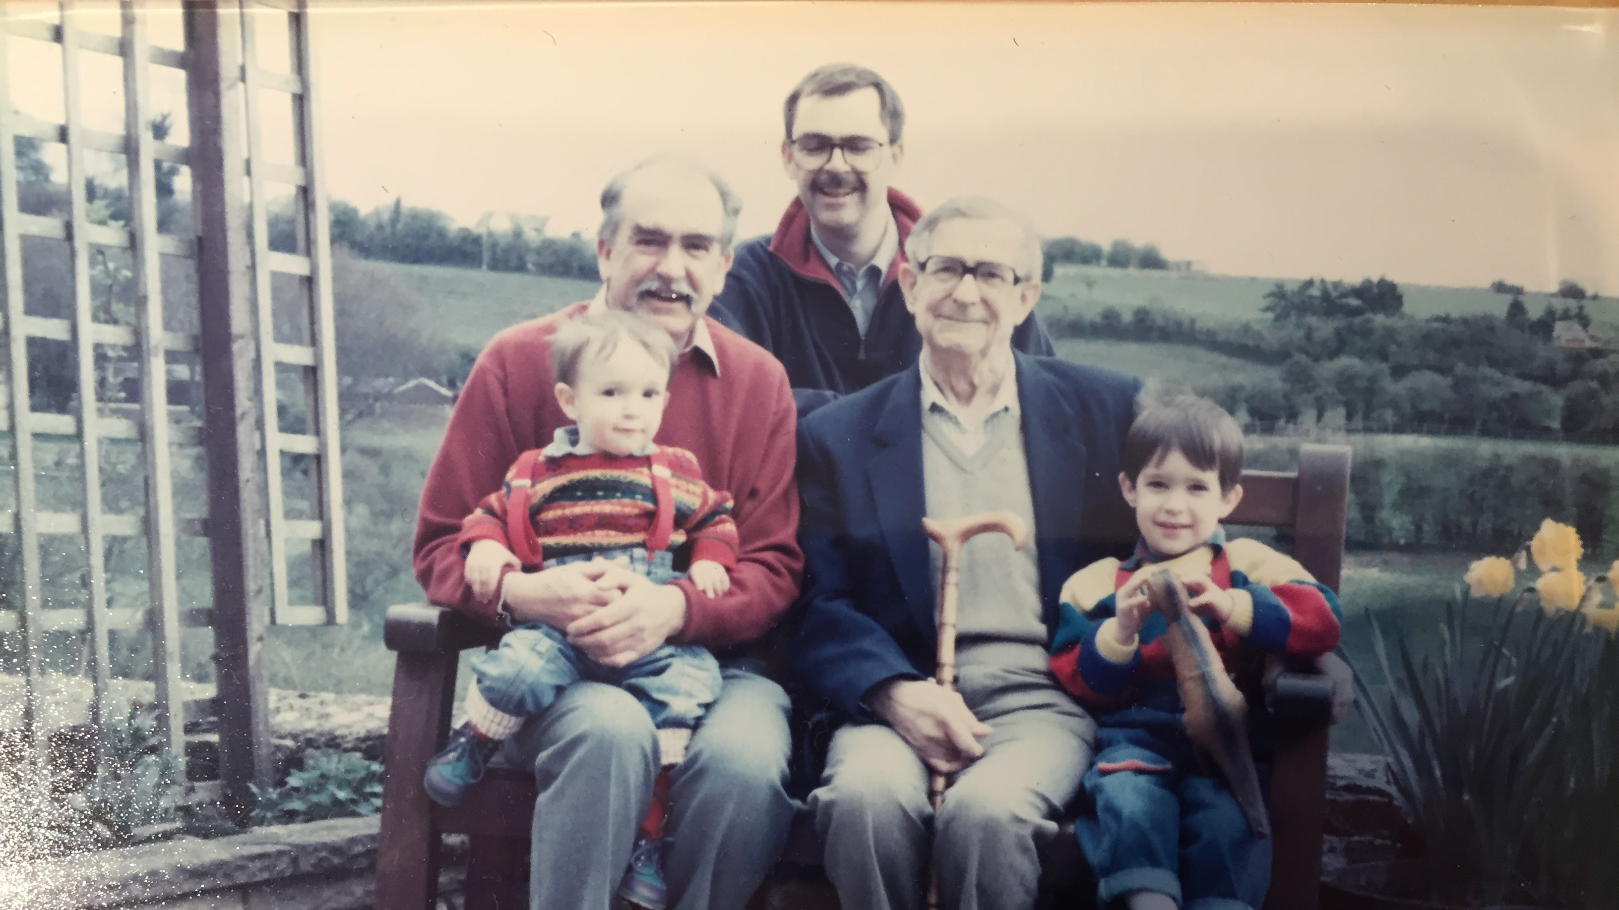

Slide 6
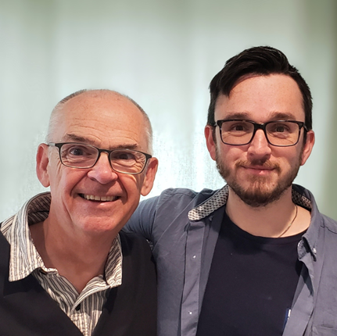
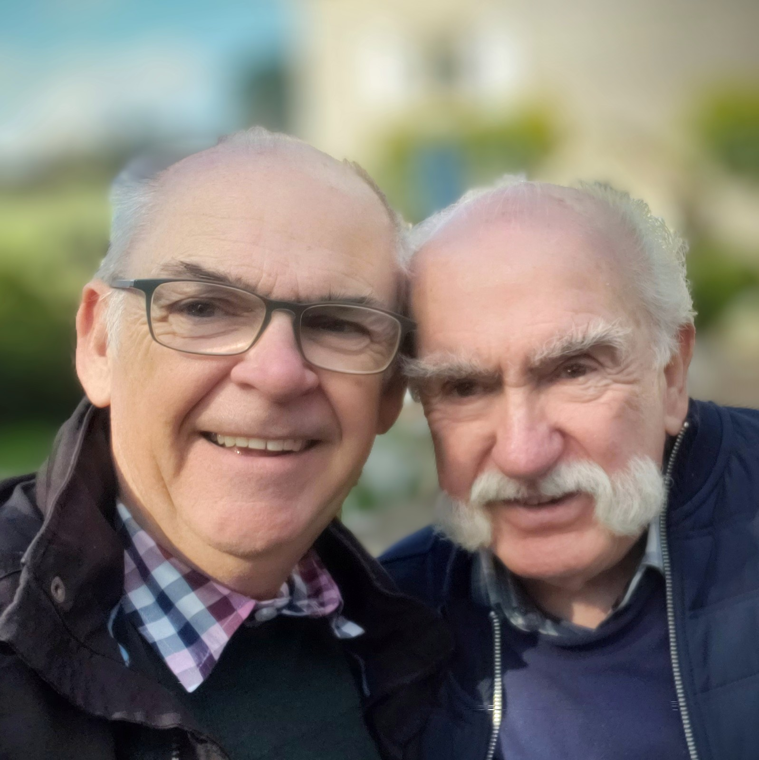

Slide 8
John 14: 1 – 11 “Don’t let your hearts be troubled. Trust in God, and trust also in me. There is more than enough room in my Father’s home. If this were not so, would I have told you that I am going to prepare a place for you? When everything is ready, I will come and get you, so that you will always be with me where I am. And you know the way to where I am going.” “No, we don’t know, Lord,” Thomas said. “We have no idea where you are going, so how can we know the way?”

Slide 9
Jesus told him, “I am the way, the truth, and the life. No one can come to the Father except through me. If you had really known me, you would know who my Father is. From now on, you do know him and have seen him!” Philip said, “Lord, show us the Father, and we will be satisfied.” Jesus replied, “Have I been with you all this time, Philip, and yet you still don’t know who I am? Anyone who has seen me has seen the Father! So why are you asking me to show him to you? Don’t you believe that I am in the Father and the Father is in me? The words I speak are not my own, but my Father who lives in me does his work through me. Just believe that I am in the Father and the Father is in me. Or at least believe because of the work you have seen me do.

Slide 10
Colossians 1:11-22
We also pray that you will be strengthened with all his glorious power so you will have all the endurance and patience you need. May you be filled with joy, always thanking the Father. He has enabled you to share in the inheritance that belongs to his people, who live in the light. For he has rescued us from the kingdom of darkness and transferred us into the Kingdom of his dear Son, who purchased our freedom and forgave our sins.

Slide 11
Christ is the visible image of the invisible God. He existed before anything was created and is supreme over all creation, for through him God created everything in the heavenly realms and on earth. He made the things we can see and the things we can’t see such as thrones, kingdoms, rulers, and authorities in the unseen world. Everything was created through him and for him. He existed before anything else, and he holds all creation together. Christ is also the head of the church, which is his body. He is the beginning, supreme over all who rise from the dead. So he is first in everything.

Slide 12
God in all his fullness was pleased to live in Christ, and through him God reconciled everything to himself. He made peace with everything in heaven and on earth by means of Christ’s blood on the cross.
This includes you who were once far away from God. You were his enemies, separated from him by your evil thoughts and actions. Yet now he has reconciled you to himself through the death of Christ in his physical body. As a result, he has brought you into his own presence, and you are holy and blameless as you stand before him without a single fault.

Slide 14
John 5:19-20
So Jesus explained, “I tell you the truth, the Son can do nothing by himself. He does only what he sees the Father doing. Whatever the Father does, the Son also does. For the Father loves the Son and shows him everything he is doing. In fact, the Father will show him how to do even greater works than healing this man. Then you will truly be astonished

Slide 16
John 14:9-18 & 25 – 27
Jesus replied, “Have I been with you all this time, Philip, and yet you still don’t know who I am? Anyone who has seen me has seen the Father! So why are you asking me to show him to you? Don’t you believe that I am in the Father and the Father is in me? The words I speak are not my own, but my Father who lives in me does his work through me. Just believe that I am in the Father and the Father is in me. Or at least believe because of the work you have seen me do.

Slide 17
“I tell you the truth, anyone who believes in me will do the same works I have done, and even greater works, because I am going to be with the Father. You can ask for anything in my name, and I will do it, so that the Son can bring glory to the Father. Yes, ask me for anything in my name, and I will do it!
“If you love me, obey my commandments. And I will ask the Father, and he will give you another Advocate, who will never leave you. He is the Holy Spirit, who leads into all truth. The world cannot receive him, because it isn’t looking for him and doesn’t recognise him. But you know him, because he lives with you now and later will be in you. No, I will not abandon you as orphans - I will come to you…

Slide 18
^{25 …}I am telling you these things now while I am still with you. But when the Father sends the Advocate as my representative - that is, the Holy Spirit - he will teach you everything and will remind you of everything I have told you.
“I am leaving you with a gift - peace of mind and heart. And the peace I give is a gift the world cannot give. So don’t be troubled or afraid.

Slide 20
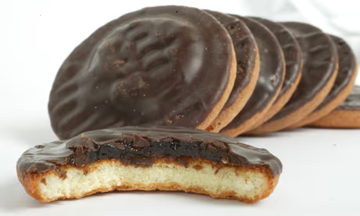

Slide 22
Psalm 68:5,6 Father to the fatherless, defender of widows,
this is God, whose dwelling is holy. God places the lonely in families;
he sets the prisoners free and gives them joy

Slide 23
1 John 3:1
See what great love the Father has lavished on us, that we should be called children of God! And that is what we are!

Slide 24
My heavenly Dad is bigger than your Dad

