Slide 1
Failing Forward
Martin Pearson

Slide 17
The End
The End

Slide 18
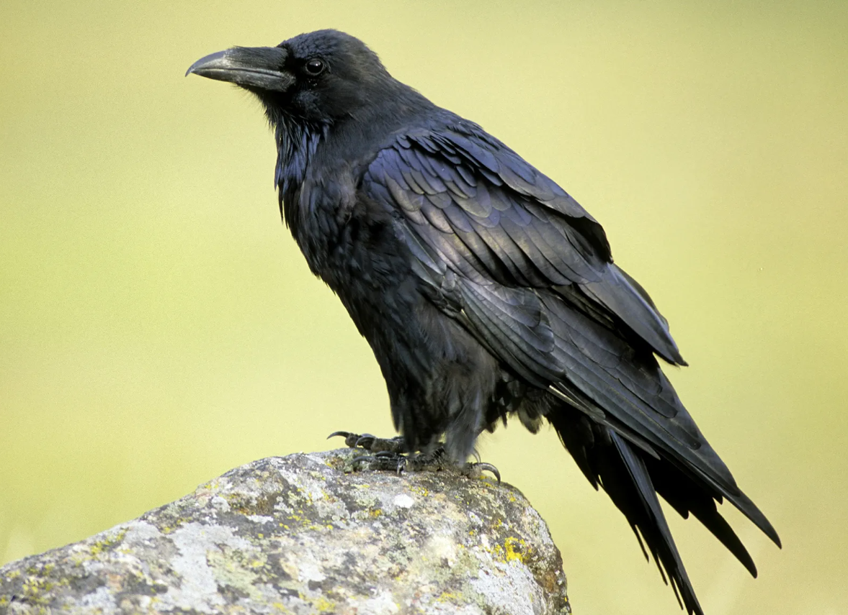

Slide 23
HOLD ON …
GOD KNOWS
WHAT HES
DOING

