Slide 1

What does it look like to be a Good news people in a bad news world?

Slide 2
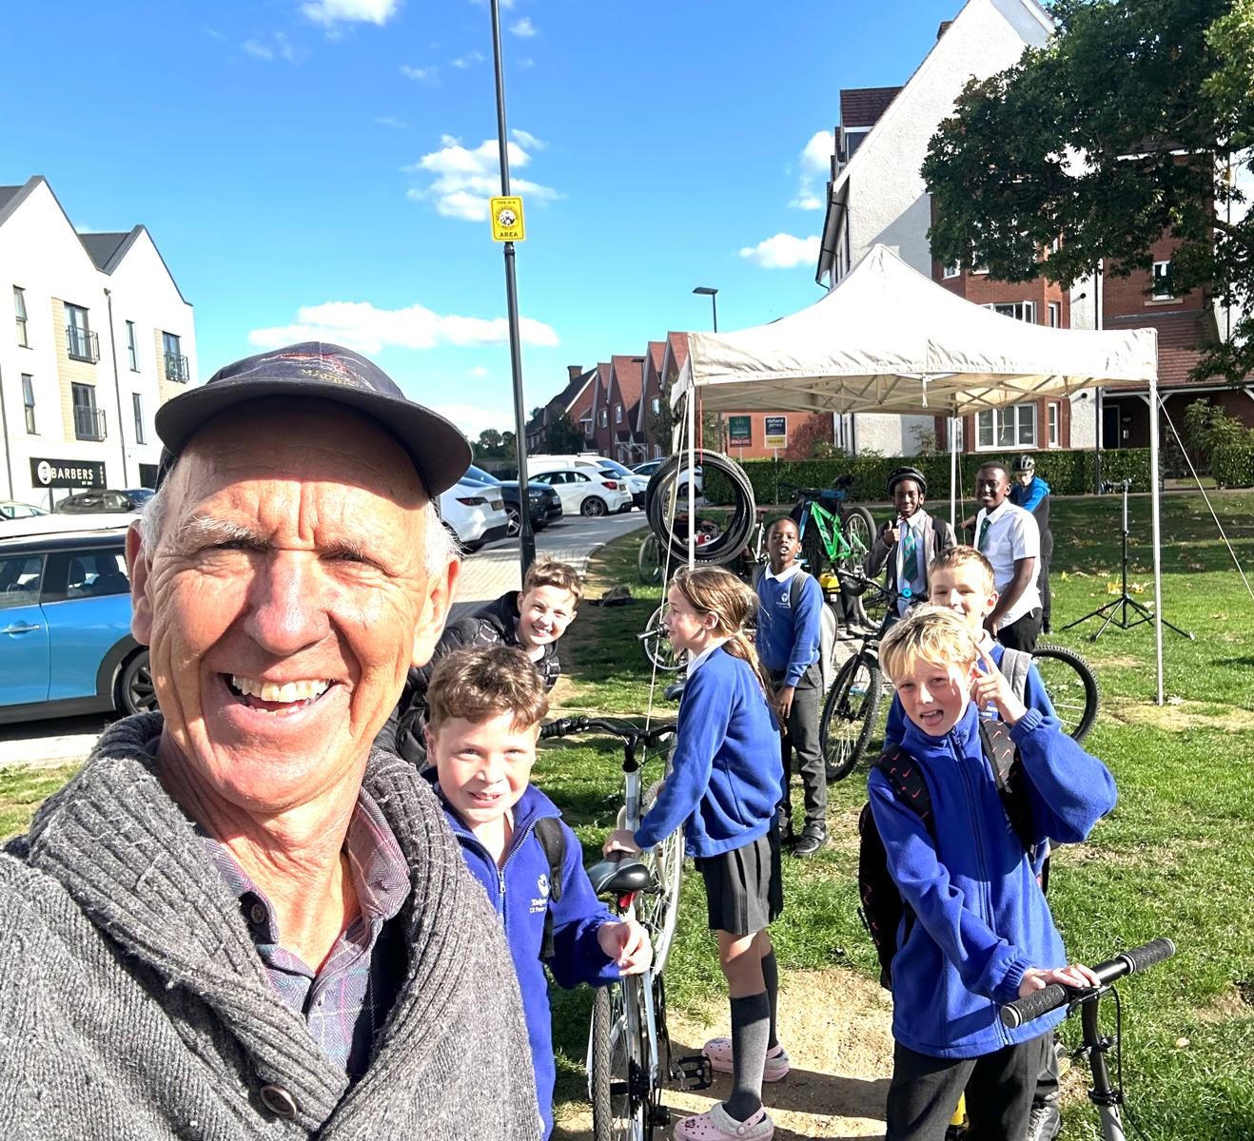
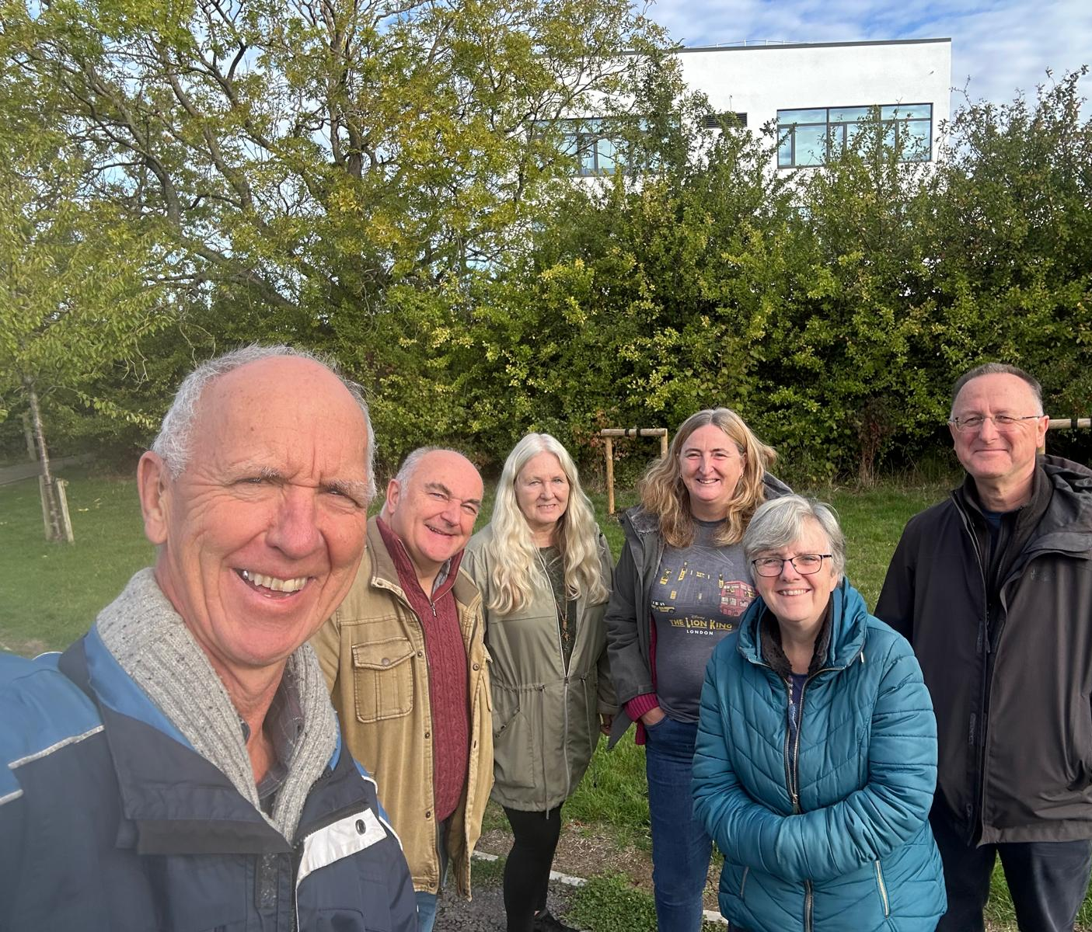
We are good news people if we become available to God

Slide 3
Romans 12.1-2
1: "Therefore, I urge you, brothers and sisters, in view of God’s mercy, to offer your bodies as a living sacrifice, holy and pleasing to God—this is your true and proper worship."
2: "Do not conform to the pattern of this world, but be transformed by the renewing of your mind. Then you will be able to test and approve what God’s will is—his good, pleasing and perfect will."

Slide 4
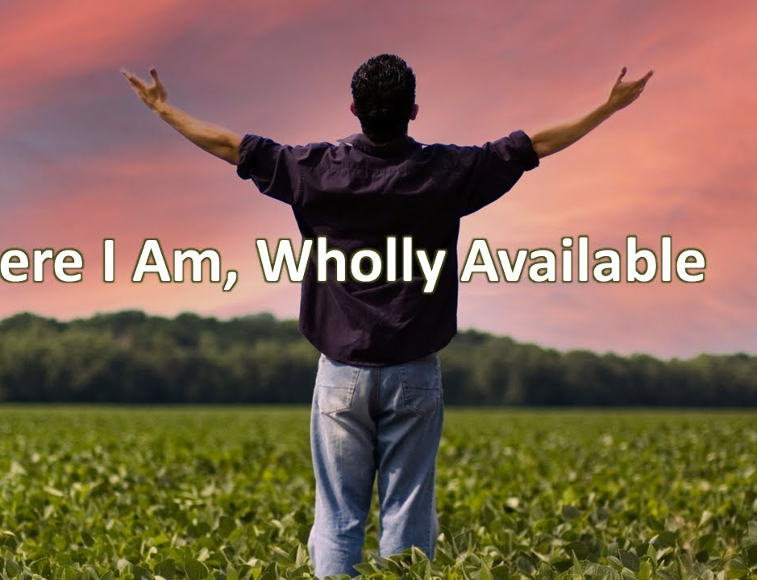
Here I Am, Wholly Available As For Me, I Will Serve The Lord Here I Am, Wholly Available As For Me, I Will Serve The Lord
Chris Bowater

Slide 5

Are you available to everyone?
Are you available to the wrong things?
Are you available to God?

Slide 6
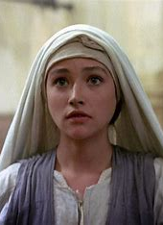
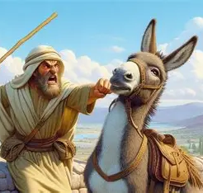
2 Bible characters who were available to God
Baalam - Numbers 22
Mary - Luke 1.26-38

Slide 7
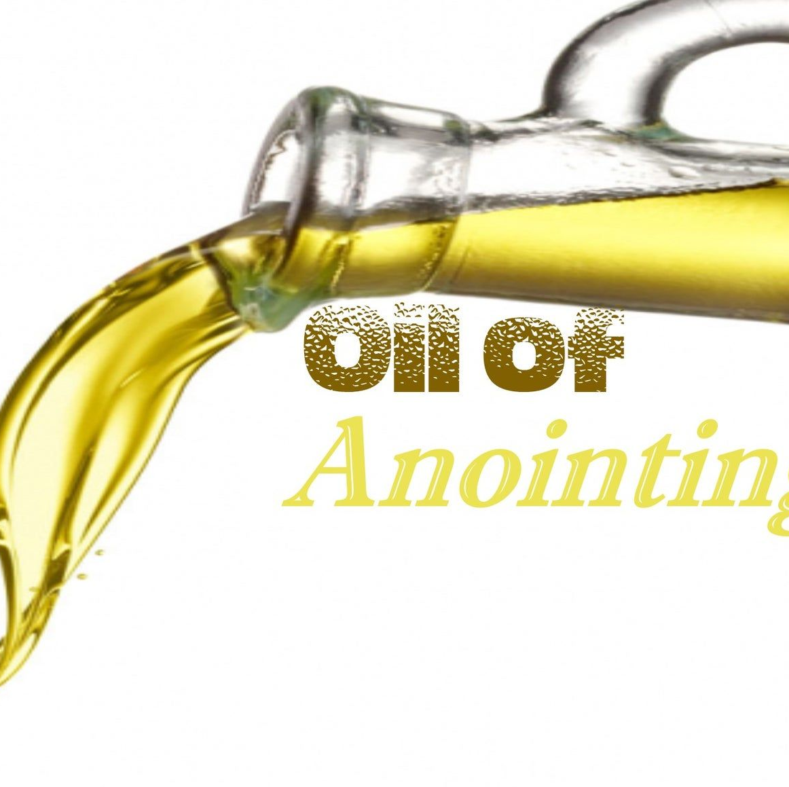
How does it work out to be available to God?
Available to an older generation to sow into a younger generation
Available to move to be closer to the place God has called you to work
Available to let go of a big income to receive a smaller income to serve God and trust him for the difference
Available to pray for healing – even if not much has happened yet

