Slide 1



Slide 2


Slide 3
Proverbs 20:14
The buyer haggles over the price, saying, “It’s worthless” Then brags about getting a bargain!

Slide 4
Genesis 23:8-16
“Since you are willing to help me in this way, be so kind as to ask Ephron son of Zohar to let me buy his cave at Machpelah, down at the end of his field. I will pay the full price in the presence of witnesses, so I will have a permanent burial place for my family.”
Ephron was sitting there among the others, and he answered Abraham as the others listened, speaking publicly before all the Hittite elders of the town. “No, my lord,” he said to Abraham, “please listen to me. I will give you the field and the cave. Here in the presence of my people, I give it to you. Go and bury your dead.”
Abraham again bowed low before the citizens of the land, and he replied to Ephron as everyone listened. “No, listen to me. I will buy it from you. Let me pay the full price for the field so I can bury my dead there.”
Ephron answered Abraham, “My lord, please listen to me. The land is worth 400 pieces of silver, but what is that between friends? Go ahead and bury your dead.”
So Abraham agreed to Ephron’s price and paid the amount he had suggeste - 400 pieces of silver, weighed according to the market standard. The Hittite elders witnessed the transaction.

Slide 5
1 Chronicles 21:18-27
When Araunah saw David approaching, he left his threshing floor and bowed before David with his face to the ground.
David said to Araunah, “Let me buy this threshing floor from you at its full price. Then I will build an altar to the Lord there, so that he will stop the plague.”
“Take it, my lord the king, and use it as you wish,” Araunah said to David. “I will give the oxen for the burnt offerings, and the threshing boards for wood to build a fire on the altar, and the wheat for the grain offering. I will give it all to you.”
But King David replied to Araunah, “No, I insist on buying it for the full price. I will not take what is yours and give it to the Lord. I will not present burnt offerings that have cost me nothing!” So David gave Araunah 600 pieces of gold in payment for the threshing floor.
David built an altar there to the Lord and sacrificed burnt offerings and peace offerings. .

Slide 6
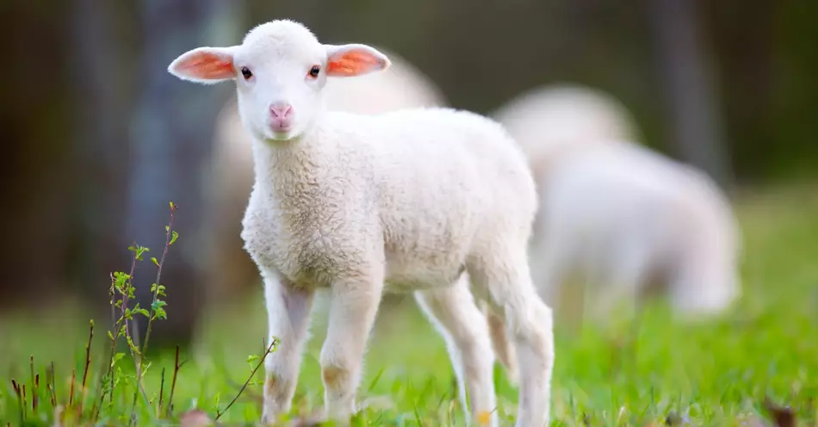

Slide 7
Do we bring God our best, or what we have left? Does it cost us?

Slide 8
Matthew 13:45-46
“The Kingdom of Heaven is like a treasure that a man discovered hidden in a field. In his excitement, he hid it again and sold everything he owned to get enough money to buy the field.
“Again, the Kingdom of Heaven is like a merchant on the lookout for choice pearls. When he discovered a pearl of great value, he sold everything he owned and bought it!

Slide 9


Slide 10
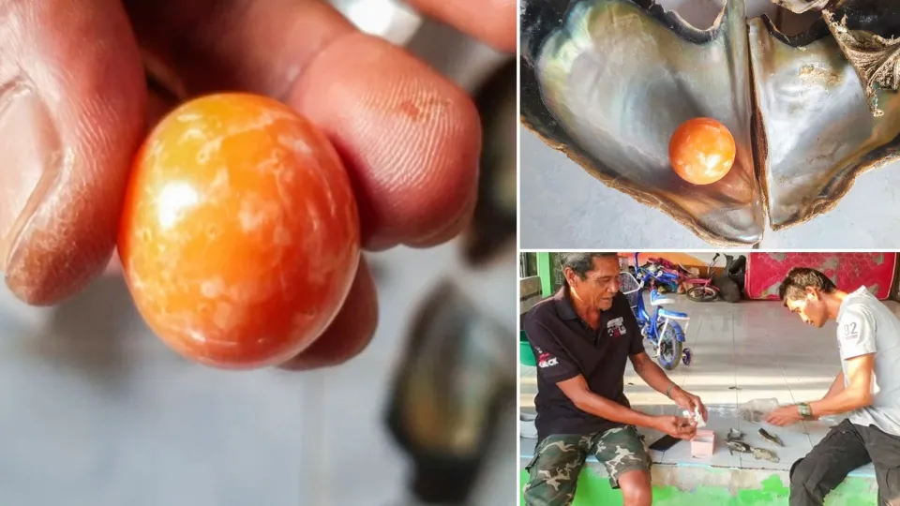

Slide 11


Slide 12

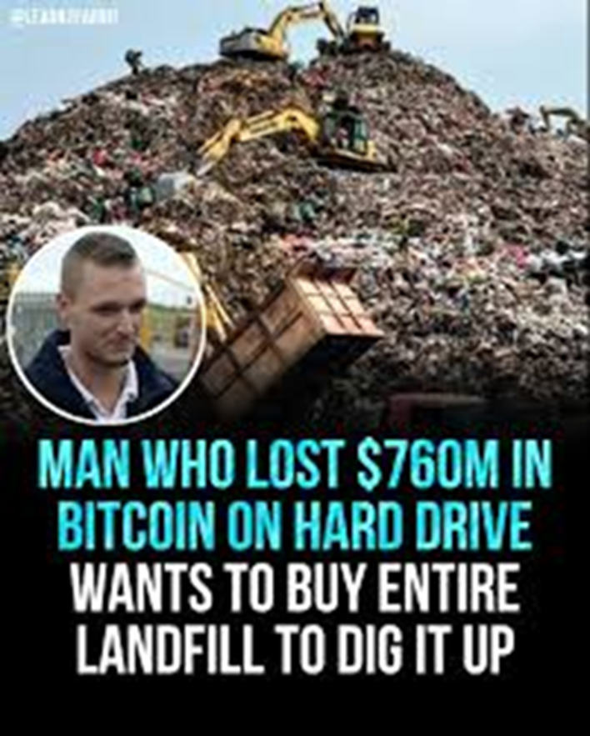
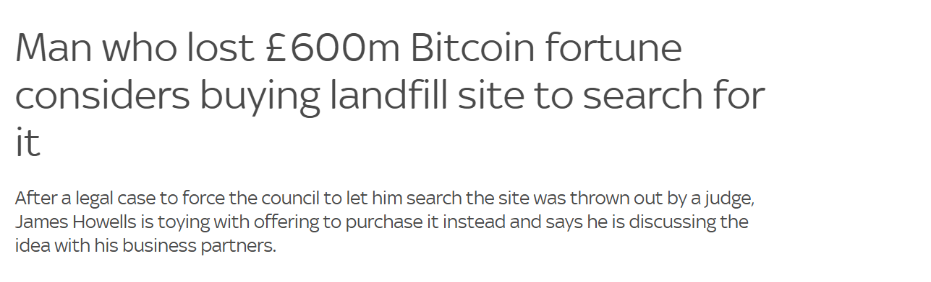

Slide 13
Luke 14:25 - 33
A large crowd was following Jesus. He turned around and said to them, “If you want to be my disciple, you must, by comparison, hate everyone else - your father and mother, wife and children, brothers and sisters - yes, even your own life. Otherwise, you cannot be my disciple. And if you do not carry your own cross and follow me, you cannot be my disciple.
“But don’t begin until you count the cost. For who would begin construction of a building without first calculating the cost to see if there is enough money to finish it? Otherwise, you might complete only the foundation before running out of money, and then everyone would laugh at you. They would say, ‘There’s the person who started that building and couldn’t afford to finish it!’
“Or what king would go to war against another king without first sitting down with his counsellors to discuss whether his army of 10,000 could defeat the 20,000 soldiers marching against him? And if he can’t, he will send a delegation to discuss terms of peace while the enemy is still far away. So you cannot become my disciple without giving up everything you own.

Slide 14
Ecclesiastics 11:4
Farmers who wait for perfect weather never plant. If they watch every cloud, they never harvest.

Slide 15
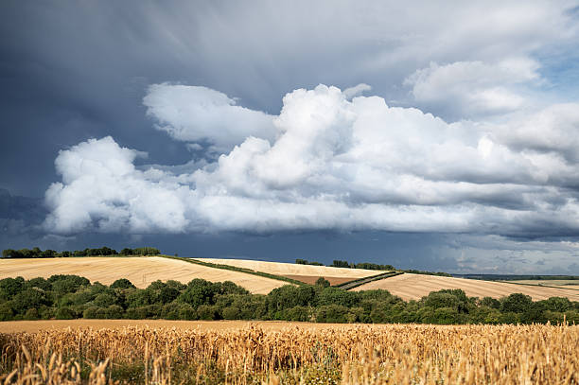

Slide 16
Do you need to make a decision? Do you bring God, what you have left or do you bring Him your best? Does it cost you?
Decision time…

