Slide 1
The light at the end of the tunnel
Martin Pearson

Slide 2

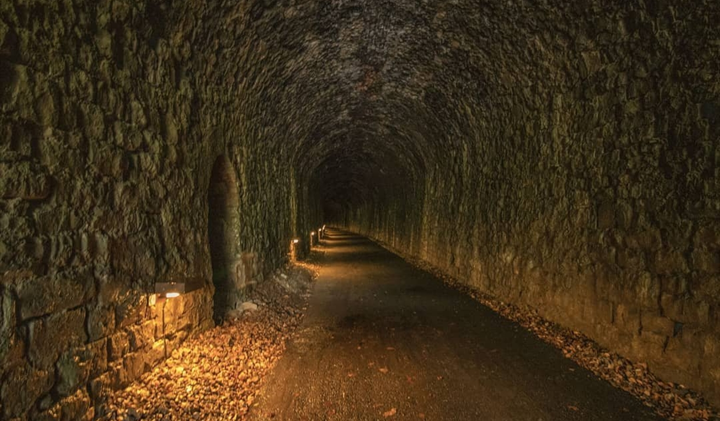

Slide 3
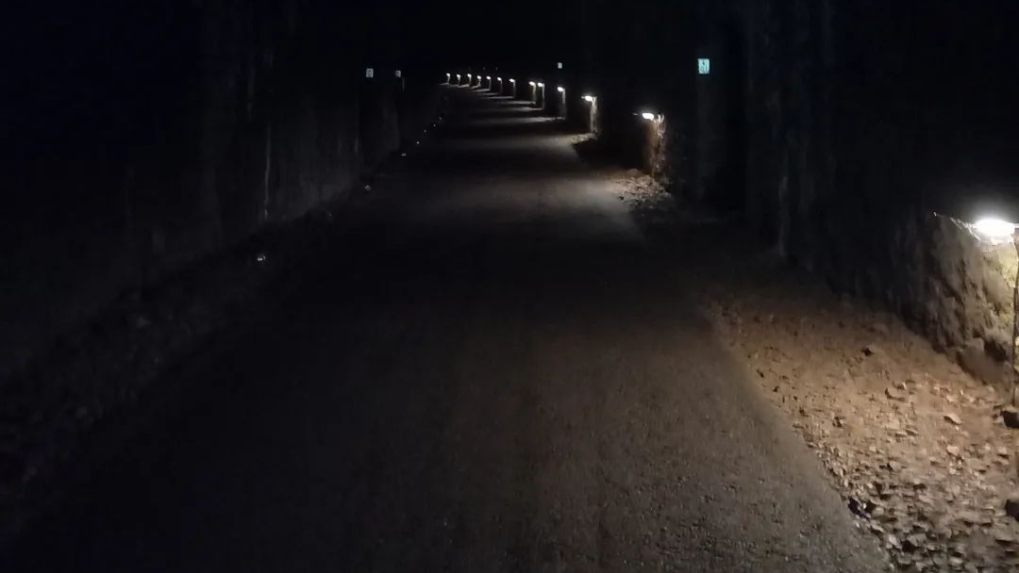

Slide 4
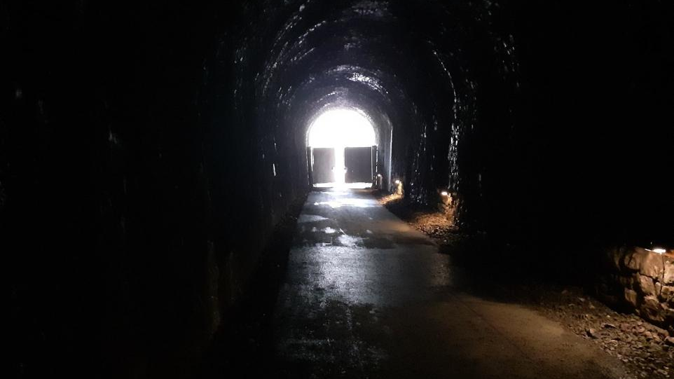

Slide 5
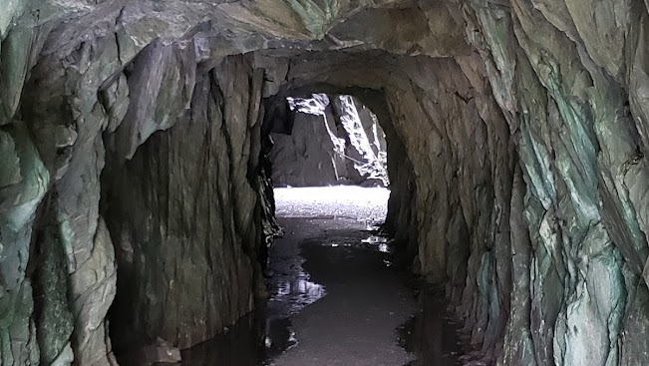

Slide 6
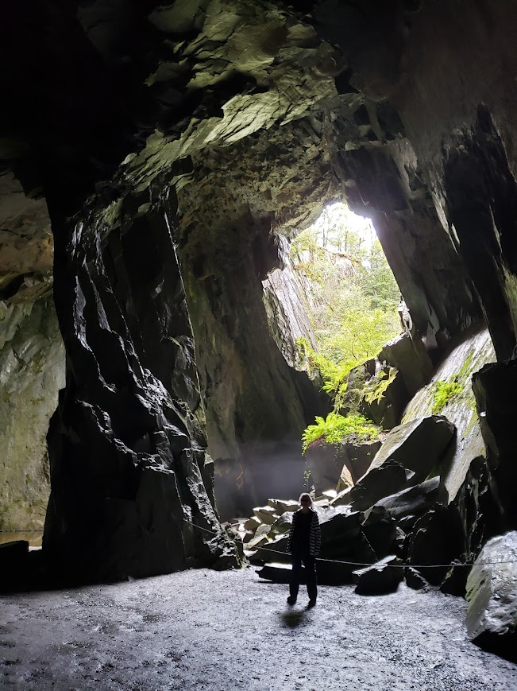
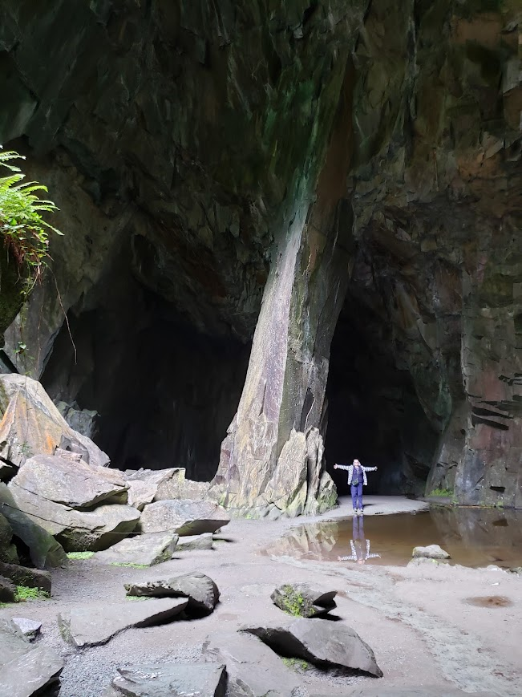

Slide 7
300+ prophecies fulfilled by Jesus

Slide 8
The Messiah
…born of a virgin
…born in Bethlehem
…would be a descendant of David
…would flee to Egypt
…there would be a slaughter of innocent babies
…would be worshiped by wise men
…there would be a guiding star

Slide 9
400 years of nothing

Slide 10
Isaiah 9:2 The people who walk in darkness will see a great light. For those who live in a land of deep darkness, a light will shine.
Isaiah 50:10 …If you are walking in darkness, without a ray of light, trust in the Lord and rely on your God.
Psalm 18:28 You light a lamp for me. The Lord, my God, lights up my darkness.

Slide 11
John 1:1-5 In the beginning the Word already existed. The Word was with God, and the Word was God. He existed in the beginning with God. God created everything through him, and nothing was created except through him. The Word gave life to everything that was created, and his life brought light to everyone. The light shines in the darkness, and the darkness can never extinguish it.

Slide 12
John 12:46
I have come as a light to shine in this dark world, so that all who put their trust in me will no longer remain in the dark.
1 John 1:5
This is the message we heard from Jesus and now declare to you: God is light, and there is no darkness in him at all.

Slide 13
2 Corinthians 4:16-18 That is why we never give up. Though our bodies are dying, our spirits are being renewed every day. For our present troubles are small and won’t last very long. Yet they produce for us a glory that vastly outweighs them and will last forever! So we don’t look at the troubles we can see now; rather, we fix our gaze on things that cannot be seen. For the things we see now will soon be gone, but the things we cannot see will last forever.
Lamentations 3:21-26 Yet I still dare to hope when I remember this: The faithful love of the Lord never ends! His mercies never cease. Great is his faithfulness; His mercies begin afresh each morning. I say to myself, “The Lord is my inheritance; therefore, I will hope in him!” The Lord is good to those who depend on him, to those who search for him. So it is good to wait quietly for salvation from the Lord.

Slide 14

Don’t curse the darkness
Light a candle

Slide 15
2 Corinthians 4:6-9
For God, who said, “Let there be light in the darkness,” has made this light shine in our hearts so we could know the glory of God that is seen in the face of Jesus Christ.
We now have this light shining in our hearts, but we ourselves are like fragile clay jars containing this great treasure. This makes it clear that our great power is from God, not from ourselves.
We are pressed on every side by troubles, but we are not crushed. We are perplexed but not driven to despair. We are hunted down but never abandoned by God. We get knocked down, but we are not destroyed.

Slide 16
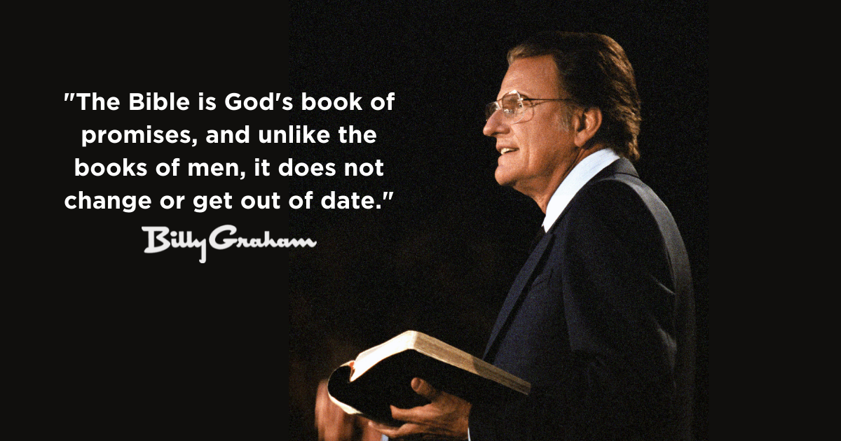
“I've read the last page
of the Bible,
it's all going
to turn out all right”"

Slide 17
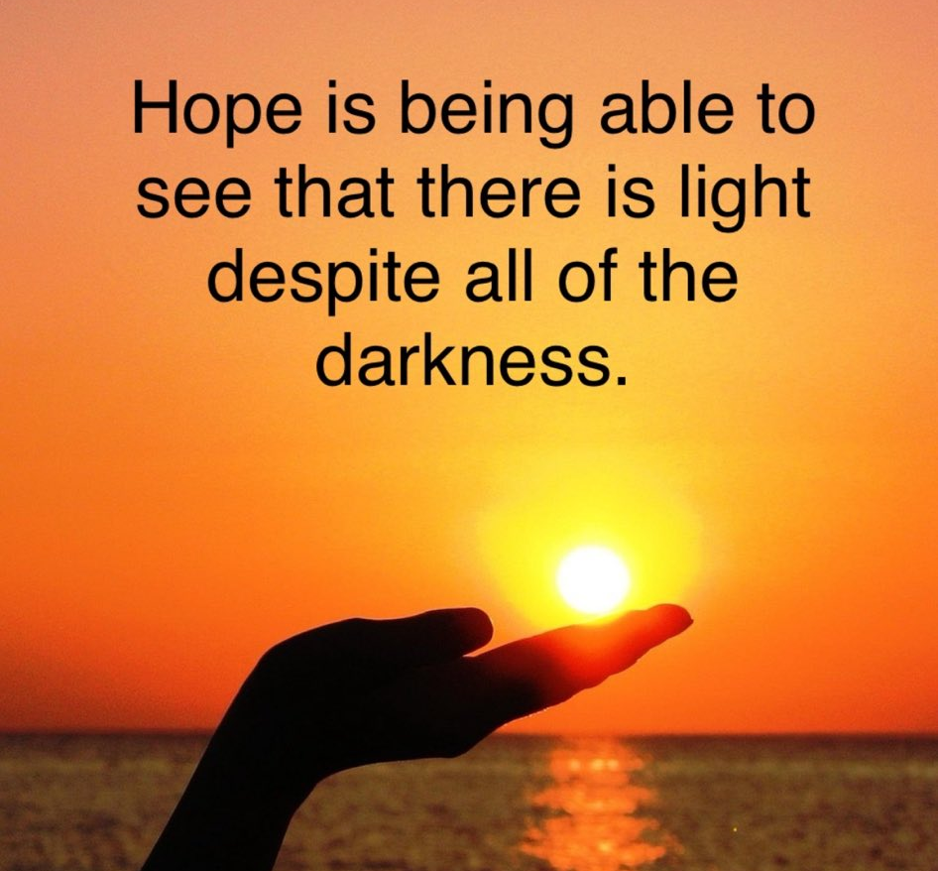

Slide 18
John 8:12 Jesus spoke to the people once more and said,
“I am the light of the world. If you follow me, you won’t have to walk in darkness, because you will have the light that leads to life.

