Slide 1

Lost
Martin Pearson

Slide 3
Luke 2:41-52
⁴¹ Every year Jesus’ parents went to Jerusalem for the Festival of the Passover. ⁴² When he was twelve years old, they went up to the festival, according to the custom. ⁴³ After the festival was over, while his parents were returning home, the boy Jesus stayed behind in Jerusalem, but they were unaware of it. ⁴⁴ Thinking he was in their company, they travelled on for a day. Then they began looking for him among their relatives and friends. ⁴⁵ When they did not find him, they went back to Jerusalem to look for him.
⁴⁶ After three days they found him in the temple courts, sitting among the teachers, listening to them and asking them questions. ⁴⁷ Everyone who heard him was amazed at his understanding and his answers. ⁴⁸ When his parents saw him, they were astonished. His mother said to him, “Son, why have you treated us like this? Your father and I have been anxiously searching for you.”

Slide 4
⁴⁹ “Why were you searching for me?” he asked. “Didn’t you know I had to be in my Father’s house? ” ⁵⁰ But they did not understand what he was saying to them.
⁵¹ Then he went down to Nazareth with them and was obedient to them. But his mother treasured all these things in her heart. ⁵² And Jesus grew in wisdom and stature, and in favour with God and man.

Slide 5
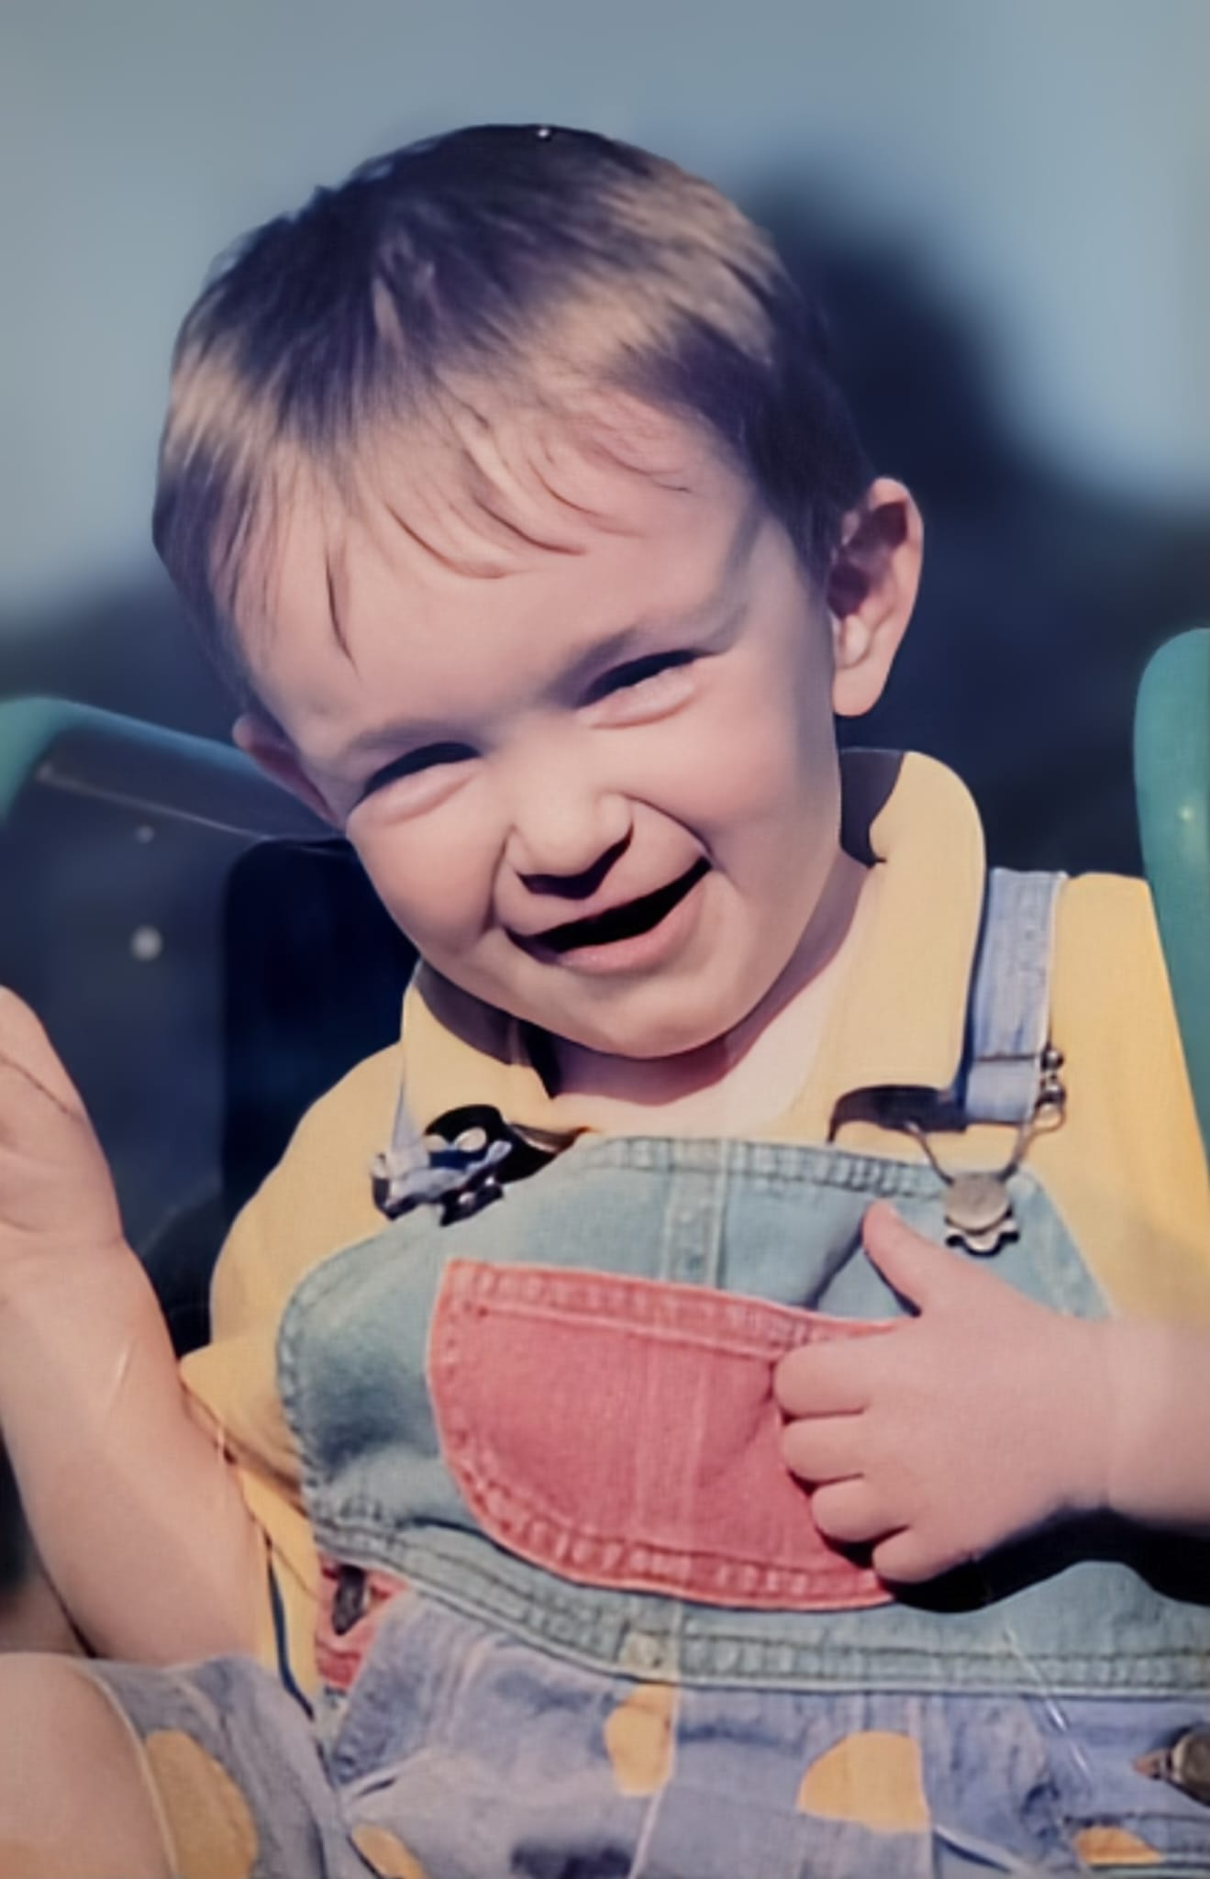

Slide 6
Destination had become more important than Devotion

Slide 7
Matthew 6:33
Seek the Kingdom of God above all else, and live righteously, and he will give you everything you need.

Slide 8
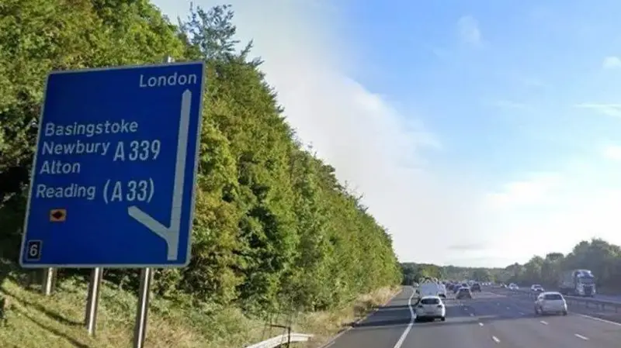

Slide 9
Destination had become more important than Devotion
They were so comfortable, they forgot about Jesus

Slide 10
Revelation 3:16
So, because you are lukewarm - neither hot nor cold
I am about to spit you out of my mouth.

Slide 11
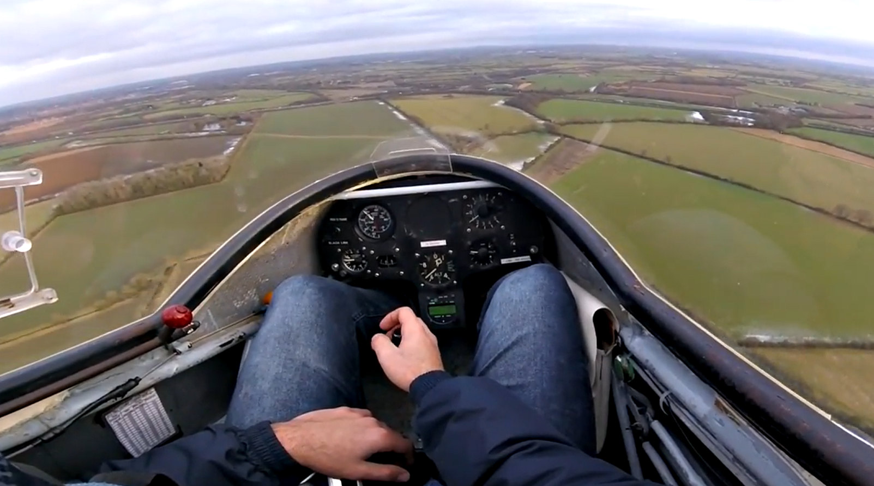

Slide 12
Destination had become more important than Devotion
They were so comfortable, they forgot about Jesus
They were anxious about something God already had in hand

Slide 13
Hebrews 12:2-3 (NIRV)
Let us keep looking to Jesus. He is the one who started this journey of faith. And he is the one who completes the journey of faith. He paid no attention to the shame of the cross. He suffered there because of the joy he was looking forward to. Then he sat down at the right hand of the throne of God. ³ He made it through these attacks by sinners. So think about him. Then you won’t get tired. You won’t lose hope.

Slide 14
Psalm 42:1 As the deer pants for the water, so my soul longs for you
Isaiah 55:6 Seek the Lord while he may be found; call on him while he is near.
Deuteronomy 4:29
But if from there you seek the Lord your God, you will find him if you seek him with all your heart and with all your soul

Slide 15
t
here
here

Slide 16
Let our devotion be of a higher priority than our destination
Let’s not get so comfortable we just drift, and lose sight of Jesus
Let’s fix our eyes on Jesus and His Kingdom way; and not be anxious about something He already has in hand.

