Slide 1
PRAYER

Slide 2

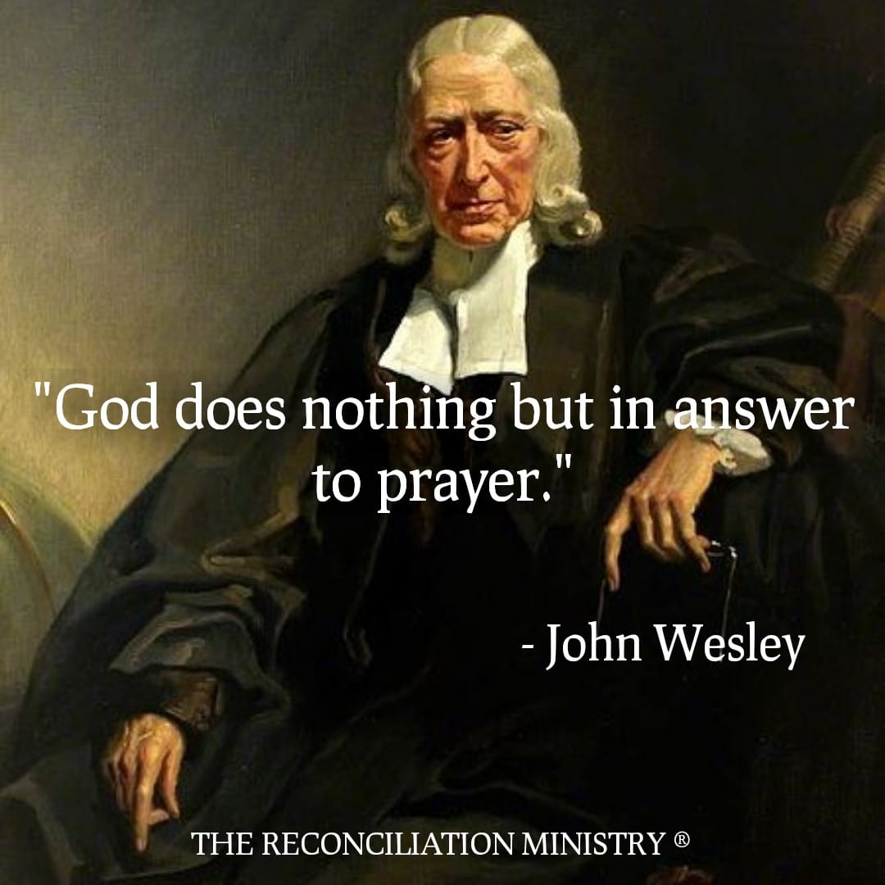

Slide 3
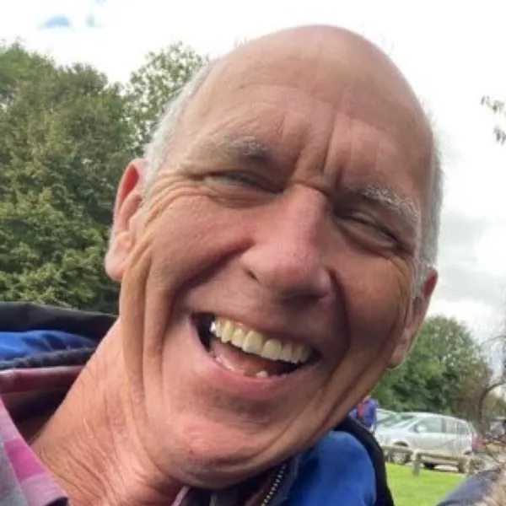
“There needs to be much prayer, maybe a week of prayer?
This will lead to the agreement of the church on the way forward
and they will ‘get it’ – unity”

Slide 4
Matthew 6:5-15 And when you pray, do not be like the hypocrites, for they love to pray standing in the synagogues and on the street corners to be seen by others. Truly I tell you, they have received their reward in full. But when you pray, go into your room, close the door and pray to your Father, who is unseen. Then your Father, who sees what is done in secret, will reward you. And when you pray, do not keep on babbling like pagans, for they think they will be heard because of their many words. Do not be like them, for your Father knows what you need before you ask him.
‘This, then, is how you should pray:

Slide 5
Our Father in heaven, hallowed be your name, Your kingdom come, your will be done, on earth as it is in heaven. Give us today our daily bread. And forgive us our debts, as we also have forgiven our debtors. And lead us not into temptation, (or testing) But deliver us from the evil one. (for yours is the kingdom and the power and the glory for ever. Amen.)
For if you forgive other people when they sin against you, your heavenly Father will also forgive you. But if you do not forgive others their sins, your Father will not forgive your sins.

Slide 6
ACTS

Slide 7
A
ADORATION
Isaiah 25:1
O Lord, I will honour and praise your name, for you are my God. You do such wonderful things! You planned them long ago, and now you have accomplished them.

Slide 8
C
CONFESSION
1 John 1:9 If we confess our sins, he is faithful and just to forgive us our sins and to cleanse us from all unrighteousness.

Slide 9
T
THANKSGIVING
Psalm 100:4 Enter his gates with thanksgiving;
go into his courts with praise. Give thanks to him and praise his name Psalm 107:1 Give thanks to the Lord, for he is good!
His faithful love endures forever.
1 Thessalonians 5:16-18
Always be joyful. Never stop praying.
Be thankful in all circumstances,
for this is God’s will for you who belong to Christ Jesus.

Slide 10
S
SUPPLICATION
Philippians 4:6
Don’t worry about anything; instead, pray about everything. Tell God what you need, and thank him for all he has done Ephesians 6:18 Pray in the Spirit at all times and on every occasion. Stay alert and be persistent in your prayers for all believers everywhere.

Slide 11
ACTS
Romans 8:26,27
In the same way, the Spirit helps us in our weakness.
We do not know what we ought to pray for, but the Spirit himself intercedes for us with groans that words cannot express.
And he who searches our hearts knows the mind of the Spirit, because the Spirit intercedes for the saints in accordance with God's will.

Slide 12


Slide 13




Slide 14
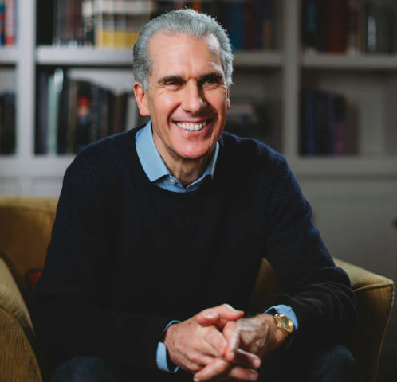
When we pray, God hears more than we say Answers more than we ask Gives more than we imagine
In His own time and in His own way
Nicky Gumbell

Slide 15
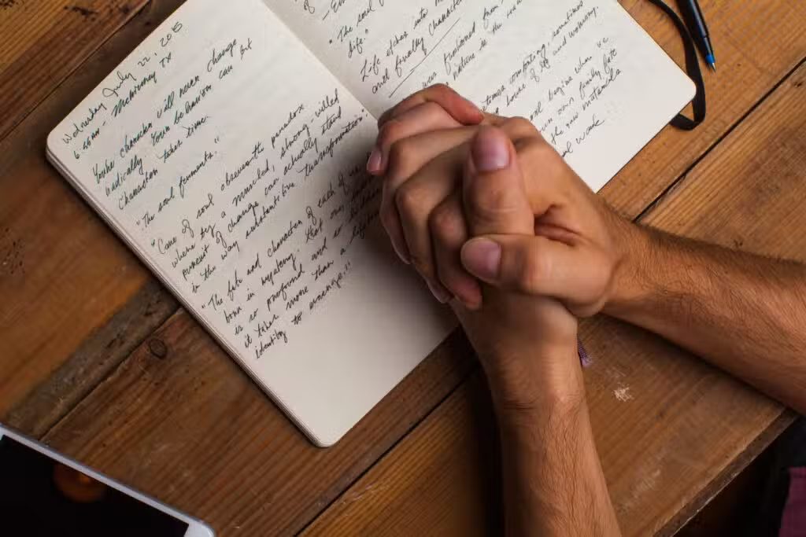

Slide 16
Psalm 34 (The Message)
I bless God every chance I get; my lungs expand with his praise.
I live and breathe God; if things aren’t going well, hear this and be happy:
Join me in spreading the news; together let’s get the word out.
God met me more than halfway; he freed me from my anxious fears.
Look at him; give him your warmest smile.
Never hide your feelings from him.
When I was desperate, I called out, and God got me out of a tight spot.
God’s angel sets up a circle of protection around us while we pray.
Open your mouth and taste, open your eyes and see - how good God is. Blessed are you who run to him.
Worship God if you want the best; worship opens doors to all his goodness.

Slide 17
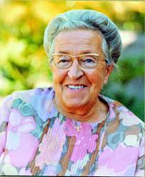
Faith sees the invisible believes the unbelievable and receives the impossible
Corrie Ten Boom

Slide 18
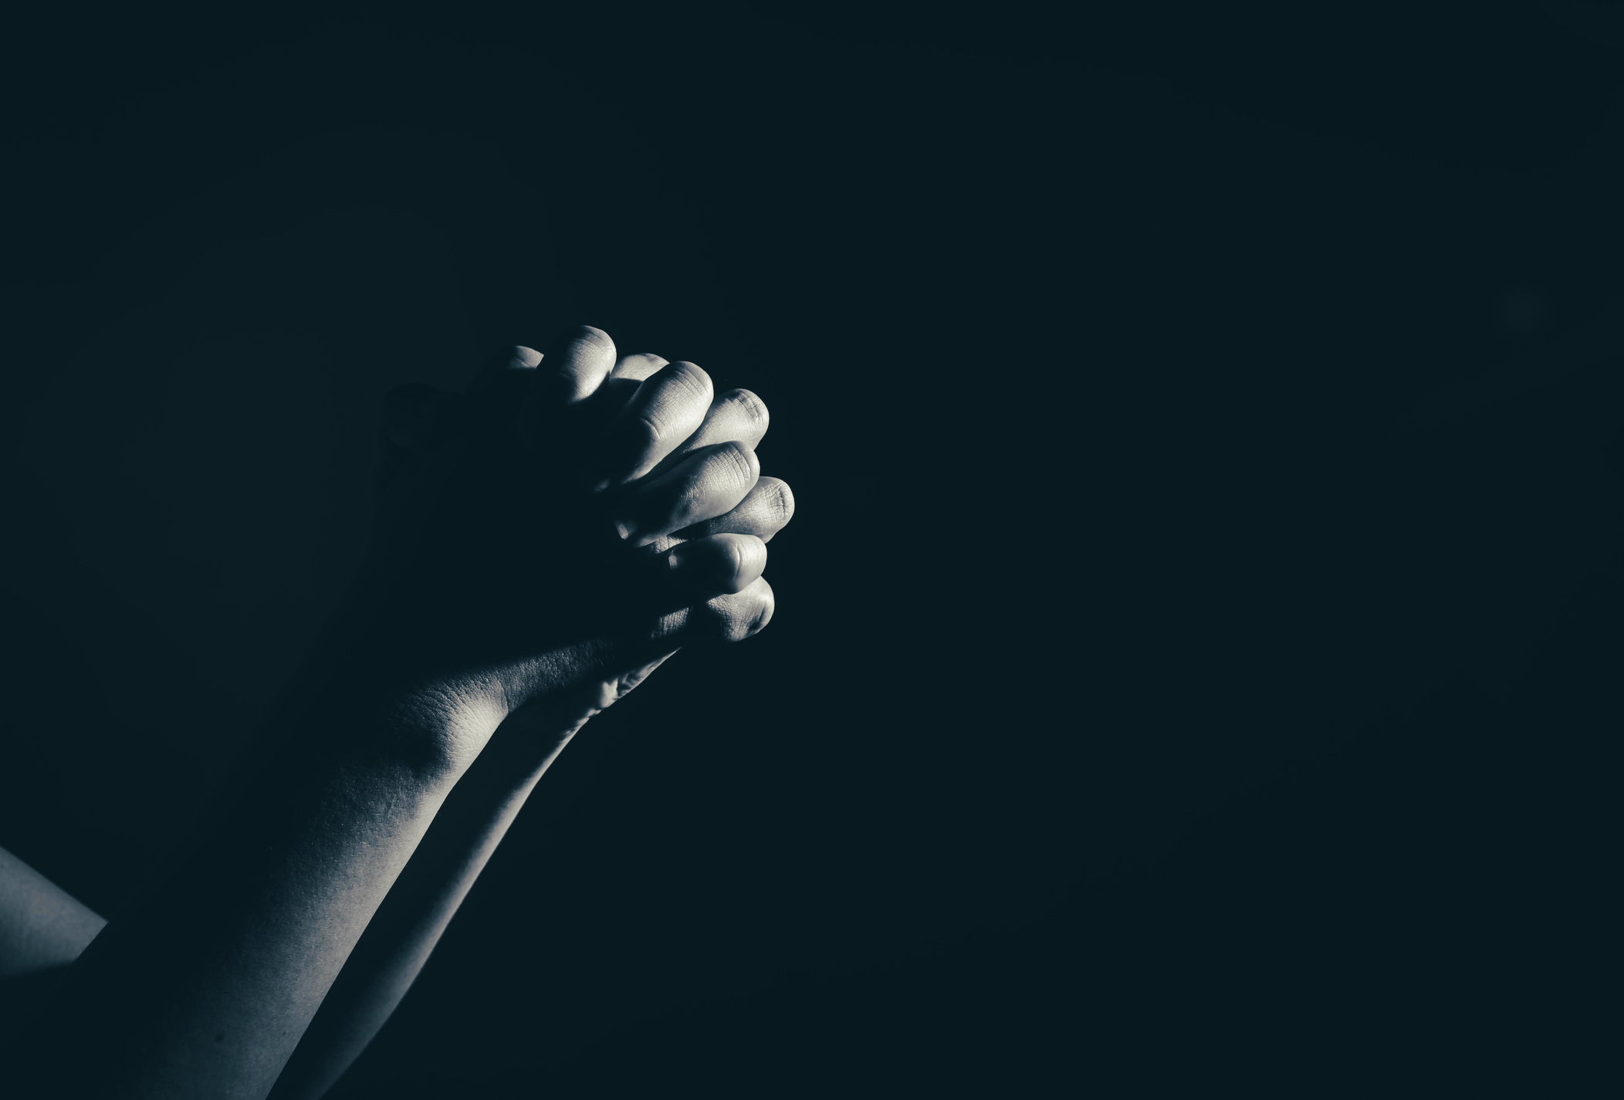
WEEK OF PRAYER
Mon 13th APRIL
Tues 14th April
Wed 15th April (Worship Eve) Thurs 16th April Fri 17th April
Wed 24th June
7:30pm at The Cross

Slide 19

You don’t have to wait for a prayer meeting to pray
You don’t have to close your eyes
You don’t have to use a special ‘prayer language’
You don’t have to be in a special place
No prayer is too big or too small for God
It’s a conversation – shut up and listen sometimes!
It’s not about me as if you should do things my way
Pray with people not for people

Slide 20


Slide 21
Our Father, who art in heaven, hallowed be thy name. Thy kingdom come, thy will be done, on earth as it is in heaven. Give us this day our daily bread, and forgive us our trespasses, as we forgive those who trespass against us. And lead us not into temptation, but deliver us from evil, for thine is the kingdom, the power and the glory, for ever and ever, Amen.

