Slide 1

Recognising God

Slide 2
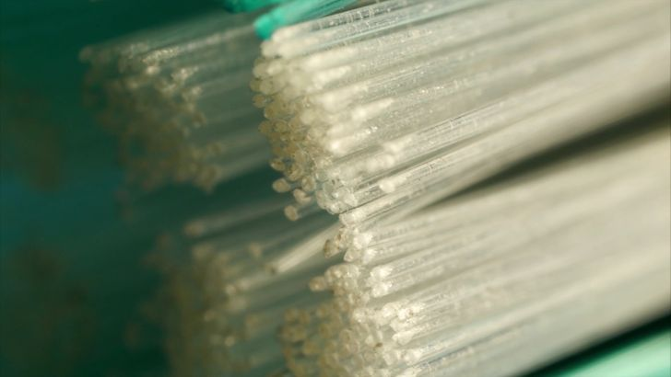

Slide 3
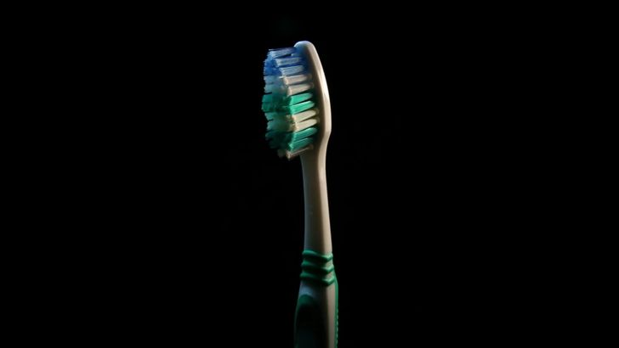

Slide 4
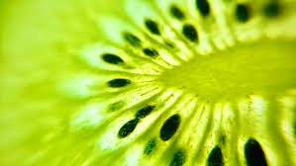

Slide 5
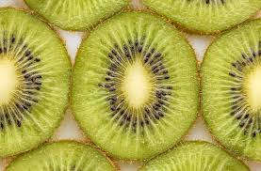

Slide 6
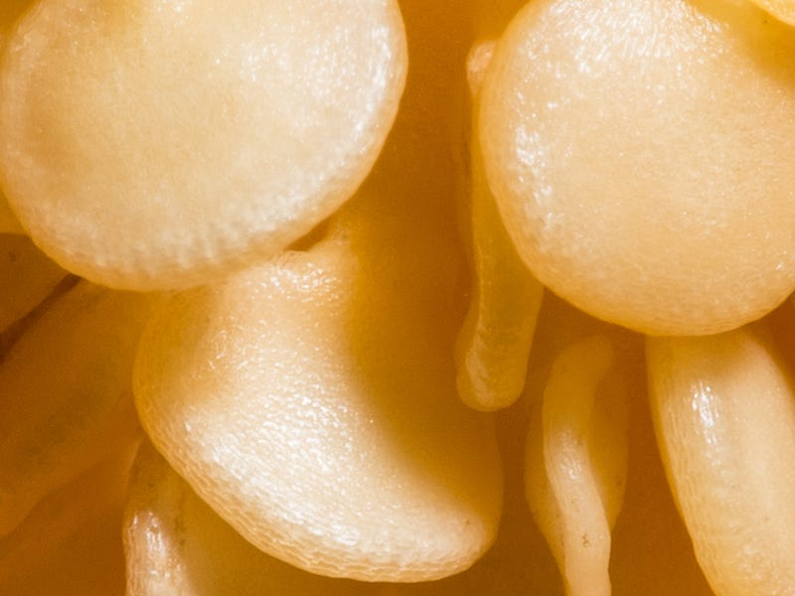

Slide 7
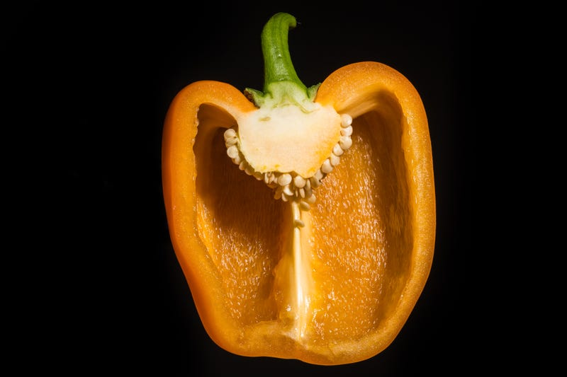

Slide 8
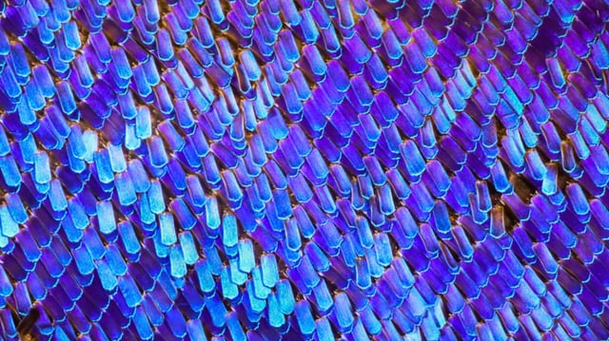

Slide 9
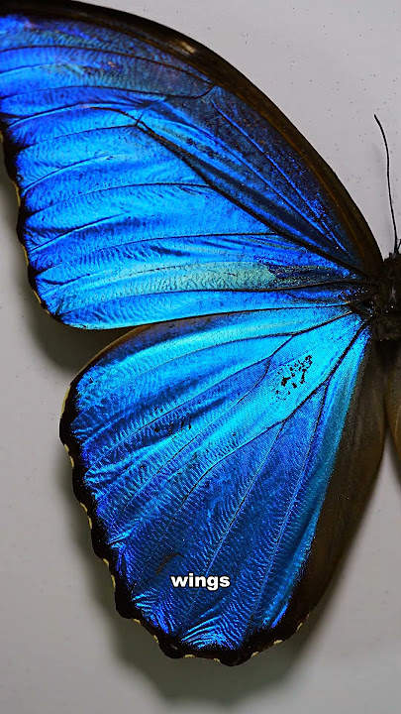

Slide 10
Signs
Miracles
Wisdom
Authority
Knowledge of Scripture
Supernatural insight

Slide 11
John 4
¹⁶ He told her, “Go, call your husband and come back.”
¹⁷ “I have no husband,” she replied.
Jesus said to her, “You are right when you say you have no husband. ¹⁸ The fact is, you have had five husbands, and the man you now have is not your husband. What you have just said is quite true.”
¹⁹ “Sir,” the woman said, “I can see that you are a prophet. ²⁰ Our ancestors worshiped on this mountain, but you Jews claim that the place where we must worship is in Jerusalem.”
²⁵ The woman said, “I know that Messiah” (called Christ) “is coming. When he comes, he will explain everything to us.”
²⁶ Then Jesus declared, “I, the one speaking to you—I am he.”

Slide 12
²⁸ Then, leaving her water jar, the woman went back to the town and said to the people, ²⁹ “Come, see a man who told me everything I ever did. Could this be the Messiah?” ³⁰ They came out of the town and made their way toward him.

Slide 13
³⁹ Many of the Samaritans from that town believed in him because of the woman’s testimony, “He told me everything I ever did.” ⁴⁰ So when the Samaritans came to him, they urged him to stay with them, and he stayed two days. ⁴¹ And because of his words many more became believers.
⁴² They said to the woman, “We no longer believe just because of what you said; now we have heard for ourselves, and we know that this man really is the Savior of the world.”

Slide 14
Mark 8 v 27-29
²⁷ Jesus and his disciples left Galilee and went up to the villages near Caesarea Philippi. As they were walking along, he asked them, “Who do people say I am?”
²⁸ “Well,” they replied, “some say John the Baptist, some say Elijah, and others say you are Jeremiah or one of the other prophets.”
²⁹ Then he asked them, “But who do you say I am?”
Peter replied, “You are the Messiah.”

Slide 15
Jude v 17 – 22
¹⁷ But, dear friends, remember what the apostles of our Lord Jesus Christ foretold. ¹⁸ They said to you, “In the last times there will be scoffers who will follow their own ungodly desires.” ¹⁹ These are the people who divide you, who follow mere natural instincts and do not have the Spirit.
²⁰ But you, dear friends, by building yourselves up in your most holy faith and praying in the Holy Spirit, ²¹ keep yourselves in God’s love as you wait for the mercy of our Lord Jesus Christ to bring you to eternal life.
²² Be merciful to those who doubt; ²³ save others by snatching them from the fire; to others show mercy, mixed with fear—hating even the clothing stained by corrupted flesh.

Slide 16
Numbers 15 v 37-41
³⁷ The Lord said to Moses, ³⁸ “Speak to the people of Israel, and tell them to make tassels on the corners of their garments throughout their generations, and to put a cord of blue on the tassel of each corner. ³⁹ And it shall be a tassel for you to look at and remember all the commandments of the Lord, to do them, not to follow after your own heart and your own eyes, which you are inclined to whore after. ⁴⁰ So you shall remember and do all my commandments and be holy to your God. ⁴¹ I am the Lord your God, who brought you out of the land of Egypt to be your God: I am the Lord your God.”

Slide 17
To him who is able to keep us from stumbling and to present us before his glorious presence without fault and with great joy.
To the only God our Savior be glory, majesty, power and authority, through Jesus Christ our Lord, before all ages, now and forevermore! Amen.

