Slide 1

The King is coming!
Whose king?
Steve Morris

Slide 2
What does it say? Mark 11v1-11
And as they approached Jerusalem, at Bethphage and Bethany, near the Mount of Olives, He sent two of His disciples, and said to them, "Go into the village opposite you, and immediately as you enter it, you will find a colt tied there, on which no one yet has ever sat; untie it and bring it here. And if anyone says to you, 'Why are you doing this? You say 'The Lord has need of it'; and immediately he will send it back here." And they went away and found a colt tied at the door outside in the street; and they untied it. And some of the bystanders were saying to them, "What are you doing, untying the colt?" And they spoke to them just as Jesus had told them, and they gave them permission. And they brough the colt to Jesus and put their garments on it; and He sat upon it.

Slide 3
Mark 11v1-11
And many spread their garments in the road, and others spread leafy branches which they had cut from the fields. And those who went before, and these who followed after, were crying out "Hosanna! Blessed is He who comes in the name of the Lord". "Blessed is the coming kingdom of our father David; Hosanna in the highest!". And he entered Jerusalem and came into the temple; and after looking all around , He departed for Bethany with the twelve, since it was already late."

Slide 4
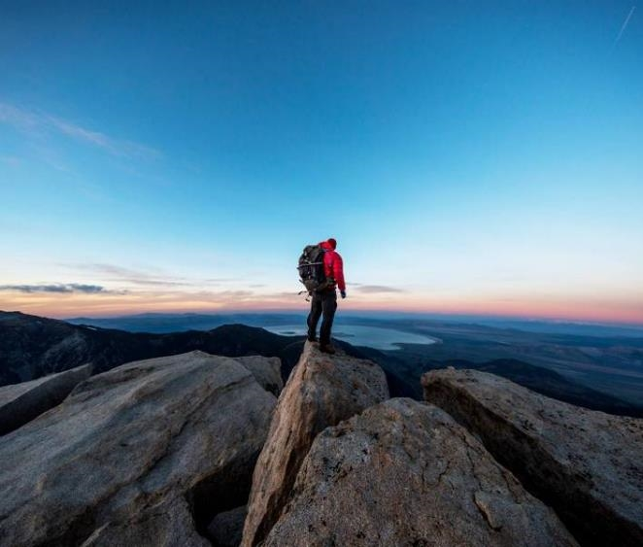

Scriptures
Matthew 21v 1-11
Mark 11v 1-10
Luke 19v28-40
John 12v12-19

Slide 5
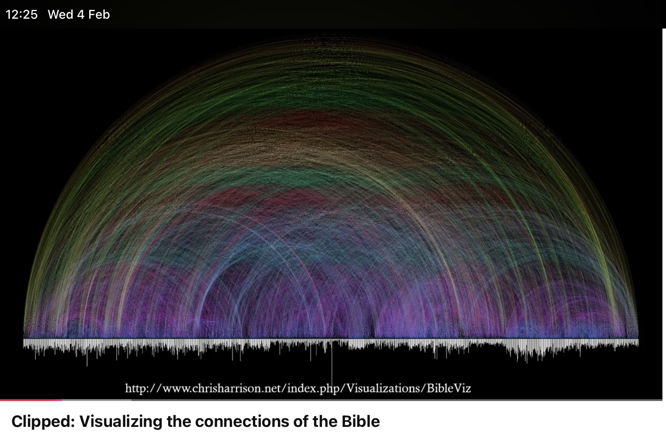
Chart
IMG_0230.jpg

Slide 6
Isaiah Chapter 53 – forbidden ?
Who has believed our report? And to whom has the arm of the LORD been revealed? For He shall grow up before Him as a tender plant, and as a root out of dry ground. He has no form or comeliness; and when we see Him, there is no beauty that we should desire Him. He is despised and rejected by men, a Man of sorrows and acquainted with grief. And we hid, as it were, our faces from Him; He was despised, and we did not esteem Him. Surely He has borne our griefs and carried our sorrows; Yet we esteemed Him stricken, Smitten by God, and afflicted. But He was wounded for our transgressions, He was bruised for our iniquities; The chastisement for our peace was upon Him, And by His stripes we are healed. All we like sheep have gone astray; We have turned, everyone, to his own way; And the LORD has laid on Him the iniquity of us all

Slide 7
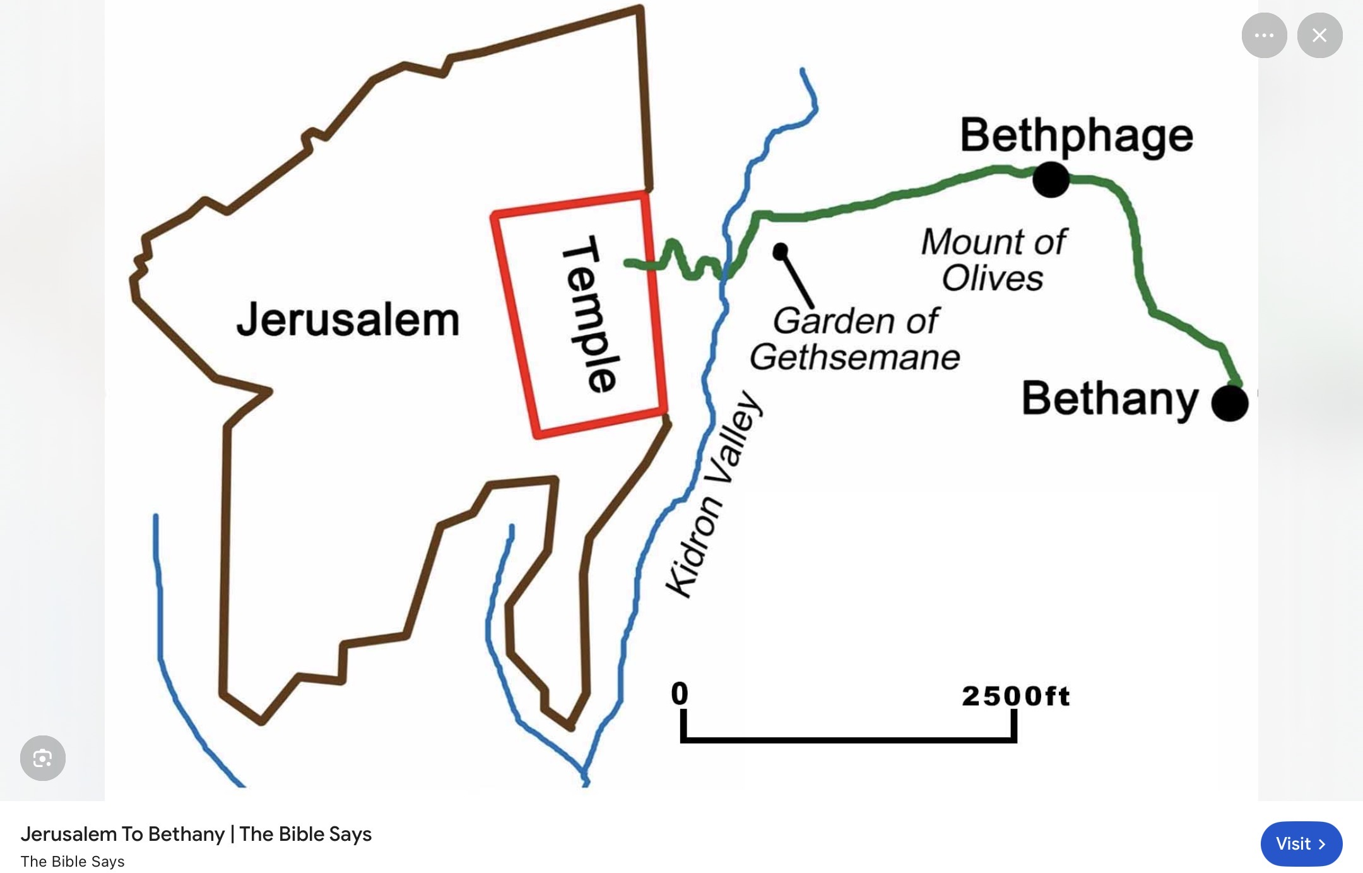

Slide 8
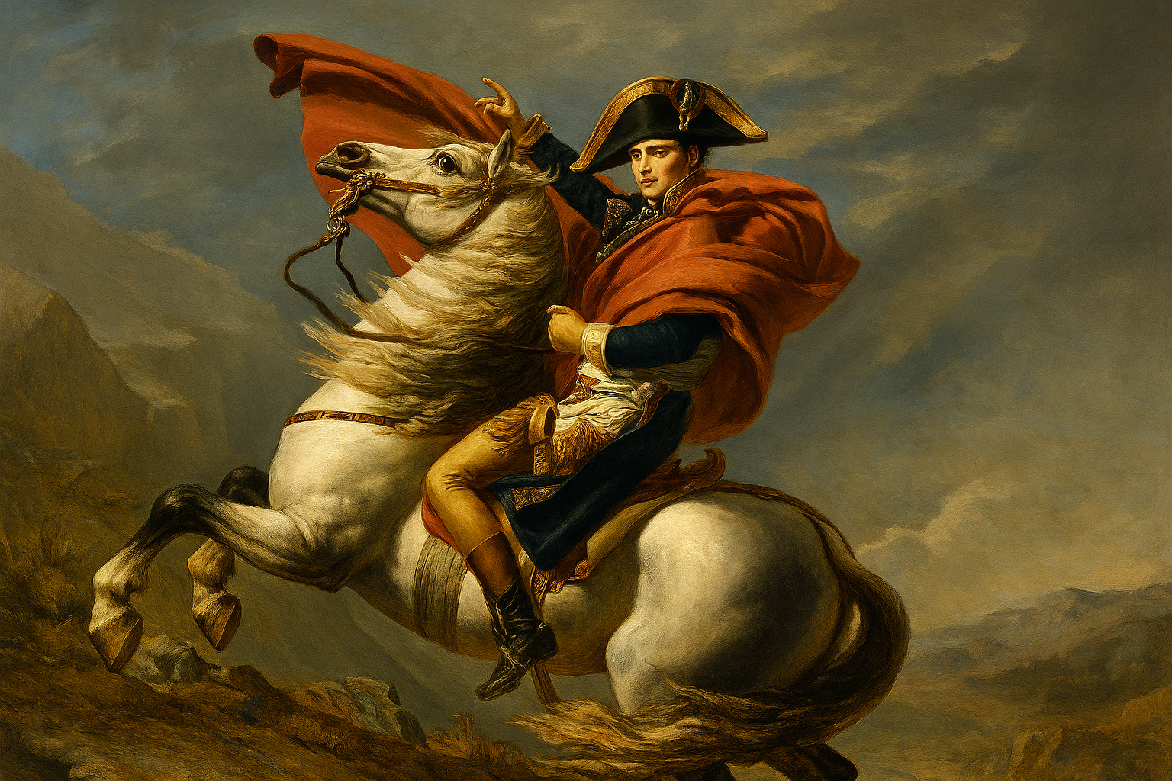
Strength power authority conqueror might oppression
------------------

Slide 9
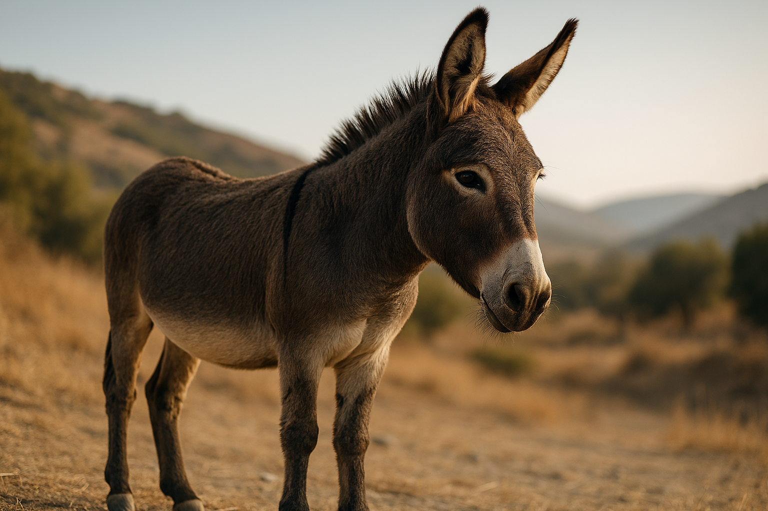
Here’s the donkey!

Slide 10
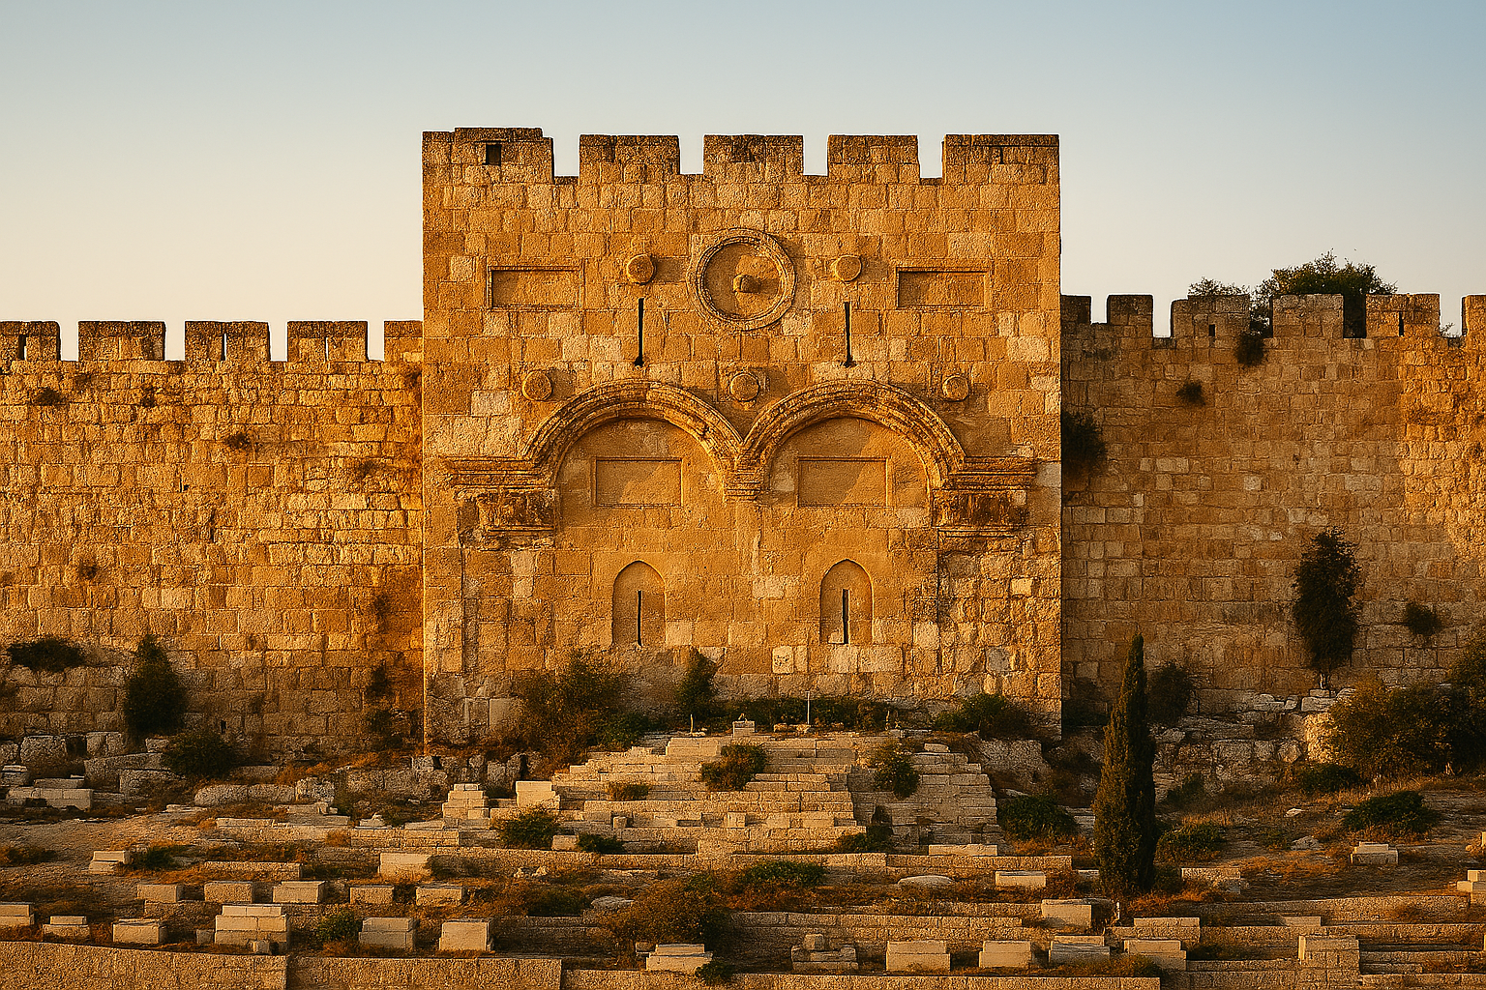
Eastern Gate- Golden Gate-
Gate of Mercy

Slide 11
God’s rescue plan.
Are you conquered? Conquered by Grace, love and forgiveness?
Michah 6v8
He has shown you O man what is good;
And what does the Lord require of you
But to do justly, and to love mercy,
and to walk humbly with your God?
Zach 4v6 Not by might nor by power but by my Spirit says the lord of hosts.
When reading your bible:-
1.Remember to ask for His help
2.Remember to look past what you think you know
3.Remember the bible is pulsating with life, with Gods true rescue plan.

