Slide 1


Slide 2
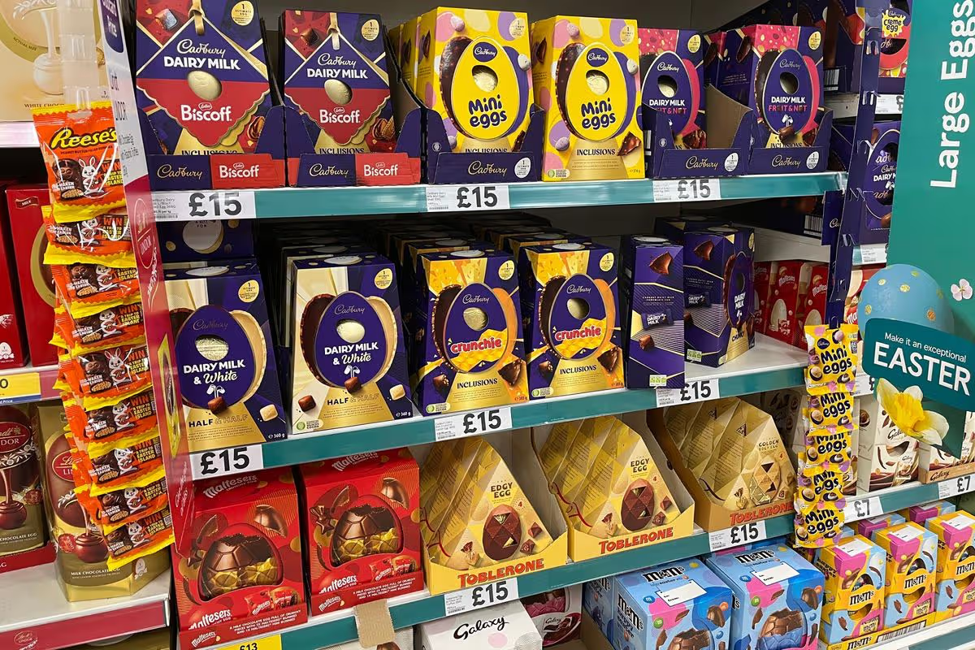

Slide 3


Slide 4


Slide 5
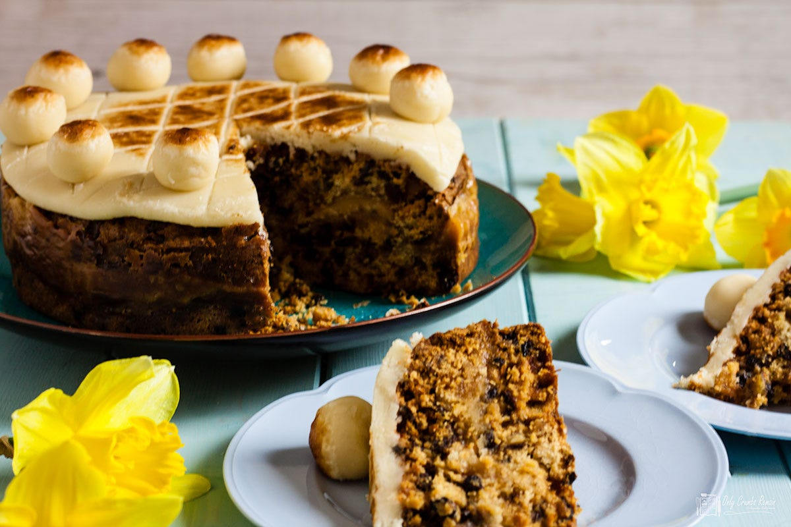

Slide 6
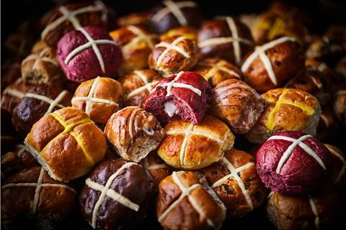

Slide 7



Slide 8
Red Velvet Filled
Neapolitan Ice Cream
Carrot Cake
Tiramisu
Cherry Bakewell
Rhubarb & Custard
Rhubarb & Ginger
Orange Marmalade
Strawberries & Cream
Lemon & White Chocolate
Berry Blush
Milk Chocolate & Fudge
Brown Butter & Chai
Extremely Cheesy
Mighty Cheesy
Double Cheddar

Slide 9


Slide 10

Matthew 27:15-26
Mark 15:6-15
Luke 23:18-24
John 18:40
Acts 3:14

Slide 11
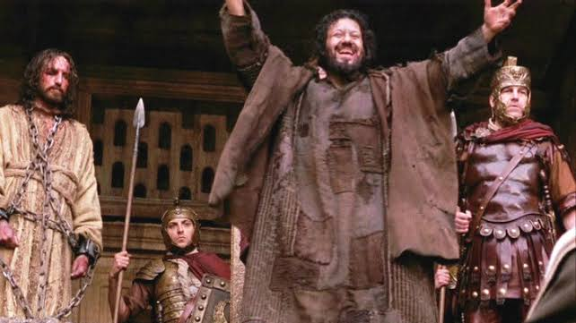

Slide 12
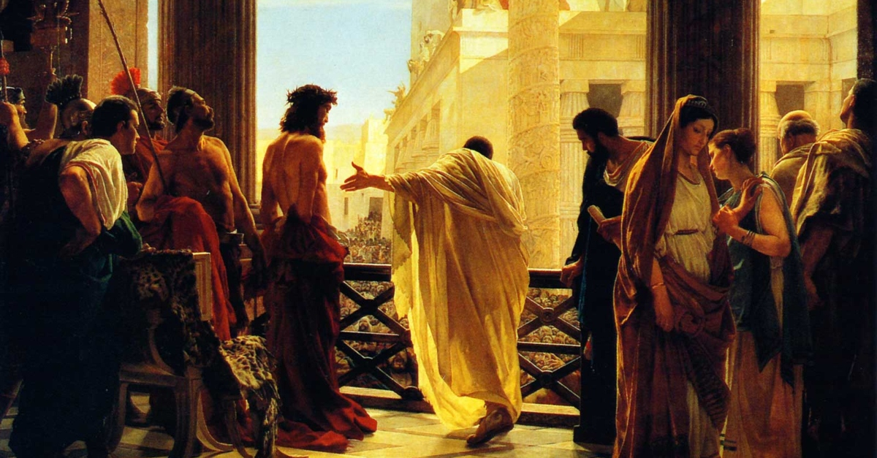

Slide 13


Slide 14


Slide 15


Slide 16


Slide 17


=
EMPTY
CROSS
EMPTY
GRAVE
NEW
LIFE

Slide 18


