Slide 1


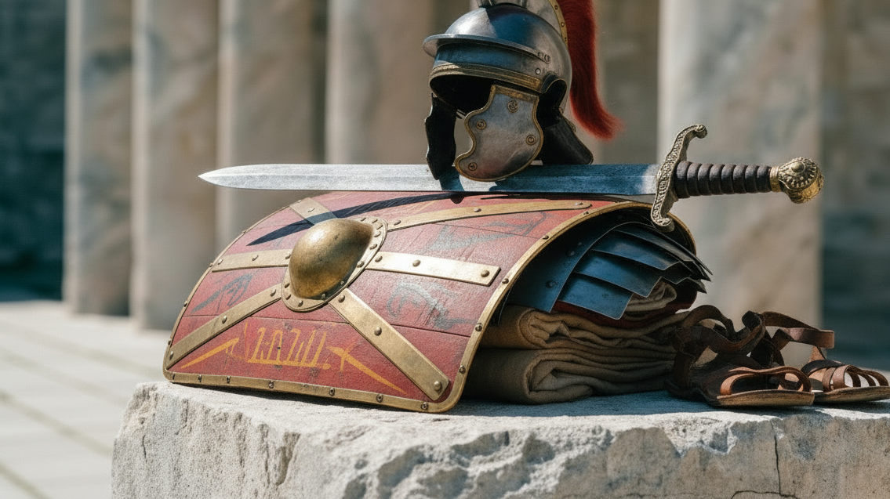



Ephesians 6

Slide 2
Ephesians 6: 10 Finally, be strong in the Lord and in his mighty power. 11 Put on the full armour of God, so that you can take your stand against the devil’s schemes. 12 For our struggle is not against flesh and blood, but against the rulers, against the authorities, against the powers of this dark world and against the spiritual forces of evil in the heavenly realms. 13 Therefore put on the full armour of God, so that when the day of evil comes, you may be able to stand your ground, and after you have done everything, to stand.

Slide 3
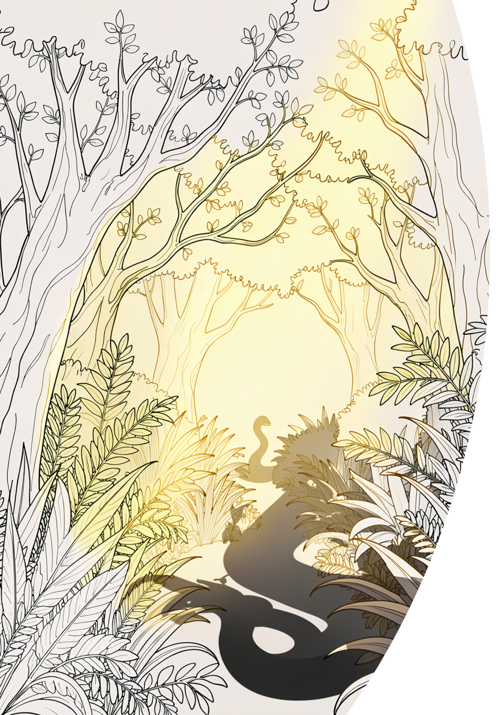
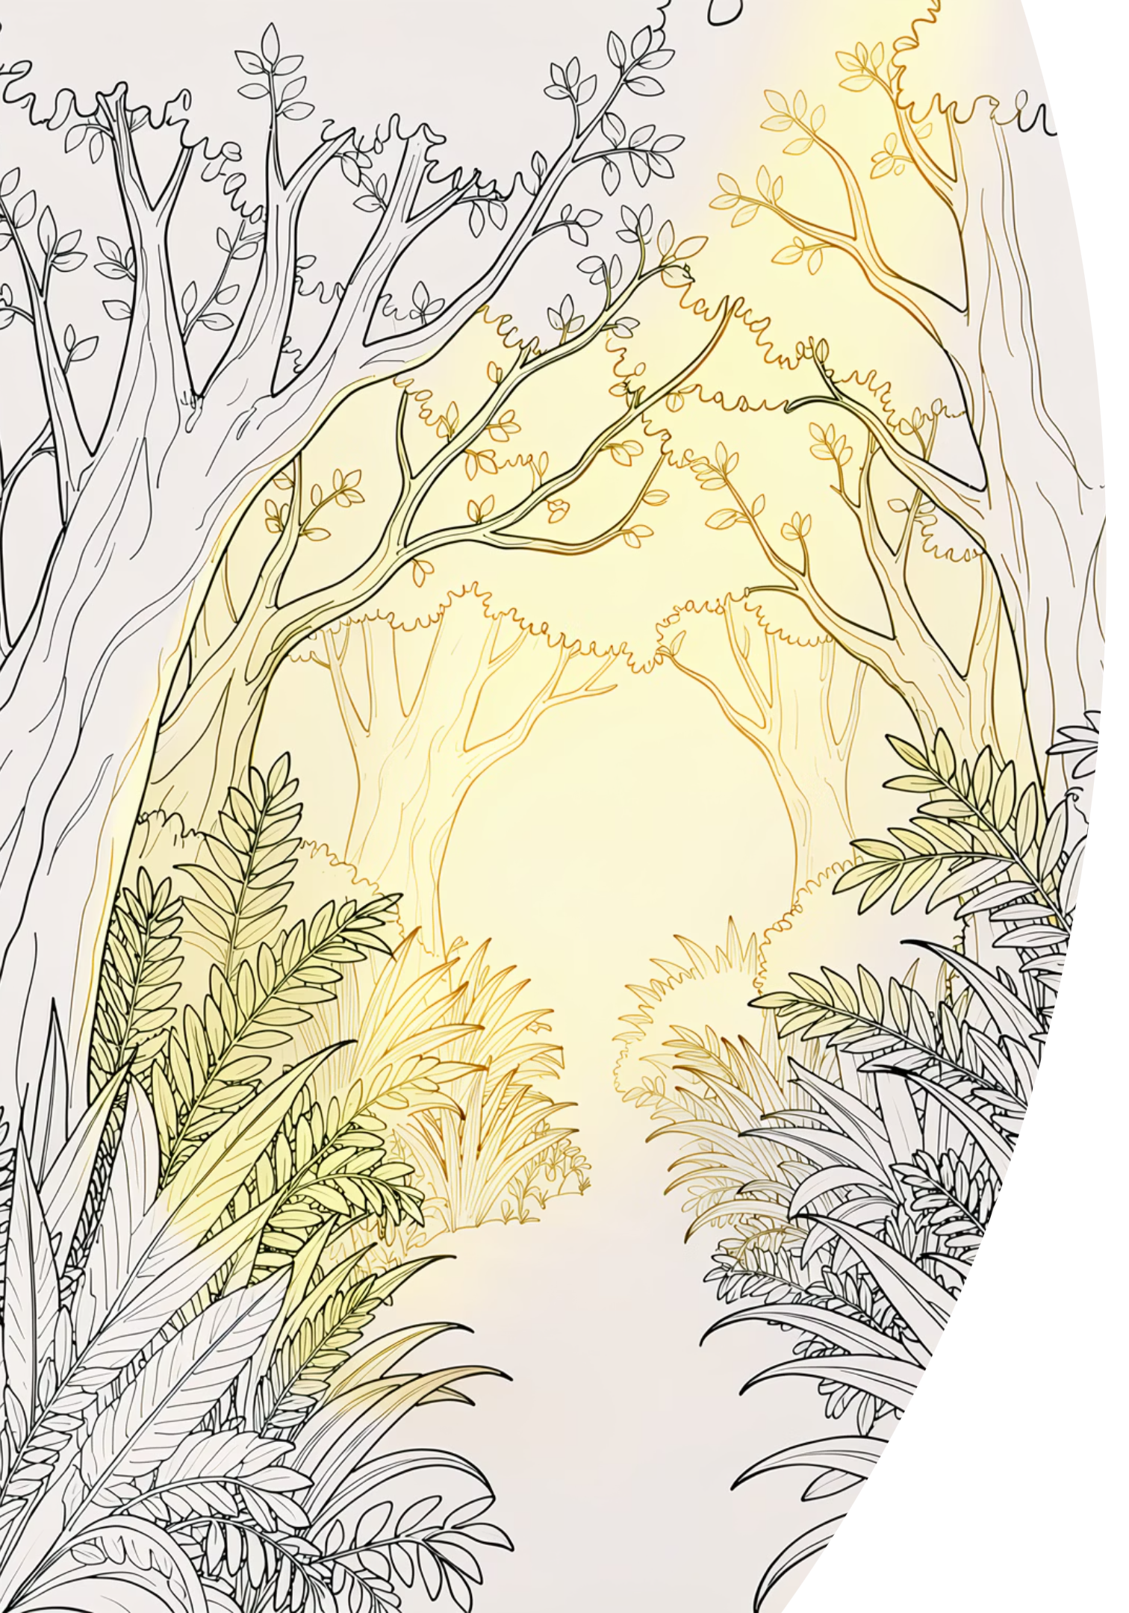
In the beginning…
Eden
Heaven and earth met — a perfect place
The Fall
Enemy tempted mankind into disobedience — cast out, separated from God
Mankind Alone
We'd lose and be doomed — we cannot fight it

Slide 4
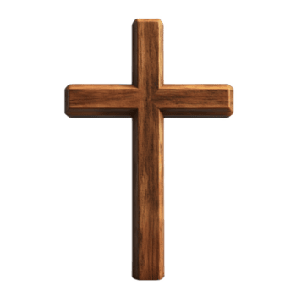
  Isiah 59
  15 Truth is nowhere to be found,
  and whoever shuns evil becomes a prey.
  The Lord looked and was displeased
  that there was no justice.
  16 He saw that there was no one,
  he was appalled that there was no one to intervene;
  so his own arm achieved salvation for him,
  and his own righteousness sustained him.
  17 He put on righteousness as his breastplate,
  and the helmet of salvation on his head;
  he put on the garments of vengeance
  and wrapped himself in zeal as in a cloak.

Slide 5

How the War Ends
¹¹ I saw heaven standing open and there before me was a white horse, whose rider is called Faithful and True. With justice he judges and wages war. ¹² His eyes are like blazing fire, and on his head are many crowns. He has a name written on him that no one knows but he himself. ¹³ He is dressed in a robe dipped in blood, and his name is the Word of God. ¹⁴ The armies of heaven were following him, riding on white horses and dressed in fine linen, white and clean. ¹⁵ Coming out of his mouth is a sharp sword with which to strike down the nations. “He will rule them with an iron scepter.”^{[a]} He treads the winepress of the fury of the wrath of God Almighty. ¹⁶ On his robe and on his thigh he has this name written:
king of kings and lord of lords.

Slide 6
14 Stand firm then, with the belt of truth buckled around your waist, with the breastplate of righteousness in place, 15 and with your feet fitted with the readiness that comes from the gospel of peace. 16 In addition to all this, take up the shield of faith, with which you can extinguish all the flaming arrows of the evil one. 17 Take the helmet of salvation and the sword of the Spirit, which is the word of God.
18 And pray in the Spirit on all occasions with all kinds of prayers and requests. With this in mind, be alert and always keep on praying for all the Lord’s people.

Slide 7
We are armoured, we are armed, we are allied
Romans 13 v 12 The night is nearly over; the day is almost here. So let us put aside the deeds of darkness and put on the armor of light.
2 Corinthians 6 v 7, in truthful speech and in the power of God; with weapons of righteousness in the right hand and in the left
2 Corinthians 10:3-4
³ For though we live in the world, we do not wage war as the world does. ⁴ The weapons we fight with are not the weapons of the world. On the contrary, they have divine power to demolish strongholds.

Slide 8
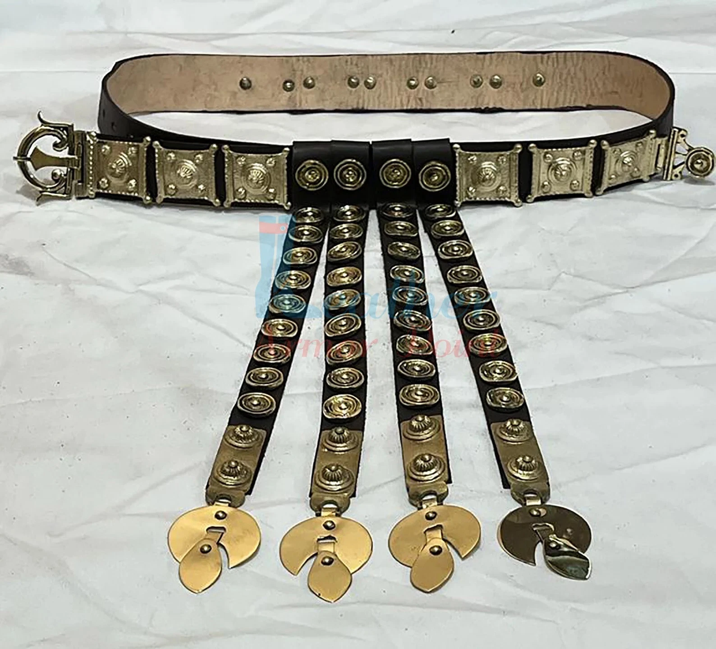
We are armoured, we are armed, we are allied
Belt of Truth
John 14:6
Jesus answered, “I am
the way and the truth
and the life.

Slide 9
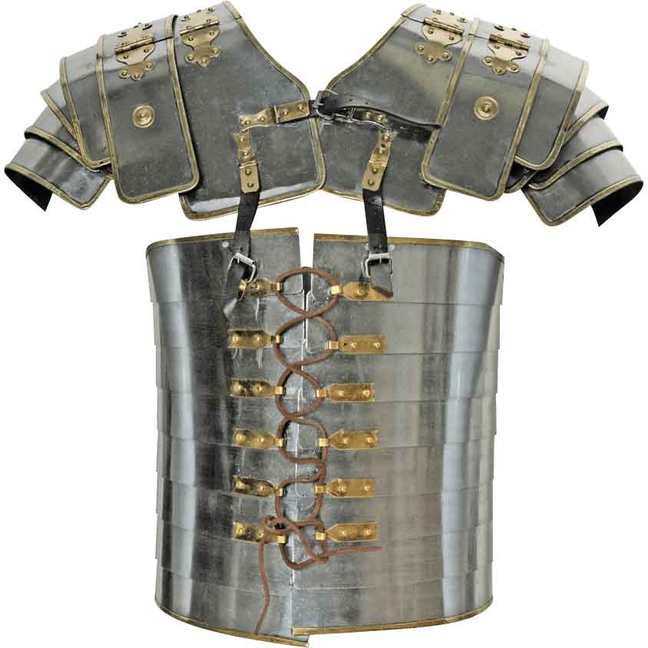
We are armoured, we are armed, we are allied
Breastplate of Righteousness
Isiah 59
17 He put on righteousness as his breastplate,

Slide 10
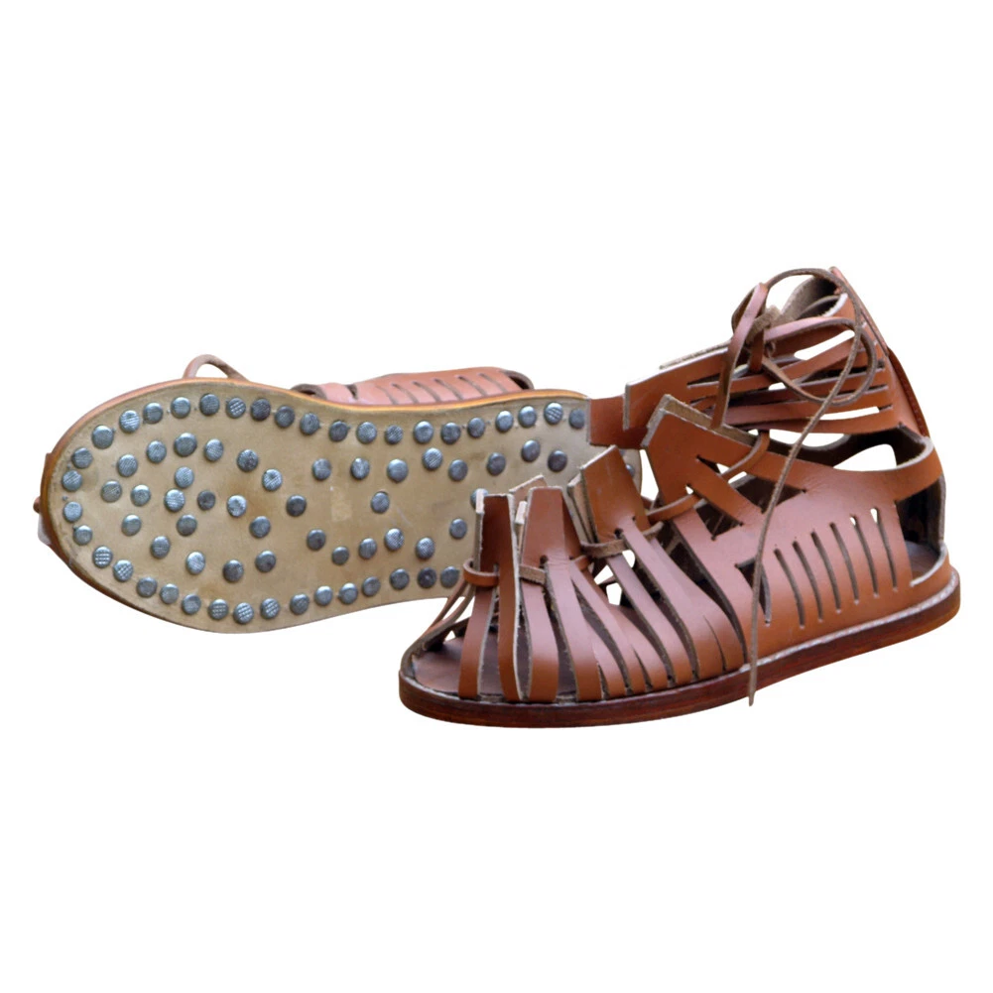
We are armoured, we are armed, we are allied
Boots of the Gospel
John 16:33
“I have told you these things, so that in me you may have peace. In this world you will have trouble. But take heart! I have overcome the world.”

Slide 11
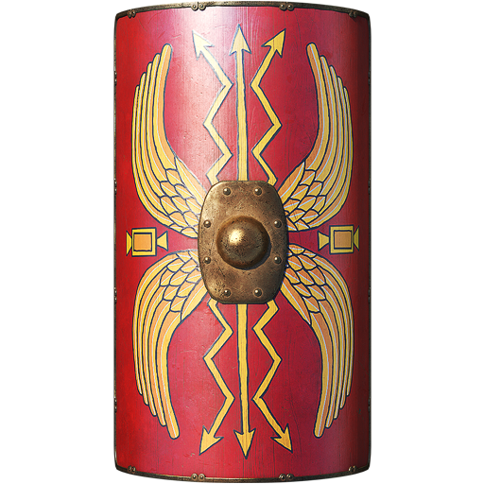
We are armoured, we are armed, we are allied
Shield of Faith
Psalm 25
In you, Lord my God, I put my trust

Slide 12
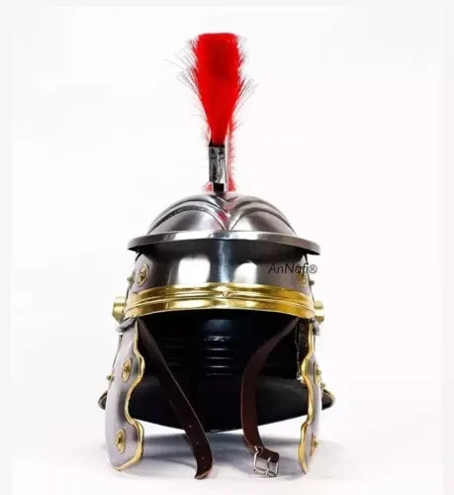
We are armoured, we are armed, we are allied
The Helmet of Salvation
Isiah 59
17 and the helmet of salvation on his head

Slide 13
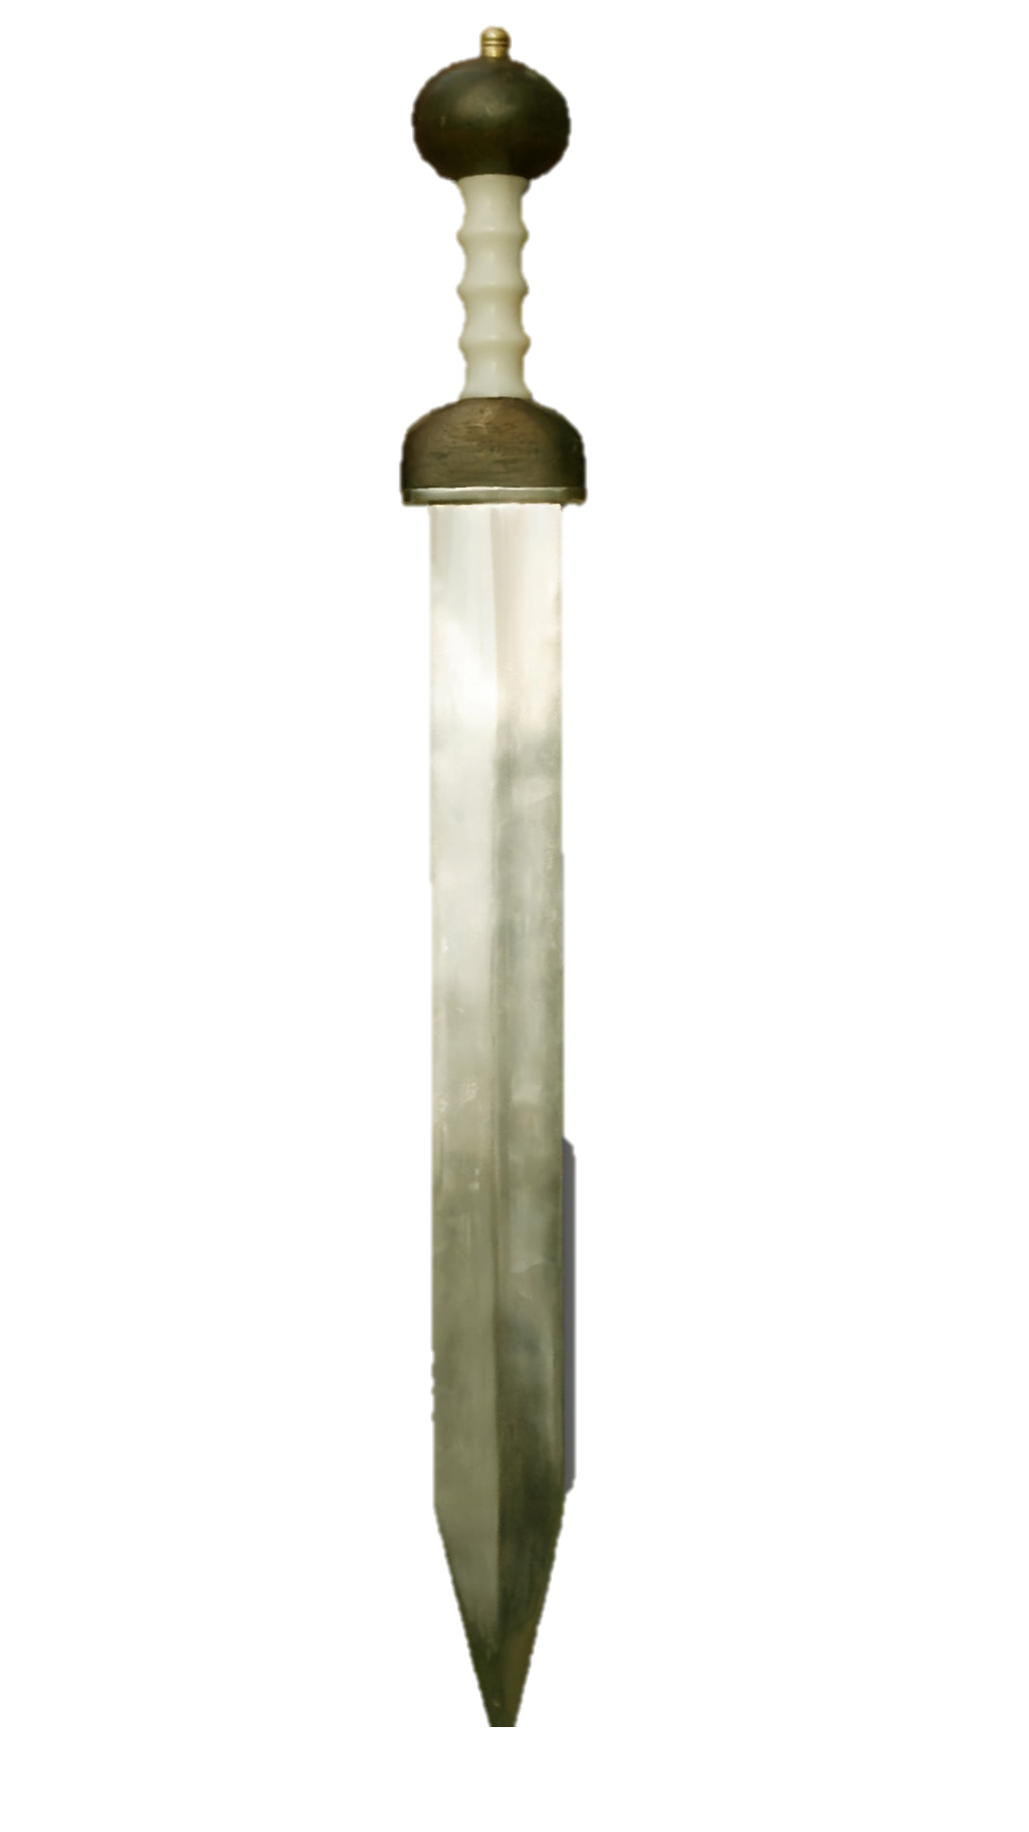
We are armoured, we are armed, we are allied
Armed: The Sword of the Spirit
Hebrews 4:12
For the word of God is alive and active. Sharper than any double-edged sword, it penetrates even to dividing soul and spirit, joints and marrow; it judges the thoughts and attitudes of the heart.

Slide 14
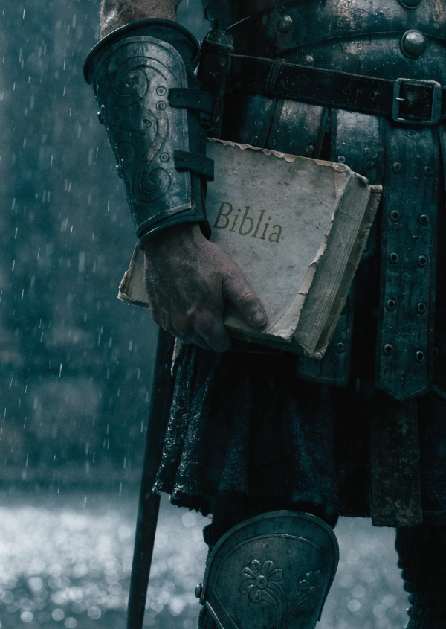
We are armoured, we are armed, we are allied
Matthew 4 Then the devil took him to the
holy city and had him stand on
the highest point of the temple.
“If you are the Son of God,” he said, “throw
yourself down. For it is written:
“‘He will command his angels concerning you,
and they will lift you up in their hands,
so that you will not strike your
foot against a stone.’”
7 Jesus answered him,
“It is also written:
‘Do not put the Lord your God to the test.’
Spend time in the Word

Slide 15
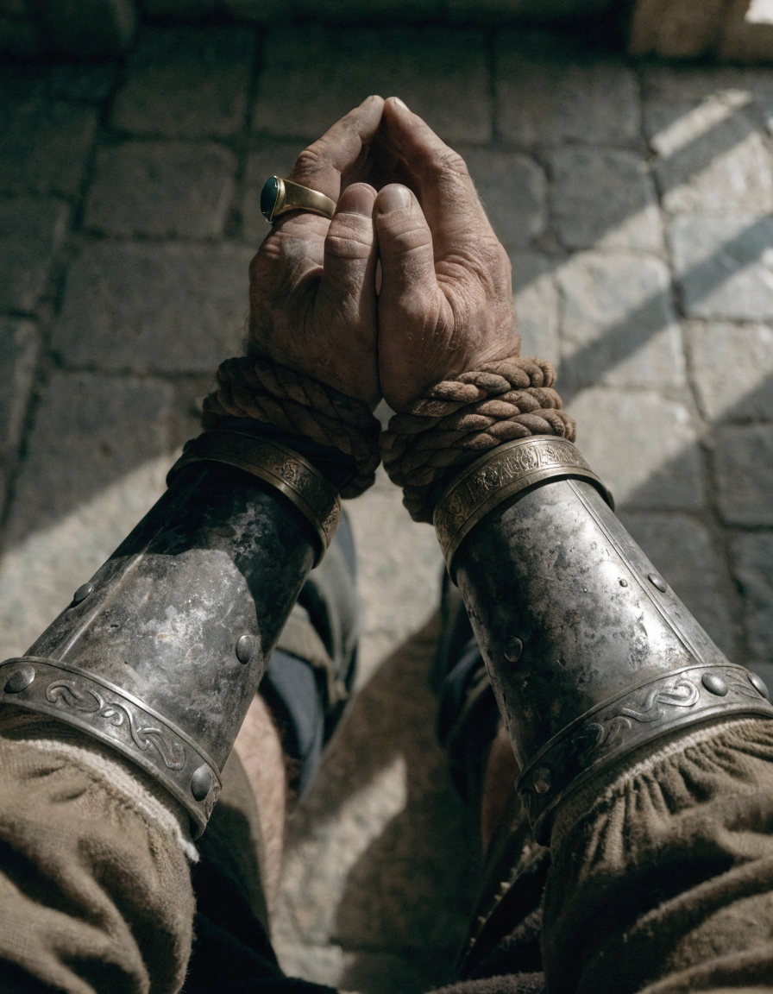
We are armoured, we are armed, we are allied
The Weapon of Prayer
Romans 8:26-27
New International Version
26 In the same way, the Spirit helps us in our weakness. We do not know what we ought to pray for, but the Spirit himself intercedes for us through wordless groans. 27 And he who searches our hearts knows the mind of the Spirit, because the Spirit intercedes for God’s people in accordance with the will of God.

Slide 16
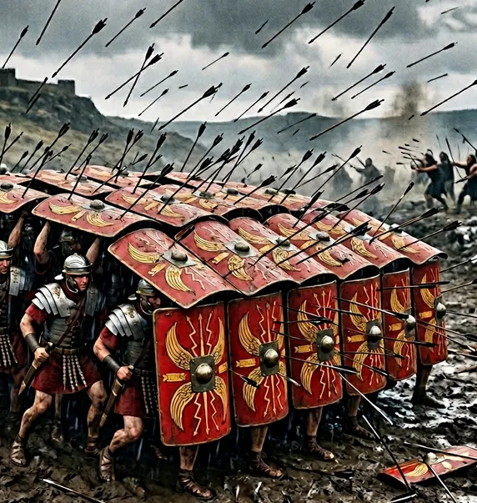
We are armoured, we are armed, we are allied
Allied: No Soldier Fights Alone
18 And pray in the Spirit on all occasions with all kinds of prayers and requests. With this in mind, be alert and always keep on praying for all the Lord’s people.
Galatians 6:2 — "Carry each other's burdens, and in this way you will fulfill the law of Christ."
1 Thessalonians 5:11 — “Therefore encourage one another and build each other up, just as in fact you are doing."

Slide 17
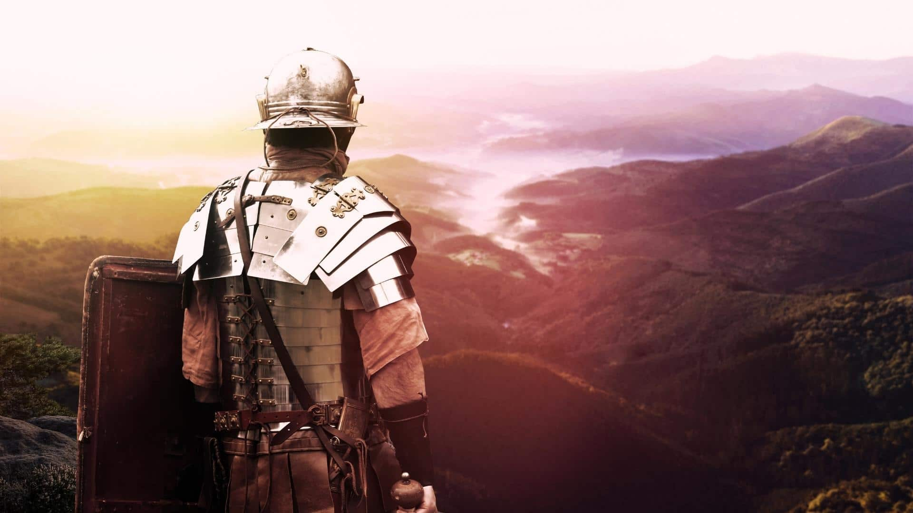
We are armoured, we are armed, we are allied

