Slide 1
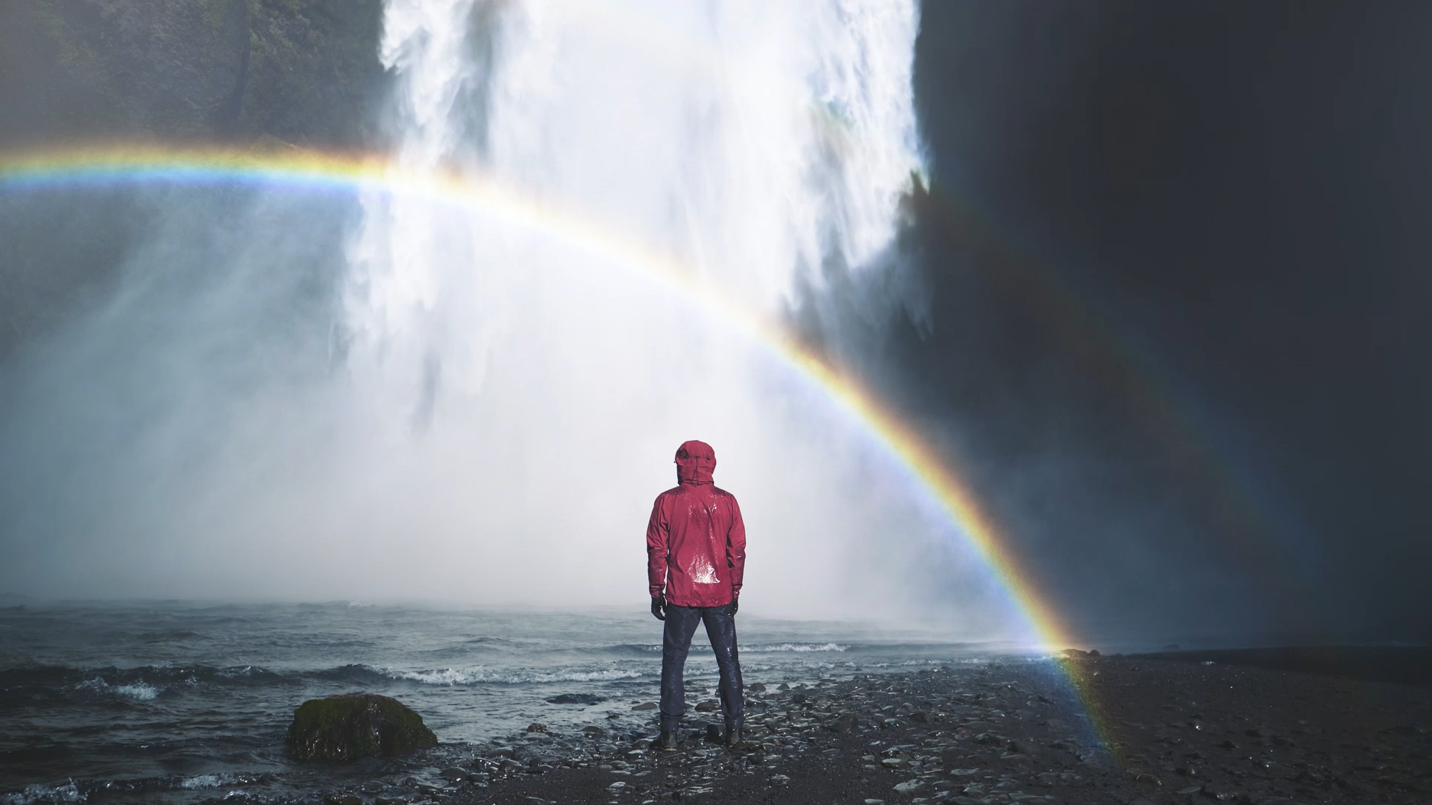
Thus far the Lord has helped us
Our Ebenezer

Slide 2
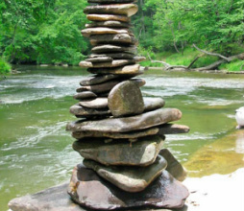
1 Samuel 7:12 ¹²Then Samuel took a stone and set it up between Mizpah and Shen. He named it Ebenezer, saying, "Thus far the LORD has helped us."
Ebenezer

Slide 3
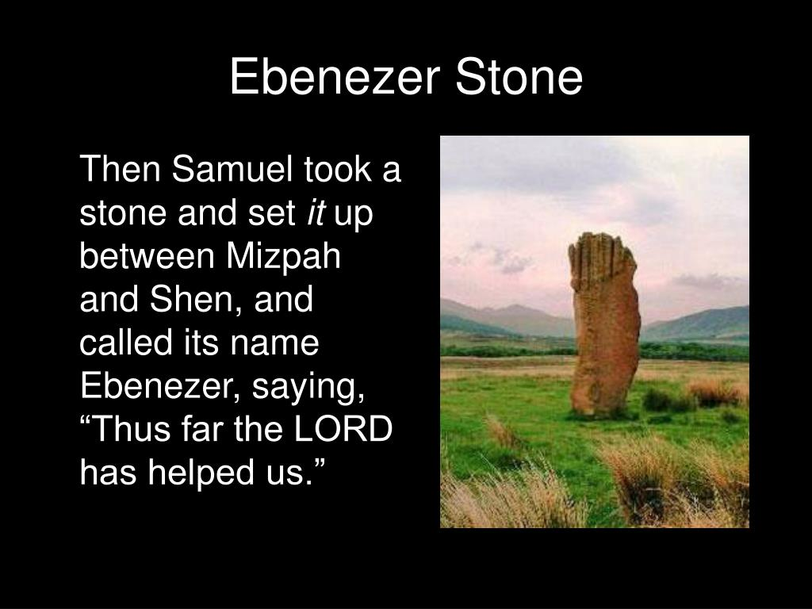

Slide 4

What is the meaning of Ebenezer?
1. A boy’s or man’s name
2. A line in a hymn by Robert Robinson 1758
3. A stone of remembrance Samuel set up between Mizpah and Shen
Meaning - A stone of help
God intervened and delivered Israel

Slide 5

Ebenezer
Ebenezer = “The Rock of Help” : a monument to God’s faithfulness; a remembrance, an altar or memorial of a time or event where God intervened.

Slide 6
What is the Background? (1 Sam 7. 1-12)
7 ¹ So the men of Kiriath Jearim came and took up the ark of the Lord. They brought it to Abinadab’s house on the hill and consecrated Eleazar his son to guard the ark of the Lord. ² The ark remained at Kiriath Jearim a long time—twenty years in all.
Samuel Subdues the Philistines at Mizpah
Then all the people of Israel turned back to the Lord. ³ So Samuel said to all the Israelites, “If you are returning to the Lord with all your hearts, then rid yourselves of the foreign gods and the Ashtoreths and commit yourselves to the Lord and serve him only, and he will deliver you out of the hand of the Philistines.” ⁴ So the Israelites put away their Baals and Ashtoreths, and served the Lord only.

Slide 7
What is the Background? (1 Sam 7. 1-12)
⁵ Then Samuel said, “Assemble all Israel at Mizpah, and I will intercede with the Lord for you.” ⁶ When they had assembled at Mizpah, they drew water and poured it out before the Lord. On that day they fasted and there they confessed, “We have sinned against the Lord.” Now Samuel was serving as leader^{[a]} of Israel at Mizpah.
⁷ When the Philistines heard that Israel had assembled at Mizpah, the rulers of the Philistines came up to attack them. When the Israelites heard of it, they were afraid because of the Philistines. ⁸ They said to Samuel, “Do not stop crying out to the Lord our God for us, that he may rescue us from the hand of the Philistines.”
⁹ Then Samuel took a suckling lamb and sacrificed it as a whole burnt offering to the Lord. He cried out to the Lord on Israel’s behalf, and the Lord answered him.

Slide 8
What is the Background? (1 Sam 7. 1-12)
¹⁰ While Samuel was sacrificing the burnt offering, the Philistines drew near to engage Israel in battle. But that day the Lord thundered with loud thunder against the Philistines and threw them into such a panic that they were routed before the Israelites. ¹¹ The men of Israel rushed out of Mizpah and pursued the Philistines, slaughtering them along the way to a point below Beth Kar.
¹² Then Samuel took a stone and set it up between Mizpah and Shen. He named it Ebenezer,^{[b]} saying, “Thus far the Lord has helped us.”

Slide 9

1. A stone that remembers God’s past help and says Thank you.

Slide 10
2. A stone that remembers God’s presence and power now and acts on it

Slide 11

3. A stone that looks for his faithfulness in the future and takes action to prepare for it.

