Slide 1
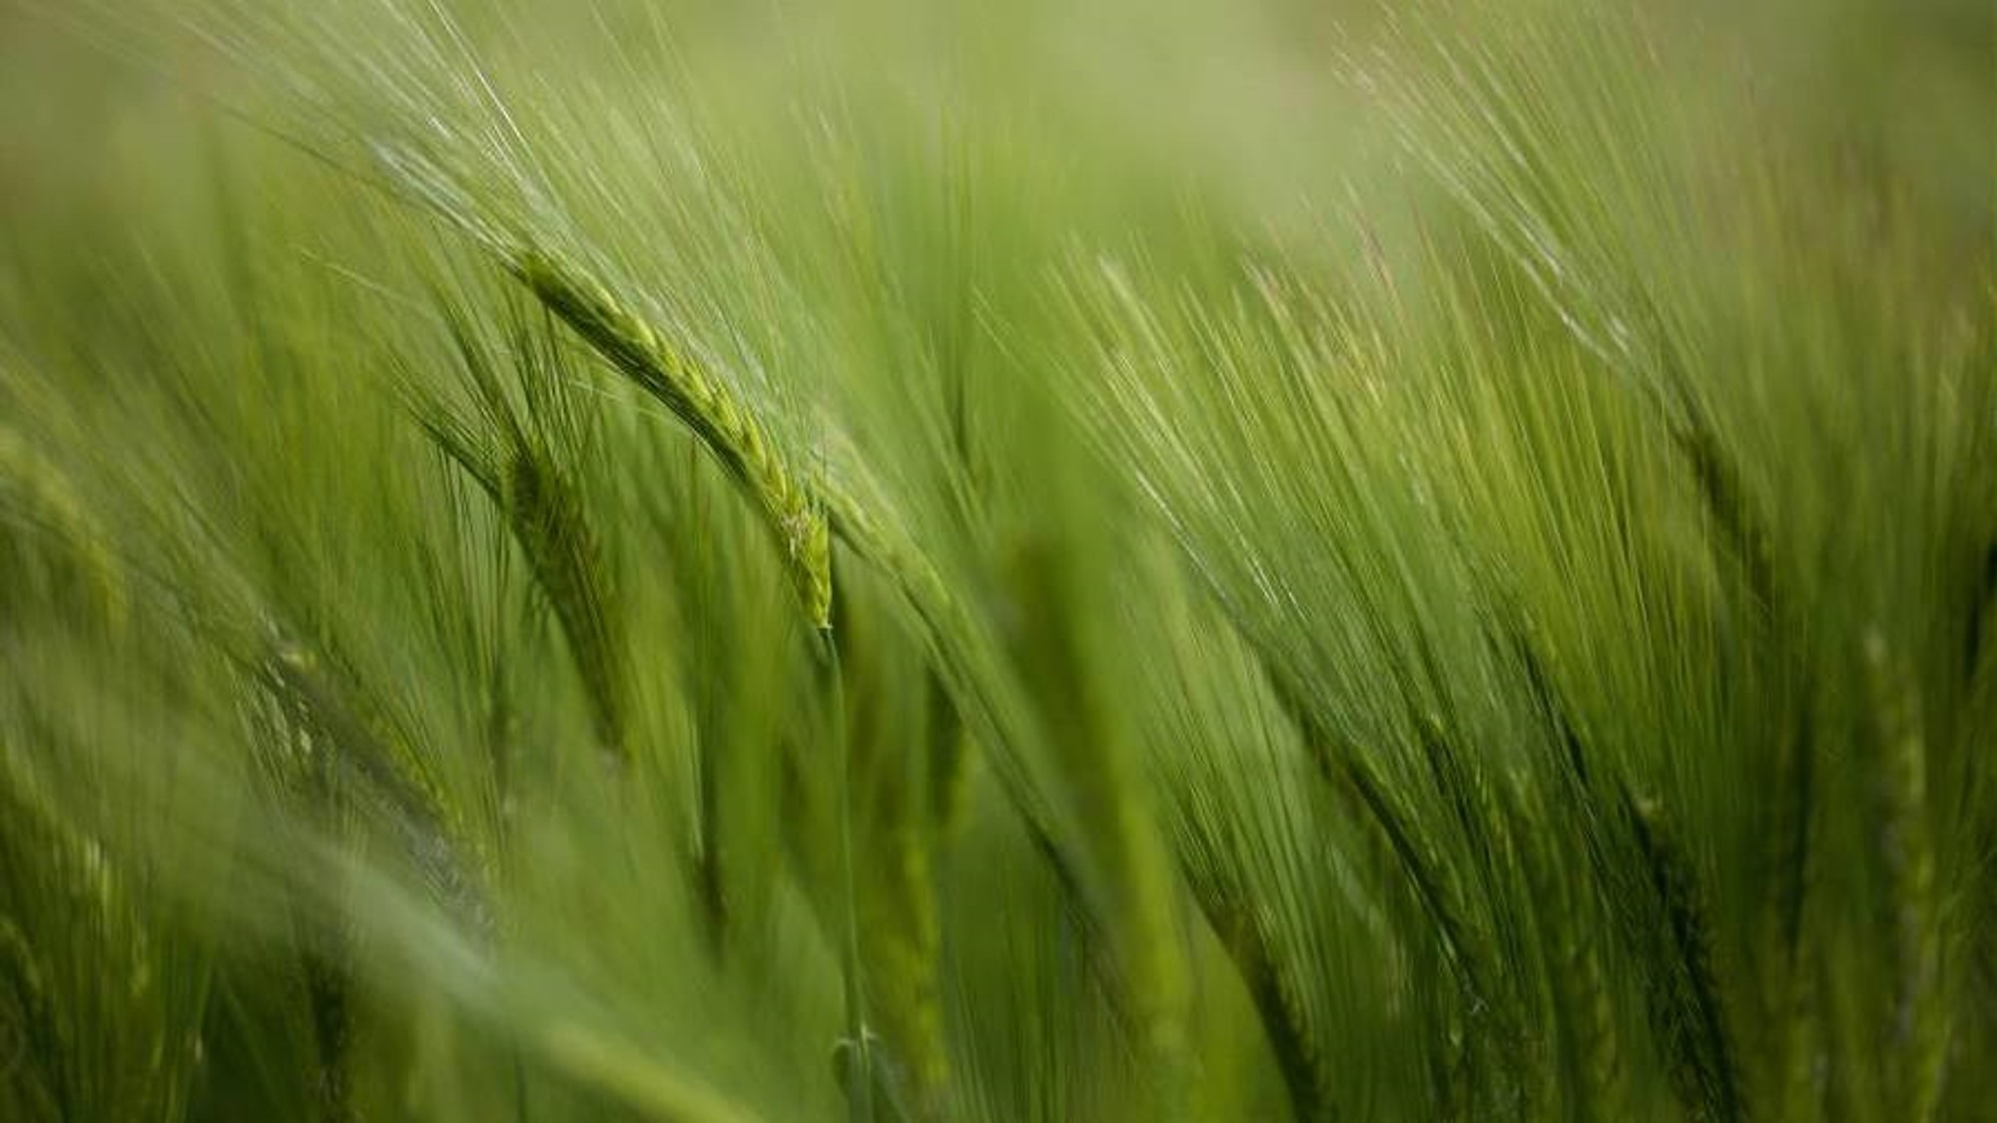
DOUBT

Slide 2
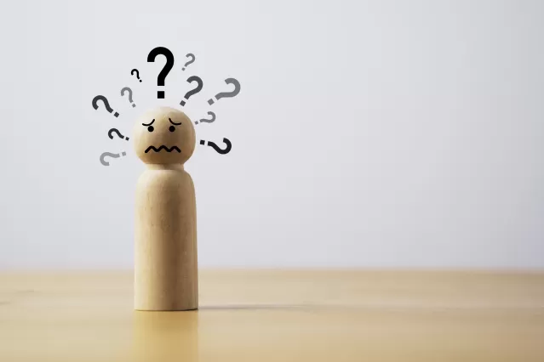
Do
Not
Doubt!

Slide 3
Matt 21:21-22
Then Jesus told them, “I tell you the truth, if you have faith and don’t doubt, you can do things like this and much more. You can even say to this mountain, ‘May you be lifted up and thrown into the sea,’ and it will happen. You can pray for anything, and if you have faith, you will receive it.”

Slide 4
James 1:6-7
But when you ask him, be sure that your faith is in God alone. Do not waver, for a person with divided loyalty is as unsettled as a wave of the sea that is blown and tossed by the wind. Such people should not expect to receive anything from the Lord.”

Slide 5
Mark 11:23
“I tell you the truth, you can say to this mountain, ‘May you be lifted up and thrown into the sea,’ and it will happen. But you must really believe it will happen and have no doubt in your heart.”

Slide 6


Slide 7
Proverbs 3:5-6
Trust in the Lord with all your heart;
do not depend on your own understanding.
Seek his will in all you do,
and he will show you which path to take

Slide 8
James 4:8
Come close to God, and God will come close to you. Wash your hands, you sinners; purify your hearts, for your loyalty is divided between God and the world

Slide 9


Slide 10
Doubt about whether God is REALLY there ?
Doubts about whether he hears us ?
Doubts about whether he can really sort this mess out?
Doubts about whether he can or will answer my prayers?
Doubts about my salvation ?
Doubts about whether he really has a plan for my life ?
Doubts as to whether he’s really in charge?
…and am I a failure as a Christian if I doubt?
Do you sometimes read the bible and doubt what you’re reading?
Does it really say that?

Slide 11
2 Tim 3:16
All Scripture is inspired by God and is useful to teach us what is true and to make us realize what is wrong in our lives. It corrects us when we are wrong and teaches us to do what is right.

Slide 12


Slide 13

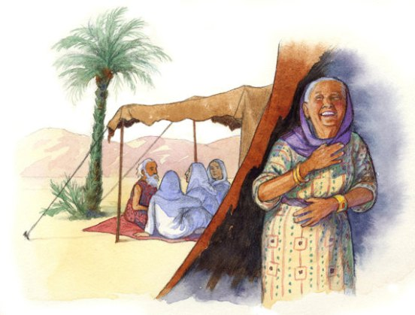
Sarah

Slide 14
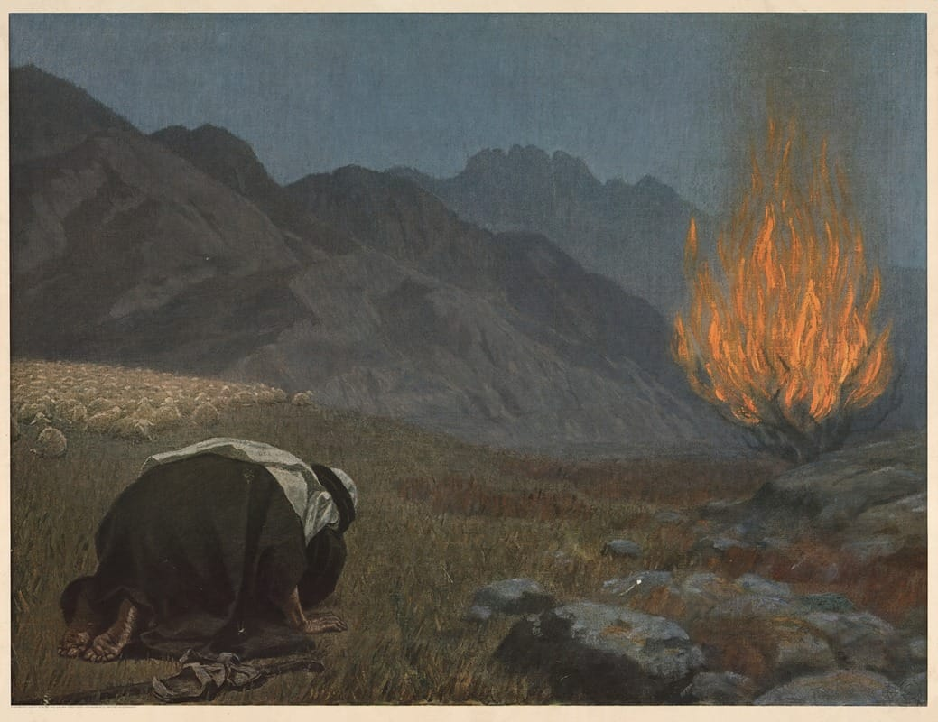
Moses

Slide 15
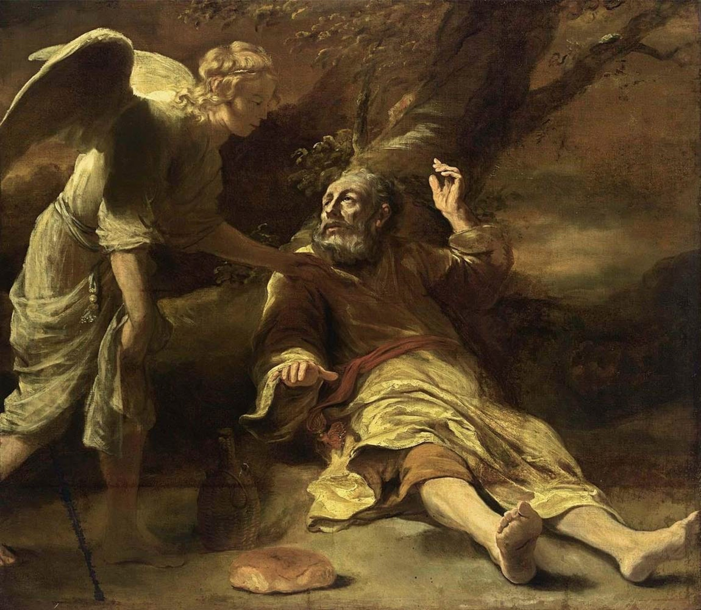
Elijah

Slide 16
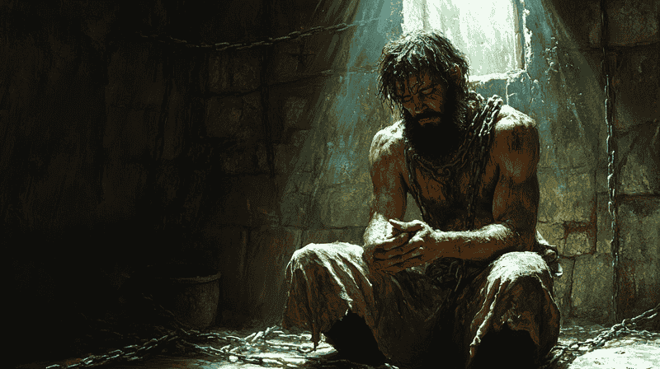
John the Baptist

Slide 17
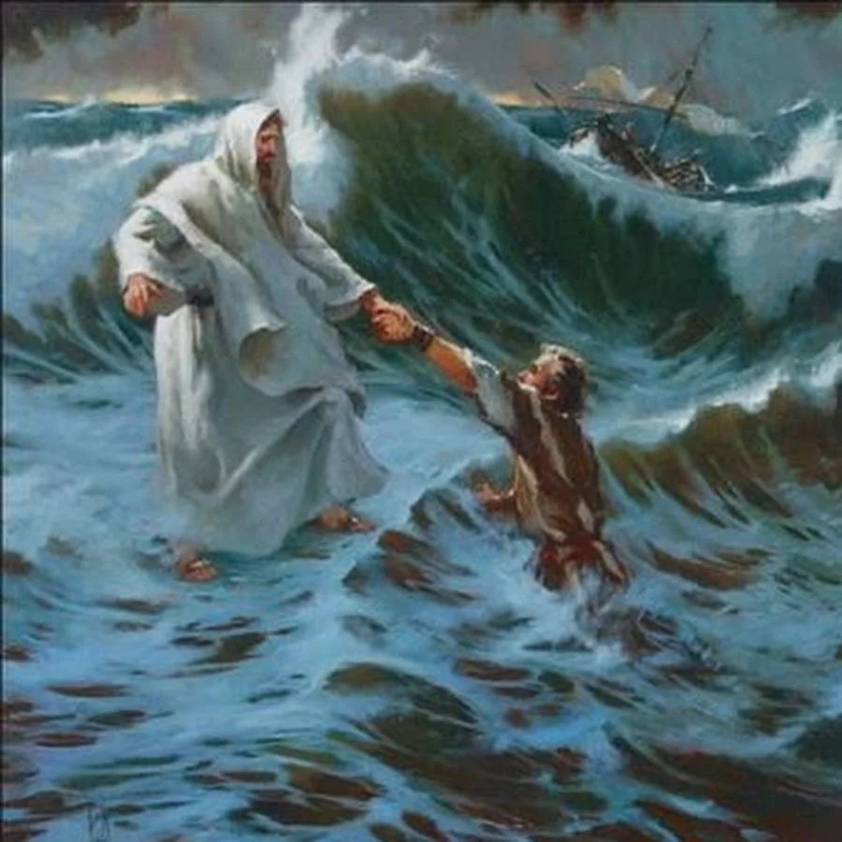
Peter

Slide 18
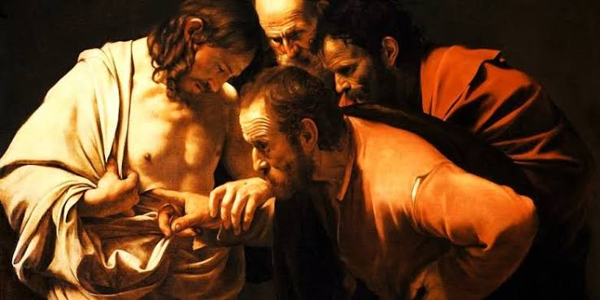
Thomas

Slide 19
Mark 9:19-24
“I believe, help my unbelief”

Slide 20
God meets doubt with Grace, not condemnation

Slide 21
“And when I don't understand I will choose You
And when I don't understand,
I will choose to love You, God”
I Breathe you in God, Bryan & Katie Torwalt

Slide 22
“Faith is dependent on doubt
without doubt there is no faith”

Slide 23
Isaiah 41:10
Don’t be afraid, for I am with you.
Don’t be discouraged, for I am your God.
I will strengthen you and help you.
I will hold you up with my victorious right hand

Slide 24
The End

