Slide 2
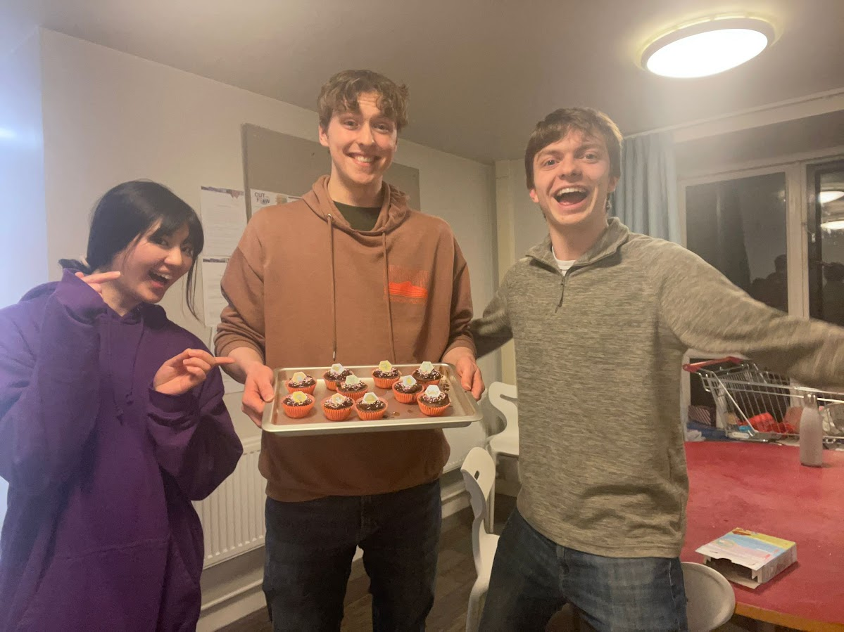

Slide 3
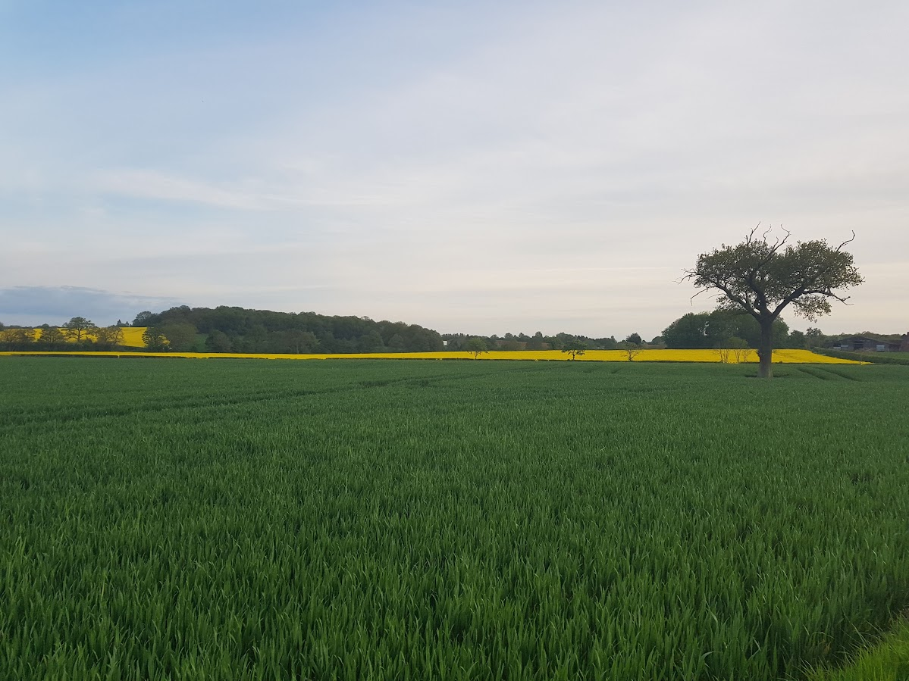

Slide 4
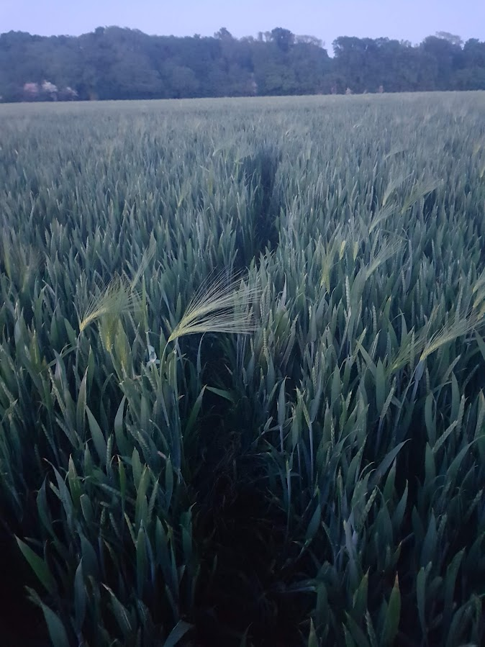
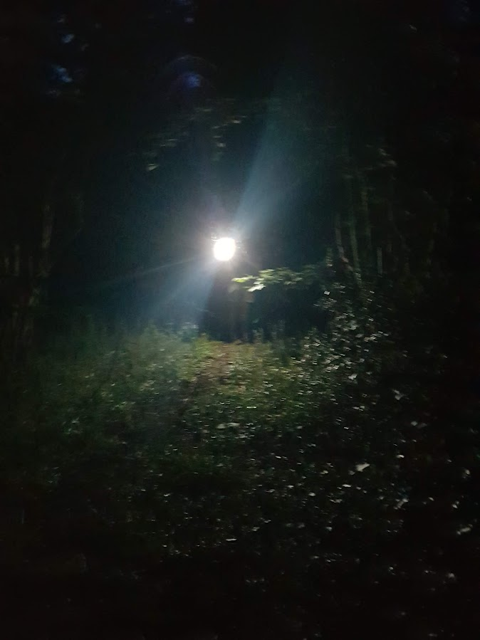

Slide 5
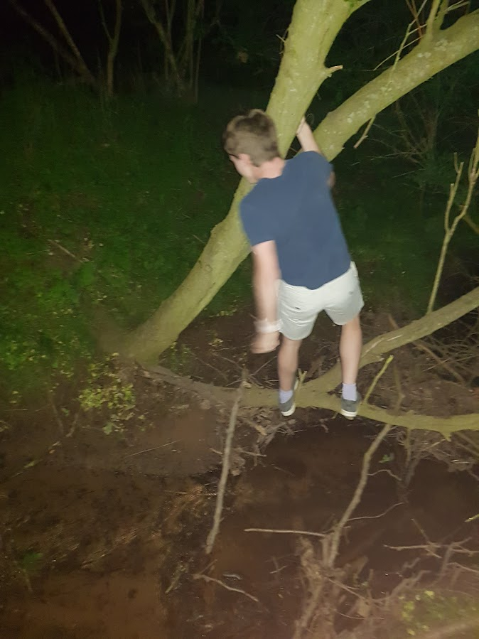

Slide 6
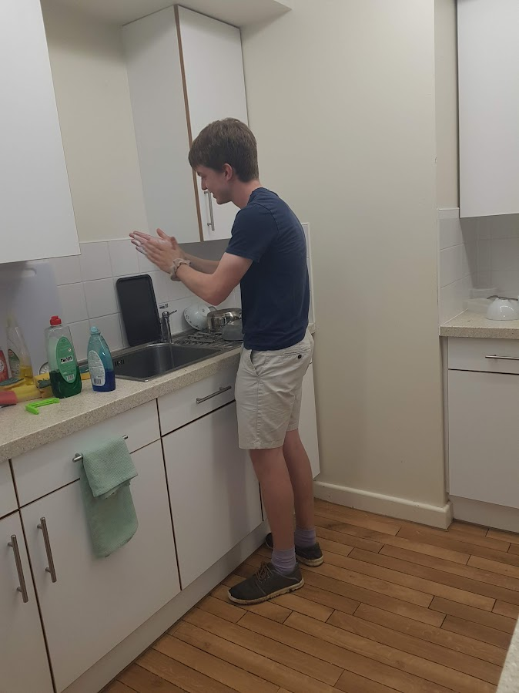

Slide 8
The desire to overcome guilt, is the desire for redemption

Slide 9
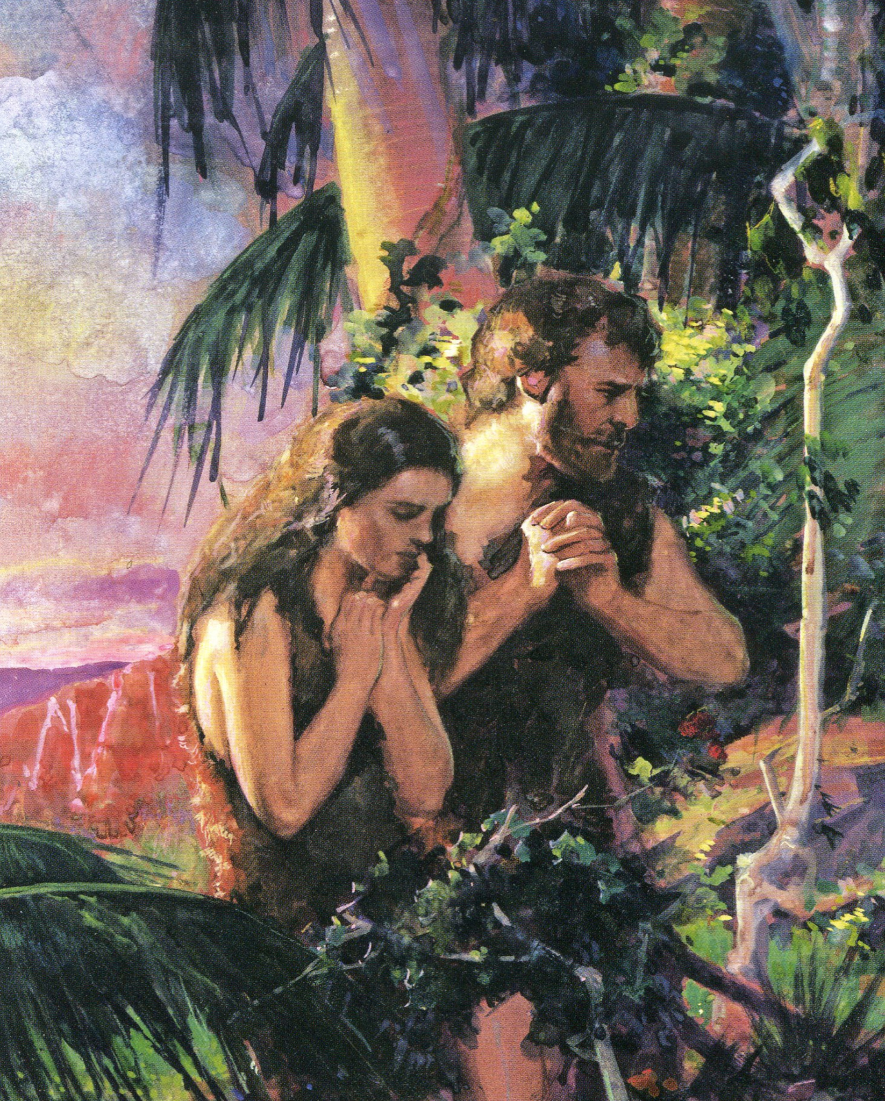
⁶ When the woman saw that the fruit of the tree was good for food and pleasing to the eye, and also desirable for gaining wisdom, she took some and ate it. She also gave some to her husband, who was with her, and he ate it. ⁷ Then the eyes of both of them were opened, and they realized they were naked; so they sewed fig leaves together and made coverings for themselves.
Genesis 3:6-7

Slide 11
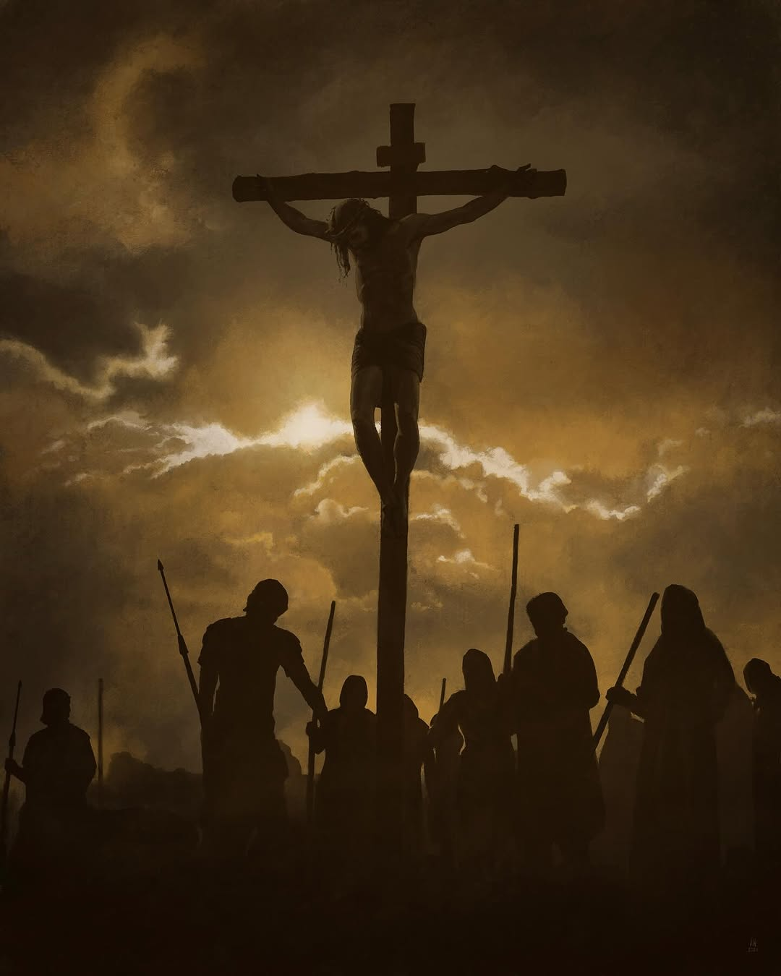
“For by one sacrifice he has made
perfect forever
those who are being made holy.”
Hebrews 10:14

